Slide 1
SouthEast Alaska Regional Health Consortium
Pediatric Services and Growth
Kathleen Hansen, OTD, OTR/L, IMH-S

Slide 2
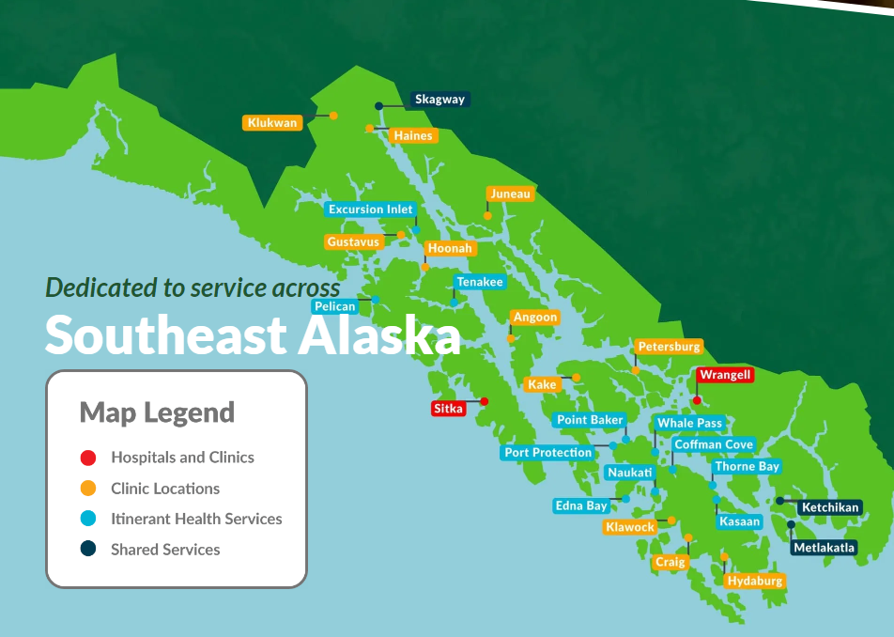
Mission
Alaska Native People working in partnership to provide the best healthcare to our communities.
Vision
Partnering with our communities to promote a healthy balance of mind, body and spirit
Values
Respect
Cultural Identity
Service
Professionalism
Compassion

Slide 3
Meeting the Needs of our Communities
Pediatric Care
Primary Care
Behavioral Health
Nutrition Services
WIC
Specialty Clinics
Rehabilitation Services
Dental
Urgent Care
Sports Medicine
Continuing to expand the pediatric services offered to meet the needs of our communities
Primary Care
Pediatrics- Pediatricians
Specialty Clinic- ENT & Audiology
Behavioral Health
Pediatric Dental Services
Dieticians
WIC
Occupational Therapy, Physical Therapy and Speech Language Pathology

Slide 4
Nutrition Services
Tara Farley, MS, RDN, LDN, CDCES, Community Wellness Nutrition Services Manager
All of our dietitians regularly see pediatric patients who struggle with weight and metabolic health
Riley O’Connor, currently pursuing a certification in treatment of eating disorders, provides extensive nutritional counseling for adolescents and teens struggling with disordered eating
Jessica Holland also works with adolescents and teens struggling with disordered eating, but also focuses on food insecurity and sports nutrition, and in fact devotes a specific block of time to Mt. Edgecumbe High School students
Audrey Conrad, a certified diabetes care and education specialist, focuses on children with diabetes and also works with picky eaters and children with food/texture aversions
Sadie Meyer is experienced in pediatric acute care including children who may require enteral nutrition

Slide 5
WIC

Slide 6
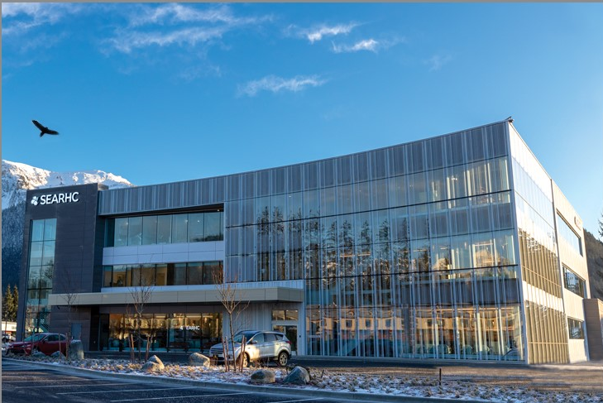
SEARHC Vintage Park Campus
Urgent Care
Primary Care
Pediatrics
Optometry
Behavioral Health
Pediatric Rehabilitation

Slide 7
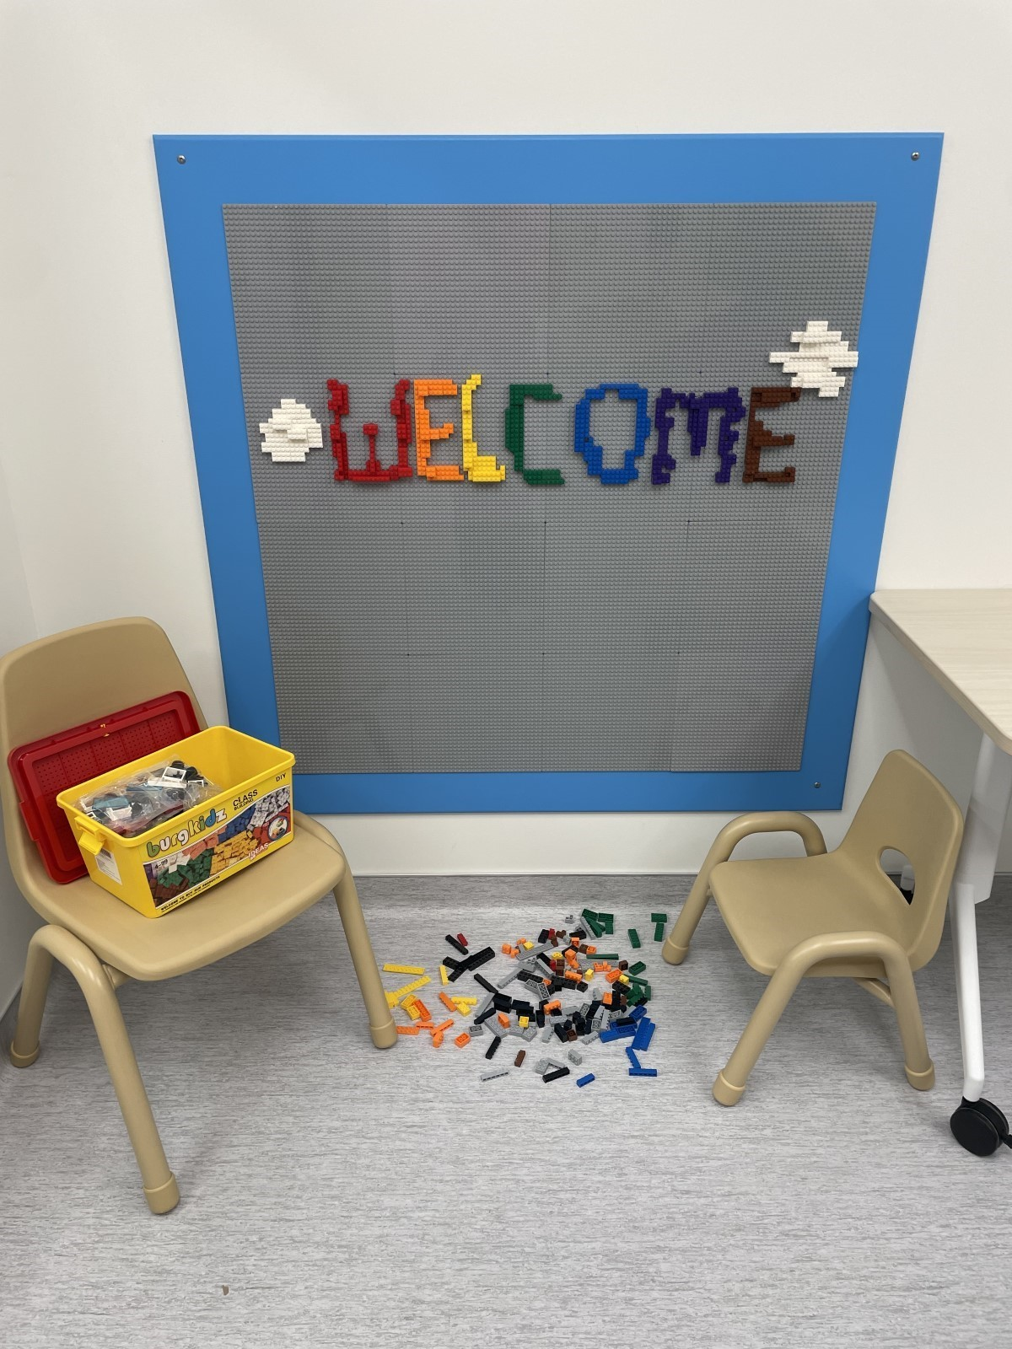
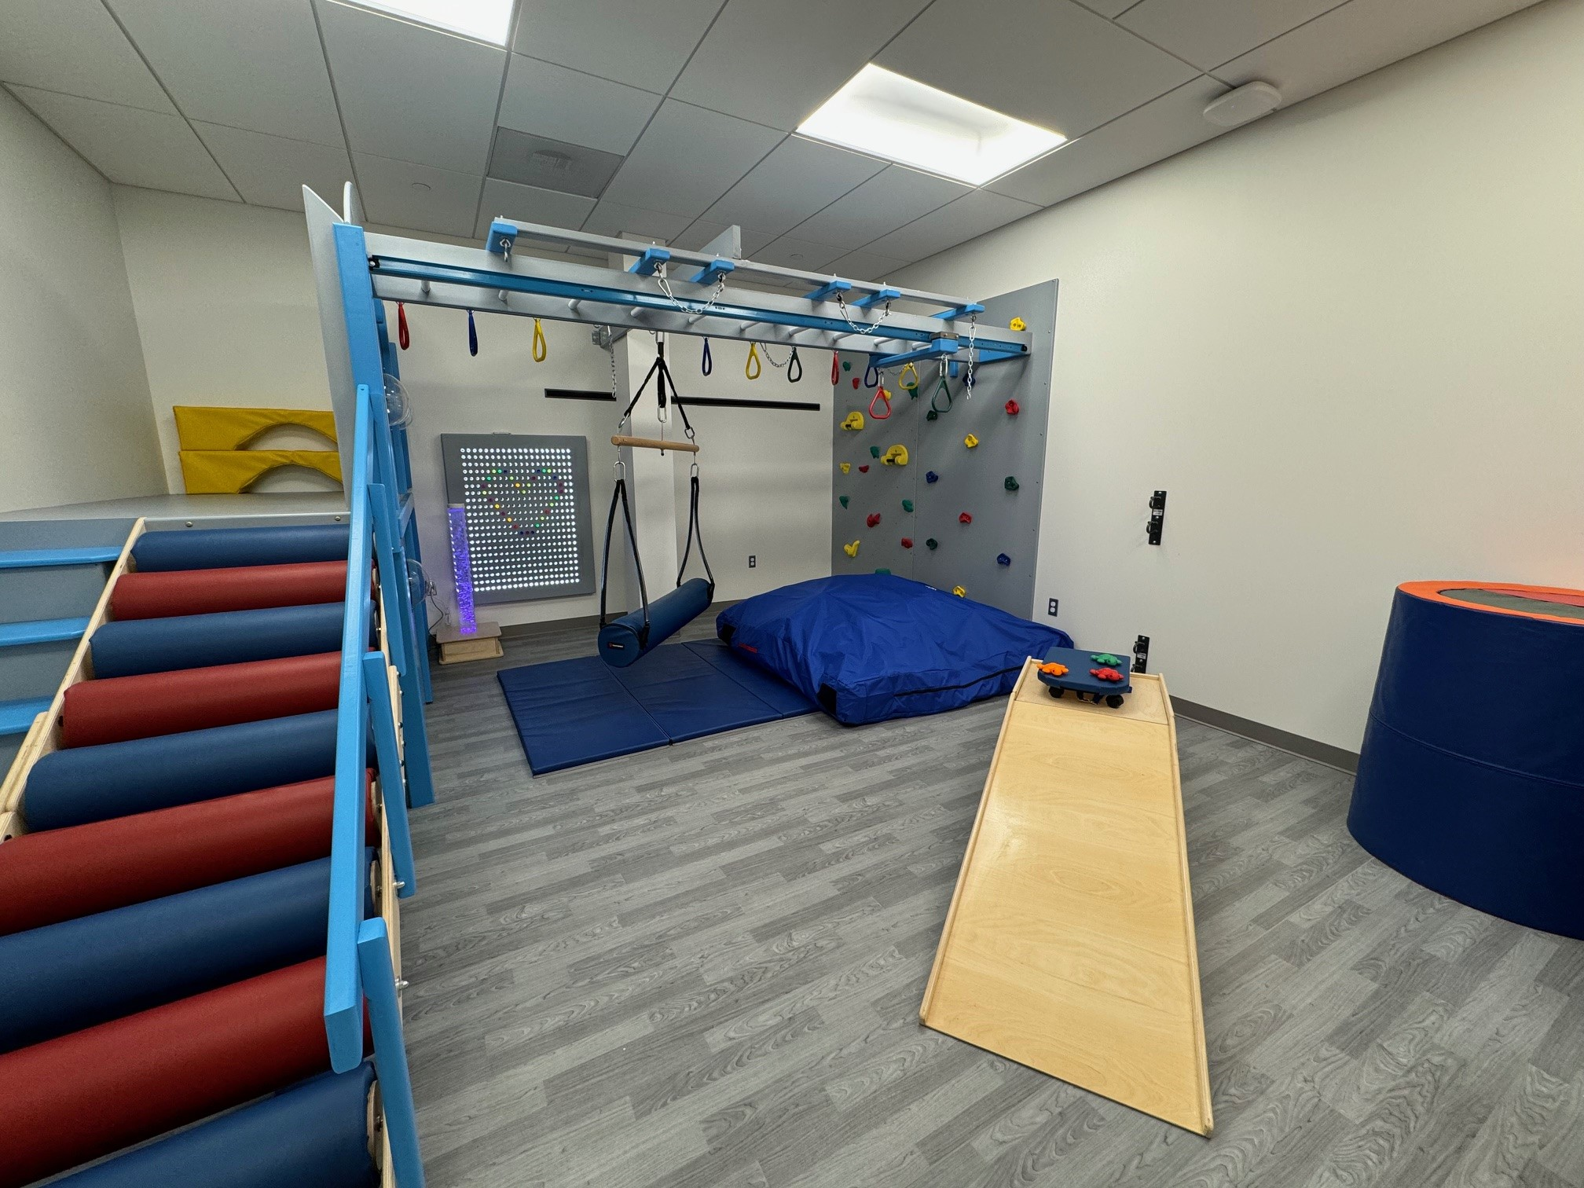
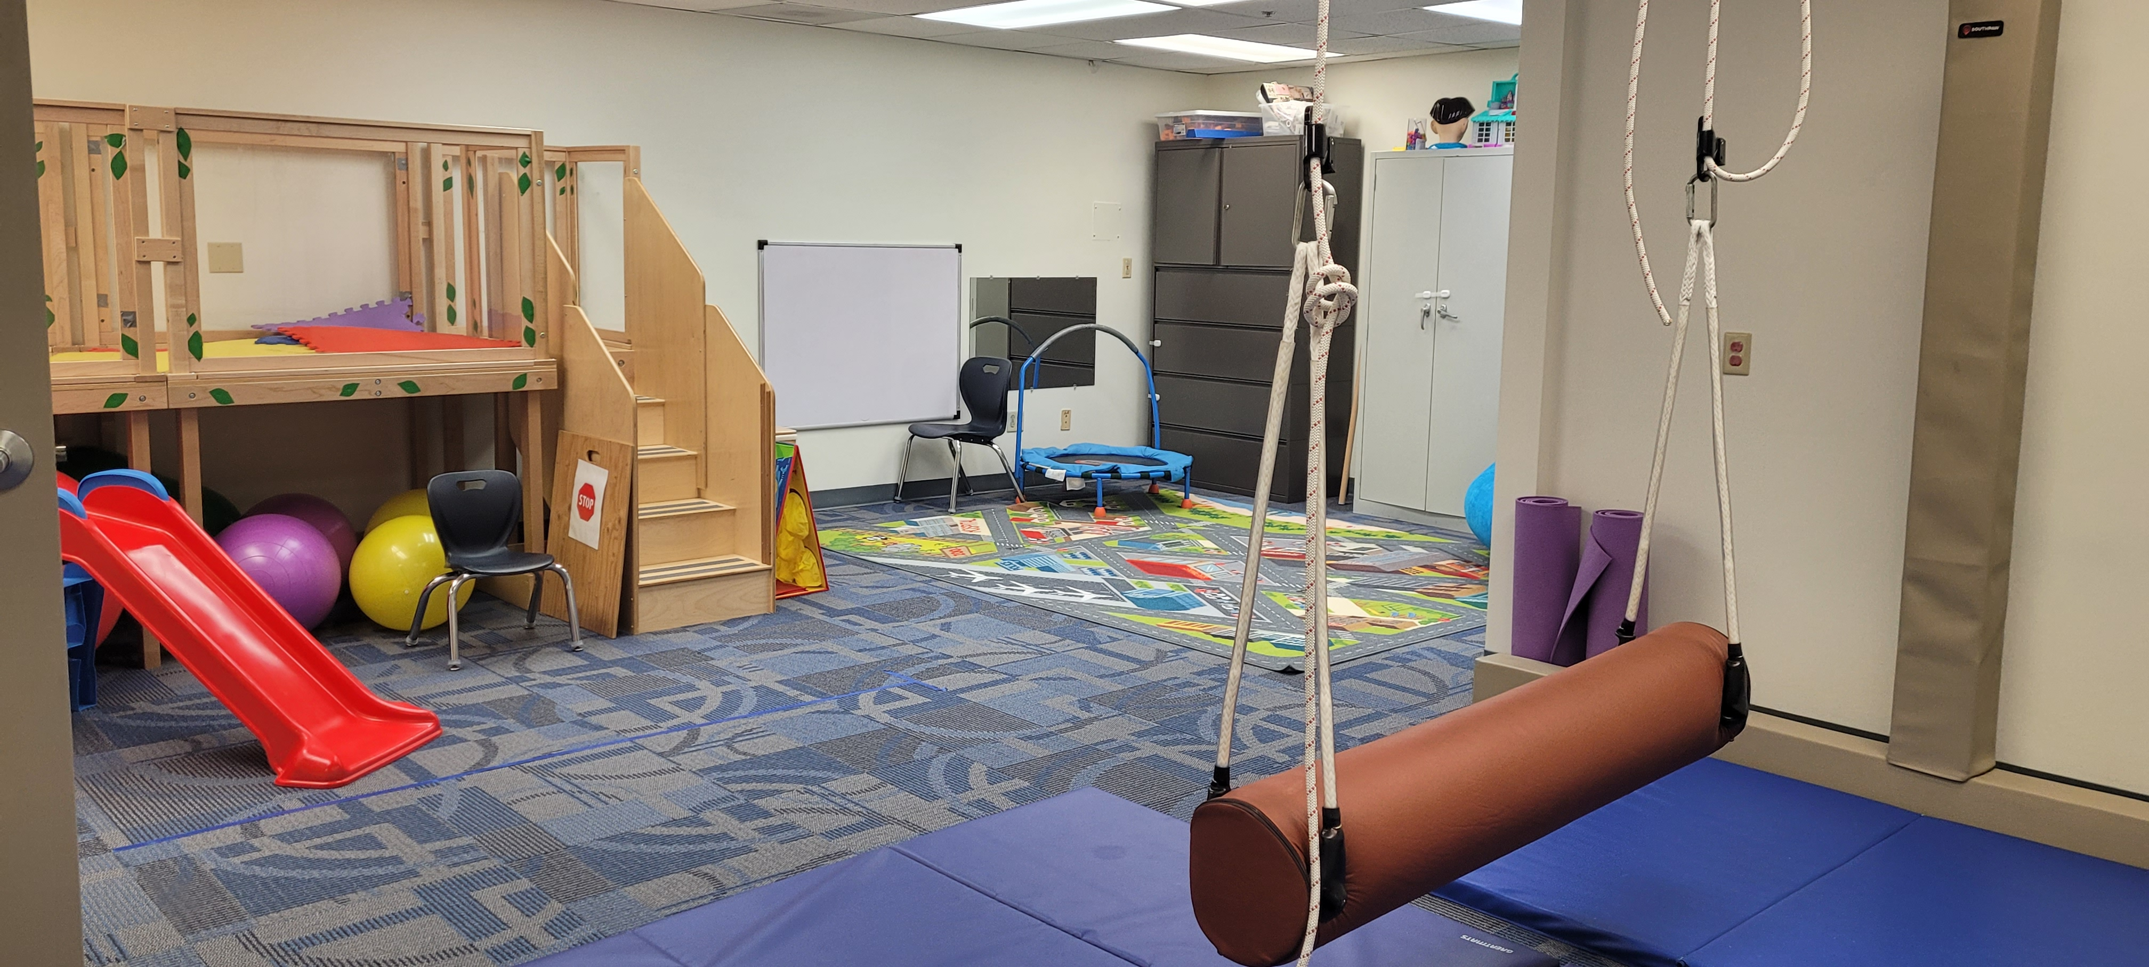
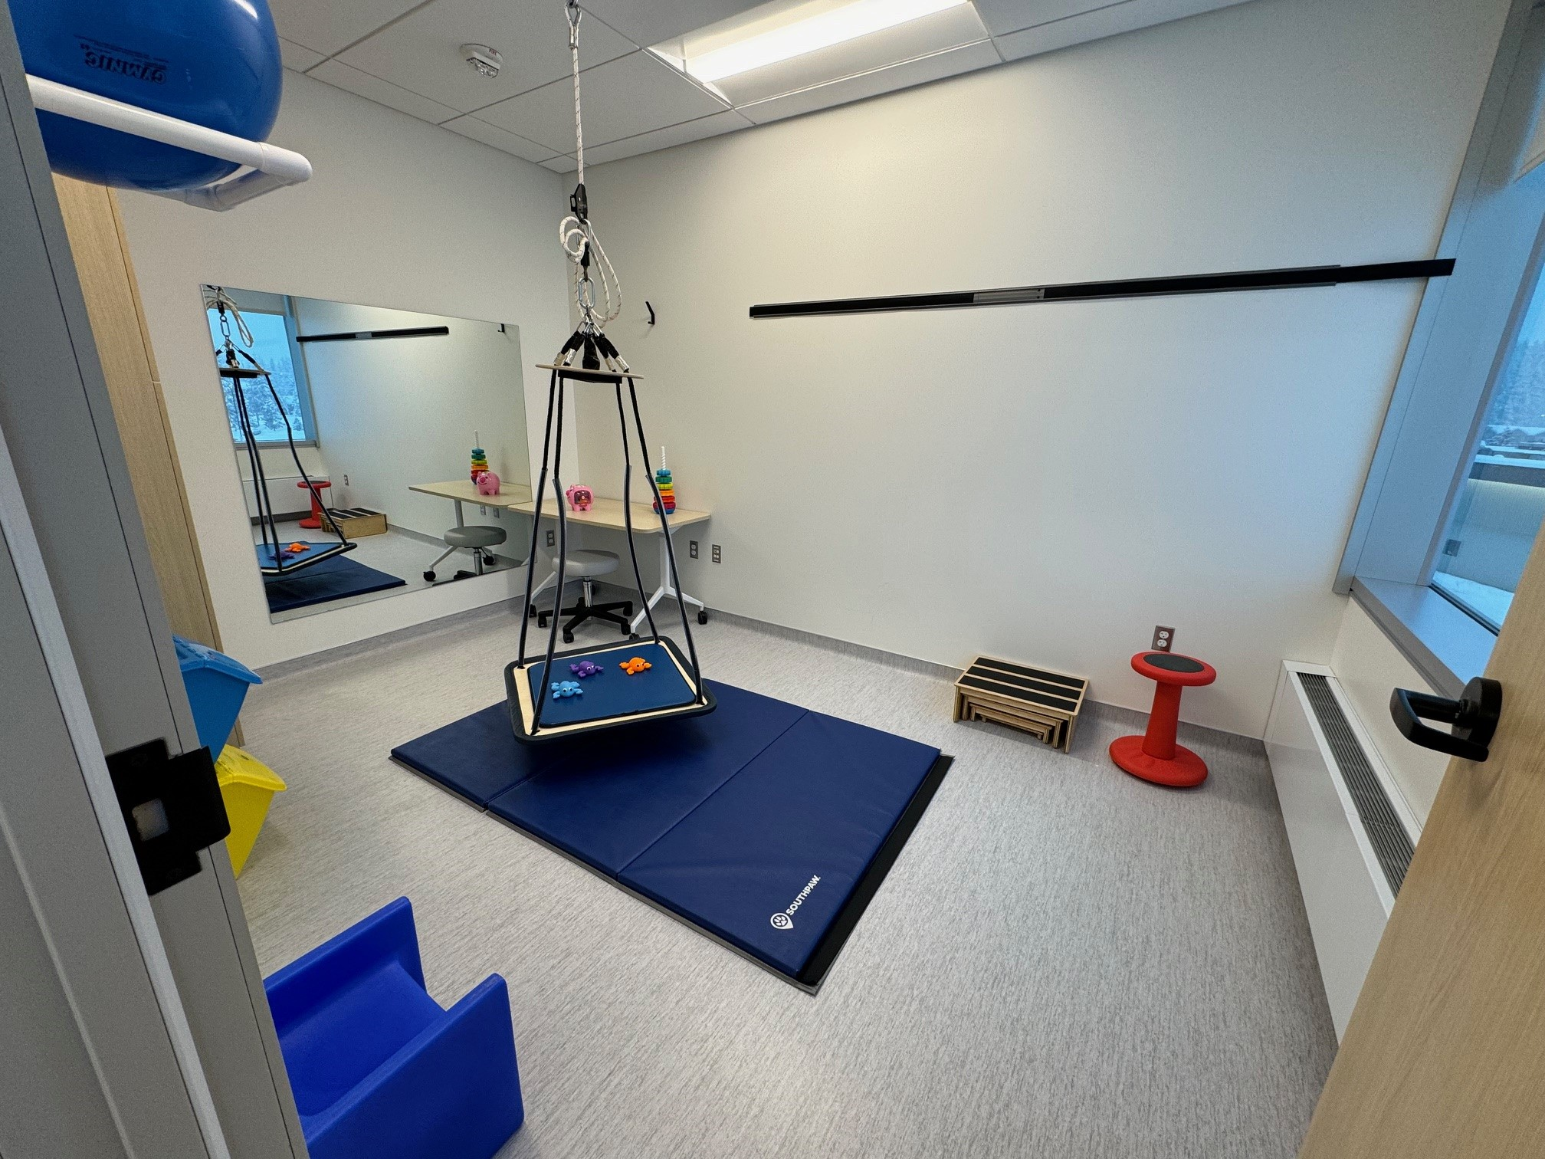
Pediatric Rehabilitation
Doubled the pediatric Rehabilitation Providers at SEARHC
Continuing to expand outreach for pediatric services. SLP provided in POW, Haines
Expanded pediatrics rehabilitation clinics in Sitka and Juneau to meet the needs of the community

Slide 8
Q & A
SEARHC services are open to all!
Kathleen Hansen, OTD, OTR/L, IMH-S
Director of Rehabilitation Juneau
Khansen@searhc.org
907.463.0140

