Slide 1
ABHA 2023
John Solomon, LPC
Chief Executive Officer

Slide 2





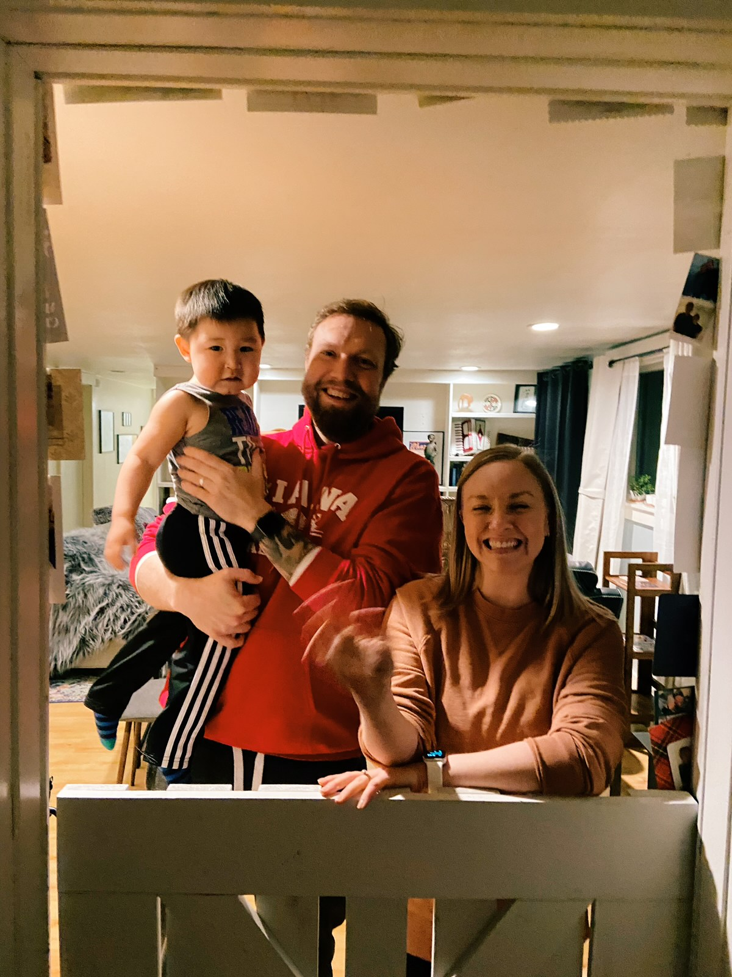

John Solomon, LPC
San Diego
To
Alaska
CEO, Alaska Behavioral Health Association
Arctic Living; Arctic Inspiration
The transition to ABHA

Slide 3
ABHA
The Alaska Behavioral Health Association (ABHA) is the trade association representing a large portion of the behavioral health provider organizations (80+) in the State of Alaska. The Association was formed in 1996 to help improve the delivery of substance use and mental health treatment services in Alaska. Behavioral health services are a critical part of the overall well-being of Alaskans, made possible only through provider/member organizations.
Vision: To advance and elevate the role of behavioral health and whole person care so all Alaskans will thrive.
Purpose: Enhance behavioral health services and the quality of life for all Alaskans by providing leadership which ensures high quality, affordable behavioral health services.
Mission: Help improve the delivery of substance abuse and mental health treatment services in Alaska by supporting behavioral health provider network and system of care through informing policy, planning, and system improvement, holding events for behavioral health leaders, and engaging in ongoing education and information dissemination.

Slide 5
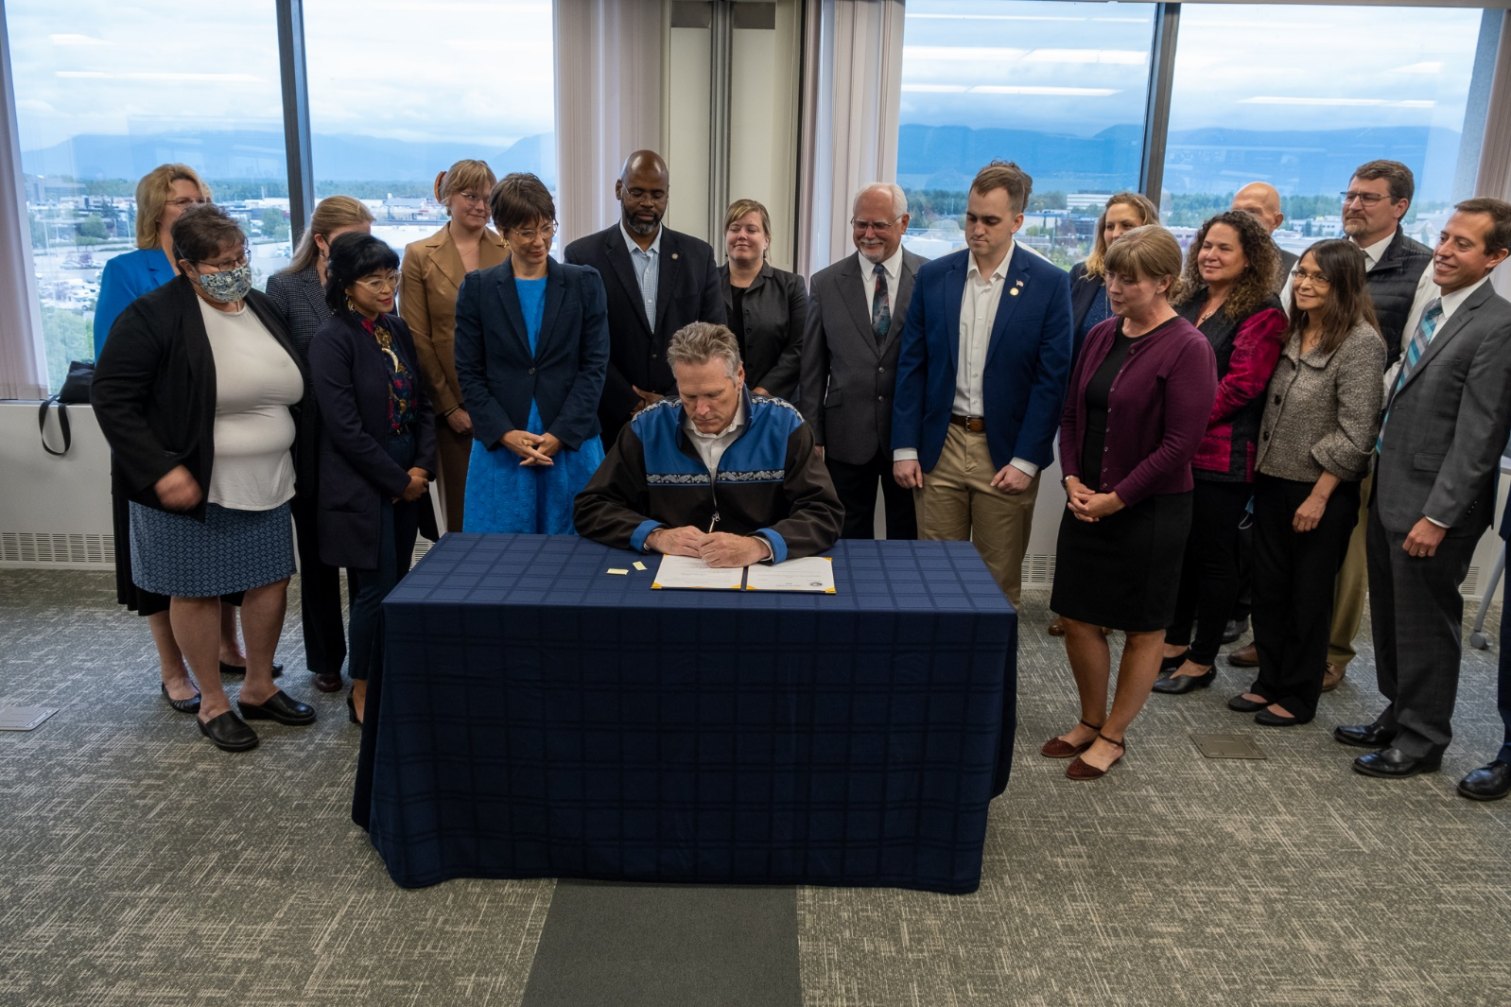
Parity
Shared Advocacy, Shared Success
Creating a unified voice from large member base.
Shared Priorities, and shared goals, with different perspectives
Utilizing collective provider expertise to affect meaningful change
The Payoff
The Partnership
BH Provider Organization voice in HB 265, HB 172, and more
Ongoing dialogue as new legislation, regulation, and innovation is created in the field
The chance to be part of the solution.

Slide 6
Behavioral Health Service Authorizations
Total SAs =
28,016
Reduced SAs by
21,855!
Total SAs =
6,162
Data notes: Based on ‘Claims Paid’ service data provided by Division of Behavior Health for FY22, as reported in December 2022.

Slide 7
The Youth Mental Health Crisis
ABHA recognizes the challenge that all health care providers, educators, and families are facing.
Behavioral Health:
In all life domains
Across the lifespan
Intersects in all healthcare settings
In all family/social systems

Slide 8
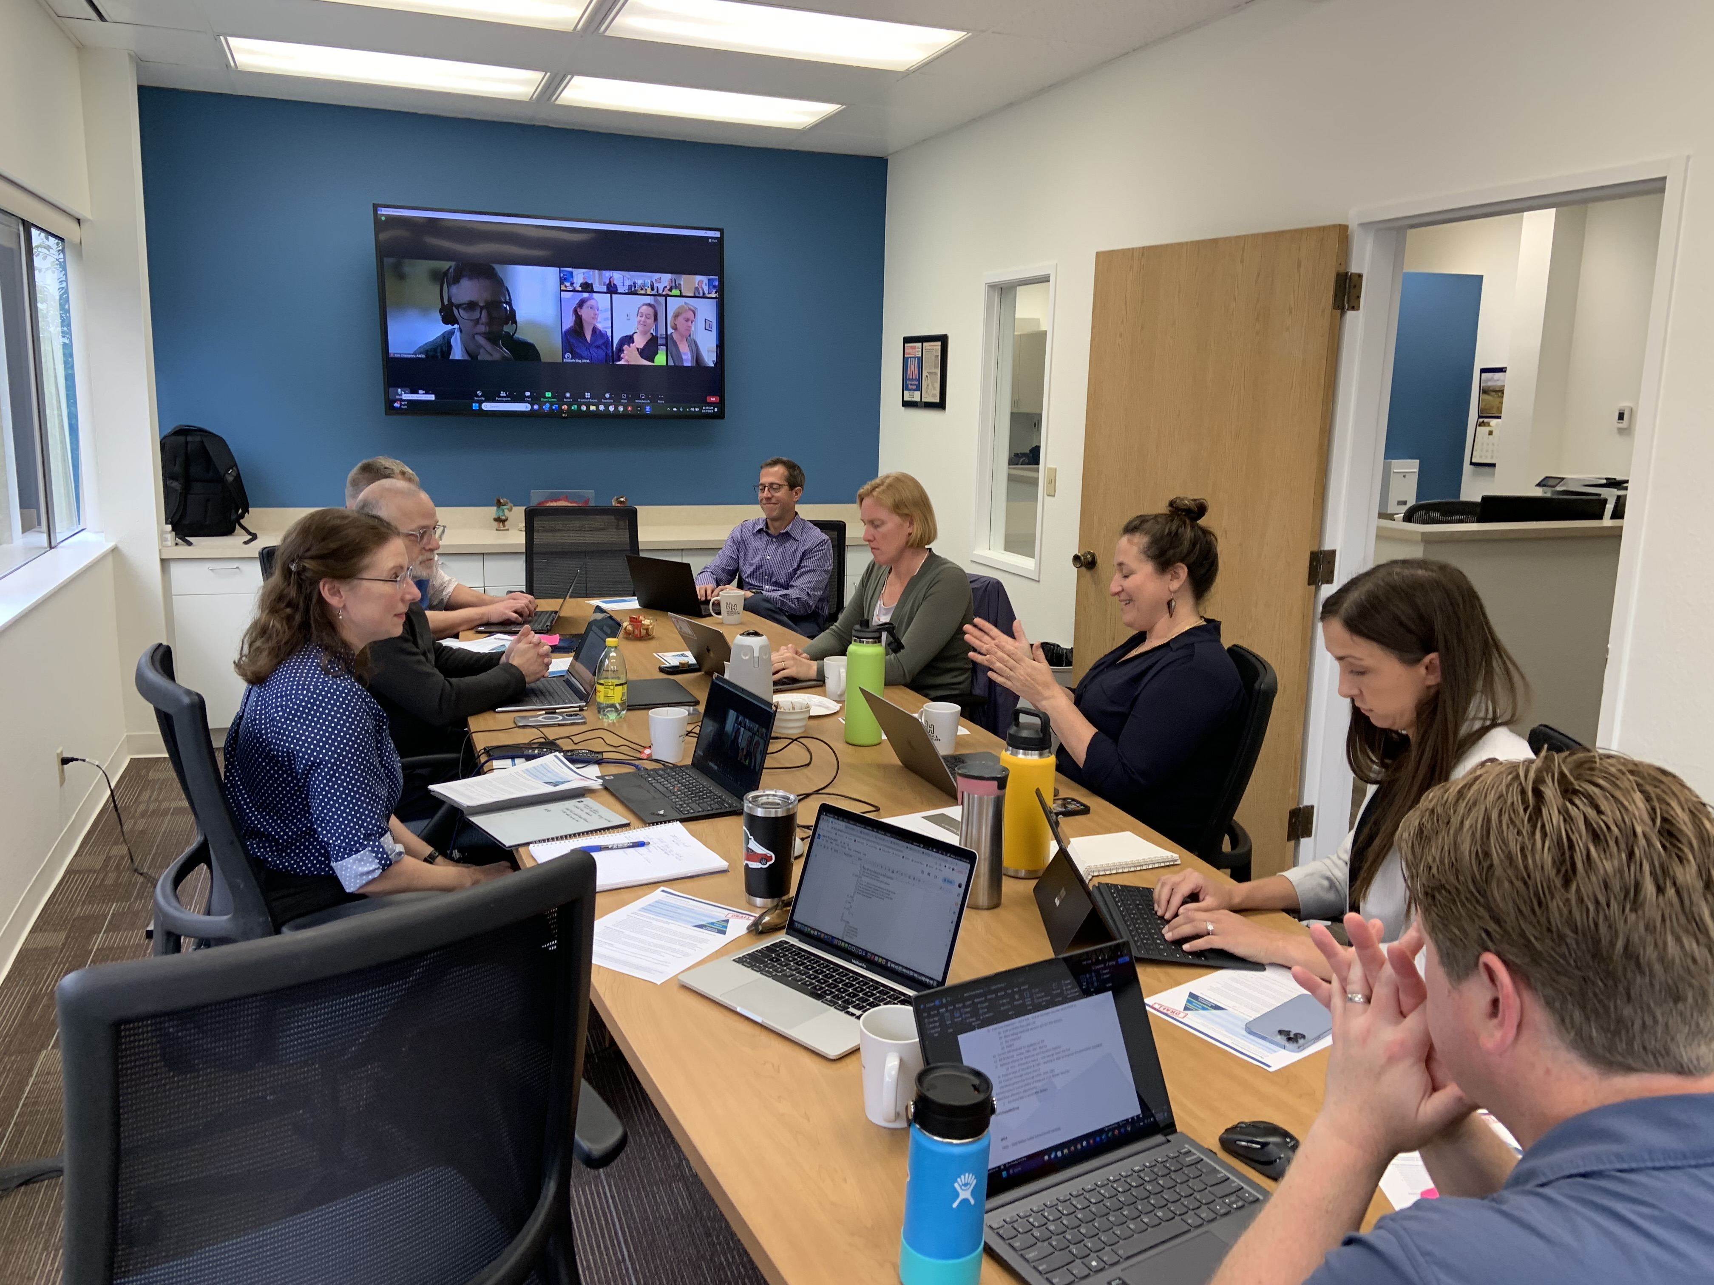
Expanding Partners, Expanding Expertise
Building New Initiatives
THE BIRCH MODEL
APCA, AHHA, A2P2, ASD, ABHA… so many acronyms…

Slide 9
The BIRCH model
Behavioral Health Investment in Resilient Community Health
A multi-tiered initiative that focuses on legislative, regulatory and financial overhaul of the behavioral health system of care
Behavioral Health as Primary Care
Parity for Behavioral Health (administrative and financial)
Expanded access and reduction in barriers
Intersectional access and coordination
Workforce development (equity, parity, and diversity)

Slide 10
Questions?
John Solomon, LPC
Chief Executive Officer
Alaska Behavioral Health Association
P.O. Box 771876 Eagle River, Alaska 99577
www.alaskabha.org
ceo@alaskabha.org

