Slide 1
Specialty Pediatrics
Amy Schumacher, MD Medical Director
Ralph Jenkins, Manager
Kelly Jensen, RN Clinical Specialist
Janel Beaudion, CMS Supervisor
Notes:
Amy

Slide 2
Notes:
Amy

Slide 3
Notes:
Amy
Emphasize “E”

Slide 4
Common Terms
Beneficiary- Alaska Native or American Indian (AN/AI) person whose documents have been submitted to ANMC Central Registration and is eligible for medical services and PRC coverage.
Non-beneficiary means a non-AN/AI person or a Native person who doesn’t have their documents (CIB card, birth certificate, etc.) into Central Registration and is not eligible to receive services and PRC coverage
Direct referral: referral that goes directly to the specialist and is not processed through ANMC Pediatrics and does not require PRC financial coverage
Direct referrals to off-campus specialists are not eligible for ANMC Patient Housing. They must stay in Medicaid hotel or other housing. ANMC Pediatrics is not involved in coordinating the care or travel/lodging for direct referrals.
Notes:
Amy

Slide 5
Eligibility & Registration for Services
A new patient needs New Registration form completed, Privacy & Practices form signed, and eligibility documents submitted. These can be sent to ANMC Central Registration, phone: 729-1395 and fax: 729-1396
Proof of Eligibility:
Certificate of Indian Blood (CIB)
Child’s birth certificate with parent’s CIB (parent listed must be listed on birth certificate)
If baby born at ANMC and mother of baby has CIB in chart, baby will be automatically listed as eligible for 6 months but will need to provide proof of eligibility to remain eligible after 6 months.
Central Registration will also accept a ‘Letter of Enrollment’ from the tribe if a patient doesn’t have a CIB
ANMC’s website with eligibility information: https://anmc.org/patients-visitors/eligibility/
Notes:
Jess

Slide 6
Medical Home: What is it?
A medical home is a primary care provider that provides comprehensive, high-quality care that is:
Accessible
Family Centered
Continuous
Comprehensive
Coordinated
Compassionate
Culturally Effective
Notes:
Amy
Information from AAP:
Accessible-easy to obtain
Family Centered-decisions made in partnership with family
Continuous- from infancy to young adulthood, assisting transition to adult care
Comprehensive- preventative, primary, and specialty
Coordinated- plan created with the family and communicated with the rest of the healthcare team and community agencies involved in the patient’s care
Compassionate- genuine concern for the well-being of the child and family
Culturally Effective- the family’s culture, language, beliefs and traditions are recognized, valued, and respected.

Slide 7
Medical Home: Who is it?
The regional team will remain the patient’s medical home even if ANMC Pediatrics is coordinating specialty pediatric care. This means that primary care provider team is the hub of the child’s care and should manage the plan of care with the family.
Notes:
Amy

Slide 8
Pediatric Care Coordination
Care Coordination in a Medical Home leads to…
Effective teamwork and improved communication
Care Coordinators have their “ears to the ground” in a way that can uniquely respond to the needs of patients and families.
Care Coordinators add value to the efforts of the team
Support the medical team
Support the patients/ families
Notes:
Jess
Care Coordination- comprehensive, family focused, community level plan and coordination. The Agency of Healthcare Research and Quality (AHRQ) describe as “deliberately organizing patient care activities and sharing information among all of the participants concerned with patient’s care to achieve safer and more effective care.” Communicating the patient’s needs to the right people.
Case Management- patient focused and carries out agency specific plan, not community level plan. Case Management Society of America (CMSA) defines case management as “a collaborative process of assessment, planning, facilitation, care coordination, evaluation and advocacy for options and services to meet and individual's and family's comprehensive health needs through communication and available resources to promote patient safety, quality of care, and cost effective outcomes.”
Certainly the roles overlap and both involve making sure our patients get the care they need which can include making appointments, arranging specialized care, coordinating travel/housing, and reaching-out to community resources.

Slide 9
Why is it important?
Notes:
Jess
Gabe’s Care Map

Slide 10
Three roles of Specialty Peds: Field Health, Sub-Specialties, Team Bee
ANMC Pediatrics Clinic: Phone: (206) 594-3375
Tiger Text: SCF Specialty Pediatrics Pediatrician
Notes:
Jess & Amy add comments
Update the phone numbers
Add the Outpatient /

Slide 11
Rural Anchorage Service Unit
You should send referrals to “ANMC Specialty Pediatrics” for pediatric clinics that we have on campus:
Endocrinology, Neurology, Pulmonology, Rheumatology, Infectious Disease, Surgery, Genetics, Hem/Onc
Utilize your SCF Primary Care Team for consultations, requests for appointments, referrals, and PRC coverage
For pediatric patients, follow the same workflow your clinic utilizes for adult patients when coordinating care with assistance from your SCF Primary Care Team.
If a pediatric consult is needed, contact your SCF Primary Care Team who can facilitate a consult with their integrated pediatrician
Off-campus referrals requiring PRC coverage should go through your SCF Primary Care Team
Notes:
Jess
Let’s talk about who we support. ANMC Pediatrics is the pediatric service to support statewide pediatric and pediatric subspecialty care when it is not available in your home community or regional center. For the Anchorage Service Unit your general pediatric care is supported by Southcentral Foundation Pediatrics. This Pediatric network is accessed through the SCF Primary Care Center network your teams are already familiar with. For subspecialty services listed here on this slide, you can refer directly.
However support of your General Pediatric evaluations or Pediatric Subspecialty not listed on this slide you will need to utilize your SCF Primary Care Team.
If you have any questions please reach out to Kindra Ashe, Nurse Clinical Specialist for ANPCC Pediatrics
For Pediatric Subspecialty Services:
ANMC Pediatrics Subspecialty Clinics

Slide 12
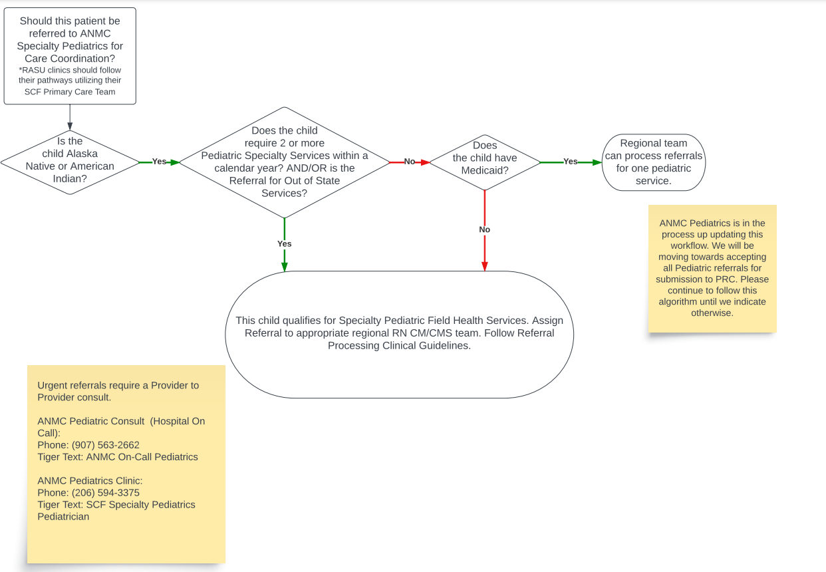
Decision Flow
Notes:
Jess
Urgent referral outpatient TT

Slide 13
Direct Referrals: Referrals that PCP/region sends directly to the sub-specialist
When to send a direct referral:
When child only needs to see one specialty provider and does not require PRC coverage
Child has Medicaid and only needs to see 1 off-campus sub-specialist
Child needs an appointment with an on-campus sub-specialist such as ENT
Child is non-beneficiary
Notes:
Amy

Slide 14
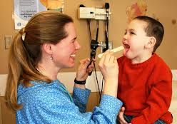
Team Bee (Anchorage clinic)
Pediatricians, Advance Practice Providers, CMAs, RN CM, and CMS
We take care of out-of-town children who are in Anchorage and need medical care (acute care, well child exams, pre-procedure H&P’s, hospital discharges, complex health needs requiring them to stay in Anchorage for an extended period)
Please note: For children who are not in Anchorage and need an evaluation by a pediatrician, send a referral to “ANMC Pediatrics” and the Field Health team will schedule with a Team Bee provider. The referral needs to be medically necessary, not patient preference.
Notes:
Amy
If you have a complex child being seen by Team Bee for a pre-procedure H&P, please send notes and special considerations in advance.
Remove numbers

Slide 15
Field Health (Referrals)
Refer To Location is: ANMC Pediatrics
When referring, make sure patient’s demographics are current and provide the best contact number for the parent/guardian
We receive referrals from Regional Hub’s (BBAHC, CAIHC, KANA, Maniilaq, NSHC, SEARHC, SSMH, YKHC)
RASU should be working through their SCF Primary Care Team rather than Specialty Pediatrics for care coordination, referrals, and PRC coverage
Extra layer of case management and includes provider review
Coordinate care for pediatric subspecialty care on and off-campus
Attempt to coordinate bundled appointments so patients do not have to make multiple trips to Anchorage
Submit for PRC coverage for off-campus appointments
Notes:
Jess

Slide 16
When to refer to Field Health
Children who have complex heath care needs and need sub-specialty medical care
PCP requests evaluation by a pediatrician and there isn’t a pediatrician available locally
When child needs more than one specialty appointment in Anchorage or out-of-state
When PRC funding is needed to cover the costs of the medical care (i.e. patient does not have Medicaid, child is being hospitalized somewhere other than ANMC, care is out-of-state)
When patient will be in Anchorage or out-of-state for extended period of time for medical care
Notes:
Jess

Slide 17
Pediatric Sub-Specialties
Limited availability on-campus
Most pediatric sub-specialty care is done off-campus and requires coordination
Wait times vary depending on sub-specialty
Notes:
Amy

Slide 18
Pediatric Sub-Specialty Clinics in our Clinic
Tracie Wright, RN CM:
Maria Apilado, RN CM:
Pulmonology: every quarter from Seattle Children’s
Rheumatology: every other month from Seattle Children’s
Neurology: 3x per month, Dr. Smith (also works at Providence)
Sherry Hammock, RN CM:
Endocrinology: full-time with regional clinics, Dr. Lescher
Pediatric Surgery: every Tuesday, Anchorage Pediatric Surgery group
Hem/Onc: every other Monday, Alaska Pediatric Oncology group
Genetics: every quarter, Primary Children’s Salt Lake City
Infectious Disease: every Wednesday afternoon, Dr. Westley
Coming soon…
Pediatric Gastroenterology
Pediatric Nephrology
*All sub-specialty clinics are by referral only and may have a waitlist
Notes:
Amy
Subspecialty Clinics require a referral

Slide 19
ANMC Specialty Pediatrics Referrals
Medical Services | Refer to Location in Cerner
Endocrinology | ANMC Pediatric Endocrinology
Genetics | ANMC Pediatric Genetics
Infectious Disease | ANMC Pediatric Infectious Disease
Neurology | ANMC Pediatric Neurology
Pulmonology | ANMC Pediatric Pulmonology
Surgery-General | ANMC Pediatric Surgery
Rheumatology | ANMC Pediatric Rheumatology
Pediatric Heme/Onc | ANMC Pediatric Heme/Onc
Things to Remember When Referring to an ANMC Pediatric Specialist
You may refer directly to the subspecialty.
“Accepted” referrals will show as “accepted” in Cerner Referral Management.
The specialty care team will contact the family, schedule the appt, and request any required travel/housing.
Rejected referrals will show as status “rejected” in Cerner.
If referral is rejected, the specialty care team will notify the referring provider by Cerner Message.
Following appt, the specialty care team will provide the referring provider the visit note and follow-up recommendations.
Notes:
Amy

Slide 20
ANMC direct referrals
If being referred to a single specialist at ANMC, patients should be referred directly to the ANMC Specialty Clinic (i.e. Urology, ENT, CFDS, Ortho, Podiatry, Ophthalmology, Dermatology, Allergy, Sleep Medicine)
For example: If a child needs to see urology only, please refer directly to ANMC Urology. If child needed to see more than 1 sub-specialist, it would be appropriate to refer to “ANMC Pediatrics” to coordinate care.
Notes:
Jess

Slide 21
What to include in your referral:
Updated demographics
Medicaid and/or private health insurance information
Last well child check by PCP or mid-level, notes for acute issues within the last year, exams, labs, images and sub-specialty notes related to the condition being referred for
Medication list
Growth charts
Notes:
Amy
If not on Cerner please include the items listed above with your referral

Slide 22
Urgency
Emergencies are medevacs or commercial flights with patient going directly to the ER for admission and should be coordinated through the Alaska Native Medical Center.
Urgent referrals should have a provider-to-provider consult. ANMC Pediatric Consult line: 907-563-2662 or TigerText: ANMC On-Call Pediatrics
ANMC Pediatrics Clinic: Phone: (206) 594-3375
Tiger Text: SCF Specialty Pediatrics Pediatrician
Urgent referrals are based on medical urgency due to an acute condition requiring care within an expedited timeframe. Please, do not indicate “urgent” because of a scheduling or travel issue
Notes:
Amy
Urgency due to timelines should be communicated to the RN CM but not be documented as “urgent” if the medical condition doesn’t require urgent care
Refer

Slide 23
ANMC Pediatricians Regional Field Clinics
Pediatricians are contracted by individual Tribal Health Organizations for local clinics, allowing the THO to prioritize patients and coordinate their own schedule/care.
The regional team creates the schedule, processes the referrals to the clinic, and manages the clinic.
Regional teams will coordinate the pediatrician's recommendations which may include referrals to Specialty Pediatric Providers.
Notes:
Jess

Slide 24
Contact Specialty Pediatrics:
RN Case Manager phone line: (907)729-8610
CMS phone line: (907)729-5410
Fax: (907)729-8664 or (907)729-6159
RN TigerText: SCF Specialty Pediatrics Case Manager
Provider TigerText: SCF Specialty Pediatrics Pediatrician
Notes:
Jess

Slide 25
Contacts for Regional Care Teams:
BBAHC, NSHC, SEARHC, SSMH
RN CM: Esther ext. 729-5416, and Emily ext. 729-6161 and Tina ext. 729-5761
CMS: Brittney ext. 729-5093 and vacant CMS ext. ####
CAIHC, KANA, MAN
RN CM: Don ext. 729-8662, Tanya ext. 729-6790, and Jacky ext. 729-8809
CMS: Ruth ext. 729-8820 and Devonte ext. 729-7490
YKHC
RN CM: Sarah ext. 729-6757, Kim ext. 729-4889, Josh ext. 729-5183 and Derek ext. 729-5081
CMS: Savannah ext. 729-6769 and Tiana ext. 729-8932
Notes:
Jess

Slide 26
Contacts for Specialty Care:
Neurology, Pulmonology, and Rheumatology
RN CM: Tracie Wright ext. 729-8817
CMS: Kathleen Geno ext. 729-8832
Surgery, Hematology, Oncology (non-acute; long term follow-up), Infectious Disease and Genetics
RN CM: Maria Apilado ext. 729-5410
CMS: Rachel Kasgnoc ext. 729-6738
Endocrinology
RN CM: Sherry Hammock ext. 729-8803
CMS: Sarah ext. 729-8822

Slide 27
Notes:
Amy

Slide 28
Notes:
No changes are to be made to this slide.

