Slide 1
Fairbanks Pediatric Update
Laura Brunner MD
Foundation Health Partners Pediatrics Clinic
Fairbanks Memorial Hospital Inpatient Pediatric & NICU Medical Director

Slide 2
Outline
Changes in the Fairbanks Community
Inpatient
Strengths
Current areas of work
Outpatient Facilities
Foundation Health Partners, Fireweed Pediatrics, Chief Andrew Isaac, Bassett Army Medical Center, Alpine Medical Clinic
Residency Update
Areas of need

Slide 3
Foundation Health Partners
Providing quality health care to Interior Alaskans
The Greater Fairbanks Community Hospital Foundation (GFCHF) owns Tanana Valley Clinic (TVC), Fairbanks Memorial Hospital (FMH) and Denali Center (DC). Foundation Health Partners took over management January 1, 2018
Denali Center, FHP’s Long Term Care Facility

Slide 4
All Alaska Pediatric Partnership
Longstanding Member
Glad to be able to participate in the work that is happening around the state surrounding important topics for children and families
Continued commitment to the importance of kids and families in Alaska

Slide 5
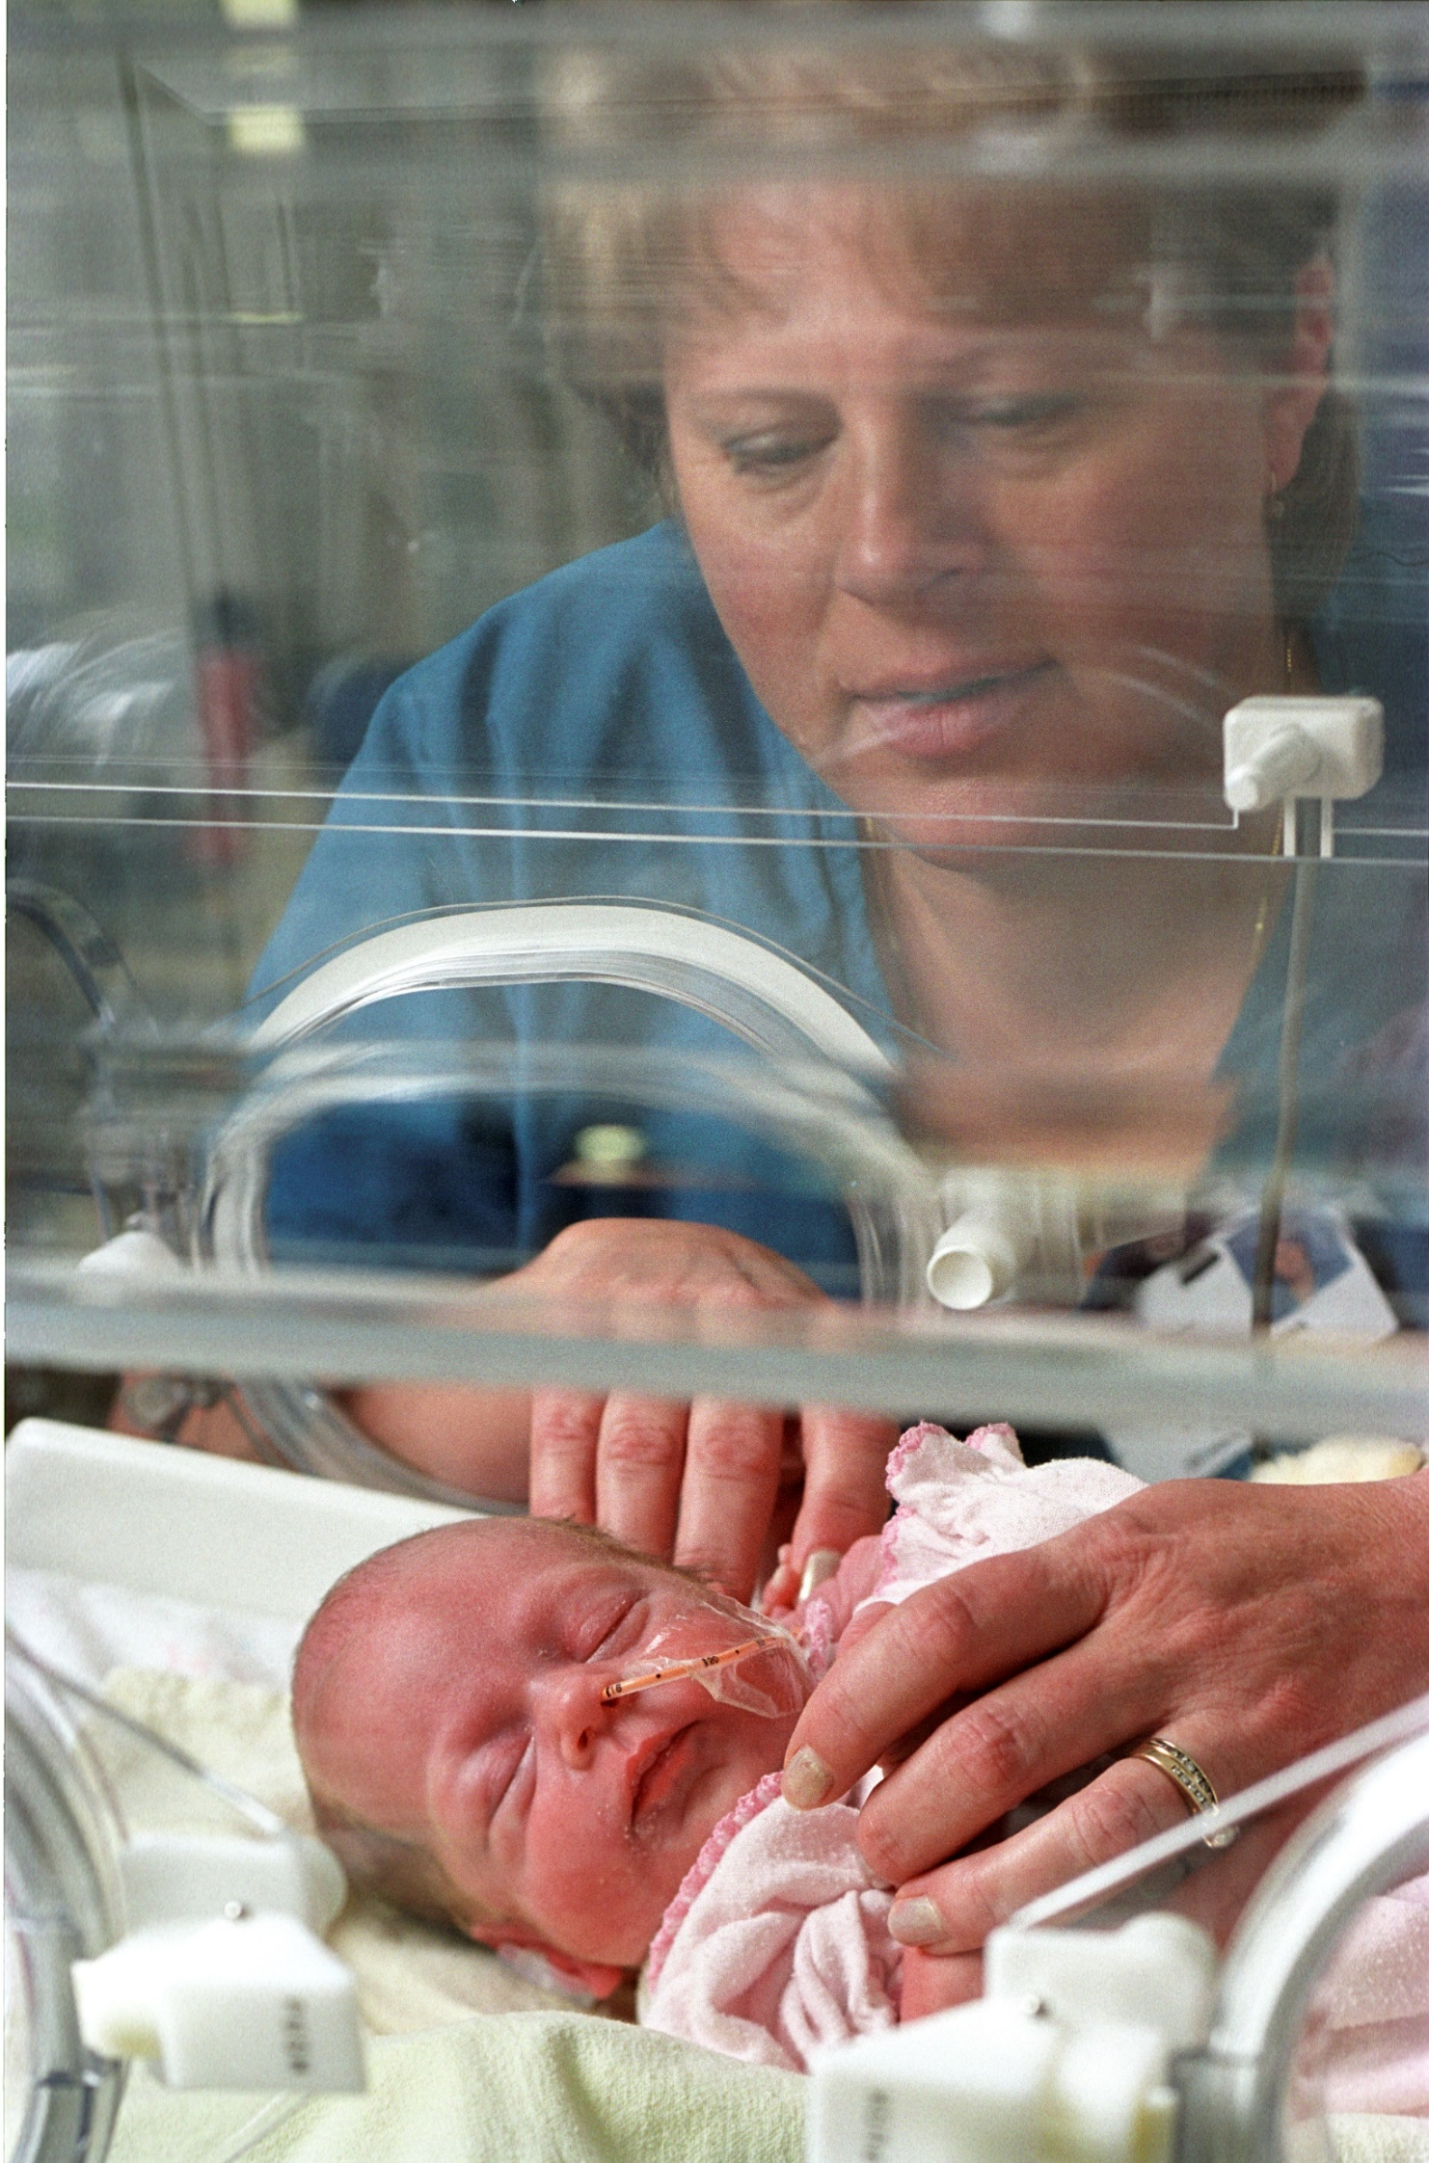
Inpatient Facilities
Fairbanks Memorial Hospital
Nursery/NICU​
Approx 1,100 deliveries per year​
Bassett Army Labor and delivery​
Level II NICU​
Quality Improvement projects​
Simulation​
Neonatal Fever
Behavioral Health

Slide 6
Inpatient Facilities
Fairbanks Memorial Hospital
Pediatrics​
11 bed unit with overflow to neighboring unit as needed​
Pediatric-trained nursing staff​
Quality Improvement focus for the care of pediatric patients in the facility​
12 bed level II NICU
Staffed 24 hours a day
Pediatric Hospitalists
NICU
Well Baby
No dedicated PICU space; can use adult ICU or NICU room as needed
FMH Pediatric PACU Room

Slide 7
Areas of Progress
Emergency Medical Services for children
Staffing and space
Behavioral health

Slide 8
Outpatient Facilities
Foundation Health Partners & Tanana Valley Clinic
FHP Pediatrics Clinic
TVC Family Medicine
TVC 1st Care
FHP General Surgery
FHP Child Psychiatry
Tanana Valley Clinic 1st Care & Main Building

Slide 9
Foundation Health Partners Pediatric Clinic
Board Certified Pediatricians and Advanced Practice Providers
Visiting Clinics Include:
Pediatric urology​
State metabolic clinic
Alaska Seattle Children’s Cardiology
Alaska Children’s Heart
State Neurodevelopment Clinic
Alaska Pediatric Surgery
Primary care
Acute care​
Hospital-Based Clinic – February 2024
Located on the Fairbanks Memorial Hospital Campus
Sustainable operations to maintain and optimize services to patients
Preserving patient access regardless of insurance type

Slide 10
Pediatric Residency
Residency Programs
Match four new residents per year​
Spend four months/year in Alaska​
Return each year for three years ​
We now have residents nearly year-round​
Advantages: large success in return to Alaska so far, ongoing education

Slide 11
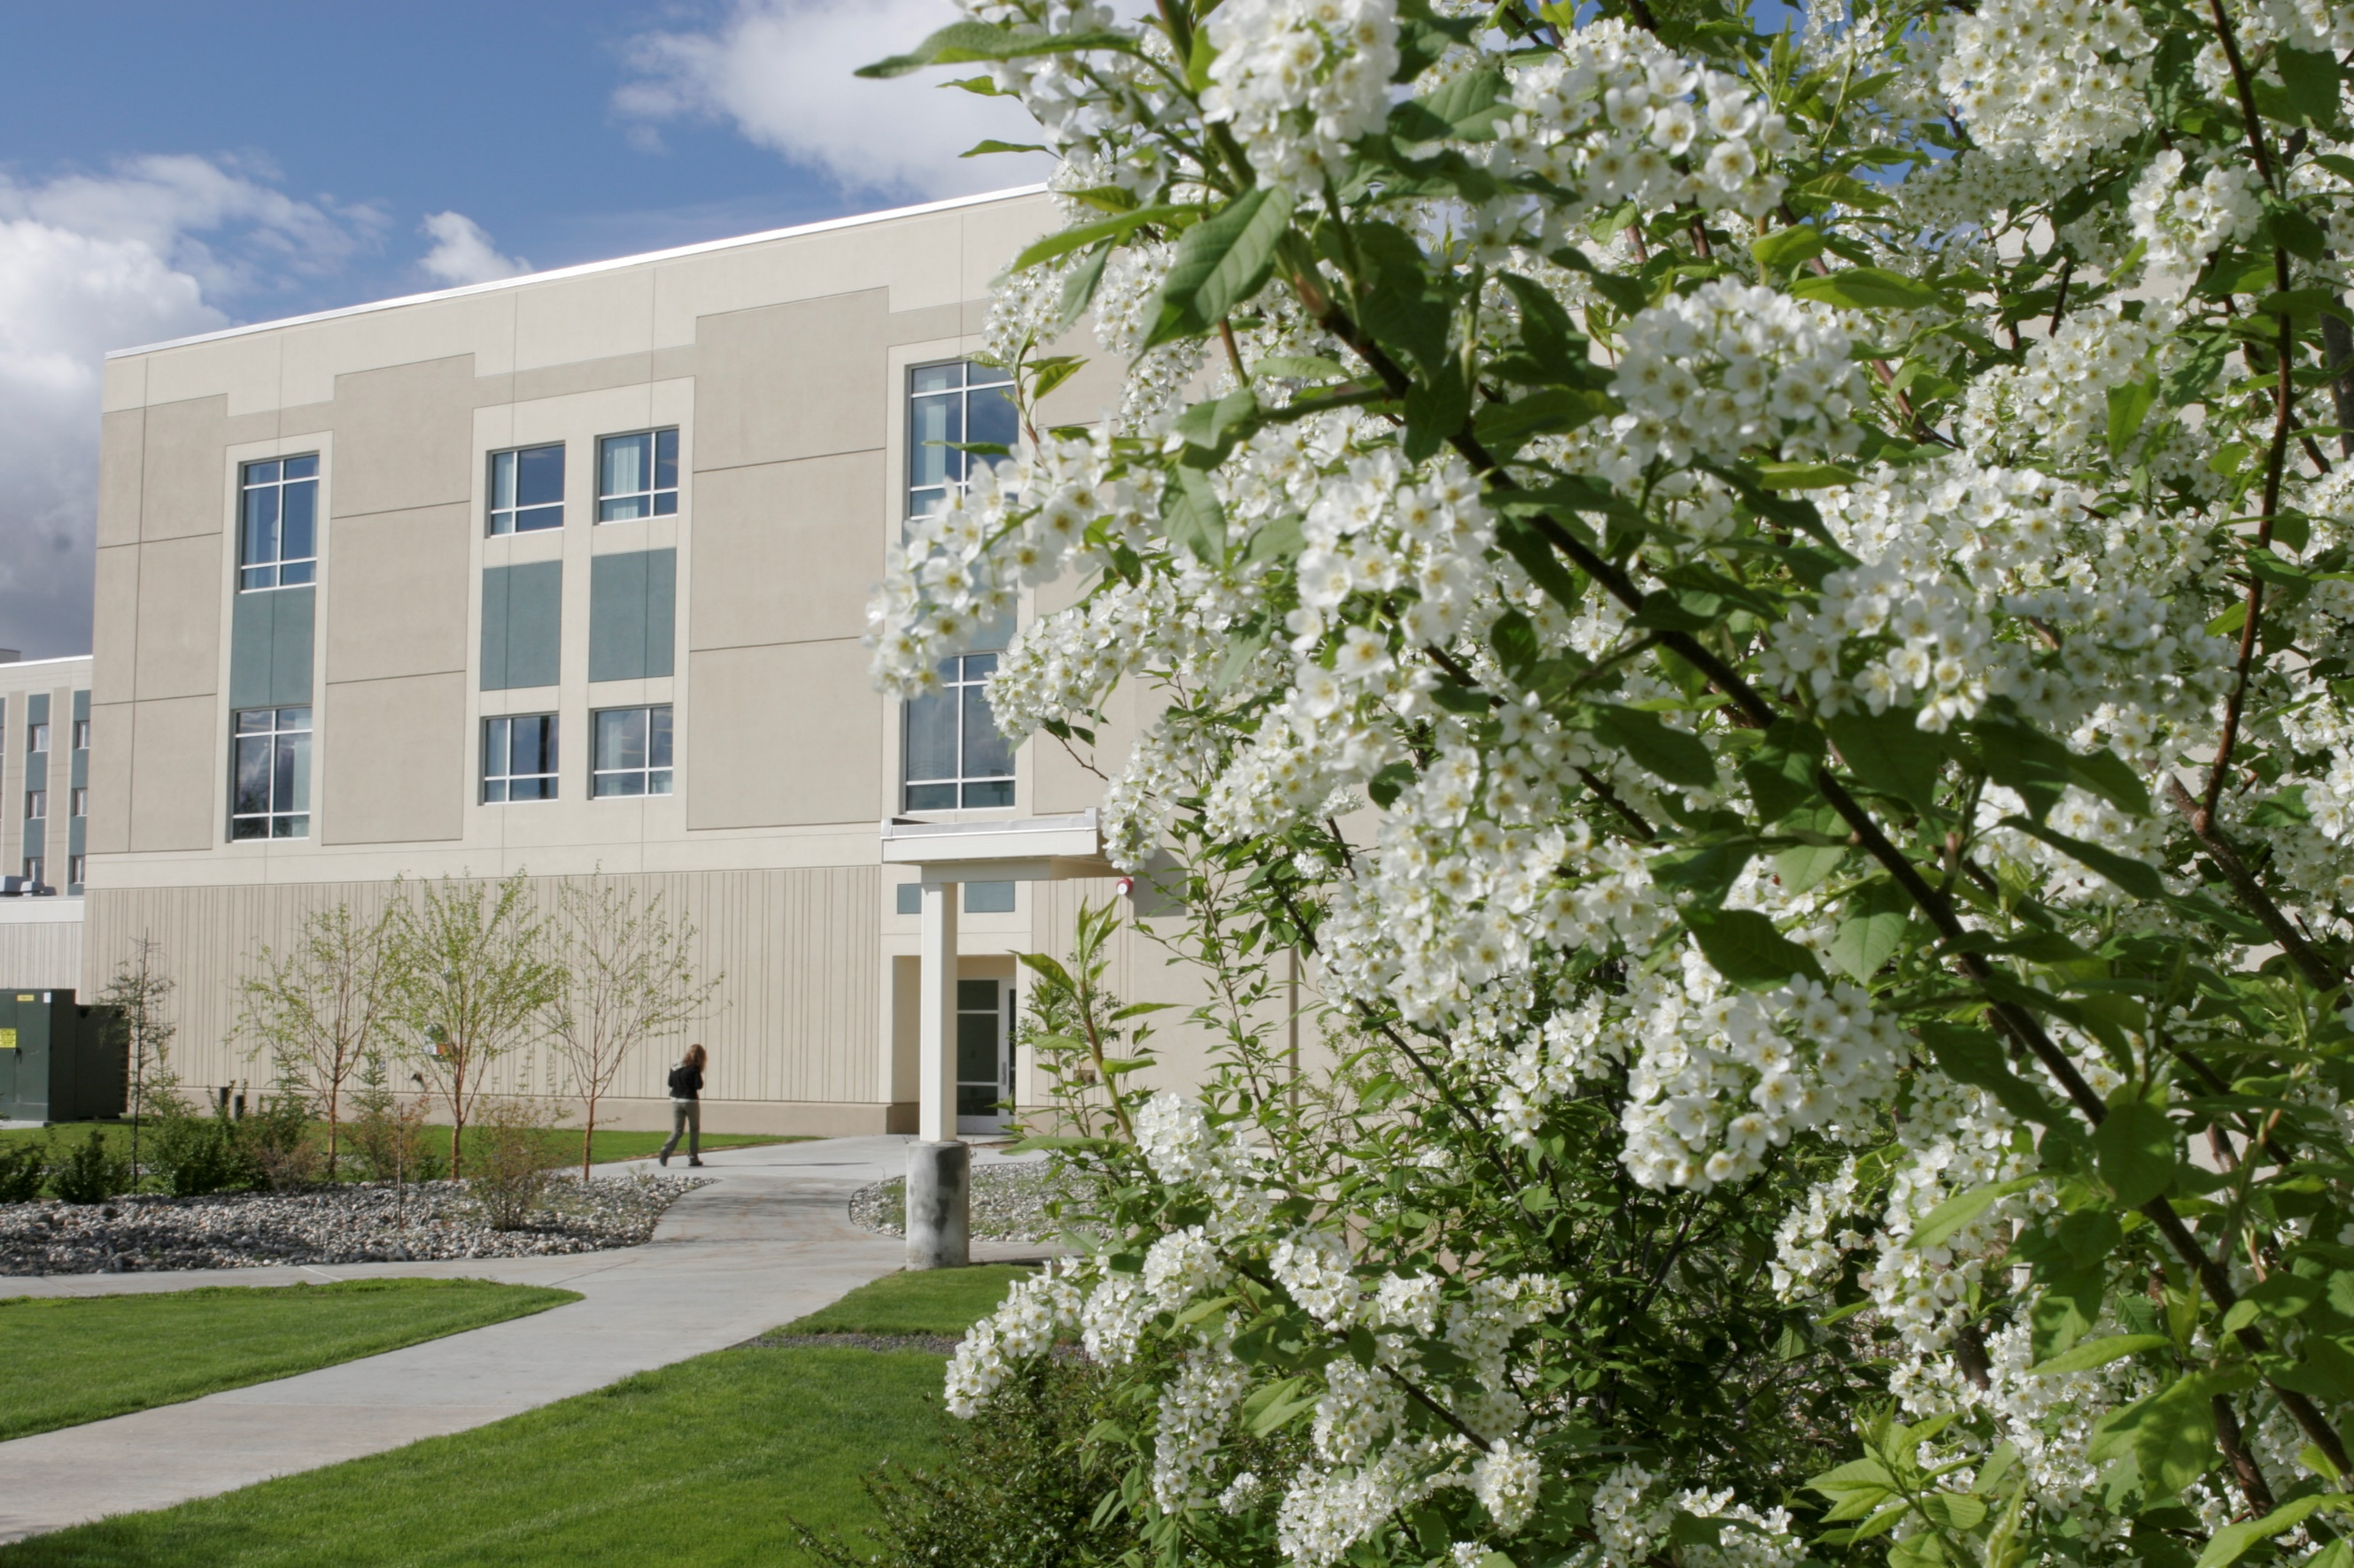
Areas of Need
Child psychiatry and behavioral health​
Health Care Staff Recruiting​
Hard to recruit areas​
Specialty staff​
Coordination of local resources​
Pediatric subspecialty care
Many children travel to Anchorage for outpatient evaluation​
Fairbanks Memorial Hospital Campus

Slide 12
Behavioral Health Needs in Our Community
Our Vision: Transforming Behavioral Healthcare
The Need for Expansion: Why Now?
At Foundation Health Partners, we have a clear and urgent vision: to transform the landscape of behavioral healthcare in Interior Alaska. Our unwavering commitment to our community drives us to address a pressing need—the lack of specialized care for adolescent patients facing behavioral health challenges.
Our community is facing a critical issue that demands immediate attention. Every day, children and adolescents in our region spend an average of 4.75 days boarding in the Emergency Department (ED), awaiting the psychiatric treatment they require. This is far from an ideal environment for their care.

Slide 13
Behavioral Health Needs in Our Community
The Current Reality
The Impact
No Local Adolescent Care: There is currently no dedicated inpatient care facility for adolescents in Northern or Interior Alaska. There are approximately 350 unique pediatric patients seen each year that require multiple days of care.
Qualifying for Inpatient Care: Almost all of these patients would qualify for adolescent inpatient behavioral health care.
Long ED Stays: The extended stays in the ED are not conducive to the appropriate evaluation and psychiatric treatment of children and young adults.
Adult Unit Over Capacity: The demand for adult behavioral health services has been steadily increasing, leading to waits in our existing adult behavioral health unit. This strains our resources and limits our ability to provide prompt care. Part of this expansion will include adding 2 adult behavioral health rooms to meet this growing need.
By expanding our behavioral health services, we will:
Enhance Care: Provide a specialized and dedicated space for young patients to receive the treatment they so desperately need.
Community Well-being: Improve the overall mental health landscape in Interior Alaska.
Local Access: Reduce the need for transfers outside the community or state, keeping families together.

Slide 14
What are we doing about this?

Slide 15
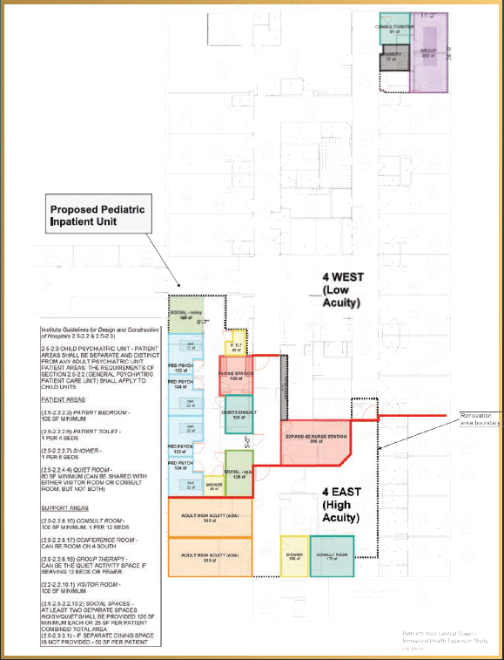
Our Build-out Goal

Slide 16
How Can You Help?
Supporting the community on this focus
Advocating for children

Slide 17
Behavioral Health Follow up
BH work group
State comment period on roadmap
Supporting our community

Slide 18
Questions & Comments

