Slide 1
Hello BABY
Plans of Safe Care
Rachel Gladhart, CNM ANP
A2P2 February 2, 2024
Notes:
Edit the title and subtitle. If no subtitle, please include the presentation date.

Slide 2
About Us
Coming Together for Your Care
Bartlett provides quality, patient-centered care to over 55,000 people in more than 35 rural communities in the northern part of Southeast Alaska.
Bartlett is licensed for a total of 57 inpatient beds, 16 residential substance use treatment facility beds in the Rainforest Recovery Center, and 61 residential beds in the Wildflower Court long-term care facility.
Bartlett is the sole health care organization in Southeast Alaska with Hospital Accreditation by The Joint Commission.
Quality in Community Healthcare
Notes:
Do not edit this slide. Include this slide in your presentation – be sure to expand on the hospital’s history and how your work/team/presentation topic supports the larger organization.

Slide 3
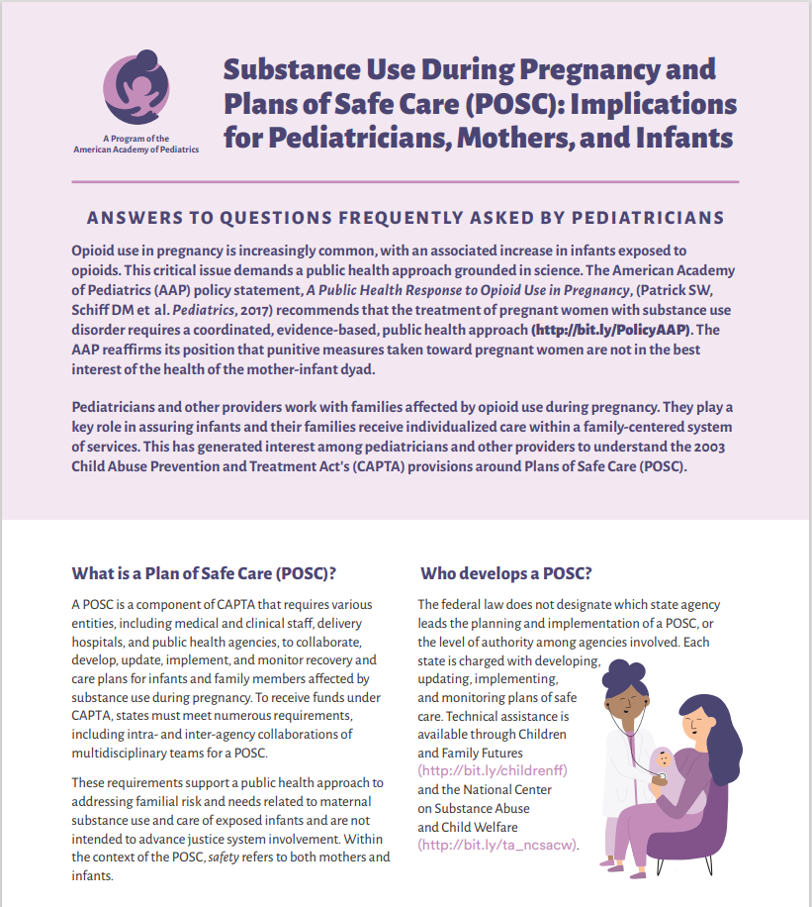
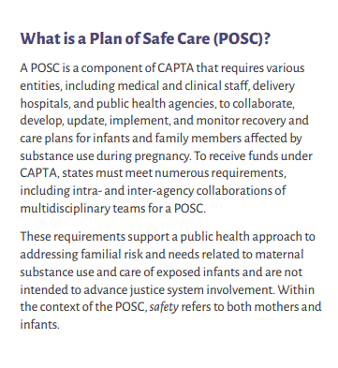
AAP POSC DEFINITION

Slide 4
GETTING STARTED
3 year pilot for the Office of Children’s Services, April 2021-April 2024.
Pilot was developed out of a community coalition convened to address infant/child welfare.
Single nurse case manager working closely with Obstetrics, primarily within the hospital, some limited home/community visiting.
Demographic data tracked for OCS:
Age, Ethnicity, Response within 24 hours, #POSC, Substance Exposure, DV concerns
Unidentified data sent to OCS biannually.
82% of patients accepted a POSC, engagement dropped off quickly after initial POSC and/or point of birth.
COVID paused the limited home/community visiting.
Needed a hospital outpatient home visiting safety protocol and training.

Slide 5
*
Largest source of referrals

Slide 6
POSC AT BARTLETT NOW
Within a year, volume was too high for a single case manager.
2 more nurses/lactation consultants were added for a total of 3 POSC staff.
219 families have been referred since April 2021.
184 Plans of Safe Care created (84% of referrals).
526 Medical/Mental Health/Community Connections.
Additional tracking: #service connections, report of harm made, OCS reports screened in, infants removed, cord tox screening.
Established a diaper bank and received a perinatal harm reduction and contingency management grant from the Alaska Children’s Trust.
Trained POSC staff in Perinatal Mood and Anxiety Prevention program, Mothers & Babies and Nurturing Parenting for Families with Substance Abuse, Treatment, and Recovery. In-person option for Juneau and virtual option for SE AK launched.

Slide 9
KEY CHANGES AND IMPACT
Electronic substance screening improved our screening rates, leading to more families with substance exposure being identified.
Built-in clinical pathways help ensure connection with Addiction Med/BH and POSC staff.
High risk prenatal referrals, especially from/to local treatment center.
Fast-tracking treatment referrals by training POSC staff in addiction medicine evaluations required for treatment program consideration.
OB Unit is now stocked with Naloxone kits and lock boxes for families with substance use as a harm reduction effort.
ACT’s Harm Reduction and Contingency Management grant has doubled our interactions with perinatal patients using methamphetamine and with teens, and overall interactions with high-risk patients by 62%.

Slide 10
KEY CHANGES AND IMPACT
POSC maintains representation in Juneau community family coalition.
POSC staff working in perinatal education classes and lactation support allows us to engage patients across the outpatient-inpatient continuum (contact in birthing classes, inpatient hospitalizations and point of birth, postpartum lactation appointments).
Changing the dynamics of OCS Family interactions at the point of birth.
Program focuses on perinatal mental health and parenting skills for families with substance use with evidence-based curriculums of Mothers & Babies and Nurturing Parenting for Families with Substance Abuse, Treatment, and Recovery.
Started offering virtual groups so families across Southeast Alaska can participate, trying to address “maternal deserts” for mental health and substance use support.
Originating our POSC program in Case Management.
Allows for every point of access to hospital to be potential POSC referrals.

Slide 11
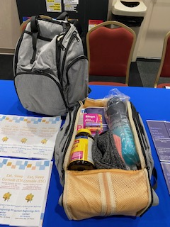
POSC IN ALASKA
Collaboration: Currently Juneau and Fairbanks have POSC approaches and are participating in a bi-monthly support call with OCS POSC Manager.
Growing conversations with other hospitals about POSC programming and state-wide collaboration.
Finding funding opportunities
Medicaid waivers and health-related social needs
SENI billing

Slide 12
Rachel Gladhart
(907) 723-0550
rcgladhart@bartletthospital.org
bartletthospital.org
Notes:
Edit the contact information to reflect the presenter(s). If you do not have a direct line, please use the main hospital line x8900.

