Slide 1
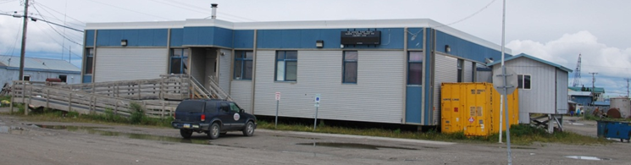
MANIILAQ PUBLIC HEALTH NURSING
750 Bison Street, Kotzebue, AK

Slide 3
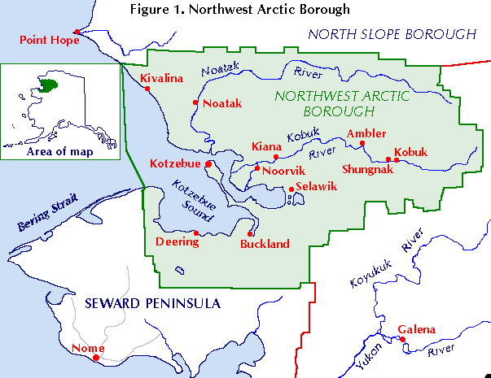

Slide 4
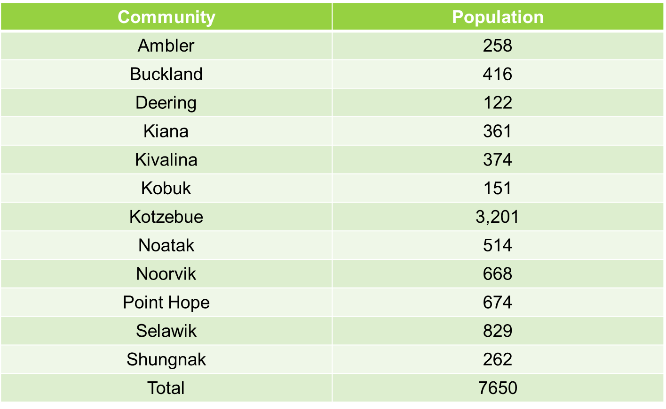
Northwest Arctic Communities & Populations

Slide 5
Healthy Lifestyle - healthy weight & physical activity
Health Protection
Screening & Risk Assessment (WCC)
Public Health Preparedness
Community Exercises tabletops, drills etc.
Preventive Services and Access to Care
Prevention, Screening & Referral
Vision & Hearing
Oral Health
DV Screening & Referral
Anticipatory Guidance
Tobacco use evaluation & promote smoking cessation
SBI
Adolescent health - talks on healthy relationship & sexual health
Health Promotion
Suicide/DV prevention activities
WCC & Anticipatory guidance
Working with city parks and recreation for community wellness programs, and healthy lifestyle programs
Lice check/clearance
Viral hepatitis talks to high risk groups at Maniilaq Recovery Center, Kotzebue Jail etc.
STD, HIV screenings & TX
Annual TB/Vision screen in schools
Immunizations & EPSDT/WCC
STD Contact Investigation
Link people to services and resources
NWAB LEPC activities, trainings
PHN/EPI investigation
Mass Dispensing exercises during FLU season (CSD)
Outbreak Investigation
Community survey cards & information sheets
PSAs & Health Campaigns
CSD &Collaboration activities
Partnership activities with Maniilaq Health Services, Schools, Borough
Committee & Taskforce activities
PPE Training
TB Case management

Slide 6
The types of services we provide include:
Vaccines for children and the entire family – mgmt. and distribution
Confidential testing for sexually transmitted diseases, treatment, and contact follow-up
Tuberculosis screening, counseling, treatment and case management
Linkage to care, resource management
School screening activities including promotion of healthy relationship
Emergency preparedness information/training
Epidemiological & Outbreak investigations – EPI boots on the ground
Opioid Emergency Kit distribution and training
Participating in community partnerships in response to public health concerns…..and so much more.

Slide 7
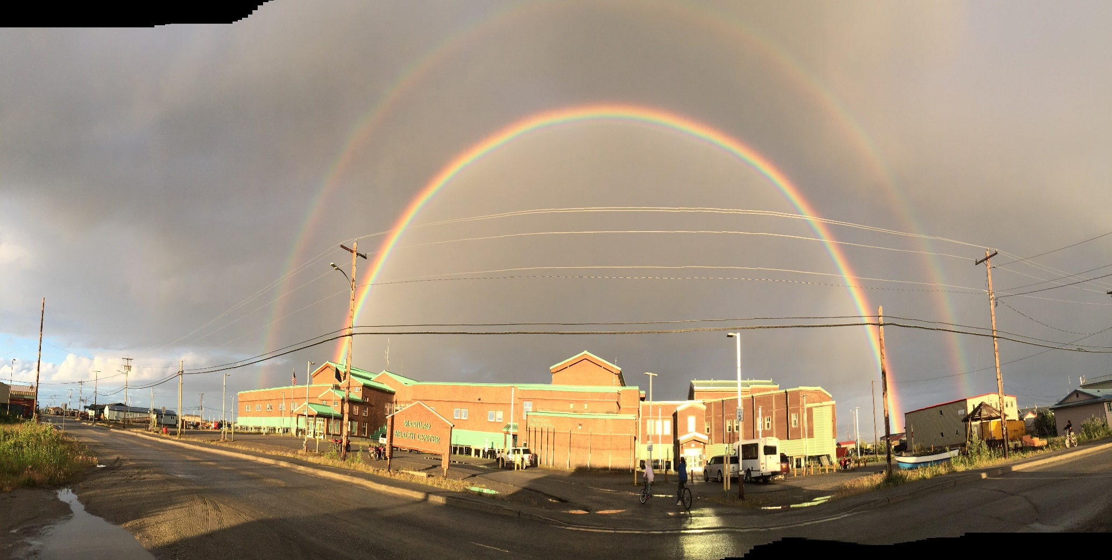
Continue if time permits

Slide 8
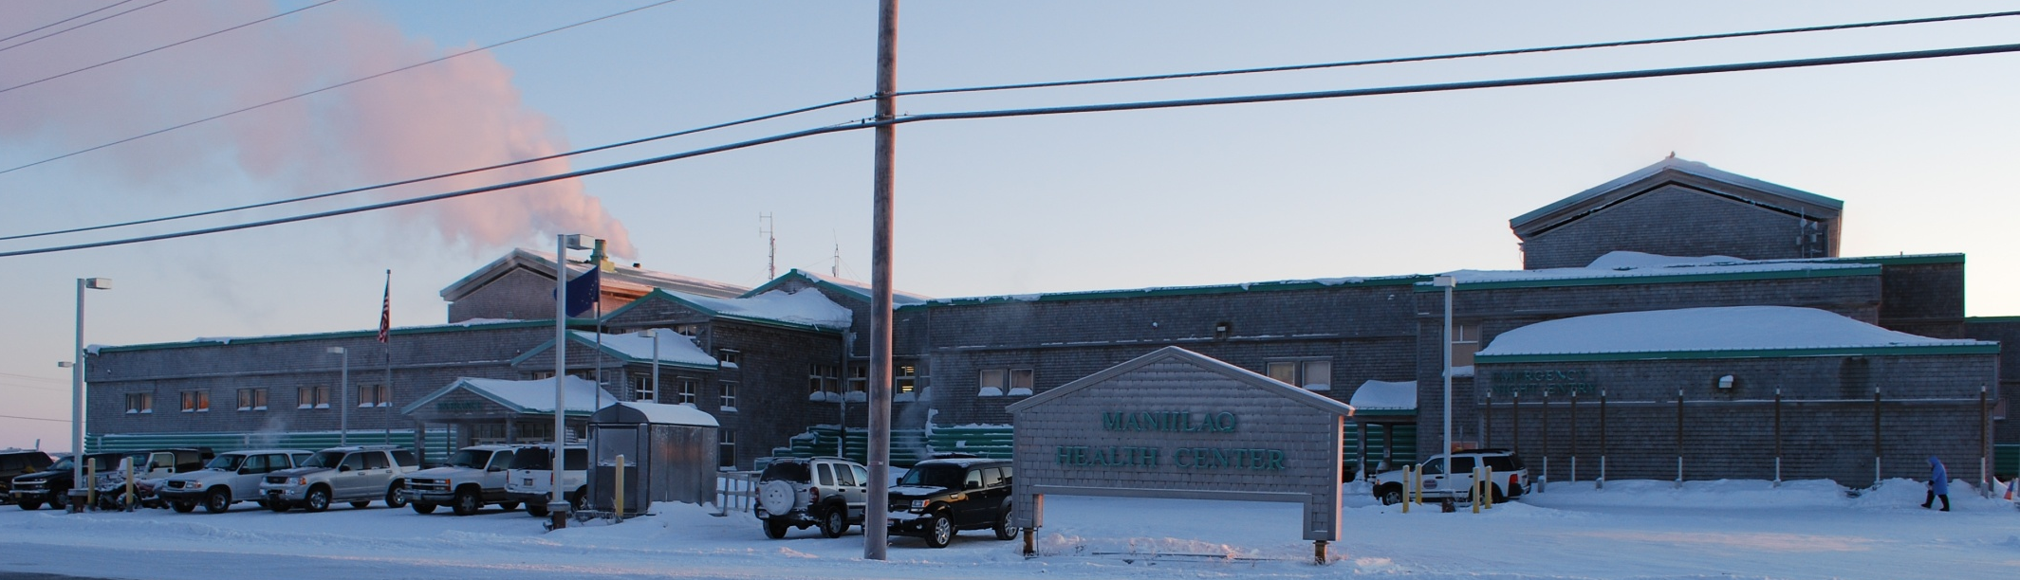
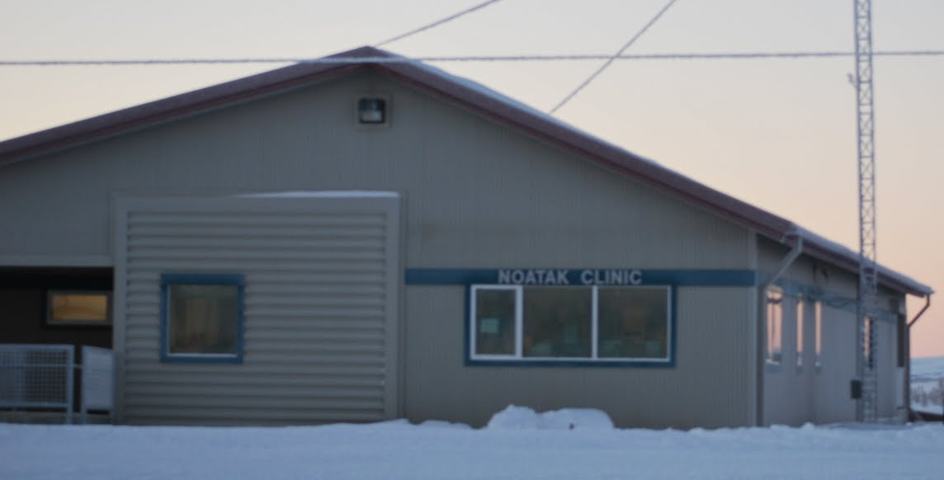
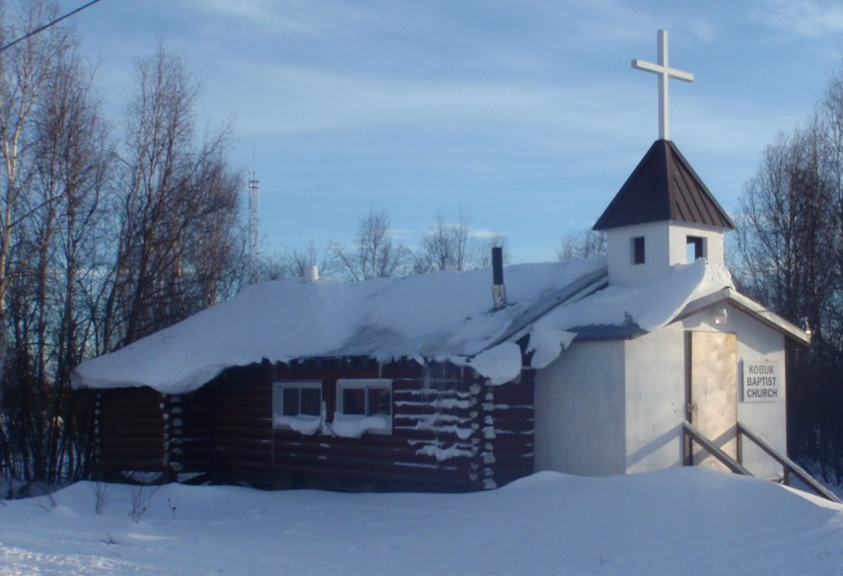
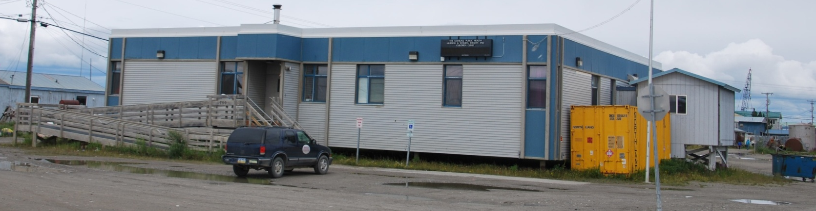
The Whole Community working together for improved healthcare

Slide 9
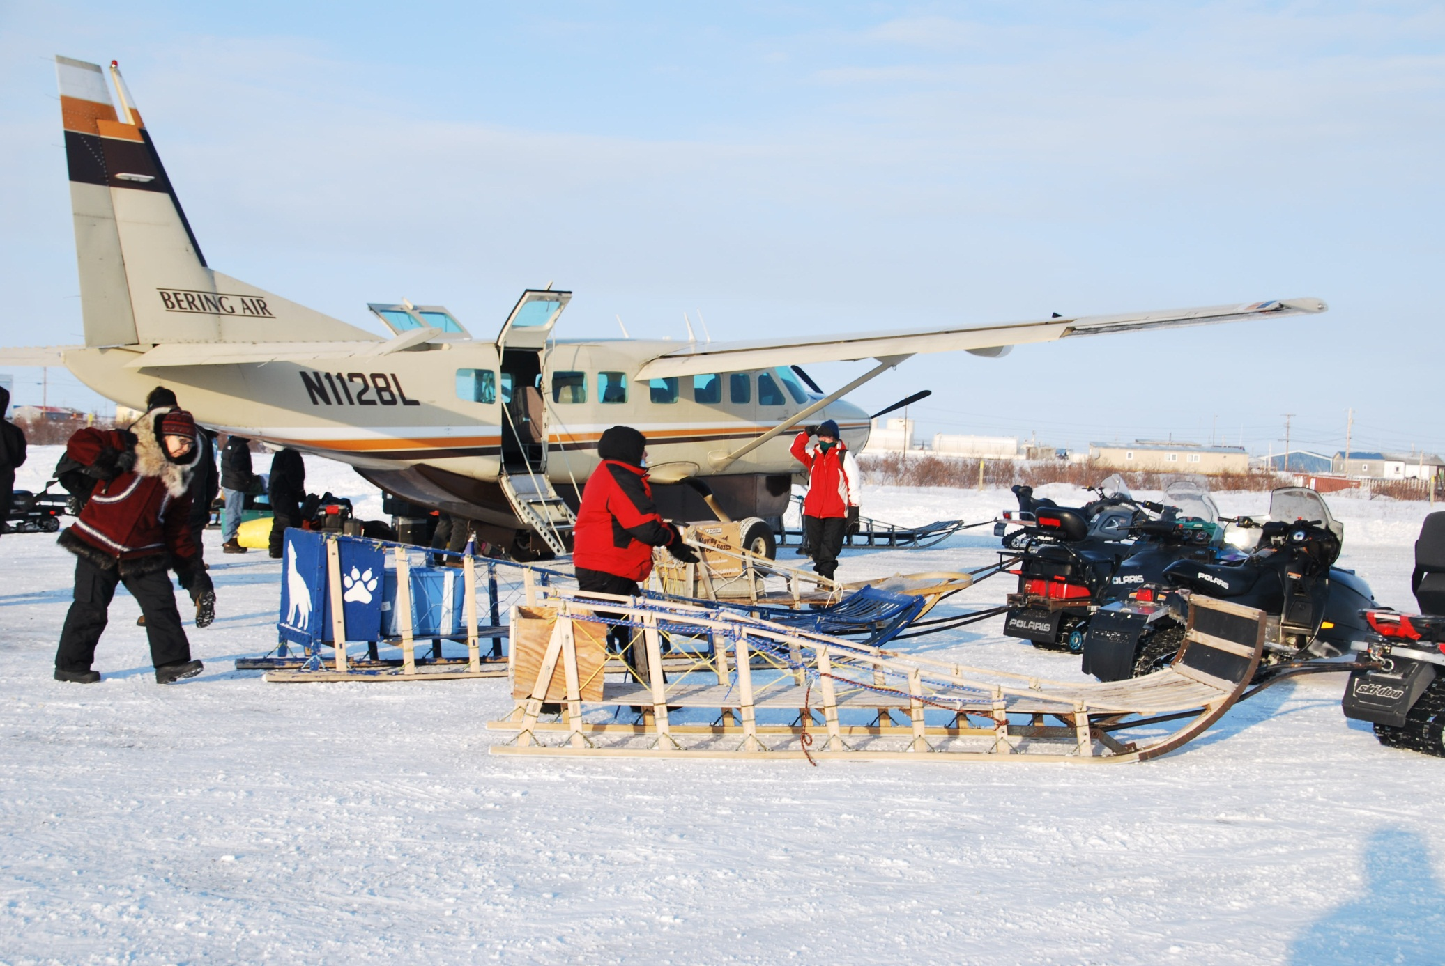
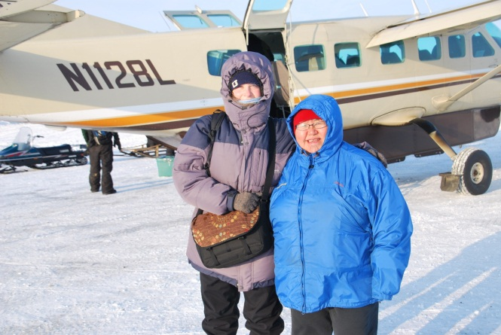
How do you get to work or school?
We each travel to the surrounding 11 villages about 2 times a month for 4 days in each visit.
Notes:
Me in the bottom corner

Slide 10
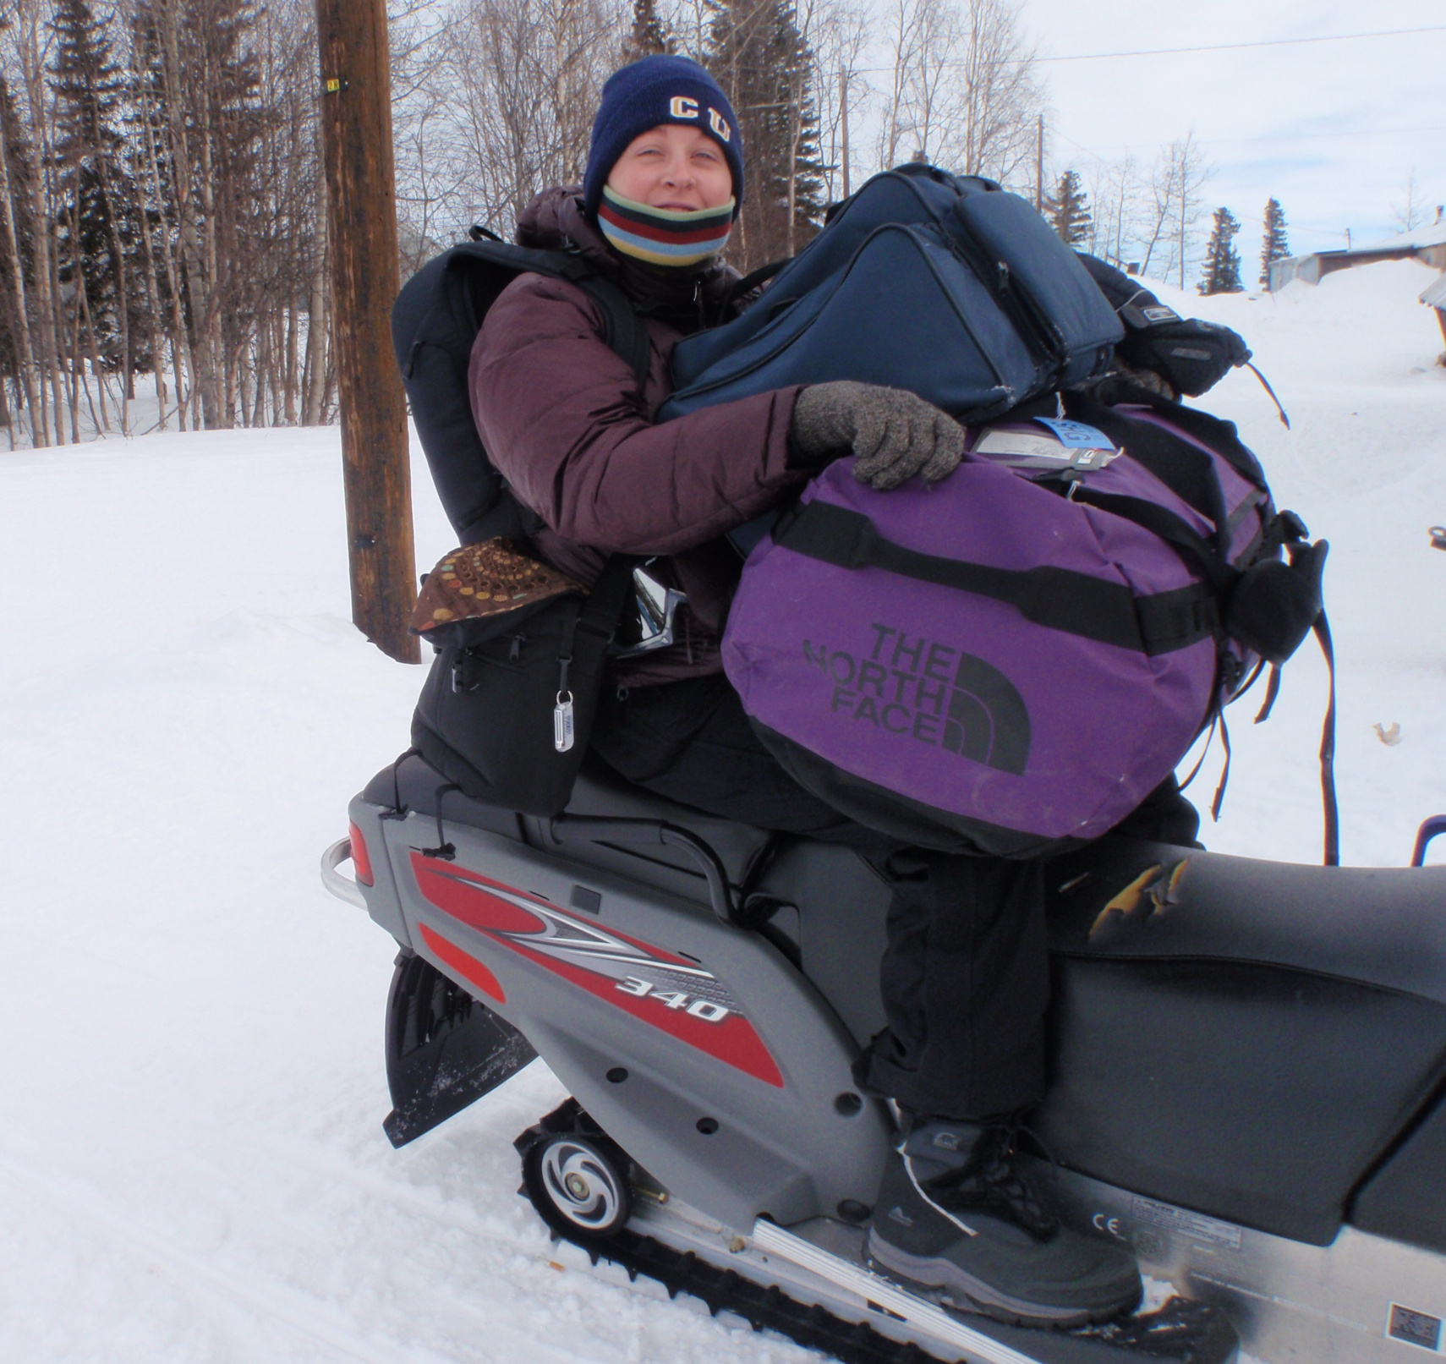
Travel by plane, then picked up from the landing strip by snow machine, sled, 4-wheeler, or truck.
Notes:
Me on the snowmachine

Slide 11
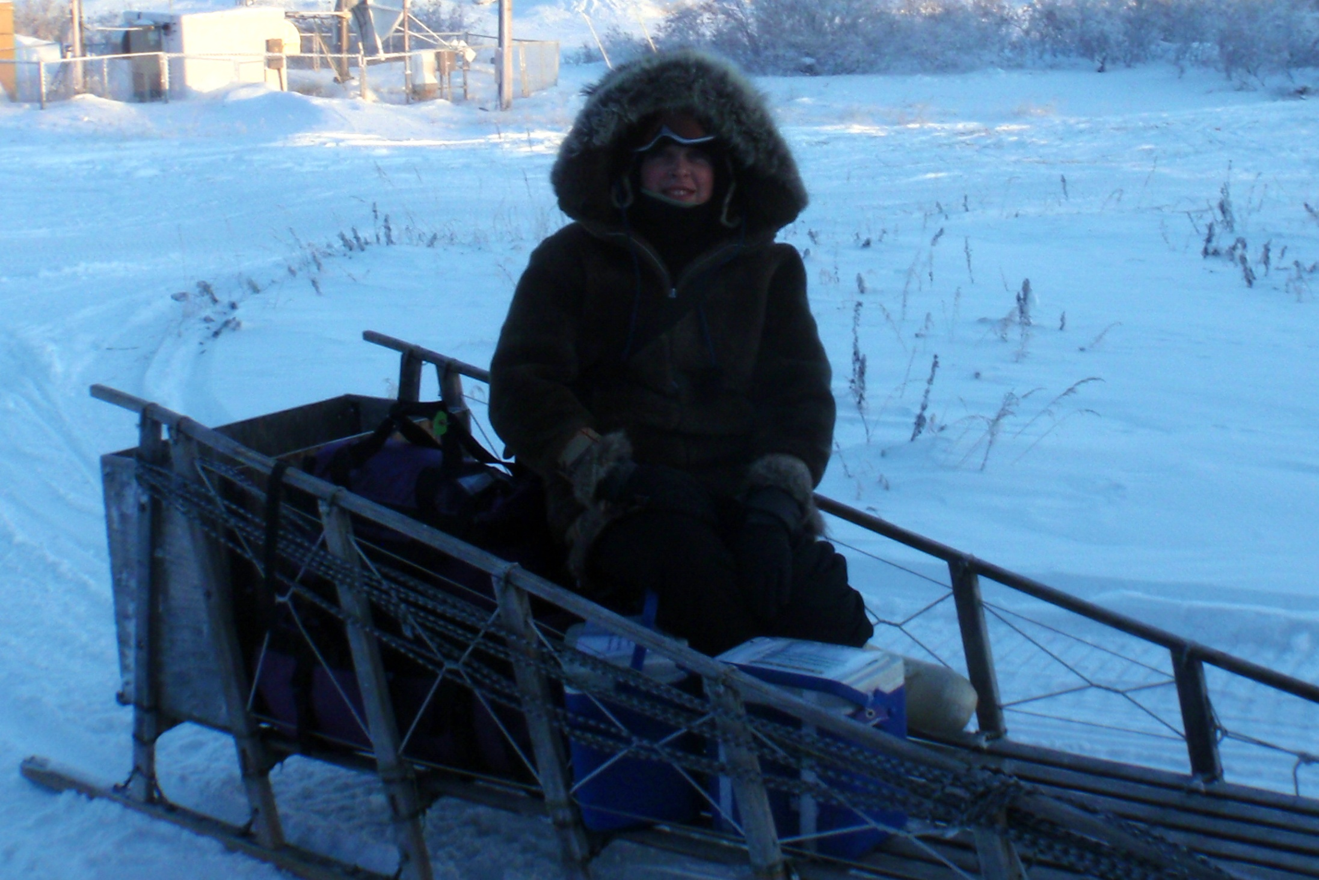
A very bumpy ride behind a snow machine!
Notes:
Me in my winter gear

Slide 12
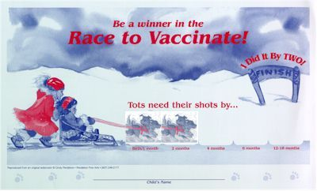

Immunizations
Prevents illnesses
Vital to the protection of the whole community
Vaccine distribution
Children and Adults

Slide 13
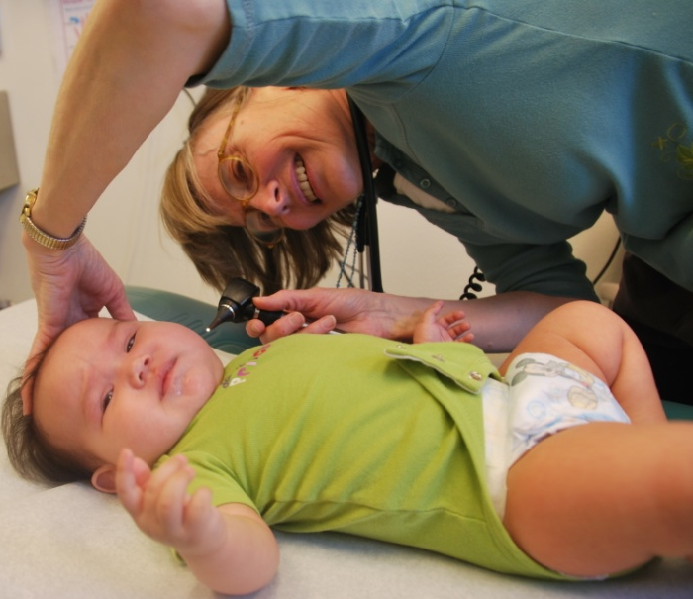
Well Child Checks
Development
Weight, Height, head circumference
Health of child
Education for parent
Connecting to resources
Reduce barriers to healthcare

Slide 14
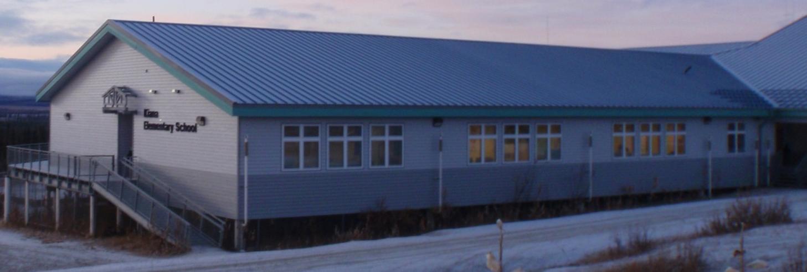
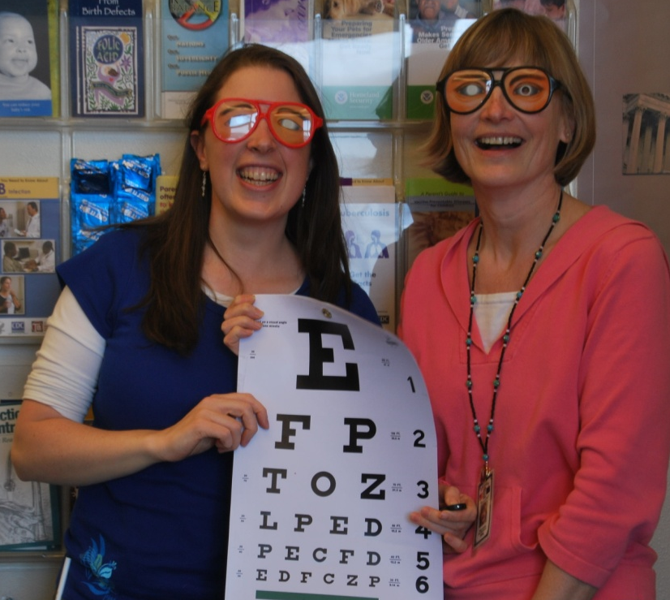
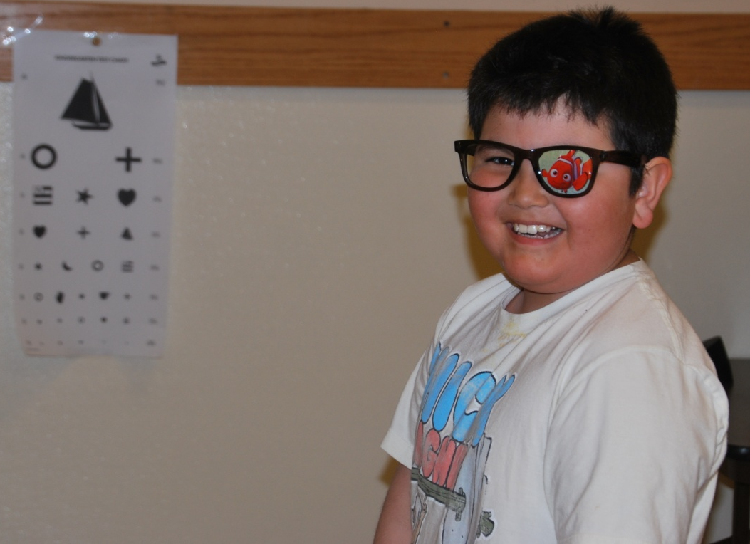
School Screenings
TB skin Tests
Vision checks

Slide 15
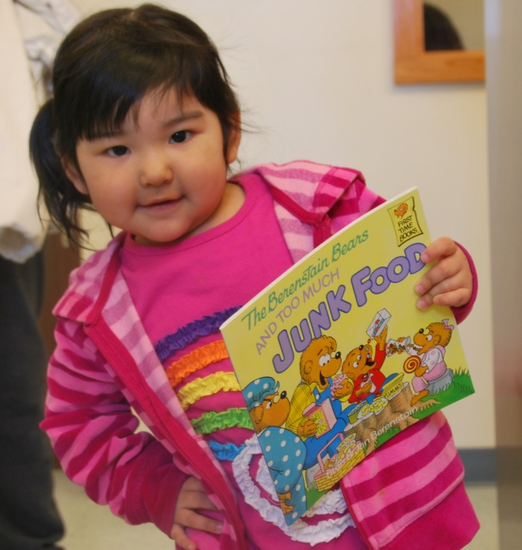
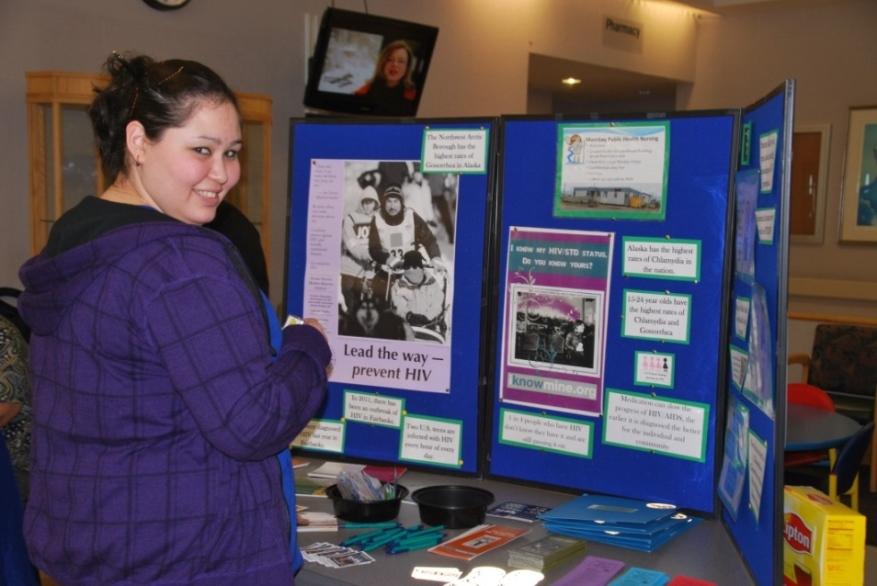
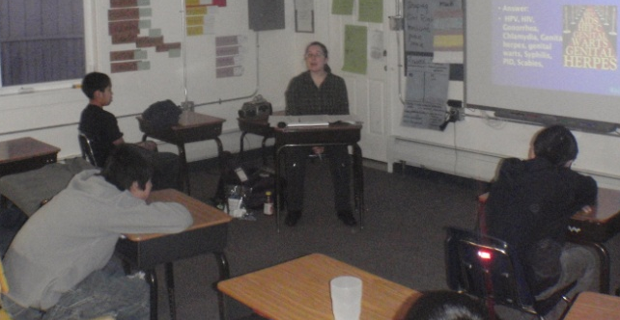
Health Teaching
Health Fairs
Classes

Slide 16
Parent Permission Form
Will be discussing “Birds & Bees and Healthy Behavior
This presentation will cover healthy ways to express emotions, feelings and affection; describe basic male and female reproductive body parts and their functions; compare and contrast healthy and unhealthy relationships; describe why sexual abstinence is the safest, most effective method of protection from HIV, other STDs, and pregnancy; explain that some STDs are asymptomatic, treatment and consequences if untreated; describe situations that could lead to pressures for sex; explain why individuals have the right to refuse sexual contact; STDs are easily preventable, so empower yourself with knowledge and avoid risky behavior. Factual information and knowledge can lead to healthy behavior. Knowledge = POWER! The presentation will be given by a Public Health Nurse. We advocate sexual abstinence as the safest, most effective method of protection from HIV, other STDs, and pregnancy.
If you have any questions or concerns, call PHN at 442-7144.

Slide 17
And so much more…….
Epidemiological and Outbreak investigations
Diseases include and not limited to: Tuberculosis, HIV, Pertussis, Gonorrhea, Chlamydia
TB Case management
Contact investigations, track & treat, or link to care
Staff development & Mentorship for OPD nurses and CHAPs

Slide 18
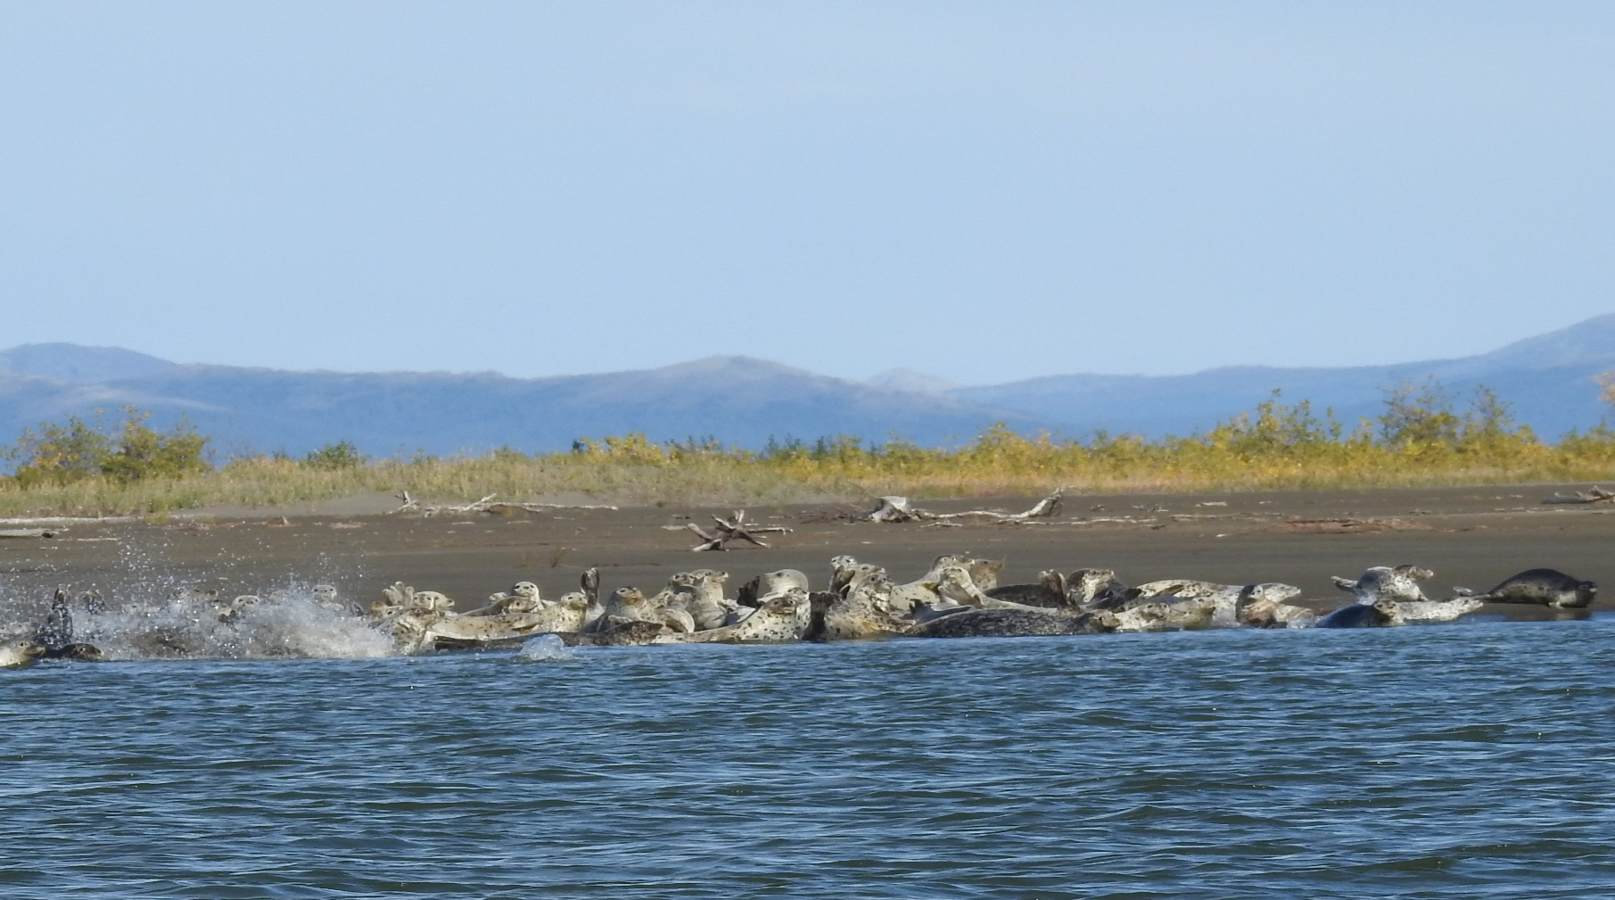
Seals on the Sandbar
Thank you !

