Slide 1



October Partnership Meeting
Anchorage, Alaska
Friday, October 3, 2025
12:00-1:30 pm
Presented by the All Alaska Pediatric Partnership (A2P2).
A2P2 transforms systems of care and increases equitable access to health care and related services to ensure all Alaska’s children reach their full potential.
Learn more at a2p2.com or by scanning the QR code

Slide 2

Agenda
Welcome!
Meg Horvath, Providence Alaska Children’s Hospital
Presentations
Carla Macgregor & Elke Villegas, Behavioral Health, Providence Alaska Children’s Hospital
Amy Simpson, Programs for Infants and Children
Dr. Sean Dugan, Alaska CARES
Virginia McGill, Pediatric/NICU Rehabilitation Therapies, Providence Alaska Children's Hospital
Dr. Emma Cantor, Pediatric Hematology & Oncology, Alaska Pediatric Specialties
Nicole Thurwanger & Dr. Elizabeth Galloway, Pediatric Sedation, Providence Alaska Children’s Hospital
Closing Announcements
Tamar Ben-Yose, All Alaska Pediatric Partnership

Slide 3

Welcome! Meg Horvath
Providence Children’s Hospital

Slide 4
Carla Macgregor & Elke Villegas
Behavioral Health, Providence Alaska Children’s Hospital

Slide 5


About us: Behavioral Health Services at
Providence Alaska Children’s Hospital
Carla Macgregor, Senior Director Behavioral Health
Elke Villegas, Director of Operations

Slide 6
Adolescent Inpatient Behavioral Health
Acute inpatient program for adolescents ages 12-18 years who need voluntary intensive crisis intervention, stabilization and behavioral health treatment
Provide groups that teach adolescents how to cope with daily pressures
Treatment includes a combination of group therapy, individual therapy and meetings with an adolescent psychiatrist

Slide 7
Pediatric Crisis Intervention
Children in crisis can receive psychiatric emergency care through the Providence Emergency Department
Evaluations provided by a behavioral health specialist who will assess the child’s mental status and safety to determine an appropriate treatment plan

Slide 8
Thank you!
Contact Information:
Elke Villegas
elke.villegas@providence.org
Carla Macgregor
carla.macgregor@providence.org

Slide 9
Amy Simpson
Programs for Infants and Children (PIC)

Slide 10
Programs for Infants and Children
Fall 2025

Slide 11
What is PIC?
PIC is an Early Intervention Program or Infant Learning Program providing services to infants and toddlers and their parents. (Birth to Three)
Part of a network of Infant Learning Programs across the state.
Provides pediatric therapy services and developmental therapy BUT much more!
99% of services are home based-Natural Environments
Primary service provider (PSP) is the families service coordinator and ensures each child receives all services that are needed to meet their goals.
Family service coordination is a major element of services; connecting children/families with service in the community.
Provided at no cost to families-PIC bills Medicaid and private insurance with permission from the family.

Slide 12
Timeline from Referral to Enrollment
Referral
Staffed by team within 7 days to identify provider
Evaluation
Multidisciplinary team (Developmental Therapist, OT, SLP, PT, Social Work)
Enrollment
IFSP development with family
Family contacted within 10 days of referral to schedule evaluation
Evaluate all area of development
Plan of care sent to physician
Completed within 45 days of referral
Report shared with physician with consent from parents
Family is contacted with 3 days of the referral.
Services begin when parent signs the IFSP

Slide 13
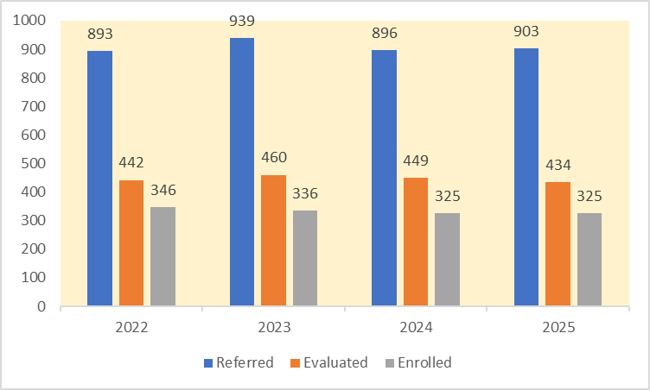
Referral – Evaluated – Enrolled

Slide 14

Eligibility – Part C of IDEA
Not all children are eligible to receive ILP services.
50% Delay in any area of development
Diagnosed Condition
Informed Clinical Opinion
Enrollments have been consistent for many years due to eligibility criteria set by the state.

Slide 15
Eligibility Expansion
Advocacy
Legislative Actions
Expand eligibility to 25% delay. This is the same eligibility for Special Education services that are available at age 3.
Change Medicaid regulations to allow ILP to bill for all services provided.
Increase funding for ILP by $5.72 million to accommodate the increase enrollment.
The Senate Health and Social Services Committee introduced SB178 to change eligibility, amend Medicaid State Plan, and increase funding.
The $5.72 million was added to last year's state budget only to be vetoed by the governor.
The bill will be reintroduced again in the next session.

Slide 16
Child Find Activities
Swaddle Me
Diaper Pantry
Gift provided to every parent of a newborn in Anchorage.
Included information on developmental milestones, area organizations and programs,
Gifts that include a swaddle blanket, Baby's Busy Day board book, links to community resources.
Open to any family in need of diapers.
Families register online
Open on the 2nd and 4th Wednesdays of each month.
Twice a year, vision screening, hearing screenings, and developmental screenings offered to all families.

Slide 17

The 2nd annual PIC a truck will be on October 5th from 2-5 at Clark Middle School.
The event is free, but we are collecting diapers for the pantry. Bring a box or pack of diaper to add to the truck!
There will be activities for the kids indoor and trucks of all kinds and sizes outside for them to see and explore outside!
For more information go to our website: www.picak.org
If you would like to print a poster for your office or post online, contact Micheala at mphillips@picak.org.

Slide 18
Thank you! Amy Simpson asimpson@picak.org www.picak.org

Slide 19
Dr. Sean Dugan
Medical Director, Alaska CARES

Slide 20

Alaska CARES
Sean Dugan, MD, FAAP
Medical Director, Alaska CARES

Slide 21

CHILDREN’S ADVOCACY CENTERS
Child-focused
Comprehensive
Multidisciplinary
Reduce trauma:
Fewer interviews
Non-invasive exam
Welcoming environment
Notes:
A CAC is, by definition, a collaboration: increases communication and efficiency, therefore reducing trauma to the child
The team approach creates communication and greater understanding of everyone’s role, leading to greater trust among agencies – and thus a better working relationship
Because of greater efficiency, CACs have seen increased prosecution rates
Because of extensive referral agreements and our team approach, more children receive the services they need to begin healing, such as physical and mental health care

Slide 22


CARES staff
Forensic interviewers
Medical providers
Mental health clinicians
Law Enforcement
APD/AST
Office of Children’s Services
Advocacy
Providence/SCF

Slide 23
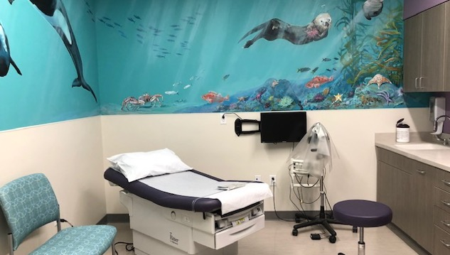
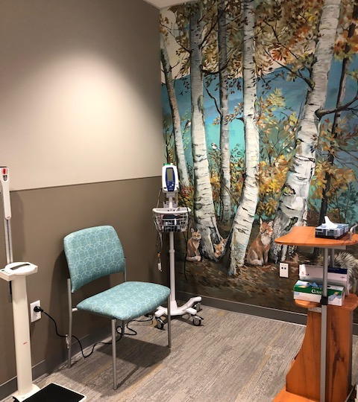

Medical Process
Holistic evaluation
Head to toe exam
Use of a CortexFlo
Specifically trained medical providers
Advanced Nurse Practitioners
Physicians
Alaska CARES' holistic treatment helps young abuse victims recover and thrive (chausa.org)

Slide 24
Medical Team
Sean Dugan MD, FAAP
Melissa Fall DNP, APRN, CPNP-PC/AC
Mindy Goorchenko DNP, APRN, FNP-C, SANE-P
Tara Nagel APRN, CPNP-PC, SANE-P
Marianne Ziolkowski APRN, CPNP-PC
Mary Kay McCarty, FNP

Slide 25


907-201-4701
Provider to Provider consultations
Available 24/7/365
Please call with ANY questions
Signs of abuse
Lab testing or imaging
Abuse reporting questions
Follow up care

Slide 26

Questions?
Sean Dugan, MD, FAAP
sean.dugan@providence.org

Slide 27
Virginia McGill
Pediatric/NICU Rehabilitation Therapies, Providence Alaska Children’s Hospital

Slide 28
Providence Alaska Medical Center CP Early Detection Pathway
Ginny McGill, PT virginia.mcgill@providence.org
Tim Marinelli, DO
timothy.marinelli@providence.org
10/3/2025

Slide 29
What’s the importance?
Term Infants
Pre-Term Infants
Early Detection
60% of new CP Diagnoses
40% of new CP Diagnoses
Diagnosis age decreases by 9-16 months
Novak 2017, Kim 2024, Maitre 2016, Byrne 2017, King 2021, Te Velde 2021, Maitre 2020, Maitre 2023
Notes:
CP is:
The most common lifelong motor disability in the world and impacts over 1 million people and occurs in every 1 in 323 babies born in the US and is defined as is a non-progressive brain disorder that appears in infancy or early childhood and permanently affects body movement and muscle coordination. It is caused by multiple intrauterine, peripartum and post-natal factors or events, genetic risk factors, or for 50% of cases, an unknown cause. As pediatricians you are seeing both NICU grads who may have been preterm or term with known risk factors like IVH or HIE and also term infants without risk factors in the newborn period. And our hope is regardless, all providers in the state of Alaska can be aware of and utilize early detection to decrease the age of diagnosis.

Slide 30

Why get an earlier diagnosis?
CP Specific Intervention
- Provides ability to deliver specific and effective neuroplastic intervention
- Improved motor and cognitive outcomes
- Prevent secondary complications
Meet family need and expectations
- Plan for needs, link families specialized and specific medical follow, improved parental mental health
- Provide families high-quality, evidence-based information
- Improved parental mental health
Optimize Neuroplasticity
- On time, effective and specific intervention during critical neuroplastic windows beginning in the NICU
- Change brain structure, activity and functional outcomes, and potentially child/family participation in their communities
Alaska Factors
- Securing TEFRA support in a timely manner
- Allows time to gather resources for follow-up to guide neuroplastic process
- Allows for the time needed for families to gather supportive resources in our remote environment
Novak 2017, Kim 2024, Maitre 2016, Byrne 2017, King 2021, Te Velde 2021, Maitre 2020, Maitre 2023
Notes:
This algorithm can drive down diagnostic age from 1.5-2 years to 3-9 months of age.
Getting an accurate diagnosis allows for referral for specific and effective therapies during prime windows of recovery. We need to start treating the first two years of life for a baby with CP the same way we would as the first few months after that baby’s grandparent had a stroke. CP specific and evidence-based interventions during the first 6 -12 months of these infant’s lives can dramatically improve motor and cognitive function, and the way we work to support them during the first two to three years and change the course of development for secondary complications associated with CP.
We know Families want this information
The majority of parents already know something is going on before a medical provider starts this conversation and 40% of parents reported dissatisfaction and resentment of providers who delayed the diagnosis and conversation, and that dissatisfaction is related to later parental depression and poor mental health outcomes
90% of parents reported receiving empathy and support during diagnosis visits when participating in an early detection clinic
These parents also reported feeling empowered and wanted more information about their infant when receiving a diagnosis or a high-risk classification
Families sought out diagnosis specific information and showed that they will access quality information when conversations are held in an honest, positive and direct way
Early diagnosis empower precision medicine and rehabilitation that we’ve already discussed changes brain structure and function, how children exhibit their neurology functionally, and, ultimately how they and their families interact with their communities.
And, finally, there are some Alaska specific factors to consider:
Securing support to access these therapies takes time – in fact, disability qualification for TEFRA can take up to a year once securing a diagnosis. Ellie’s family had to hire a lawyer to advocate for the state to process their TEFRA application in a timely manner so she could continue to access her therapy supports.
We all know that getting specialized care can be difficult here and families need as much time as they can get to build the right team to manage their child’s care and, and also to investigate and find the folks that are going to support them in the ways that we know the research supports as being most effective.

Slide 31
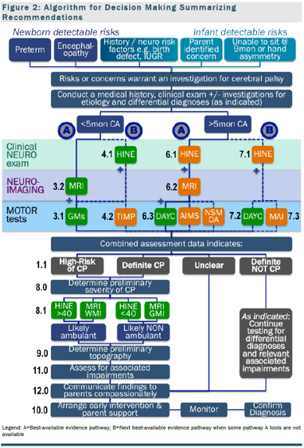
Early Detection Algorithm
Refer to Specialist
Performed by Specialist
Figure: Novak I, Morgan C, Adde L, et al. Early, accurate diagnosis and early intervention in cerebral palsy – Advances in diagnosis and treatment. JAMA Pediatr. 2017;171:897-907
Novak 2017, Kim 2024, Maitre 2016, Byrne 2017, King 2021, Te Velde 2021, Maitre 2020, Maitre 2023
Notes:
CP Early Detection is an evidence-based strategy to drive down the age and increase the accuracy of CP diagnosis to be able to improve child and parent outcomes. This pathway and clinical practice guideline was published in 2017 by an international consortium of physicians, therapists and experts in developmental disability, and is considered the gold standard process for CP diagnosis. Because CP has no biomarkers and has multiple etiologies, it can be a challenging diagnosis to make. Often, children were not diagnosed until after a now debunked “silent” period that delayed care and limited family access to important resources.
This pathway uses a triangulated diagnosis framework consisting of reliable tools to determine the presence of neurological differences, motor abnormalities and imaging to support identification, diagnosis, and classification. The early detection algorithm has been shown to be able to deliver accurate CP diagnosis as early as 3 months corrected age and has driven down the age of diagnosis at several institutions to 6-9 mos.
For the population we’re focusing on today, use of the General Movements Assessment @ term age and 3 mos, along with term age MRI and a standardized neurologic examination at 3 months (HINE) provides a highly reliable basis to identify new borns at high risk for developing CP or who have CP.
These complementary assessments are important to be completed together for a few reasons:
They examine related, but different constructs that allow for a more reliable assessment and provide high clinical confidence
Examinations can more specifically detail a potential etiology that could later go on to influence intervention decision
Results of each assessment can be used to accurately predict motor function and prognosis to allow families some confidence in making choices for their infant
Specifically, the HINE and GMA can help predict potential for ambulation and at what functional level a child is likely to move and MRI can better detail and specify the exact injury that occurred, specifically differentiating between gray and white matter injuries and may find other neurologic signs of other neurologically based associated impairments.
And as we keep reviewing, these assessments can drive and inform what interventions are chosen and gives families like Ellie’s the ability to best support their child.
This pathway has shown itself to be feasible and effective across multiple institutions globally and is an integrated, gold-standard practice or developing practice in multiple care centers.
Additional notes: the numbers refer to the specific section of the clinical practice guideline. Colors: green is strong, orange is conditional recommendations (dependent on patent values, level of resources) (rigor of evidence)

Slide 32
Development Process + Next Steps
Best Evidence and External Program Review
Review of multiple external early detection and at-risk infant clinics
Adaptation of Evidence and External Programs
Adapted CPG guidance to fit local capacity and needs
Expert Consensus Review
Stacey Dusing, PT, DPT, PhD
Nathalie Maithre, MD, PhD
Paige Church, MD
Vera Burton, MD, PhD
Mor Cohen-Eilig, MD
Ram Mishaal, MD
Local Capacity Building
GMA Basic and Advanced Alaska Trainings
HINE tutoring
Evidence Review
Review of best-practice and current evidence within department
Initial Implementation
Referrals from NICU for infants meeting criteria
Clinical visits with therapies scheduled
TEA MRIs completed in NICU
Next Steps:
Ensure support of specialist physicians to refer children with concerns
Develop increased stakeholder support in Alaska pediatrician community
Abstract submitted to A2P2
Begin discussions with community pediatricians to build comfort and familiarity
Work with other therapy groups/therapists with GMA/HINE training to follow similar framework
Novak 2017, Kim 2024, Maitre 2016, Byrne 2017, King 2021, Te Velde 2021, Maitre 2020, Maitre 2023

Slide 33
PAMC Early Detection Pathway
1-1.5 Month Visit (Per NICU Therapy Triage)
3rd Month Visit (Standard)
AIMS
6-9 Month Visit (Standard)
9-12 Month Visit (as needed)
AIMS
12-18 Month Visit (Standard)
GMA
GMA
HINE
AIMS
DAYC-2
HINE
DAYC-2
HINE
AIMS
DAYC-2
HINE
Bayley IV Motor, Language, Cognitive and Social
HNNE
Feeding + Vision Screen
Feeding + Vision Screen
Feeding + Vision Screen
Feeding + Vision Screen
Language/Cognition Screen
CP Bedside Tool (term age)
CP Bedside Tool (term age)
CP Bedside Tool (term age)
CP Bedside Tool (term age)
CP Bedside Tool (term age)
Language/Cognition Screen
Novak 2017, Kim 2024, Maitre 2016, Byrne 2017, King 2021, Te Velde 2021, Maitre 2020, Maitre 2023
Notes:
At Providence, therapies is providing this needed follow-up as above. We’ve followed a knowledge translation framework and vetted our clinical process to ensure we are providing high-quality and cutting edge care to support early detection efforts for Alaskans.
END HERE
I’d like to finish up today to briefly review what is developing to support these babies and implement this guideline after your patients discharge from the NICU.
Our team, which by the way we’d love for you to join, has approached this idea using a knowledge translation based framework. We began by reviewing the evidence and synthesizing what we believed constitutes best and evidence-based practice and compared this synthesis to other early detection programs. We reviewed this the early detection program internally with therapy teams for feedback about feasibility of assessments, housing the number of infants that are likely to be referred, and other contextually specific concerns, and sought expert feedback from some of the authors you’ve seen cited today.
We’re currently working through engaging additional stakeholders for feedback and to recruit more team members to support our work and will begin stage implementation and community engagement soon.
So, to briefly review before I had this over to Tim, we will use assessment results from the NICU to combine with standard visits at 3-3.5 months and at 6-9 months to capture assessments recommended by the early detection pathway when they carry the most significant diagnostic power for CP and refer to specialists for review and diagnostic work-up. Infants and families will access 1-1.5 month visit and a 9-12 month visit as directed by the therapy team to monitor developmental concerns or capture other assessments as needed and, we intend, to have family’s attend a 12-18 month standard visit to begin focusing less on assessment for CP and begin looking out for other, specifically, neurobehavioral concerns that infants graduating the NICU often experience.
So with that, let’s hand it over to Tim to discuss the potential for term equivalent brain MRI and explore some way that we all can partner to support this effort.

Slide 34
PAMC Early Detection Pathway Entry Criteria
PAMC Early Detection
NICU Referral Criteria
Infant Detectable Risks
Pregnancy Risks
Genetic disorders
IUGR
GA <32 weeks or <1500 g
Symmetric SGA with <1st percentile microcephaly
In-utero substance exposure (ex. barbiturate, cocaine, amphetamine)
Perinatal Risks
CNS abnormality, Encephalopathy, Stroke, or seizures
IVH or HIE
Any CUS or MRI/imaging abnormality
Bronchopulmonary dysplasia (requiring mechanical ventilation at 36 weeks) or Chronic Lung Disease
Intracranial infection (meningitis, encephalitis, congenital CMV)
Chronic Heart Disease
Severe ROP requiring intervention
Post-neonatal Risks:
Intracranial infection (meningitis, encephalitis, congenital CMV)
CNS abnormality, Stroke, brain injury or seizures
Abnormal term age GMA
Abnormal hyper/hypotonia (HNNE <26 preterm or <30 term age)
Positive Early Detection Infant Detectable Risks
Other
Late Preterm
Infants screening positive on PAMC NICU MRI Guideline
Term infant Bedside CP Risk Calculator > 0.5
Early Detection Clinical Practice Guideline
Inability to sit by 9 months
Hand function asymmetry
Inability to take weight through plantar surface of the feet
International Expert Consensus
Hand preference before 12 months
Stiffness or tightness in legs between 6-12 months
Keeps hands fisted after 4 months
Persistent head lag beyond 4 months
Consistent asymmetry of posture and movement after 4 months
Persistent startle reflex after 6 months
Consistent toe walking or asymmetric walking after 12 months
Clinical Risk Calculator
0.3-0.5 risk: motor and neurologic screening/testing (HINE) using standardized tools
>0.7 risk: motor and neurologic screening (HINE) using standardized tools and referral for specialized testing (GMA)
Novak 2017, McIntyre 2011, Maitre 2022, Roubahi 2023, Boychuck 2019
Notes:
Along with screening infants in your care for historical factors on the left that would gain automatic referral from our NICU, we are using the criteria on the left to support detection and referral for infants that may have had typical pregnancy and birth histories.
The criteria on the right can help with clinical identification of infants without other known risk factors that as a pediatrician you are likely to interact with more often and refer in to this pathway. We don’t have time to dive into specifics about the clinical risk calculator, however, an easy to use tool has been developed that can calculate percentage risk of CP development based on common pregnancy and birth history items that you are likely already asking.
We welcome and encourage to use any of the above factors to refer babies to this clinic because they are either present high risk for CP (odd ratio >10) or are considered expert consensus opinion of a high risk for neurologic abnormality.

Slide 35
Tools/Strategies to Help ID Babies
Screen for Infant Detectable Risks
Use Term Infant Risk Calculator
Screen for “Newborn” Detectable
Risk Factors
Early Detection Clinical Practice Guideline
Inability to sit by 9 months
Hand function asymmetry
Inability to take weight through plantar surface of the feet
International Expert Consensus
Hand preference before 12 months
Stiffness or tightness in legs between 6-12 months
Keeps hands fisted after 4 months
Persistent head lag beyond 4 months
Consistent asymmetry of posture and movement after 4 months
Persistent startle reflex after 6 months
Consistent toe walking or asymmetric walking after 12 months
0.3-0.5 risk: motor and neurologic screening/testing (HINE) using standardized tools
>0.7 risk: motor and neurologic screening (HINE) using standardized tools and referral for specialized testing (GMA)
Prematurity (27-32 weeks
Birthweight <1500 g
Cystic periventricular leukomalacia
Intraventricular Hemorrhage (IVH) Grade III-IV
Moderate to severe neonatal encephalopathy (ex. HIE, infectious encephalopathy, etc.)
Neonatal/post-neonatal meningitis
Congenital CNS defects
Genetic abnormality associated with CP
Placental abruption
Apar <7 at age 5 minutes
History of stroke
Severe TBI requiring hospitalization or rehab
Hospitalization due to encephalitis or bacterial meningitis at < 2 years of age
Novak 2017, McIntyre 2011, Maitre 2022, Roubahi 2023, Boychuck 2019
Notes:
Slides 5 and 6 talk about our program, what we are doing, and how we got there. This slide organizes the information in a different way in order to be useful. At the end of the day, any baby that matches any of this criteria should be referred for early detection.

Slide 36
Early Detection Pathway
NICU Direct Referral
Community Provider Referral
PAMC Early Detection Pathway
Referral for CP Specific Therapy
Refer to Specialist for Diagnostic W/U
Link to Social Services
Complete Early Detection Standard Visits
CP or High Risk for CP/DD Detected?
Link to Support Services as Needed
Complete Early Detection Standard Visits
Yes
No
Communicate Results with Pediatrician/PCP and Family
Opportunities to Support
ID at-risk infants using known risk factors and bedside risk calculator
Communicate importance and need for early detection with families at need
Support PAMC early detection referral
Assist and support specialty referral for diagnosis
Join our team!
Notes:
You might be asking yourself, why would I refer these children to therapies for specialty assessment before referring to a specialty physician? The answer is that PAMC therapists have completed training and certification in the assessments that provide the reliable and accurate information for the support a physician considering a diagnosis. Our team has partnered with specialty physicians supporting our community while developing this clinic.
Upon referral to the early detection program, children will begin assessment according to the framework we reviewed earlier that is based on their age. If the clinical assessments that examine the different areas defined by CP (neurologic abnormality with the HINE, alternations in brain development with the GMA, or differences in motor development with the AIMS or DAYC2), our team will communicate with the family and pediatrician to explain the results and the indication for a possibility of a developmental difference. We will work to support referral to a physician who can support the family with further work-up to determine if a child has a diagnosis of CP, is at high-risk of CP, or does not have CP and provide therapy supports as needed.
Regardless if CP or high-risk of CP or developmental delay is detected or not, we will continue to follow these children on the standard schedule because the tools used in the early detection framework are more reliable when conducted serially.
It is important to note that not every therapy clinic in Anchorage or the state has the ability to carry out these assessments, and if children are already receiving services elsewhere, infants who have been identified as at-risk can and should still be referred for early detection assessment.
We are hoping that pediatricians in our community will support this effort by identifying and referring infants to the PAMC Early Detection Program when known risk factors are identified, communicate and support the importance of completing standard visits through the program even if the referred infant seems to be doing fine, assist and support referral to specialty physicians to complete diagnostic work-up using early detection clinical information, most importantly, to join our team!

Slide 37
MD Referral Process
Always discuss results/concerns with the child’s referring provider/pediatrician and collaborate for referral to a physician specialty to interpret assessments/imaging and CP early detection.
Seattle Children’s
Providence Pediatric Subspecialties
Rehabilitation and Physical Medicine
Molly Fuentes
Neurology
Jan Martin
Nina Naratajan
Neurology
Carey Wilson (1 year)
Locums Neurologists pending 2026/2027
Pediatrics
Michelle Laufer

Slide 38
Want to Discuss More?
Contact us:
Virginia.mcgill@providence.org
Tim.Marinelli@providence.org
See you at the A2P2 conference in November!

Slide 39
References
Novak I, Morgan C, Adde L, et al. Early, accurate diagnosis and early intervention in cerebral palsy – Advances in diagnosis and treatment. JAMA Pediatrics. 2017;171:897-907. https://jamanetwork.com/journals/jamapediatrics/fullarticle/2636588
Kim F, Maitre N, CP Foundation. A call for early detection of cerebral palsy. NeoReviews. 2024;25:e1-e11.
Maitre NL, Chorna O, Romeo DM, Guzzetta A. Implementation of the Hammersmith Infant Neurological Examination in a high-risk infant follow-up program. Pediatr Neurol. 2016;65:31-38. doi:10.1016/j.pediatrneurol.2016.09.010.
Byrne R, Noritz G, Maitre N, NCH Early Developmental Group. Implementation of early diagnosis and intervention guidelines for cerebral palsy in a high-risk infant follow-up clinic. Pediar Neurol. 2017;76:66-71.
King AR, Machipsia C, Finlayson F, et al. Early detection of cerebral palsy in high-risk infants: Translation of evidence into practice in an Australian hospital. J Paediatr Child Health. 2021 Feb;57(2):246-250. doi: 10.1111/jpc.15191
Te Vekde A, Tantsis E, Novak I, et al. Age of diagnosis, fidelity and acceptability of an early diagnosis clinic for cerebral palsy: A single site implementation study. Brain Sci. 2021 Aug 16;11(8):1074. doi: 10.3390/brainsci11081074.
Maitre NL, Burton VJ, Duncan A, et al. Network implementation of guideline for early detection decreases age at cerebral palsy diagnosis. Pediatrics. 2020;145:e20192126.
Maitre NL, Damiano D, Byrne R. Implementation of early detection and intervention for cerebral palsy in high-risk infant follow-up programs – U.S. and global considerations. Clin Perinatol. 2023;50:269-279.
McIntyre S, Morgan C, Walker K, Novak I. Cerebral palsy – don’t delay. Dev Disabil Res Rev. 2011;17:114-129.
Roubahi A, Husein N, Dewey D, et al. Development of a bedside tool to predict the diagnosis of cerebral palsy in term-born neonates. JAMA Pediatrics. 2023;177:177-186.
te Velde A, Morgan C, Novak I, Tantsis E, Badawi N. Early diagnosis and classification of cerebral palsy: An historical perspective and barriers to early diagnosis. J Clin Med. 2019 Oct 3;8(10):1599. doi: 10.3390/jcm8101599.
Boychuck Z, Andersen J, Bussieres A, et al. International expert recommendations of clinical features to prompt referral for diagnostic assessment of cerebral palsy. Dev Med Child Neurol. 2020;62:89-96.
Notes:
Other locations that have an early detection program that we met with or did a program review to inform our decision: Early Detection team and physiatry at Seattle Children's, Boston Children's, Nationwide Children's and expanded across the country (Intermountain in UT, Kenedy Kregger Institute, UT Houston, UCLA), Children's Colorado. Reviewed with Stacy Ducine, who is running a project to implement this across early intervention in CA (California Children's Services), BC Children's Hospital (British Columbia). Based off of American Academy of Pediatric Guidelines for pre-term follow up.

Slide 40
Dr. Emma Cantor
Pediatric Hematology & Oncology, Alaska Pediatric Specialties

Slide 41

Alaska Pediatric Specialties: Pediatric Hematology & Oncology

Slide 42




Meet our Providers
Dr. Brenda Wittman
Dr. Rebecca Weicht
Dr. Emma Cantor
Ronda Nakoa, NP

Slide 43
Benign Hematology
Abnormal Blood Counts
Anemia
Thrombocytopenia
Neutropenia
Bone Marrow Failure
Red Blood Cell abnormalities
G6PD deficiency
Hereditary Spherocytosis
Pyruvate Kinase Deficiency
Thalassemia
Sickle Cell Disease
Thrombosis/Anticoagulation Management
We DO NOT treat:
Bleeding disorders (Hemophilia, VWD)

Slide 44
Oncology
Leukemia:
ALL
AML (initially treated in Seattle, but can transition back to our care later in therapy)
Can treat DS-AML
Lymphoma
Solid Tumors:
Wilm’s tumor/renal tumors
Neuroblastoma (go to Seattle for auto BMT)
Ovarian and Testicular Tumors
Sarcoma
Bone
Soft Tissue
Brain tumors (some go to Seattle for surgery and initial therapy, then transition back to our care)
Post Bone Marrow Transplant

Slide 45
Genetic Conditions
Neurofibromatosis Type 1
Li-Fraumeni Syndrome
DICER1 Syndrome
Dyskeratosis Congenita
Beckwith-Wiedemann Syndrome
Fanconi anemia
Cohen Syndrome

Slide 46
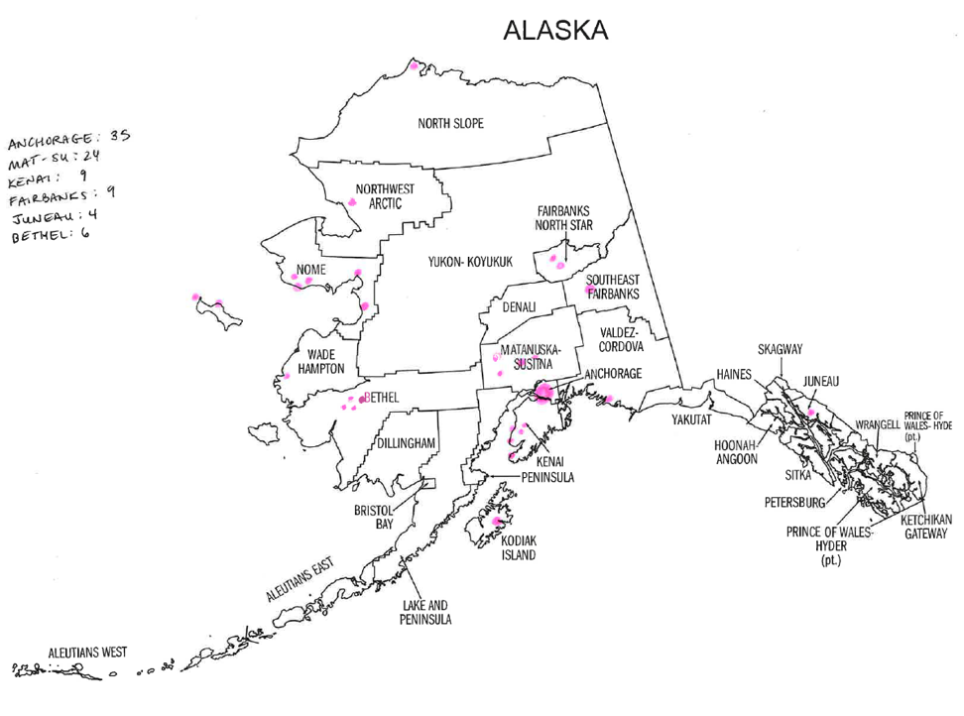

Slide 47
Thank you
Emma Cantor:
emma.cantor@alaskapeds.com

Slide 48
Inpatient Pediatric Oncology
Our nurses take a specialized Oncology 101 and Association of Pediatric Hematology and Oncology (APHON) course led by to Certified Oncology RNs to maintain competency and provide safe chemotherapy administration, response to oncological emergencies, and assessments
Interdisciplinary huddles with therapies, Providence Infusion Center, APS Providers, and nursing to maintain consistent care planning for patients
The hospital interdisciplinary team educates families to help parents advocate for patient needs throughout their admission and cancer treatment
Our Nurses, Child Life Team and Parent Navigator supports the oncology patients, their parents and families to provide family centered care throughout their admission
Continuous Renal Replacement Therapy Program with skilled PICU RNS to administer CRRT and keep patients and their families in the state if appropriate
Patients requiring LPs, bone marrow biopsies, and port needle accesses utilize pediatric sedations as needed

Slide 49
Nicole Thurwanger & Dr. Elizabeth Galloway
Pediatric Sedation, Providence Alaska Children’s Hospital

Slide 50
Outpatient Pediatric Sedations

Slide 51


Location and Hours
Pediatrics, Tower D, 3rd Floor
Monday-Thursday 0700-1700
Primary RNs:
Amy Robberson
Holly Himler
Malary Vigil
Phone: (907) 212-8485
Fax: (907) 212-8486
Internal: Epic Chat or Teams
Pediatric Sedation | The Children’s Hospital at Providence | Providence
Nurse Manager: Nicole Thurwanger
Phone #: (907) 212-7914
Email: Nicole.Thurwanger@providence.org
Medical Director: Elizabeth Galloway
Email: elizabeth.galloway@providence.org

Slide 52
Who We Are
Our team consists of highly skilled PICU nurses and intensivists/hospitalists who expertly evaluate each pediatric patient and deliver the appropriate sedation needed for their procedure
Our dedicated Child Life team plays a key role in Comfort Promise initiatives. By combining their supportive techniques with the sedation team's clinical expertise, procedures that might typically require sedation are often completed successfully without it—resulting in a positive and empowering experience for the child.
This program enables patients to receive necessary procedures, tests, or lab work locally in Alaska—eliminating the need to travel out of state or undergo day surgery elsewhere.
Our care coordination nurses also serve at the bedside, directly administering sedation to patients. If your call isn’t answered immediately, please leave a message—they will return your call as soon as patient care allows.

Slide 53
Referral & Care Process
Provider sends fax referral to pediatric sedation nurses.
Sedation nurses contact the family and complete a screening to determine referral needs and the appropriate level of sedation.
If prior authorization (PA) is required, the clinic or radiology team submits necessary documents to insurance.
Once PA is complete, sedation RNs schedule the procedure by coordinating with the hospitalist, intensivist, anesthesia, and the relevant department.
The day before the procedure, the sedation RN calls the family to confirm the appointment.
On procedure day, the sedation RN supports the patient through pre-procedure, sedation during the procedure, and recovery.
Patient is discharged home the same day.

Slide 54
What is Sedation?
When a child is sedated, they become calm and less anxious.
With minimal sedation, the child can respond normally to spoken directions.
Moderate sedation causes the child to be less responsive and more relaxed.
With deep sedation, the child is asleep but can still be awakened with repeated stimulations.
Sedation can be given by mouth, intranasal, or through an IV. It differs from general anesthesia in that general anesthesia makes the child completely unresponsive.
With sedation the child breathes on their own, while with general anesthesia they may need breathing assistance with a ventilator.

Slide 55

Frequently Referred Procedures
VCUG
MRI
CT
Neurodivergent/Autistic Lab Draws
Renal Biopsy
BAER (hearing screening)
Transesophogeal Echocardiogram
Higher Risk Cardiac/Airway Patients (ASA 3 and above)
Lumbar Puncture
Bone Marrow Biopsy
Burn Dressings
Wound Vac Changes
Botox injections
Chest Tubes/Interventional Radiology Procedures

Slide 56






Frequently Used Medications
Nitrous Oxide
Ketamine
Propofol
Versed
Precedex

Slide 57
Questions?
Nurse Manager:
Nicole Thurwanger
(907) 212-7914
Nicole.Thurwanger@providence.org
Medical Director:
Elizabeth Galloway
Email: Elizabeth.Galloway@providence.org

Slide 58
Announcements
Tamar Ben-Yosef, All Alaska Pediatric Partnership

Slide 59



Slide 60

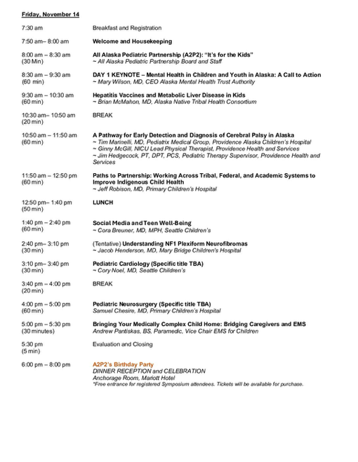

Draft Agenda

Slide 61

Help Me Grow Alaska: Family Support Specialist
First Review of Applicants: October 22, 2025
Anticipated Start Date: January 6, 2026

Slide 62







Help Me Grow Alaska is an agency dedicated to promoting healthy child development across Alaska by providing support and information to individuals and organizations who care for and about children, youth, and adults ages prenatal-26. Whether you are a parent, provider, teacher, or other caregiver with questions or concerns about a child in your life, we are here to help you.
Our call center is staffed with Family Support Specialists, individuals with experience in, and an understanding of, child development, social services, and resources available in Alaska and beyond. They are available to listen to concerns, help organize a path forward, and get families connected to the most available and appropriate service across Alaska.
To order materials scan the QR code or visit:
a2p2.org/help-me-grow-alaska/

Slide 64
Thank you for joining!
Special thanks to Providence Alaska Children’s Hospital and Providence Alaska Medical Center for hosting the October Partnership Meeting.
All the presenters today have shared their value and committment of supporting children, youth, and families in Anchorage and throughout Alaska.
The relationships and support you provide is helping create a safer, healthier, and happier Alaska!
Thank you!

Slide 65

See you at the A2P2 Pediatric Symposium!
November 14-15, 2025

Slide 66
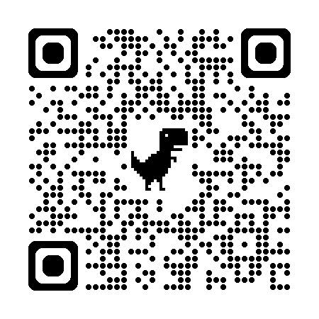

Thank you for joining this months Partnership Meeting!
Stay informed!
Scan the QR code and sign up to the All Alaska Pediatric Partnership’s mailing list.
Partnership Meeting resources and presentations from recent meetings are available on the
All Alaska Pediatric Partnership (A2P2) website a2p2.org

