Slide 1


December Partnership Meeting
Mat-Su Valley, Alaska
Friday, October 3, 2025
12:00-1:30 pm
Presented by the All Alaska Pediatric Partnership (A2P2).
A2P2 transforms systems of care and increases equitable access to health care and related services to ensure all Alaska’s children reach their full potential.
Learn more at a2p2.com or by scanning the QR code

Slide 2

Agenda
Welcome!
Esther Pitts, Mat-Su Health Foundation
Announcements
Tamar Ben-Yose, All Alaska Pediatric Partnership
Presentations
Dr. Bruce Hess, Ptarmigan Pediatrics
Shannon Parker, State of Alaska Preschool Development Grant Leadership Team
Mark Lackey, CCS Early Learning
Dr. Tina Audie, Beneth Nuutah Valley Native Primary Care Center
Karol Fink, Alaska Department of Health, Physical Activity and Nutrition Program (PAN)
Jessica Clarkson, Mat-Su Health Foundation

Slide 3

Welcome! Esther Pitts
Mat-Su Health Foundation

Slide 4
Announcements
Tamar Ben-Yosef, All Alaska Pediatric Partnership

Slide 5



Slide 6
Dr. Bruce Hess
Ptarmigan Pediatrics

Slide 7
Shannon Parker
State of Alaska, Preschool Development Grant Leadership Team

Slide 8
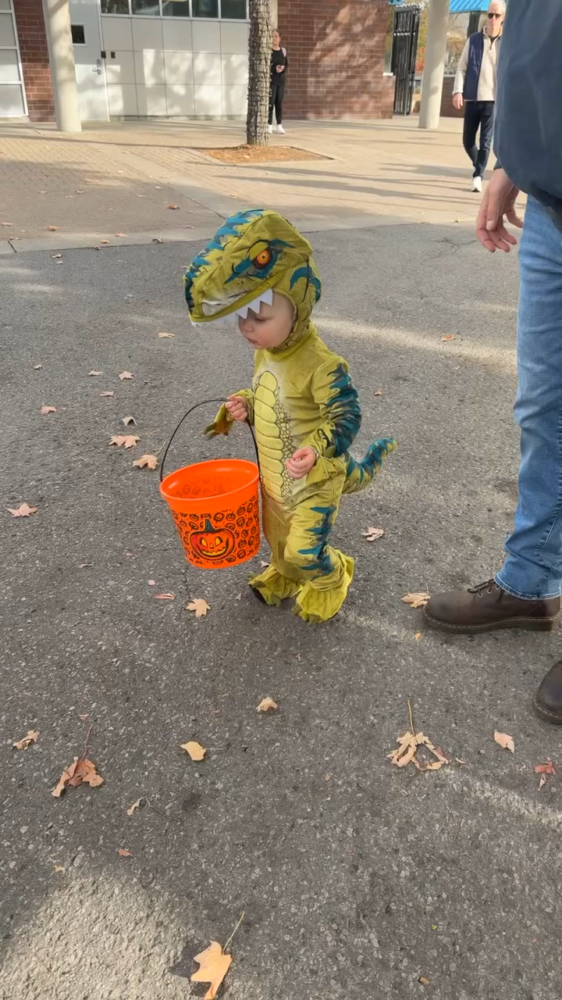
Building Strong Beginnings:
PDG B-5 in Action
Across Alaska
A statewide initiative to strengthen access, quality, and coordination from birth through age five.
All Alaska Pediatric Partnership Meeting
December 5, 2025
Notes:
The Alaska PDG B-5 Grant strengthens the systems that support children during the most critical years of development—when learning looks just like this.

Slide 9
Purpose & Importance
PDG B-5 strengthens and coordinates Alaska’s early childhood system.
Aligns existing services to prepare children for school success.
Improves transitions, family access, and system efficiency.
Notes:
The PDG Grant is a federal grant program that supports states in building and improving coordinated early childhood systems for children birth to age five and their families. The goal of PDG B-5 is to help states align programs, reduce duplication, improve access, and ensure families can easily navigate early childhood services—so children are healthy, safe, and ready to succeed in school and life.

Slide 10
.
The Community INNOVATION Grant opportunity was designed to fund projects requiring community collaboration, especially those that highlight and maintain partnerships with municipalities and/or Tribal agencies across Alaska.
Notes:
I’d like to share several PDG projects that have generated remarkable momentum across Alaska and beyond. The first is the Community Innovation Grant, which supports Alaskan communities in designing and leading their own early childhood solutions. Seventeen communities were awarded the Community INNOVATION Grant

Slide 11
“Building Strong Starts Across Alaska.”
Notes:
This new building represents more than construction—it represents expanded access to quality early learning for the Hoonah community

Slide 12
When communities lead, innovation follows—Little Bears and PDG B-5 in partnership for Alaska’s children.
Notes:
PDG B-5 Innovation Grants support sustainable, community-driven improvements in early learning at Little Bears, Girdwood.

Slide 13
PDG B-5 Sponsorships
Diaper Banks serve as a critical family support resource by increasing access to basic needs, reducing stress on caregivers, and strengthening connections to early childhood and health services.
An event to celebrate our newest residents, provide a space for parents to connect, learn about how to support their child’s development, and gain material resources to support their growing family.
Notes:
PDG Sponsorships are another exciting funding opportunity that helps communities and providers bring innovative ideas to life. Community baby showers create joyful first connections—PDG B-5 helps families access support before challenges begin. Donation to Community Diaper Bank
Kodiak Diaper Bank opened in 2022
2025 gave out 493 baskets of diapers
Kodiak ECN donated 6,846 diapers

Slide 14
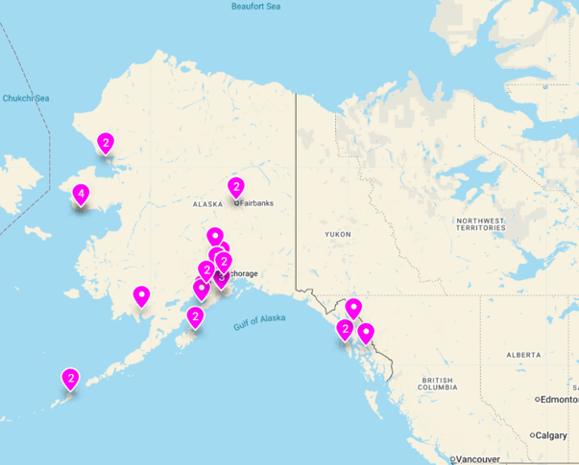
Alaska Early Childhood Network (ECN)
Community-driven partnerships working across the state to strengthen early childhood systems, improve coordination of services, and support Alaska’s children and families where they live.
Notes:
Finally, I’d like to highlight a project that is especially meaningful to me: the Early Childhood Network, or ECN. This is where our collaboration with A2P2 has been especially strong and impactful. Every dot on this map represents local leadership driving better outcomes for Alaska’s children and families. The ECN is a network of 21 community coalitions around the state that work together to build relationships, share ideas, generate opportunities for peer support, and elevate early childhood in Alaska. The ECN provides a hub for communities to network and learn from each other, learn together about local, state, and federal policies and programs. While there are currently 21 member communities, it is a primary goal to generate expanded interest and continue equipping more Alaskan communities to participate. PDG B-5 funds support A2P2 in co-facilitating the ECN with WCFH. The co-facilitator from WCFH is also on the PDG B-5 leadership team.

Slide 15
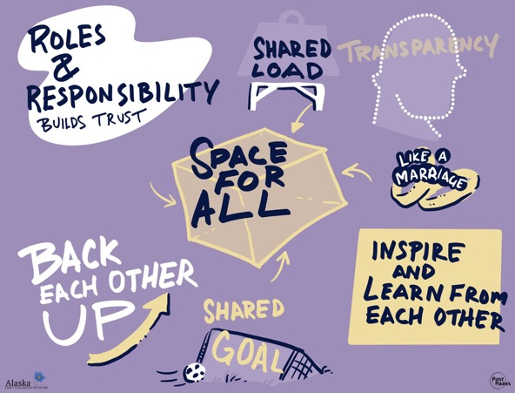
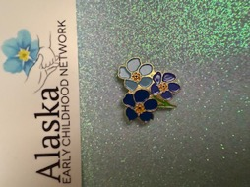
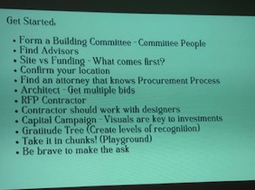
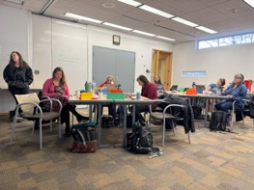
“Alaska’s Early Childhood Network connects communities through trust, collaboration, and a shared vision for young children.”
Notes:
The momentum behind ECN reflects the broader success of PDG statewide—so I’ll close with a final video that reminds us why this work is so important

Slide 16
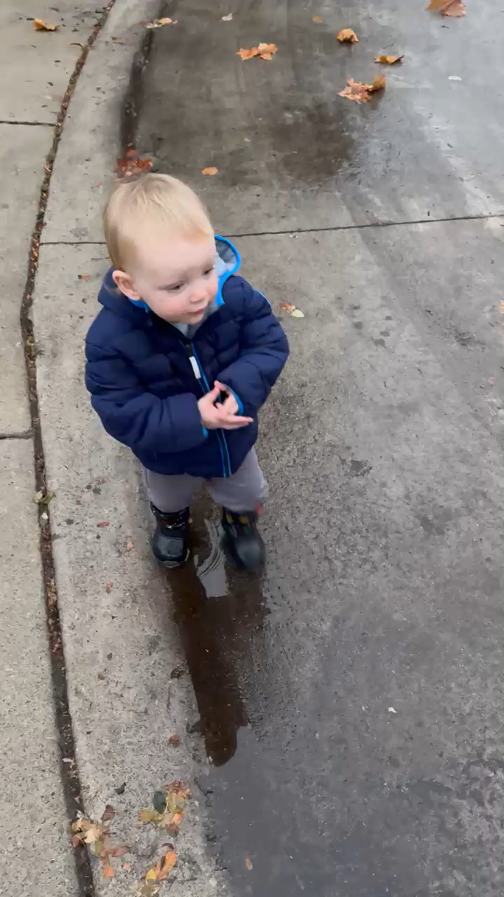
“This simple moment of play reflects the powerful impact of strong early childhood systems for families across Alaska.”
Notes:
PDG B-5 laid the foundation—now the work continues. The systems, partnerships, and innovations built through this grant will continue to strengthen Alaska’s early childhood landscape for years to come.
Thank you for being part of this statewide effort.

Slide 17
Every splash, every step, and every moment of curiosity reflects the reason for Alaska’s PDG B-5 investment—supporting children during the most critical years of growth and development.
Thank you for your partnership in building Alaska’s early childhood system
Shannon Parker
State of Alaska | Department of Health
Division of Public Health | Section of Women’s, Children’s & Family Health
shannon.parker@alaska.gov

Slide 18
Mark Lackey
CCS Early Learning

Slide 19

Mission Statement:
Making a difference in the lives of families of young children within our community
Since 1971

Slide 20

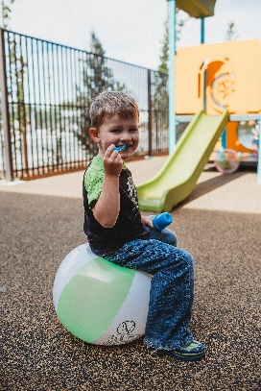
Over 150 staff members across four centers and one administrative office:
Wasilla Head Start (ages 3-5) – Wasilla CCS Campus (across the Parks Hwy from Tacos Cancun)
Wasilla Early Head Start (ages 0-3) – Wasilla CCS Campus
Administrative Office – Wasilla CCS Campus
Palmer Center (ages 0-5) – across Bogard Rd from the Palmer Pool
Fairview Center (ages 0-5) – one mile down Fairview from intersection of KGB/Fairview Loop

Slide 21
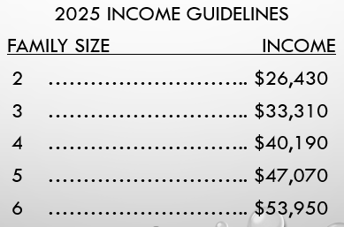
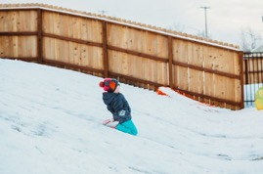

We provide free – high quality early childhood education and family advocacy services to eligible families. Currently…
Low income = 45% of our enrollment
Children who are in foster care = 20% of our enrollment (national avg = 2.61%)
Children whose families are homeless = 26% of our enrollment (national avg = 7.13%)

Slide 22


INFLATION VS FLAT FEDERAL $$$
2024 Federal Grant - $6,186,808
2025 Federal Grant - $6,186,808
Expected 2026 Federal Grant - $6,186,808
But… the costs of everything have gone up drastically during this same time frame.
Our wages were already much lower than the school district.
WE NEED QUALIFIED PEOPLE TO CARE FOR CHILDREN & SUPPORT FAMILIES
In order to recruit and retain staff we have to keep up with local compensation trends.
Our only option – consolidate services and decrease # of children served.
2022 – Closed our Chugiak Center
2024 – Closed our Meadow Lakes Center
Head Start & Early Head Start Slots:
2022 – 369
2025 – 230
38% decrease in the number of children served in the Mat-Su
# of New Hires:
19/20 = 55
20/21 = 40
21/22 = 41
22/23 = 91
23/24= 45
24/25 = 72
25/26 (so far) = 25

Slide 23


Please help us spread the word!
Head Start
Early Head Start Programs…
Employment Application:
www.ccsalaska.org/employment
Child enrollment application:
www.ccsalaska.org/enrollment

Slide 24
A BRAND NEW PROGRAM! Parents as Teachers (PAT)
Parents as Teachers - Evidence based home visiting program that provides support to families through personal visits, group connections, screenings, referrals to local resources, and educational material.
Funding provided by the Maternal, Infant, and Early Childhood Home Visiting Program (MIECHV) grant.
Our team - Two Parent Educators and a Program Coordinator. Each educator will support up to 20 families! Prenatal up to five years old.
Starting to serve families at the beginning of 2026.
Enrollment - We utilize a priority point system waitlist and enrollment is based on eligibility and family needs. We encourage all families to apply to determine eligibility. *Must reside in the Mat-Su Borough*

Slide 25

How to apply to PAT?
Visit our CCS Early Learning website- https://www.ccsalaska.org/parents-as-teachers-pat
Contact our administrative office by phone 907-373-7000
Referring a family?
Complete the outside agency referral form under the P.A.T tab on our website either by paper or google form.
Families still must complete an application to begin the process.

Slide 26
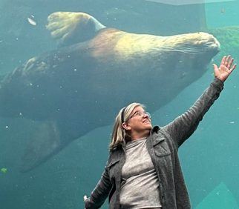
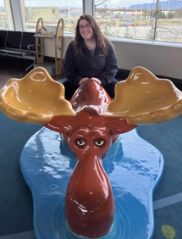
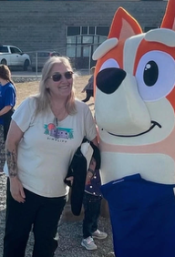

CCS Parents as Teachers Staff
Stefanie Ostlind
Parent Educator
Samantha Glick-MacCracken
Program Coordinator
Lana Arsenault
Parent Educator

Slide 27


Ending with a Positive!
These 40 PAT slots help us regain some of those Head Start & Early Head Start services we lost!
When PAT is fully enrolled we will “claw back” 11% of our losses in children CCS serves in the Mat-Su.

Slide 28




Any Questions?

Slide 29
Dr. Tina Audie
Benteh Nuutah Valley Native Primary Care Center

Slide 30

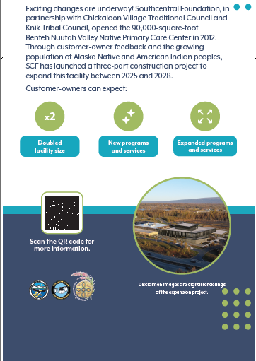

Slide 31
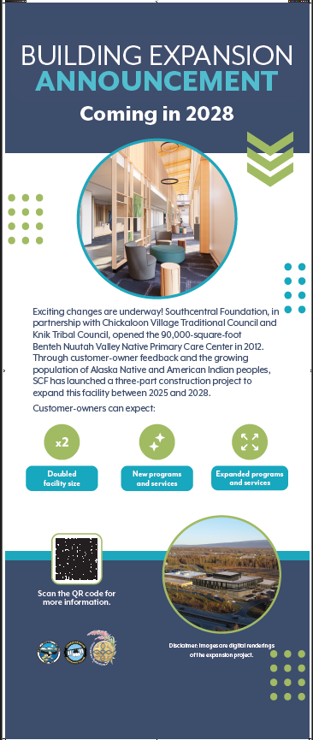
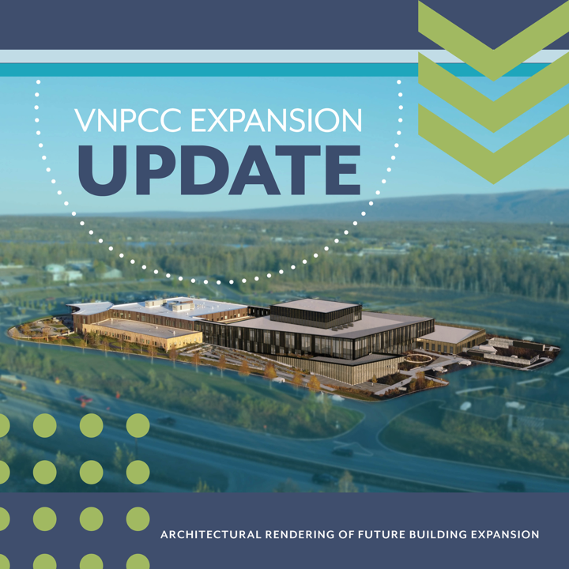

Slide 32
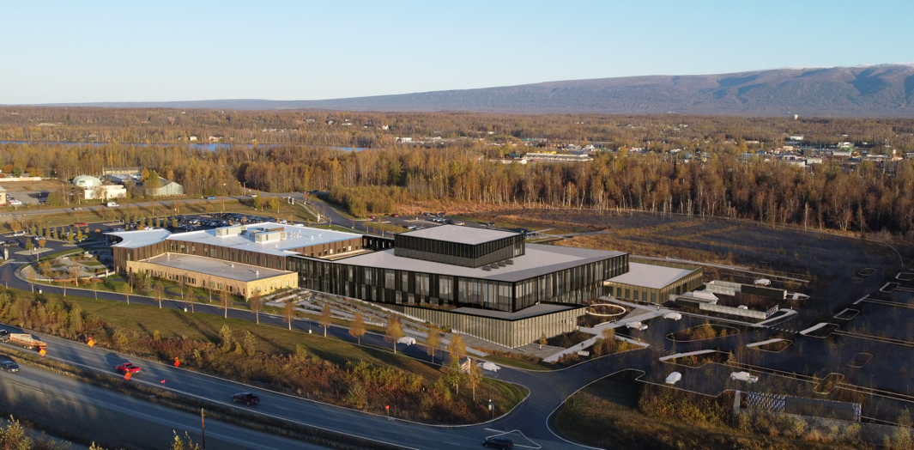

Slide 33
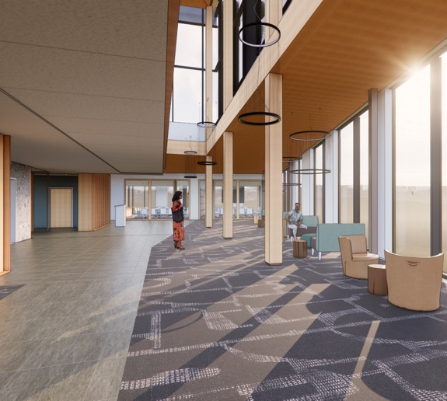
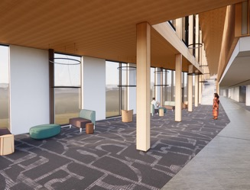
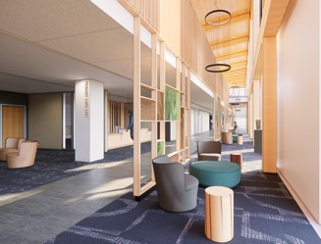

Slide 34
Karol Fink
Alaska Department of Health, Physical Activity and Nutrition Program (PAN)

Slide 35

All Alaska Pediatric Partnership ~ Food is Medicine and Growing Hope ~ December 5, 2025
Karol Fink, MS RDN
Dietitian, Alaska Department of Health, Physical Activity and Nutrition Unit (PAN)

Slide 36





Growing Hope Produce for Patients in Cancer Treatment
A Pilot Project

Slide 37
Growing Hope Objectives Produce for Patients in Cancer Treatment
Improve nutritional intake
REDUCE financial worries
Reduce patient and caregiver burden
IMPROVE Food security
Notes:
Cancer treatment often involves physical, emotional, and financial stresses for patients and their caregivers. For those already experiencing food insecurity, these challenges are magnified.
Limited access to healthy foods can reduce nutritional intake, complicate treatment, and create additional strain on the household.
Health care providers are well-positioned to address food insecurity by connecting patients with community resources at the point of care.

Slide 38
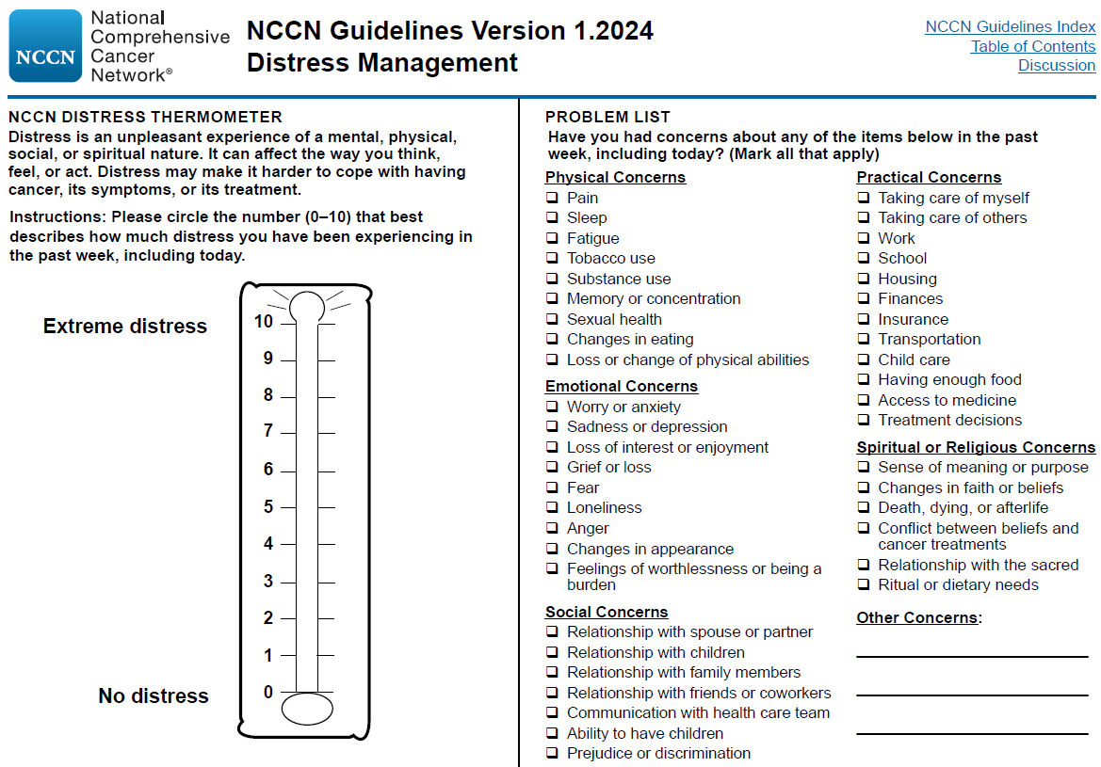
Participant Criteria
Patients undergoing cancer treatment
Anchorage Radiation Oncology Center
Providence Cancer Center
Patients are identified by navigators/social workers
Distress Screener
Notes:
Karol

Slide 39




Slide 40

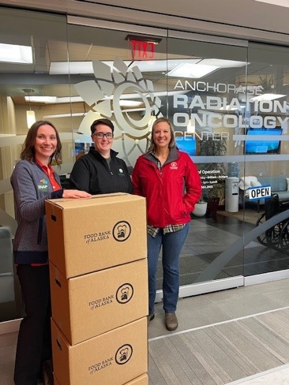
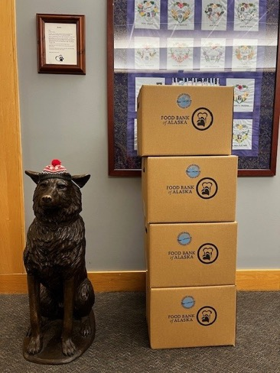
Caregiver Wellness Resources
Two Anchorage sites:
Providence Cancer Center
Anchorage Radiation Oncology Center

Slide 41
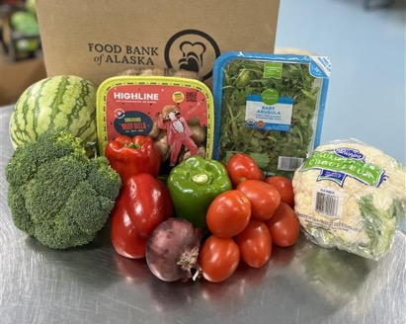

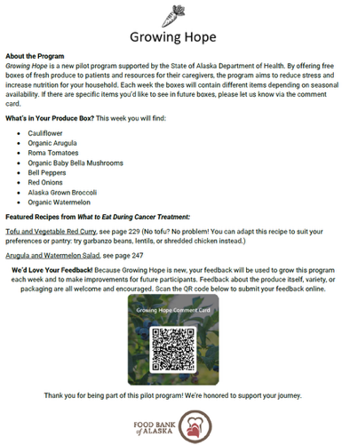
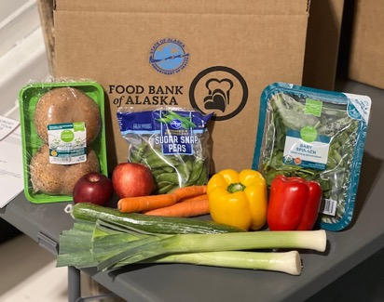
Weekly Produce Boxes
Improve nutritional intake
Alleviate financial worries
Reduce patient and caregiver burden

Slide 42
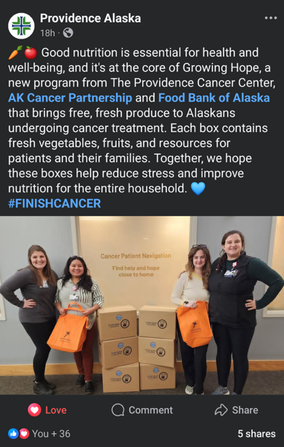

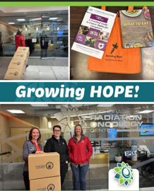
Social Media

Slide 43
Pilot launched Sept 9, 2025 Evaluation –
Patient
Perception of change in food security, nutrition, burden and finances
Satisfaction, preference
Cancer centers
Logistics, perception, time invested
Food Bank of Alaska
Logistics and costs
Process evaluation
Capturing lots of other information!

Slide 44
Get involved
Join our Food is Medicine
Coalition
Drop your name and email in the chat or sign up on the paper here in person
Interested in starting a program for your patients, reach out to me and let’s talk.
I currently don’t have funding, but if I have identified partners and funding opportunities arise that will help.

Slide 45

Karol Fink, MS RDN
Dietitian
Alaska Department of Health
Physical Activity and Nutrition Unit (PAN)
Karol.Fink@alaska.gov
907.269.8447

Slide 46
Jessica Clarkson
Mat-Su Health Foundation

Slide 47

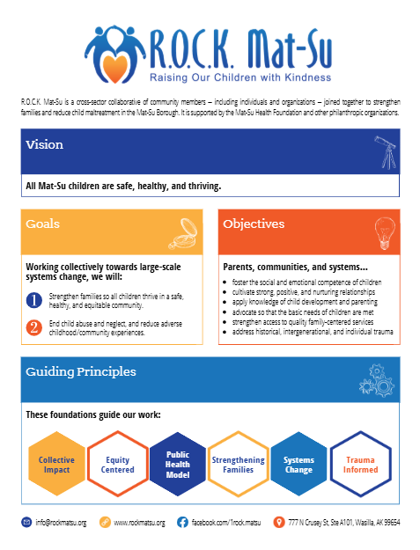


Jessica Clarkson
jclarkson@rockmatsu.org

Slide 48
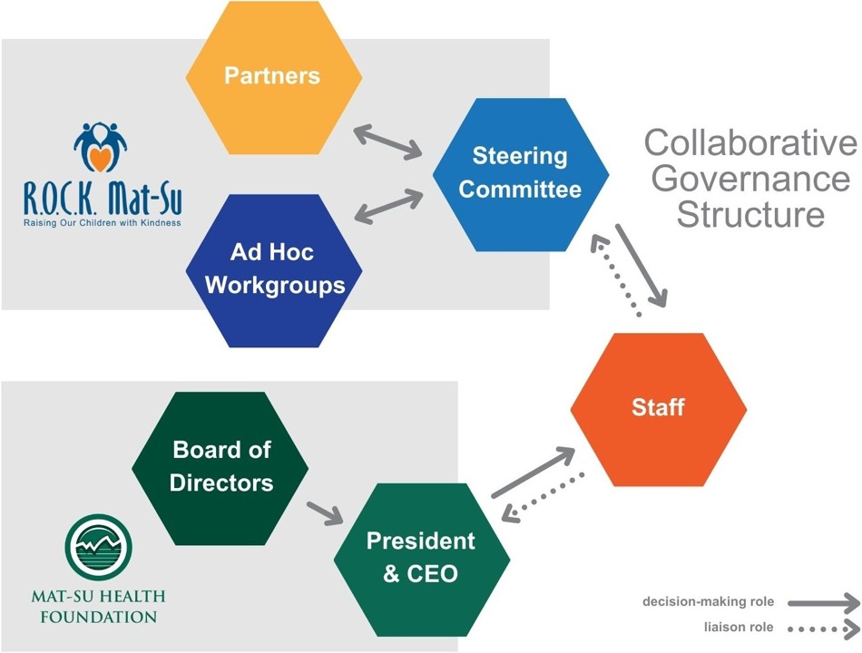



Slide 49






COLLECTIVE IMPACT
Ad Hoc Workgroups
Partner Workgroup
Steering Committee
Membership
Context and content experts
Partner Leadership
Liaisions, appointed by volunteering
Membership
All partners
Partner Leadership
Leadership committee, 2 appointed by steering committee, 2-4 appointed by membership
Membership
up to 16 nominated members approved by the steering committee
Partner Leadership
Co-chairs, with the addition of a chair elect

Slide 50
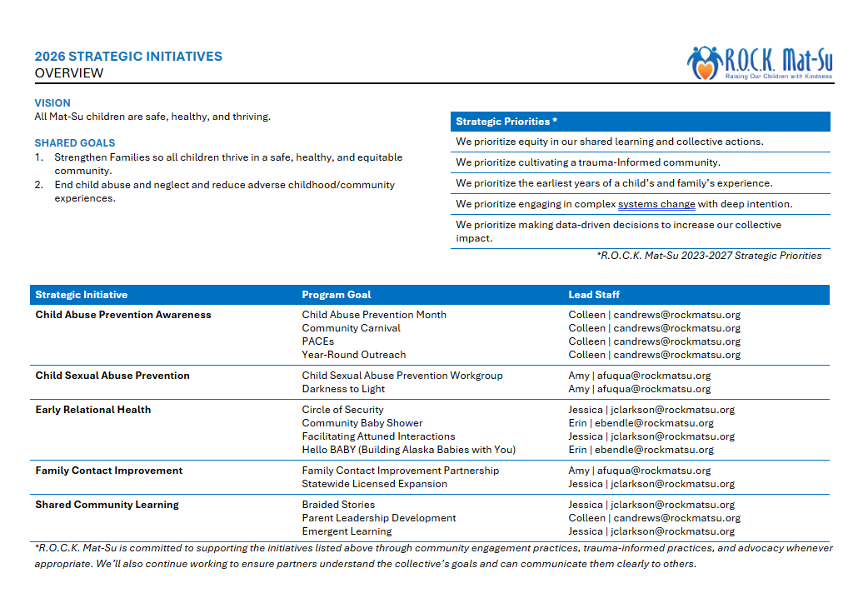




2026
Operating Plan

