Slide 1


September Partnership Meeting
Dillingham, Alaska
Friday, September 5, 2025
10:00-11:30 am
Presented by the All Alaska Pediatric Partnership (A2P2).
A2P2 transforms systems of care and increases equitable access to health care and related services to ensure all Alaska’s children reach their full potential.
Learn more at a2p2.com or by scanning the QR code

Slide 2

Agenda
Welcome!
Announcements
  Tamar Ben-Yose, All Alaska Pediatric Partnership
Presentations
  Lynn Van Vactor, Bristol Bay Area Health Corporation (BBAHC)
  Lisa Susunaga, State of Alaska- Public Health Nursing
  Anne Shade, Bristol Bay Native Association Head Start
  Suzie Nunn, Early Childhood Interdisciplinary Team & WIC
  Dr. Geoffrey Waite, Bristol Bay Area Health Corporation Audiology
  Denise Hendrickson, Bristol Bay Area Health Corporation Diabetes Community Wellness Program
Closing Announcements

Slide 3

Announcements
Tamar Ben-Yosef, All Alaska Pediatric Partnership

Slide 4

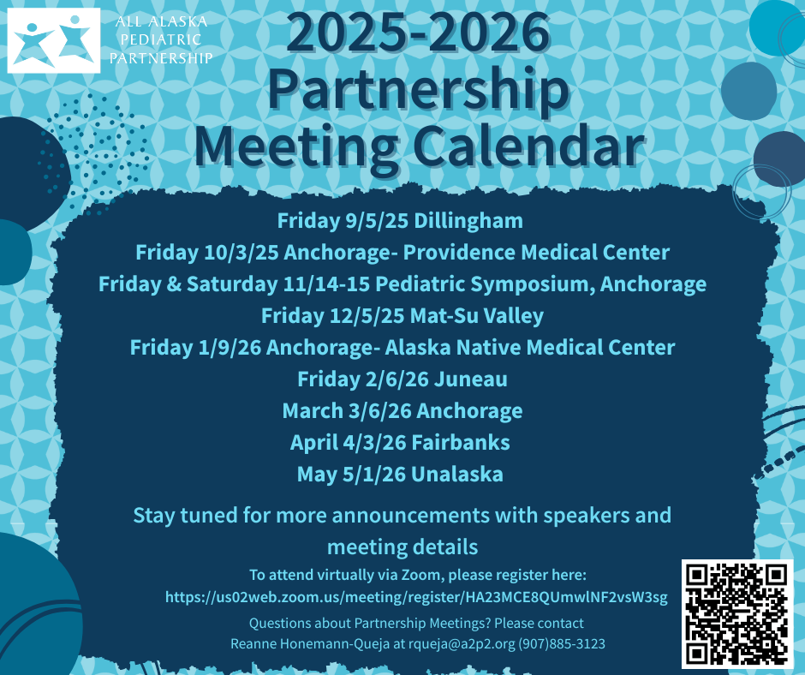

Slide 5
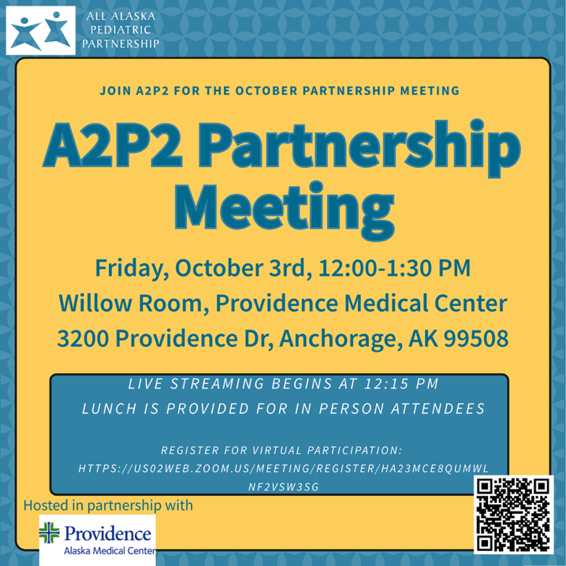

Slide 6


Slide 7


Slide 8
Welcome!
Lynn Van Vactor
Bristol Bay Area Health Corporation

Slide 9
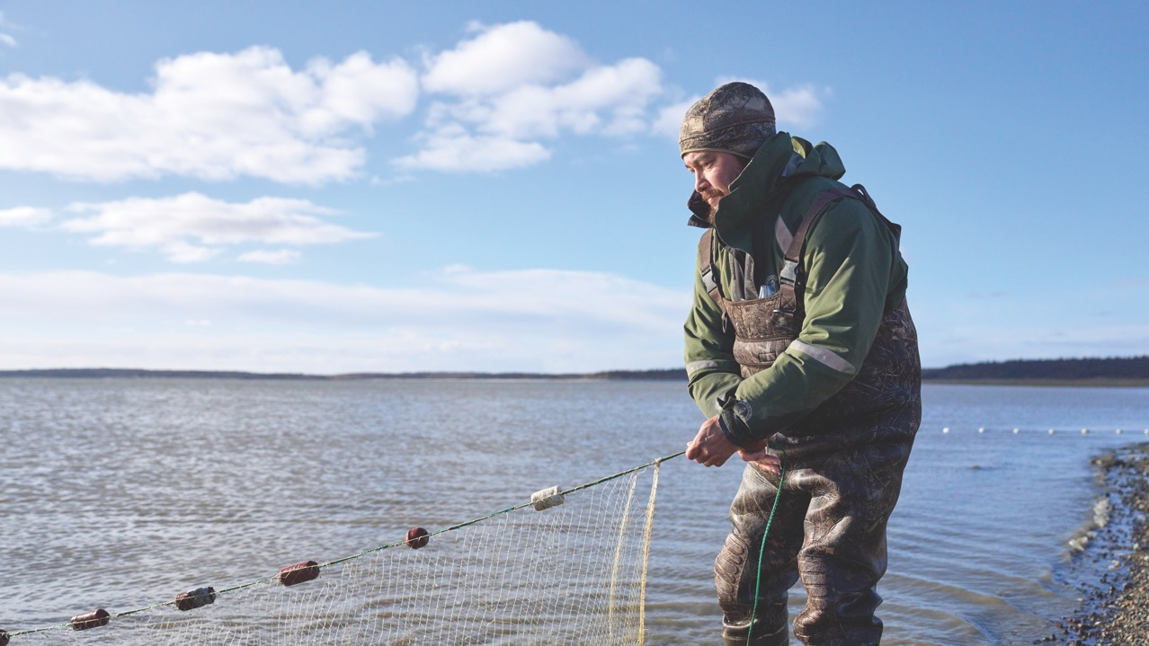

All Alaska Pediatric Partnership (A2P2) Meeting
September 5, 2025

Slide 10

Welcome to the Bristol Bay Area Health Corporation
Camai!
OUR MISSION: We provide quality health care with competence, compassion, and sensitivity.

Slide 11
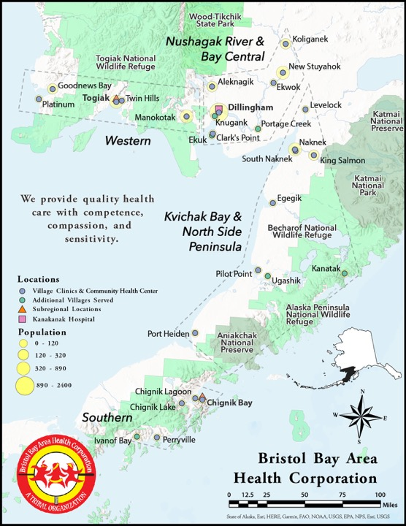
BBAHC Overview
Incorporated in 1973, 501(c)(3) Tribal Health Organization
We manage the Bristol Bay Service Region for IHS, since 1980
BBAHC is comprised of 28 villages in four subregions
Regional health care service delivery through 21 village clinics
Critical access Kanakanak Hospital in Dillingham
We serve approximately 8,000 year-round clients
BBAHC Information Packet

Slide 12
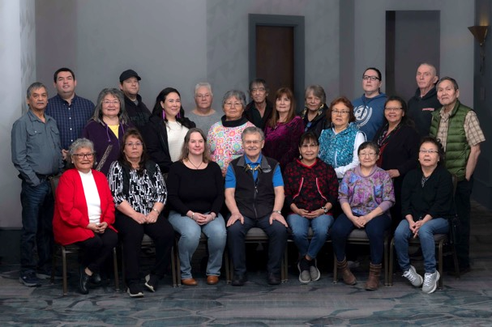
Our Mission, Vision, Core Values & Governing Body
Mission
We provide quality health care with competence, compassion, and sensitivity
Vision
To be a model of quality and financial stability
Core Values
Accessible, quality health care for all
Promotion of health and prevention of disease
Respect for an individual’s dignity, independence, and choices
Basic medical services for everyone regardless of ability to pay
Governing Body
28 board of directors, and of those 9 are executive committee members

Slide 13
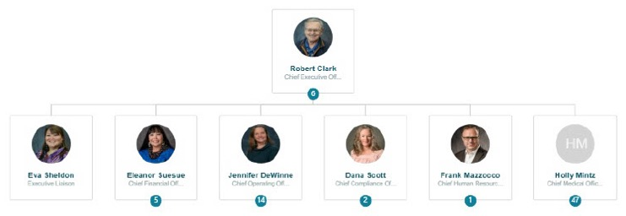
BBAHC Organizational Chart
Chief Medical Officer
  13 of 16 FTE Providers
  6 Locums Mid-Level Practitioners, Goal: 14 on contract
  60 Community Health Aides
Critical Access Hospital
  Emergency Room, Inpatient, Outpatient Clinic
Medical Staff Village Travel
  21 Village Clinics
Physician Practice Division Manager
  Diabetes Wellness Program
  Community Health Aide Program

Slide 14

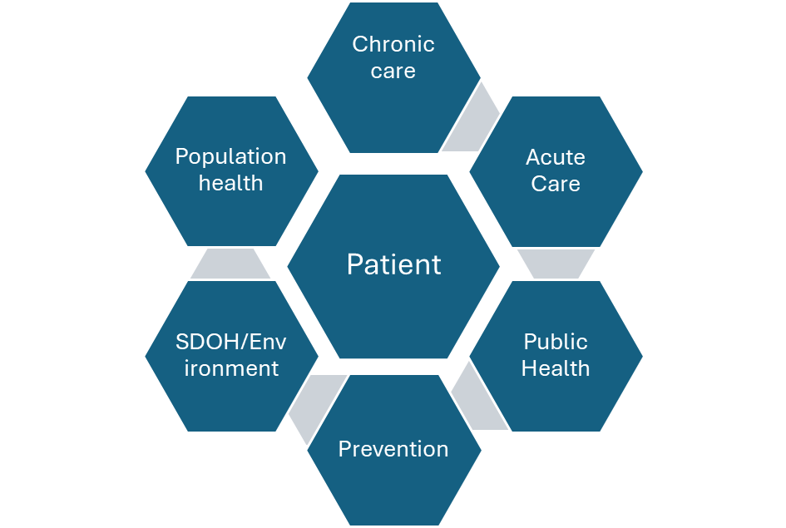
Medical Staff Priorities
Care: Accessible, Consistent, Reflective of Best Practice
Challenges: Space in clinics, having enough exam rooms to access telehealth (medical, Physical Therapy, Psychiatry, Behavioral Health) and on-site clinical care. Logistics, getting providers and medications to the remote village clinics.

Slide 15
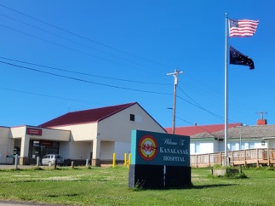
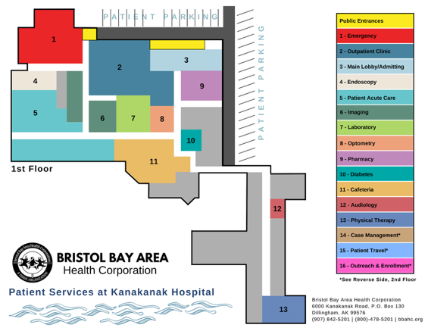
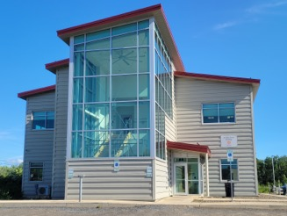
Clinical & Ancillary Services
Dental
  H. Sally Smith Building
Physical Therapy
Medical Imaging
Laboratory
Optometry
Pharmacy
Audiology

Slide 16
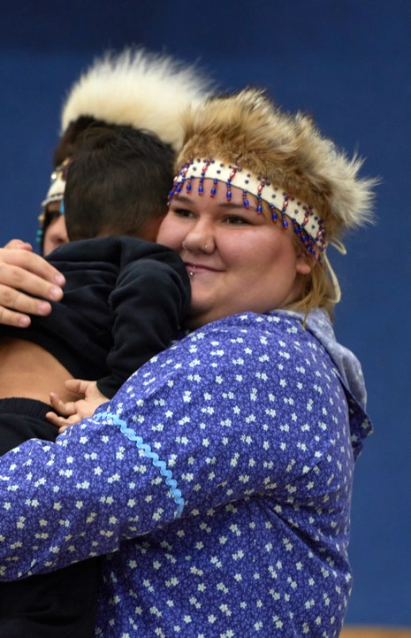
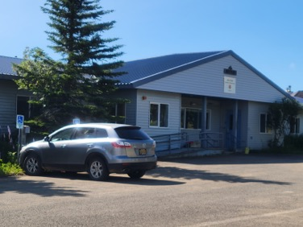
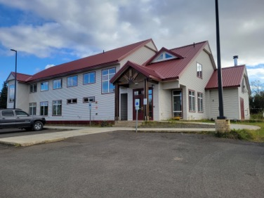
Behavioral Health
Jake’s Place, Residential Treatment Facility
CAC, Nitaput Child Advocacy Center
Bristol Bay Counseling Center

Slide 17
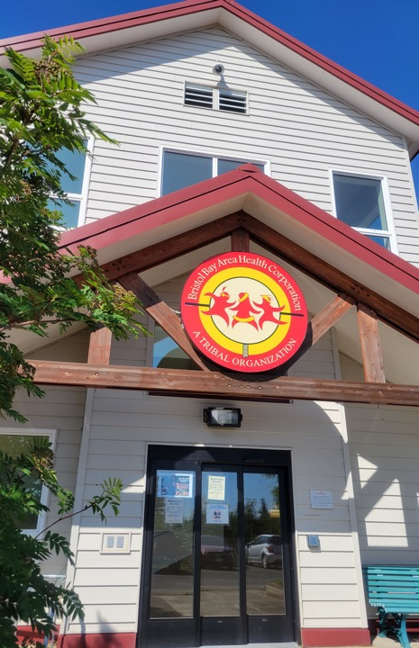
Looking Ahead
Land Transfer from IHS
Allows BBAHC to fulfill our mission
North Campus Development
Ambulatory Care Center will house all Primary Care Services
Partnerships
Erosion Mitigation
Opioid Crisis Regional Response
Capital Improvement Project Funding

Slide 18
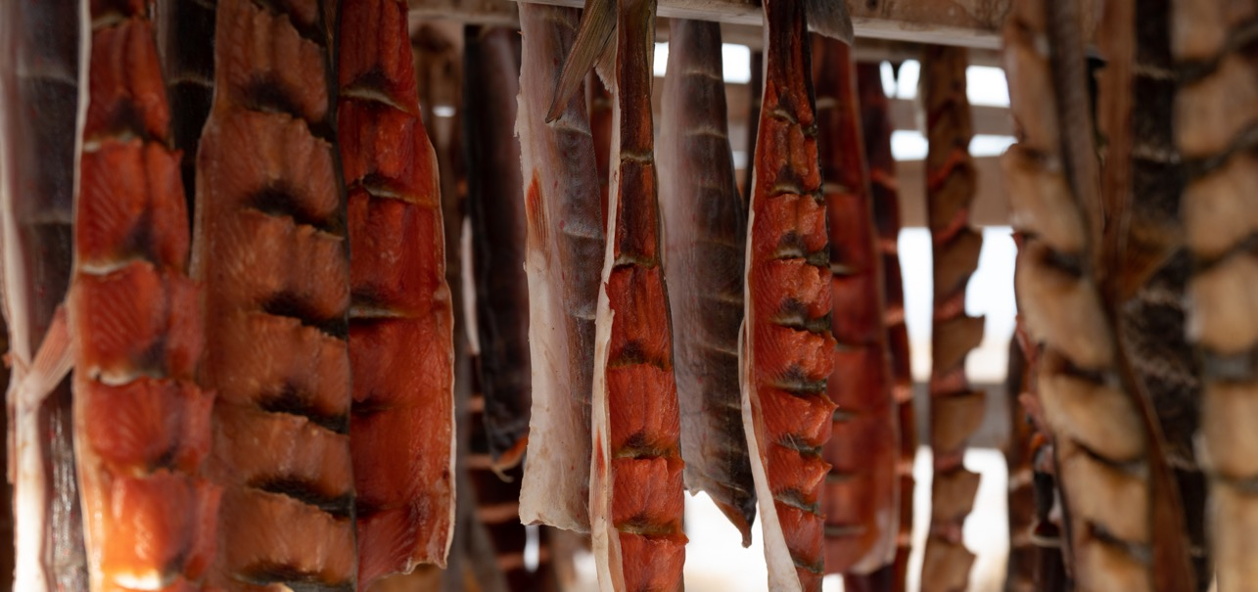
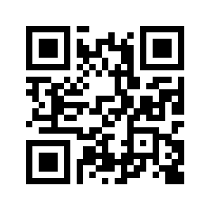
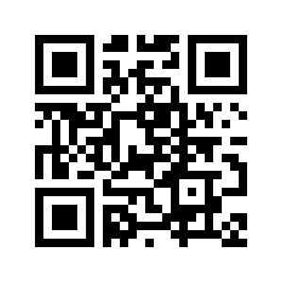
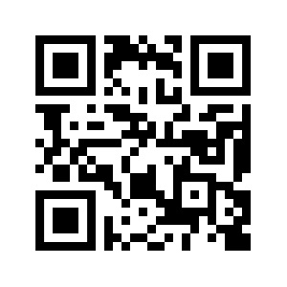




BBAHC CONTACTS:
Cynthia Rogers, Public Relations & Community Engagement Director, crogers@bbahc.org
Holly Mintz, Chief Medical Officer, hmintz@bbahc.org
Lynn Van Vactor, Physician Practice Division Manager, lvanvactor@bbahc.org
Thank You For Visiting BBAHC
QUYANA!

Slide 19
Anne Shade
Bristol Bay Native Association

Slide 20
Bristol Bay Native Association
    Child Development
    Community Services
    Family Services
    Land Management
    Natural Resources
    Transportation and Infrastructure Development
    Program Development
    Work Force Development

Slide 21
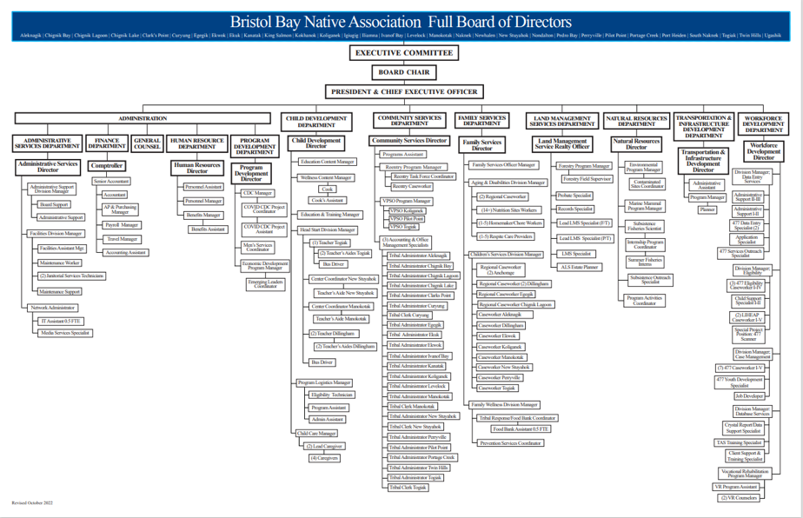

Slide 22
PL 102-477- what is that??
BBNA is a PL 102-477 grantee, which means supportive service funds are received in one lump sum. In the past, all these programs have been housed under the Workforce Development Department. Programs include employment and training, youth employment, higher education, childcare assistance, TANF, general assistance, heating assistance, burial assistance, heating assistance. Tribes are allowed to use 477 funds to provide support in any of the above areas, in a way that works best for them.
For the first time ever, tribal programs have been approved to include Head Start under the “477 umbrella”. BBNA and 4 other grantees applied to include Head Start and were approved! This will allow flexibility in how we’re using funding, as well as providing a more streamlined application and referral processes. Because we are in the first cohort of grantees to do this, we will be paving the way for others to follow!

Slide 23
477 Youth Programs Housed in the Child Development Department
Head Start/ Pre-K
  Head Start serves 80 students in 5 classrooms in the communities of Dillingham, New Stuyahok, Manokotak and Togiak. Collaborations with SWRSD are intended to place certified teachers in the Head Start classrooms located in New Stuyahok and Manokotak. BBNA provides the Teacher’s Aides and supportive services.
Child Care – Home Based & Center Based Oversight
  The Center Based Child Care Program in Dillingham is currently closed due to multiple staff vacancies. Home based providers provide care to over 30 children region wide.
Child Care Assistance for eligible parents.
Support and Training of Home Child Care Providers
  Educational and sanitizing equipment sent out to all providers when needed or requested
  Annual Child Care Providers Training Conference

Slide 24
Youth Programs continued
Tribal Early Learning Initiative Site (TELI)
  BBNA was chosen as 1 of 8 programs nationwide to participate in the Tribal Early Learning Initiative (TELI). The idea behind TELI is to use braided funding to provide comprehensive wrap around services for early education programs.
The Youth Employment Program (YEP) is available for youth 14 – 24 years old. Youth under the age of 16 have packets designed to provide them valuable work skills and identify areas of interest. Youth 16 through 24 are placed in job sites. Whether on packets or job sites, youth have an opportunity to earn $1,000 for their efforts.
Bristol Bay Regional Career Technical Exploration Program (BBRCTE)- Collaboration with all 4 Bristol Bay School Districts to give students the opportunity to learn new skills, earn dual credits and prepare to be part of the workforce. BBNA was instrumental in the creation of the Early Childhood Education track and the UAA Teacher Apprenticeship Program.

Slide 25

What is Head Start?
What is Head Start?
Head Start is a free, mostly federally funded comprehensive early childhood program for children aged three to five, and their families. Head Start believes that children grow and learn within the context of their families and communities. Head Start provides group and individual activates for young children that will help them be prepared for kindergarten. BBNA Head Start Center based programs serve a total of 80 students in 5 classrooms which operate four to five days a week, for four to five and a half hours a day in the communities of Dillingham, New Stuyahok, Manokotak and Togiak.
Who can go to Head Start?
Children who are at least three years and not over five years old by September 1st of the current year are eligible. Families living below the federal poverty guidelines, children in foster care, children with disabilities, and homeless families are prioritized. The Office of Head Start waived income requirements for tribal programs, so even if families are over the income guidelines please encourage them to submit their child’s application. Head Start collaborates with local school districts to provide specialized services for children with disabilities.
What does Head Start offer?
Head Start provides early childhood education, health and family support services for all families enrolled. Our classes offer activities and play opportunities for children that will help them develop mentally, socially, emotionally, physically, and academically. We acknowledge parents as their child’s first teacher and encourage their involvement in all aspects of our program. Parents have regular opportunities to meet with staff as well as other parents. Our family services component offers opportunities for families to develop social support networks.

Slide 26

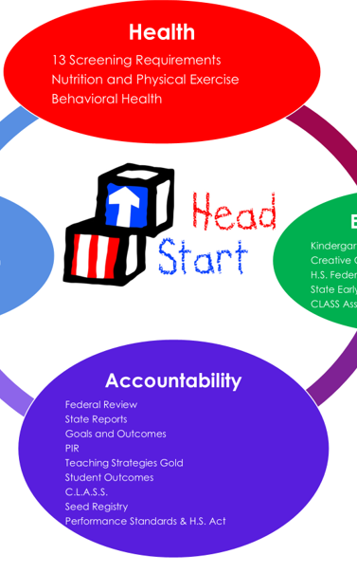


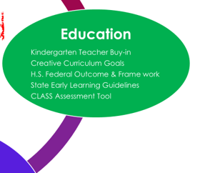


Slide 27
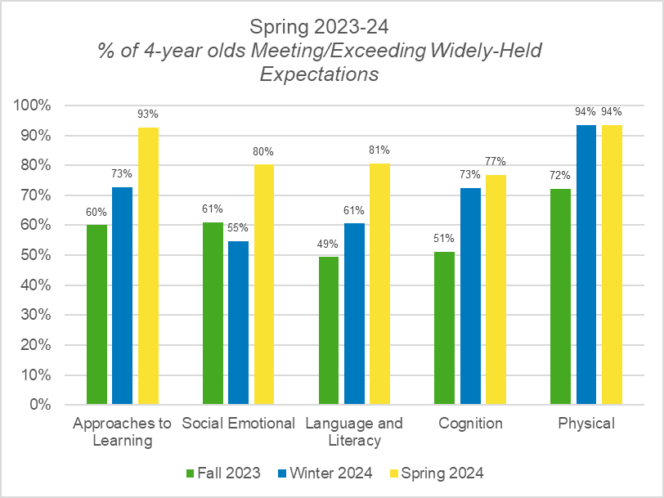
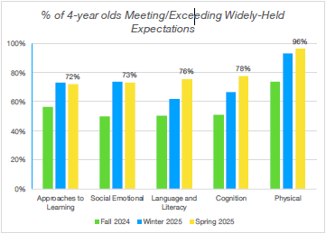
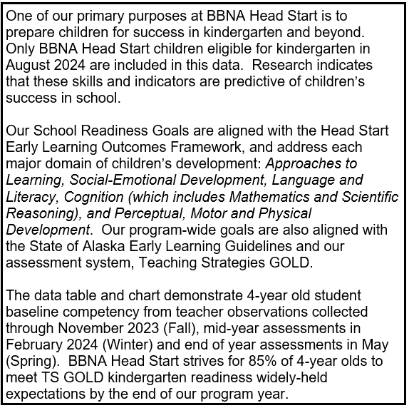

Slide 28


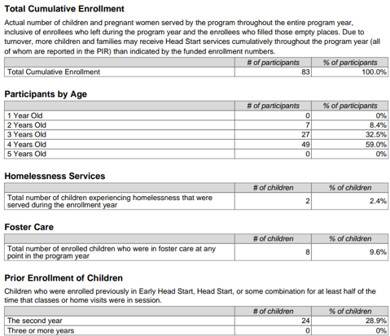
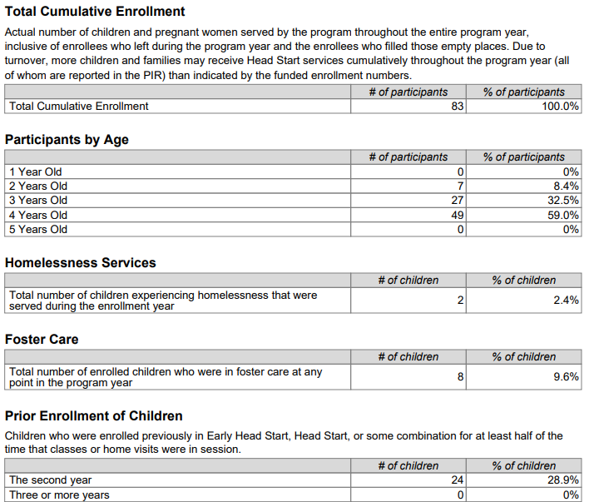
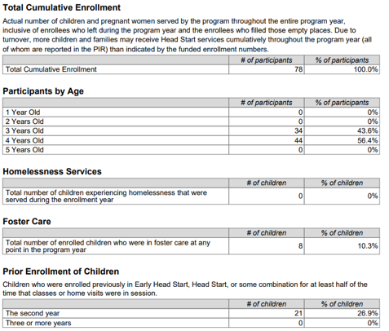
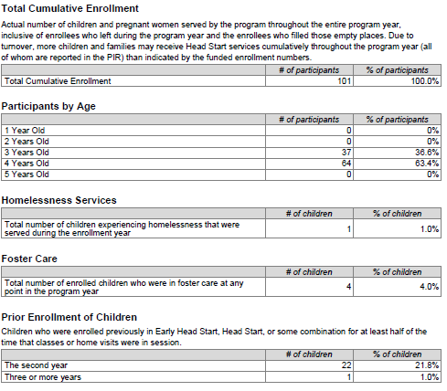
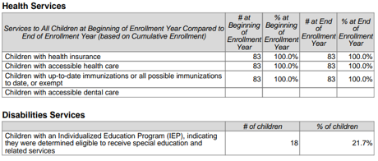
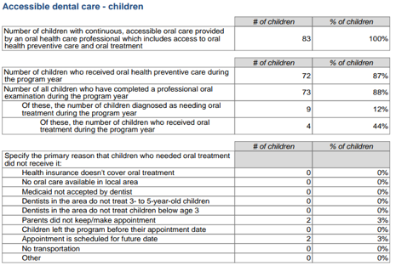
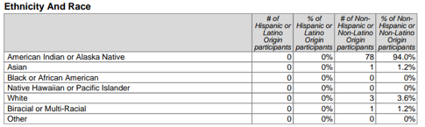
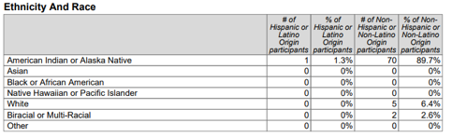

Slide 29
The NET Project
Vision: To create a streamlined comprehensive approach to providing supportive services to families.
Which BBNA departments and programs are involved?
Workforce Development Department
  Heating Assistance, Cash Assistance, Educational Services, Vocational Rehab, Buriel Assistance.
Child Development Department
  Head Start, Center Based Childcare, Youth Employment, Childcare Assistance, Oversight of home childcare providers.
Family Services Department
  Indian Child Welfare Act (ICWA), Aging and disabilities, Food bank, Tribal Men’s Services, and Prisoner Reentry.

Slide 30
Lisa Susunaga
Public Health Nursing, State of Alaska

Slide 31


State of Alaska
Public Health Nursing
Dillingham:
Teresa Seybert OA II
Lisa Susunaga PHN III
Drew Shannon PHN IV (Anchorage based)

Slide 32
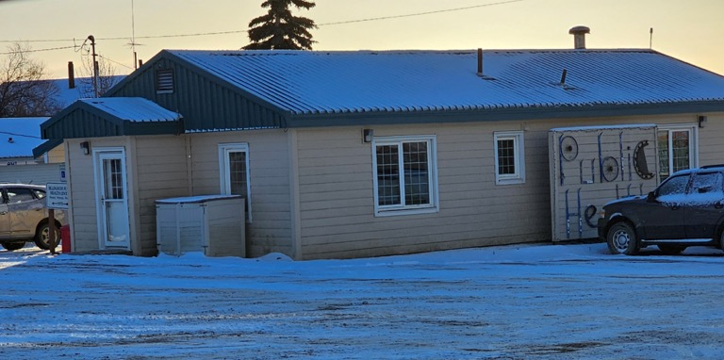
Dillingham Public Health Nursing

Slide 33
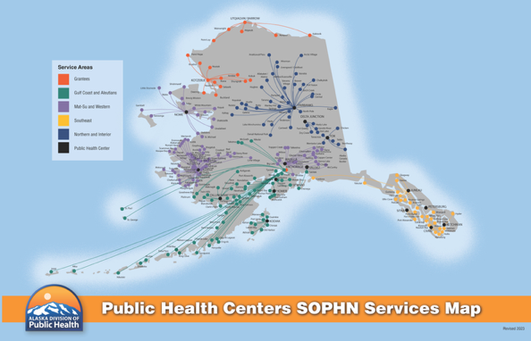
Service map

Slide 34
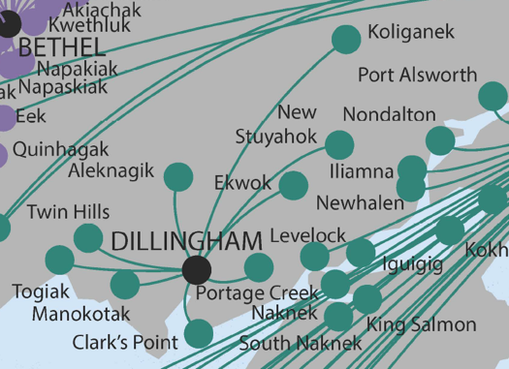
Dillingham
Aleknagik
Clarks Point
Ekwok
Koliganek
Manokotak
New Stuyahok
Portage Creek
Togiak
Twin Hills

Slide 35

Our Mission
Partnering with Alaskans to protect and improve the health and wellbeing of communities.

Slide 36
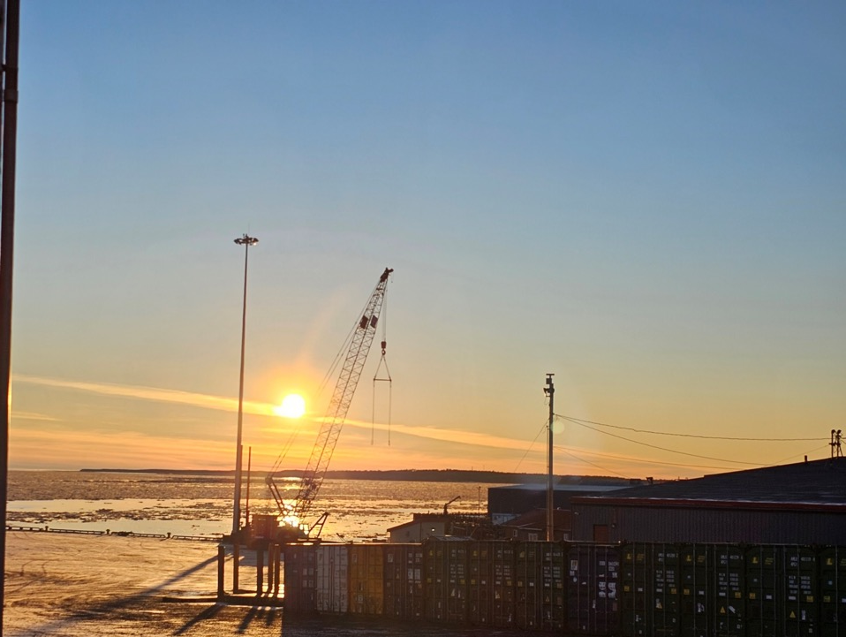
Vision Statement
Alaskans thriving across generations.

Slide 37

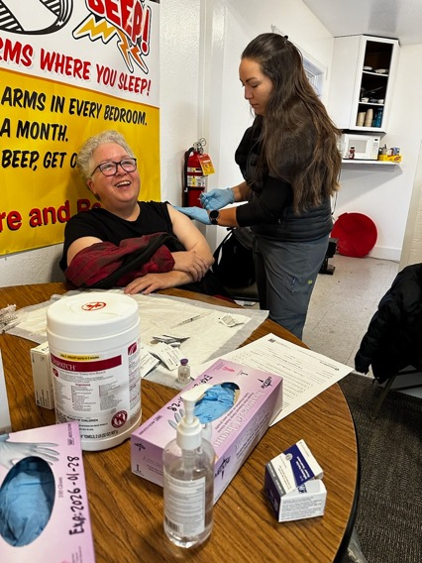
We work together with local entities to provide health care

Slide 38
Children’s Services 0-18 years
Immunizations
Well baby/well child exams
Lead screening
Hearing and vision screening
TB screening (head start, new students)
Reproductive health care
Education in the schools (reproductive health/healthy relationships, opioid/tobacco/etoh)

Slide 39
Suzie Nunn
Early Childhood Interdisciplinary Team & WIC

Slide 40

ECIT
Early Childhood Interdisciplinary Team
Consists of members who work with young children (Example: WIC, Head Start, ILP, 4H, SAFE, school districts, BBNA programs, CAC)
Share program updates
Collaborate on projects
  Young Children’s Fairs
Usually meet the 3rd Wednesday of every other month and sometimes combine with Head Start Advisory Committee (HSAC)
  Next meeting will be September 11 combined with HSAC
Email Suzie at snunn@bbahc.org to be added to the email group

Slide 41


Slide 42
Dr. Geoffrey Waite
Bristol Bay Area Health Corporation, Audiology

Slide 43
all Alaska Pediatric Partnership:
Hearing healthcare in Bristol Bay
Geoffrey Waite, Au.D.
BBAHC Audiology
Dillingham, Alaska

Slide 44
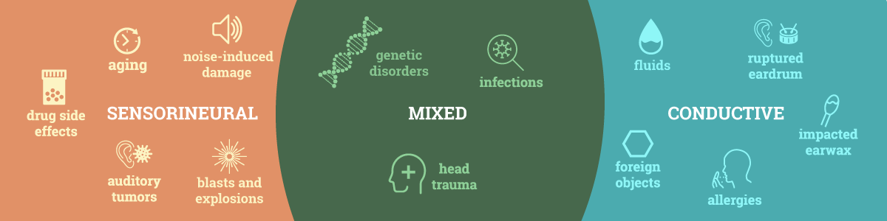
Pediatric Audiology in Rural Alaska
Services We Provide:
  Diagnostic:
    Hearing tests
    Newborn Hearing Screens
  Treatment:
    Telemedicine consult with ENT
    Coordinate field clinics and surgeries
  Rehabilitation & Consultation:
    Hearing Aids
    IEP, 504 Plans
Overview:
Rural Alaska children experience hearing loss at a rate of 30% vs 2-5% in the lower 48 (Emmett, et.al 2022).
Mix of Conductive and Sensory hearing losses
  Middle Ear Diseases are common in children (e.g. AOM)
  Sensorineural loss in hunters and older boys
https://hearingaidclinics.com/hearing-loss/types/

Slide 45
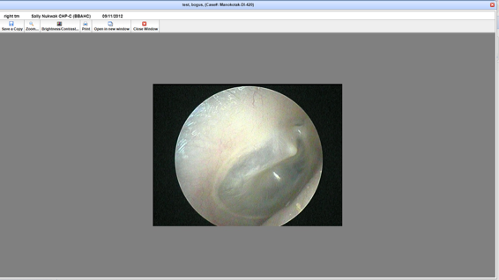
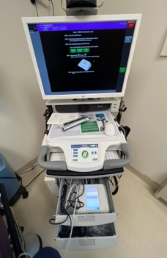
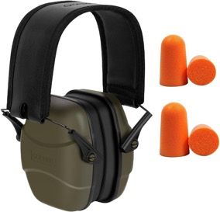
Current & Future Projects
Current Efforts to Expand Access:
  AFHCAN telemedicine
    Developing CHAP training modules on ear pathology and exams
  School Screening
    Optometry-led effort to screen elementary school children at the largest schools in the region
Future Projects:
  Increase access to hearing healthcare via telemedicine
  Improve hearing protection access in-region

Slide 46
Denise Hendrickson
Bristol Bay Area Health Corporation, Diabetes Community Wellness Program

Slide 47

BBAHC Diabetes
Community Wellness Program
The BBAHC Diabetes Community Wellness Program has proudly served Bristol Bay for 27 years. Our focus is the same: diabetes prevention, education, and treatment for people with diabetes.
What do we do?
  Diabetes Clinic at Kanakanak Hospital
  Diabetes Team Village Visits (see patients in village clinics or their homes)
  Diabetes Team Village School Visits
  Diabetes Team Community Presentations
  Regional Community Engagement Activities
  Ongoing collaboration with BBAHC programs like WIC, ILP, Optometry, and Dental

Slide 48

Promoting “Generational Wellness” with support of federal and private grants.
Received $100k grant from CDC/ANTHC to increase physical activity in DLG by increasing activity-friendly routes to everyday places.
Received $15k grant from AARP to purchase benches, tables, and bike racks for city of DLG to increase physical activity.
*Looking for a grant to address the Social Determinant of Health (SDOH) – “food security”. We aim to teach school children in Bristol Bay how to grow fresh, nutritious food in greenhouses and hydroponic stations.

Slide 49


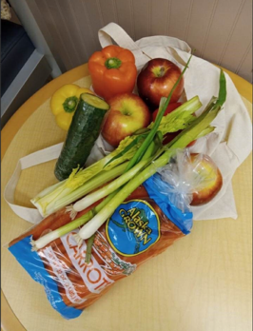





Slide 50
Closing Announcements
All Alaska Pediatric Partnership & Help Me Grow Alaska

Slide 51








Help Me Grow Alaska is an agency dedicated to promoting healthy child development across Alaska by providing support and information to individuals and organizations who care for and about children, youth, and adults ages prenatal-26. Whether you are a parent, provider, teacher, or other caregiver with questions or concerns about a child in your life, we are here to help you.
Our call center is staffed with Family Support Specialists, individuals with experience in, and an understanding of, child development, social services, and resources available in Alaska and beyond. They are available to listen to concerns, help organize a path forward, and get families connected to the most available and appropriate service across Alaska.
To order materials scan the QR code or visit:
a2p2.org/help-me-grow-alaska/

Slide 53


Save the Date!

Slide 54
Thank you for joining!
Special thanks to BBAHC for hosting the September Partnership Meeting
BBNA Headstart for hosting the Dillingham Children’s Fair
All the agencies who welcomed A2P2 & Help Me Grow Alaska for conversations, connections, and opportunities to learn more about the impactful working happening in Dillingham and the Bristol Bay Region for children, youth, and families!
We value your partnerships with one another!

Slide 55
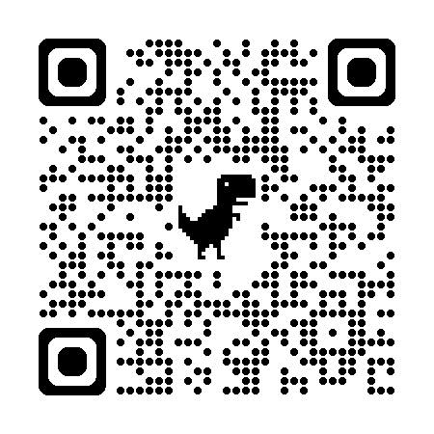
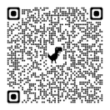
Thank you for joining this months Partnership Meeting!
Stay informed!
Scan the QR code and sign up to the All Alaska Pediatric Partnership’s mailing list.
Partnership Meeting resources and presentations from recent meetings are available on the
All Alaska Pediatric Partnership (A2P2) website a2p2.org

