Slide 1

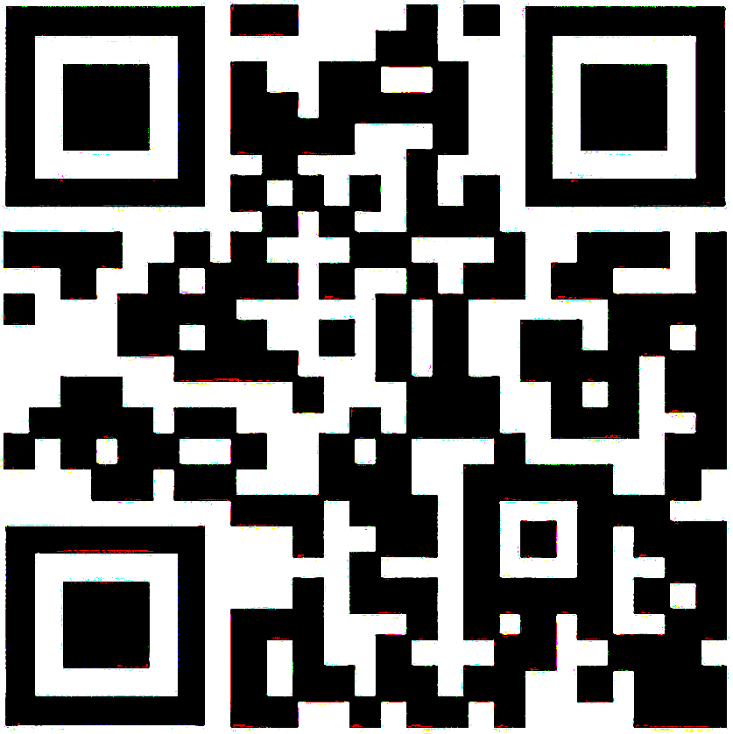

February Partnership Meeting
Juneau, Alaska
Friday, February 6, 2026
12:00-1:30 pm
Presented by the All Alaska Pediatric Partnership (A2P2).
A2P2 transforms systems of care and increases equitable access to health care and related services to ensure all Alaska’s children reach their full potential.
Learn more at a2p2.com or by scanning the QR code

Slide 2

Agenda
Welcome!
Announcements
Tamar Ben-Yosef, All Alaska Pediatric Partnership
Presentations
Lindsey Kato, State of Alaska Dept. of Health & Social
Renee Escamilla, State of Alaska, EMS Services for Children
Nikki Love, Southeast Childhood Collective
Christy Doyon, Juneau Alliance for Mental Health, INC. (JAMHI)
Niamh Dardis, Infant Learning Program, REACH
Dr. Amy Dressel, Bartlett Glacier Pediatrics
Heidi Richardson-Mazon, SEARHC Home Visiting

Slide 3


Welcome! Lindsey Kato State of Alaska Department of Health and Social Services Division of Public Health
Juneau sunset amongst the beautiful snow: Ella Nadine Photo

Slide 4
Introductions
Name, Role, Agency
Online: Name, Community, Role, Agency

Slide 5
Announcements
Tamar Ben-Yosef, All Alaska Pediatric Partnership

Slide 6


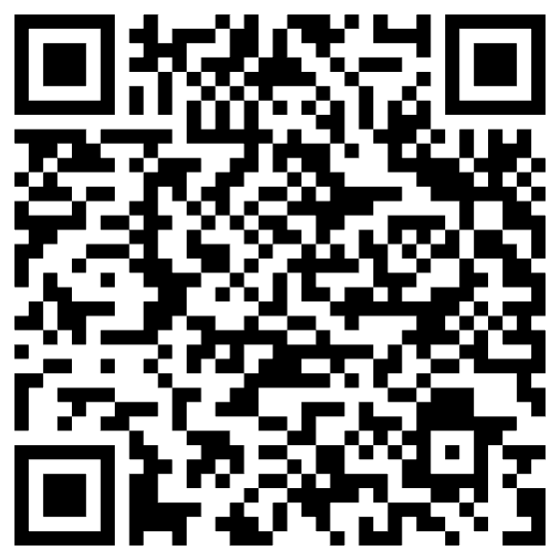

For 30 years, A2P2 has brought together private, public, and tribal partners to improve the health and wellbeing of Alaska’s children. From shaping the state’s first pediatric subspecialty clinics to leading efforts in provider education, early childhood systems, and family support through Help Me Grow Alaska, our work is built on collaboration and care. As we celebrate this legacy, we invite you to help carry it forward. Your gift supports A2P2's work on behalf of Alaska’s children, families, and the communities they are part of.
Notes:
Put link in chat: https://secure.givelively.org/donate/all-alaska-pediatric-partnership/a2p2-30th-anniversary

Slide 7




NEW PROGRAM!!!
Are you a professional working with young children not currently able to access Infant and Early Childhood Mental Health (IECMH) Consultation, including Family, Friend and Neighbor care, home visiting, early intervention, medical or social service providers?
Growing Minds offers support for providers in nurturing young children’s social and emotional development and to enhance the quality of care for children from birth through five years old across settings. This is a non-emergency service for providers to receive guidance on their practice or to ask questions about a specific concern in their professional setting.
Call 1-833-HMG-ALASKA (1-833-464-2527) today and ask to be connected with Growing Minds!
or visit helpmegrowak.org/growing-minds
The Health Resources and Services Administration (HRSA), Department of Health and Human Services (HHS) provided financial support for this publication. The award totaled $3,057,637.00 and contents may not reflect the policies of HRSA, HHS, or the U.S. Government.

Slide 8



Slide 9
Lindsey Kato
State of Alaska Department of Health & Social Services, Division of Public Health

Slide 10
Renee Escamilla
State of Alaska, EMS Services for Children

Slide 11

Alaska Emergency Medical Services for Children
Notes:
Hi, my name is…
I work for… Alaska DOH/DPH/SRCHS – Office of EMS – based out of Juneau.
I am the Alaska EMS for Children State Partnership Program Manager.

Slide 12

What is EMSC?
Only federal program focused on pediatric emergency readiness
Goal: improve hospital & EMS care for kids – better patient outcomes!
Focus: equipment, training, policies, family-centered care, *disaster prep
This project is supported by the Health Resources and Services Administration (HRSA) of the U.S. Department of Health and Human Services (HHS) as part of an award totaling ~$174,650 with 0% financed with non-governmental sources. The contents are those of the author(s) and do not necessarily represent the official views of, nor an endorsement, by HRSA, HHS, or the U.S. Government. For more information, please visit HRSA.gov.
Notes:
EMSC is a national initiative (federal grant) funded through the Health Resources and Services Administration.
It is the only federally funded program dedicated solely to improving emergency care for kids.
Other federal efforts touch on children as part of broader emergency planning, but
EMSC is the one program whose entire mission is pediatric readiness.
Goal: Improve pediatric patient outcomes by ensuring readiness across EMS and emergency departments.
Focus: equipment, training, policies, family-centered care, *new focus- disaster prep

Slide 13
What is Pediatric Readiness? https://emscimprovement.center/domains/pediatric-readiness/
Notes:
Pediatric Readiness is ensuring that every EMS and fire-rescue agency and emergency department (ED) has the pediatric-specific champions, competencies, policies, equipment, and other resources needed to provide high-quality emergency care for children.

Slide 14
Why EMSC Matters in Alaska
Vast distances, remote communities, limited specialists
Children have distinct clinical needs in emergencies
Small hospitals & volunteer EMS crews are the front line — not pediatric specialists
Pediatric emergencies are low-volume, high-acuity
EMSC works to ensure our hospitals and EMS providers are prepared when they do
For references, visit https://bit.ly/pedsreadyimpact
Notes:
Alaska’s geography creates unique challenges—many communities are only accessible by air or water, with longer response times
Children have distinct clinical needs in emergencies, yet more than 80% receive care in general emergency departments and small hospitals/clinics, not pediatric specific facilities.
Pediatric incidents account for approximately 10% of all prehospital calls.
The limited frequency of pediatric interactions results in clinicians being less familiar with – and often less confident in – providing pediatric care.
4. Being Pediatric Ready can reduce anxiety and increase confidence. Related research suggests it may also improve patient outcomes.

Slide 15
What Alaska EMSC is Doing
Hospitals: Preparing for 2026 Pediatric Readiness assessment; Recognizing excellence in pediatric readiness
EMS: Reviewing baseline readiness scores; Developing Ambulance “PedsReady” program; Offering a medication dosing app – 5,000+ EMS calls supported last year; Sharing a training IO pediatric leg kit & matrix recipe
Families: Providing home emergency care support tools
Notes:
In hospitals, preparing hospitals for the 2026 pediatric readiness assessment, which measures how well emergency departments are equipped to care for children.
Alaska EMSC has a long-standing Pediatric Facility Recognition Program that highlights hospitals who are dedicated to pediatric emergency care. Several facilities have already earned recognition, and we continue to encourage others to participate. If your facility isn’t yet recognized, this is a proven way to demonstrate excellence and join those already leading the way.
In EMS, we are reviewing baseline readiness scores across the state and will soon develop an Ambulance ‘PedsReady’ program. This program will be similar to the Facility Recognition Program for hospitals.
We’re using technology—like the Handtevy mobile app—that helps providers calculate doses and run resuscitations safely for kids -- and adults. Last year alone, it was used in more than 5,000 calls across Alaska, including nearly 3,000 pediatric emergencies.
We also have a Manikin Extremity Matrix Kit that we share with Emergency Medical Care instructors to utilize for clinician skills training and practice.
For families, we’re creating tools that support care at home—especially for children with complex medical needs who are transitioning home from the hospital.
Together, these efforts are raising the standard of care for kids across Alaska—whether they show up in an emergency department, call 911, or need support at home.

Slide 16
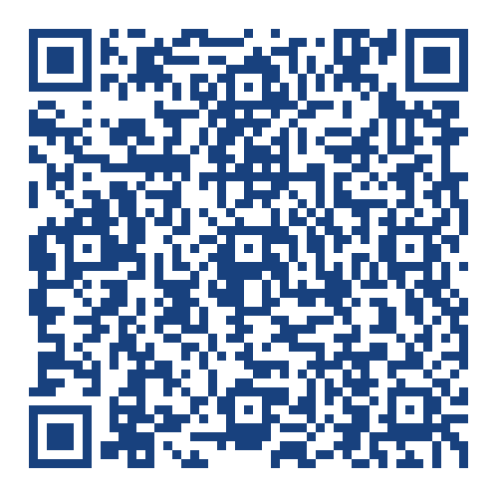
EMSC Needs Your Help 1 of 2
Upcoming National Pediatric Readiness Assessment for our Emergency Departments launches March 3rd
Share information with hospital leaders [download flyer]
Notes:
EMSC needs your support to help hospital emergency departments prepare for the upcoming National Pediatric Readiness Assessment launching March 3rd—full participation from all Alaska hospitals is critical to accurately reflect pediatric readiness statewide.
1. The assessment gives each ED a personalized score, national benchmarking, and a tailored gap report.
2. Invitations typically are sent to ED nurse managers, who should coordinate with their team—including the ED medical director, pediatric emergency care coordinators (PECCs) and trauma program staff—to ensure accurate responses.
3. Only one assessment can be completed per ED.
4. National assessment periods generally occur only every five years, so we don’t want to miss this chance for Alaska to participate!

Slide 17
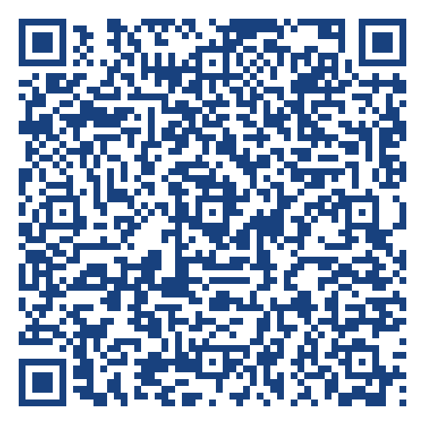
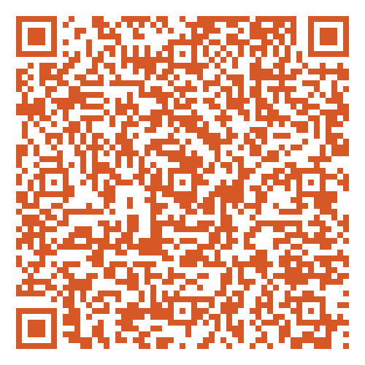
EMSC Needs Your Help 2 of 2
Support medically complex children transitioning home by bridging communication between families and EMS.
Share the parent brochure and home information form
Connect EMSC with associated organizations that aid in helping families come home from the hospital
Brochure
Home Information Form →
Notes:
Medically complex children who are discharged home from the hospital occasionally get sent home with complex devices and medications.
In these cases families and caregivers are the given many tools to succeed in home care. What happens though when this care is expended, stretched thin, or something out of the ordinary happens? Whether it is an adverse reaction to medications or a device failure.
To better support families; prevent unnecessary transfers; and improve kid-centered care for our medically complex kids EMSC has developed a parent brochure to help connect emergency professionals with these families before an emergency happens.

Slide 18
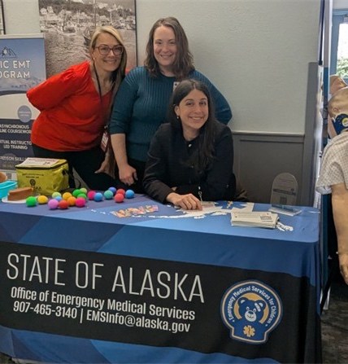
Thank you!
Renée Escamilla
907-465-5467
AlaskaEMSC@alaska.gov

Slide 19
Nikki Love
Southeast Childhood Collective

Slide 20

SOUTHEAST
Chilhood Collective
SUPPORTING FAMILIES, BUILDING CHILD CARE
www.childhoodcollective.org

Slide 21
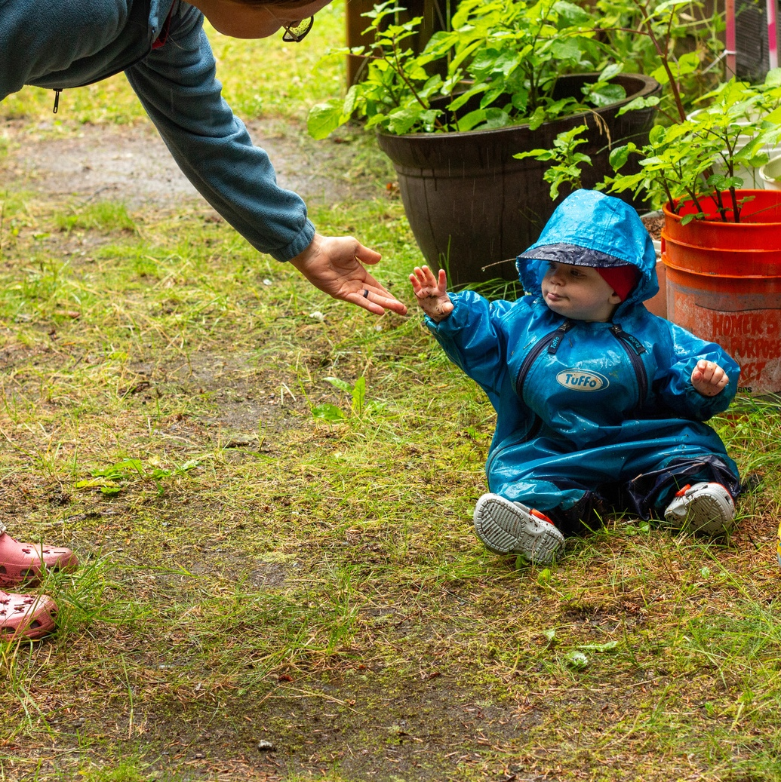
ABOUT US
Southeast Childhood Collective, known originally as AEYC, was established in 1982.
We are a Child Care Resource & Referral organization for Southeast Alaska.
In 2025, we adopted our new name to reflect the collective of programs and partnerships.
We have a long history of strong fiscal stewardship and administer a variety of grants that support families, children, and childcare providers.

Slide 22
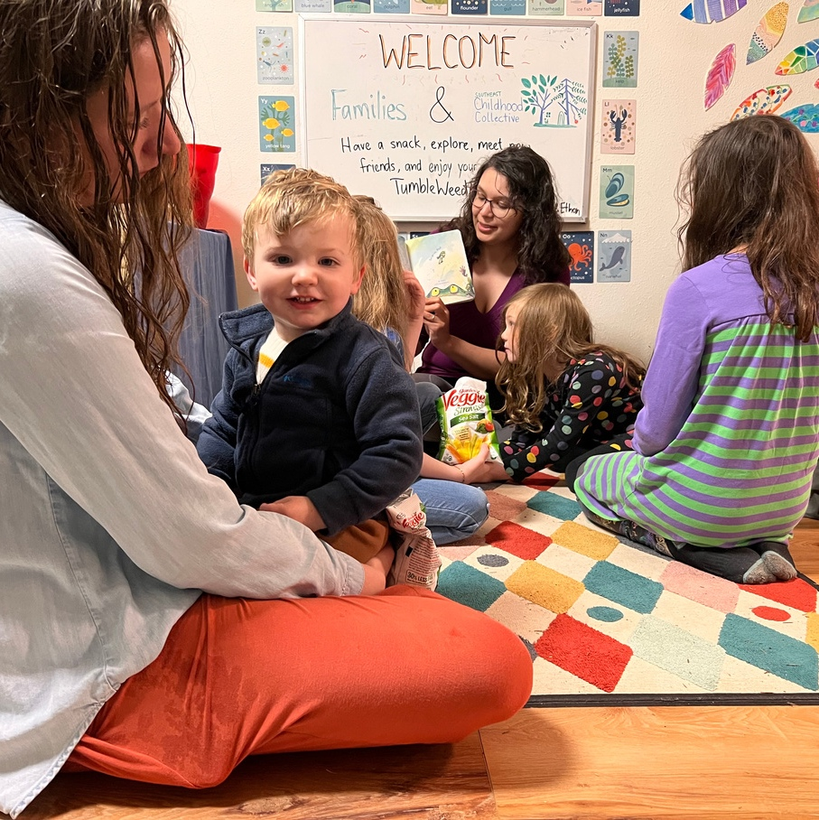
HOW WE WORK
Focus on Families
Families and children are central to our mission. We provide a range of programs designed to support families in raising their children.
Early Educator and Provider Support
Through training opportunities, the apprenticeship program, and grants from the City and Borough of Juneau, we strengthen the system of care for young children.
Community Collaboration
We foster strong inter-agency partnerships to boost the early childhood system.

Slide 23

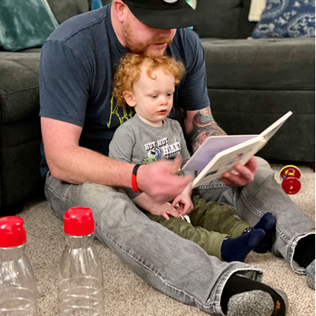
PARENTS AS TEACHERS
Personalized Home Visits
Group Opportunities
Other services such as the diaper bank, sleep consultation, and postpartum doula services

Slide 24
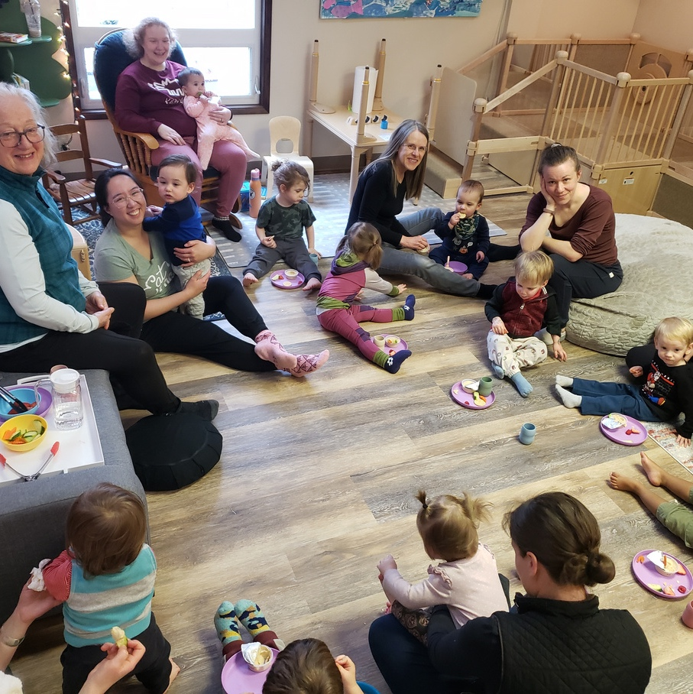
5 Home visitors
152 families
191 Children
70 families on the waiting list
Over 1200 individual, personalized home visits
54% of families reported at least 1 stress indicator (low income, substance use, death in immediate family, child protective involvement, parent mental health issues, child disability or chronic health condition, etc)
2025 HIGHLIGHTS

Slide 25
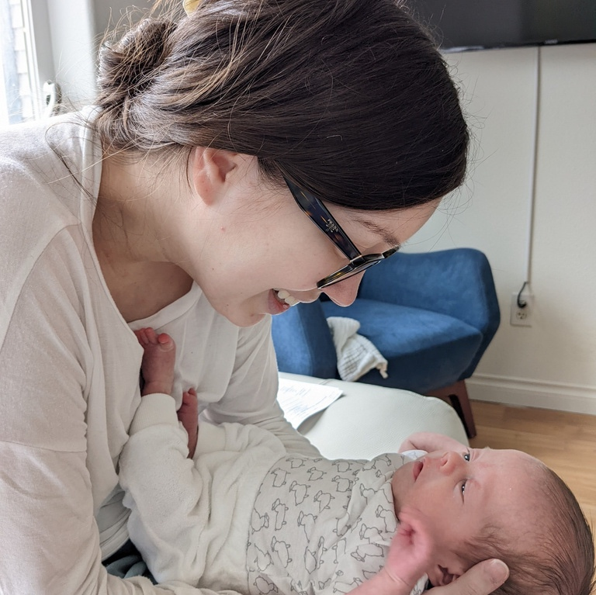
PARENTS AS TEACHERS:
4TH TRIMESTER PROGRAM
Weekly home visits during the first three months postpartum
Immediate support while families are on the waiting list
A bridge to enrollment into the full three-year Parents as Teachers program
Guidance focused on early adjustment, parent–infant connection, and stabilization
Invitation to all group events

Slide 26
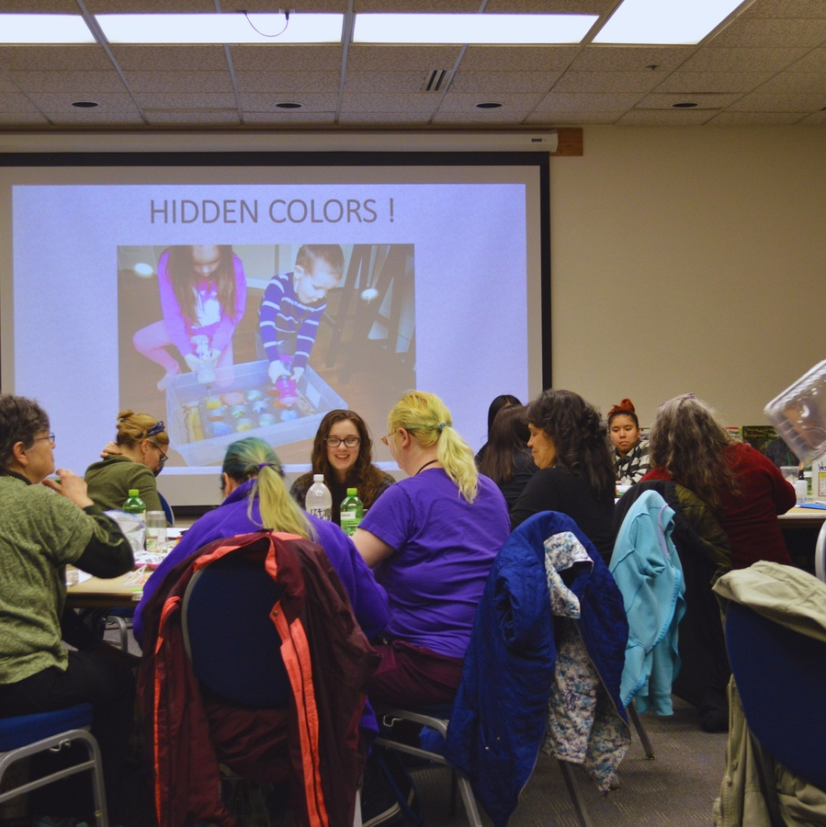
EARLY EDUCATOR & PROVIDER SUPPORT
Monthly childcare operating grants
Childcare Apprenticeship Program
Circles of Security in the Classroom
Cultural and literacy-focused coaching
Annual Early Childhood Conference

Slide 27
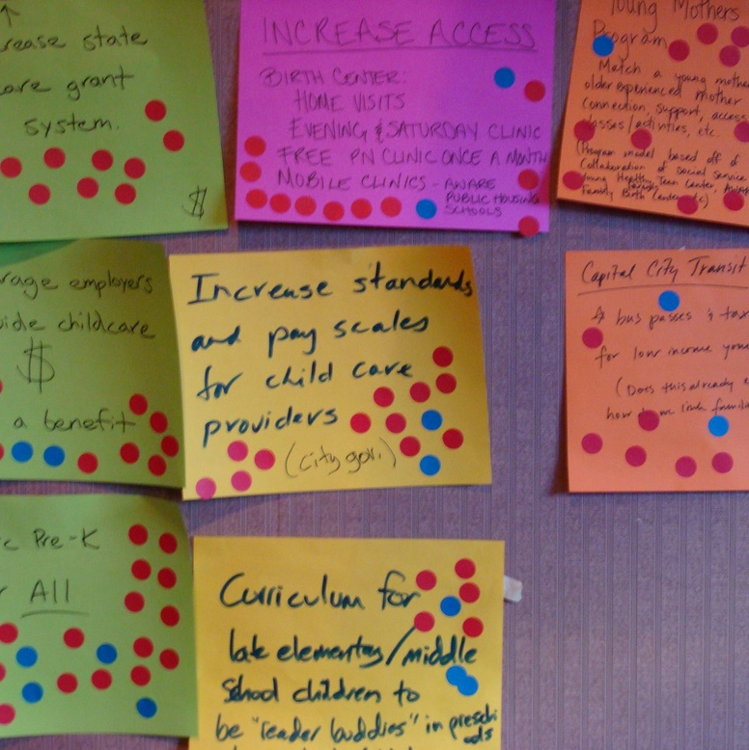


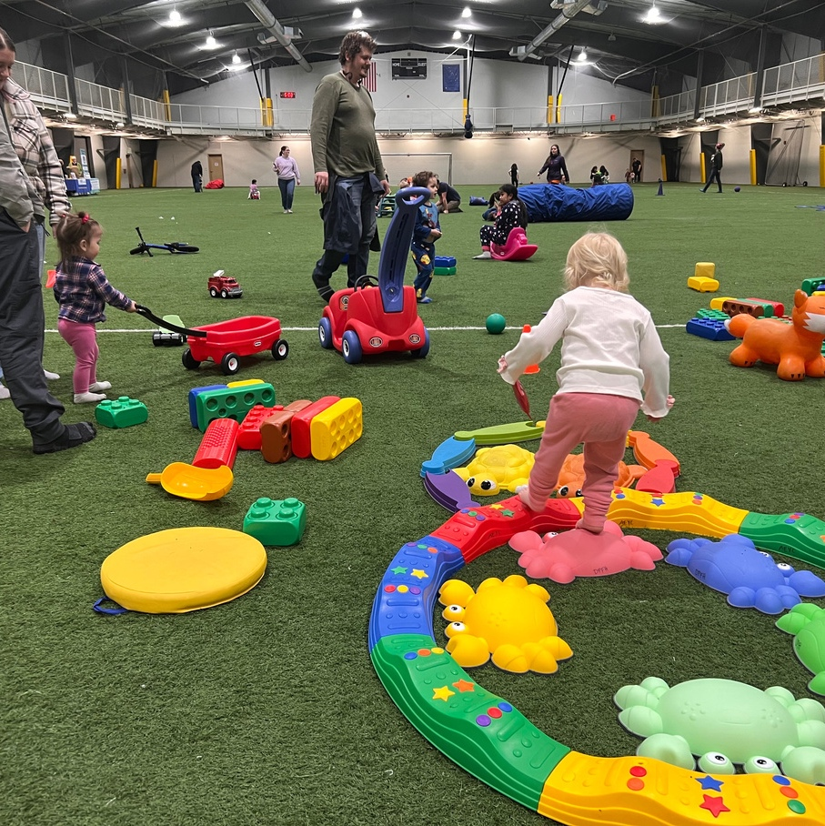
PARTNERSHIPS FOR FAMILIES & CHILDREN
20+ local, tribal, and statewide partners
Shared planning and coordination
Focus on kindergarten readiness and early literacy

Slide 28
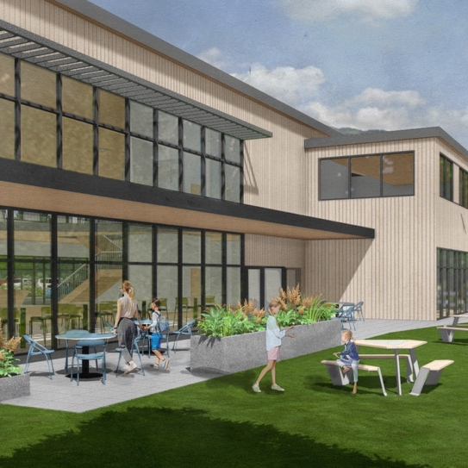
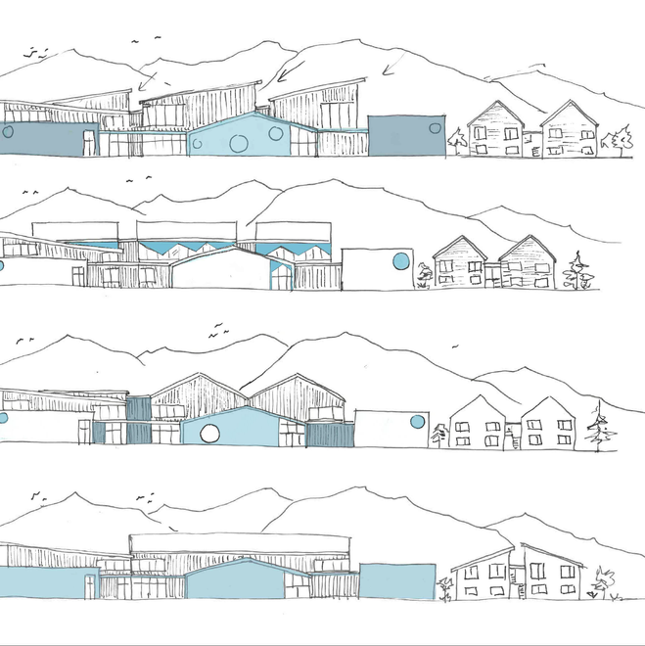
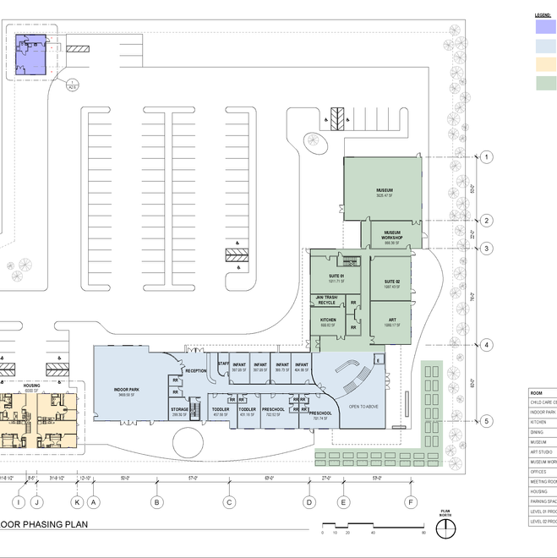
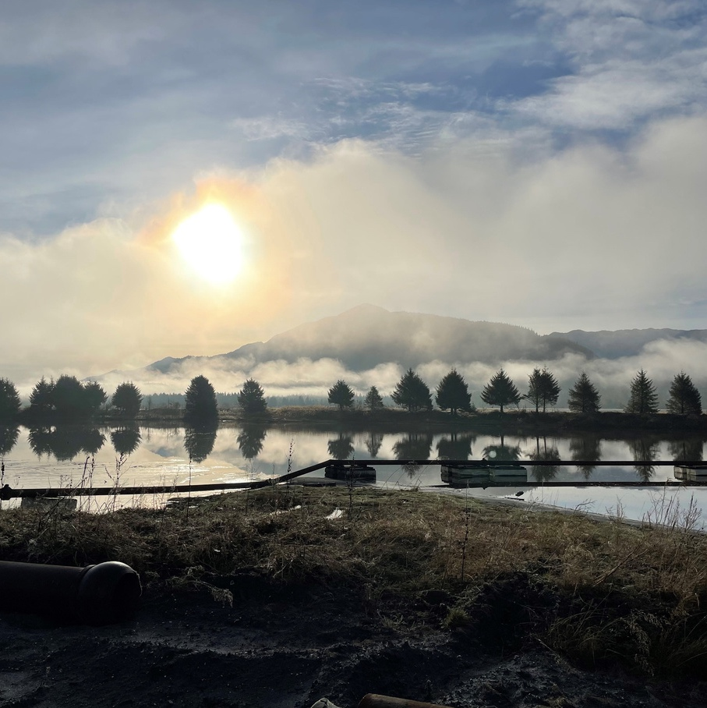
FAMILY & CHILD CARE CENTER
Hub for care, training, and family support
Built on coordinated, proven work
Site ownership secured
Feasibility study completed
Pro forma developed at 35% design
Capital campaign in developent

Slide 29

CONTACT US
Call
1-907-789-1235
Email
nlove@childhoodcollective.org
info@childhoodcollective.org
Address
3200 Hospital Dr., Ste. 204
Juneau, AK 99801

Slide 30
Christy Doyon
Juneau Alliance for Mental Health, Inc (JAMHI)

Slide 31

PHONE:
WEBSITE:
ADDRESS:
907-463-3303
www.jamhihealthandwellness.org
3406 Glacier Hwy., Juneau, AK 99801
2705 Jordan Ave., Juneau, AK 99801

Slide 32
Integrated Behavioral Health Services
Primary Care Services
Behavioral Health Services
Child Wellness Visits
Family Planning Services
Health Education & Coaching
Health Screenings
Pregnancy & Birth Care
Preventive Dental Care
Primary Medical Care
Vaccines & Immunizations
Women’s Health Services
-Psychotherapy:
Individual and Groups
-Case Management
-Substance Use Services:
ASAM Level 0.5, 1.0, and 2.1
-Medication Management and Medication-Assisted Treatment
-24/7 Emergency Services
-JASAP
-Community Health Supportive Services
08
Marketing
Channel
03

Slide 33

...and JAMHI Family
JAMHI Family provides individual and group psychotherapy to children and adolescents, as well as family therapy services to our youth clients.
Some of the treatment modalities utilized by JAMHI Family clinicians include:
Play Therapy
Trauma-Focused Cognitive Behavioral Therapy
Trauma and Grief Component Therapy for Adolescents
JAMHI Family also provides case management services to our clients.
Services offered by JAMHI Family case managers include:
Connection to community resources
School supports, such as IEP advocacy
Skill Building and parenting classes
Peer Support

Slide 34
JAMHI Family
Who we serve:
Children and adolescents age 5 to 18 years old, (and their families), who have emotional disturbances and severe emotional disturbances
JAMHI Family referrals primarily come from OCS, school counselors, primary care and psych providers, DJJ, and parents/guardians.

Slide 35

Any questions?

Slide 36
Niamh Dardis
Infant Learning Program, REACH

Slide 37
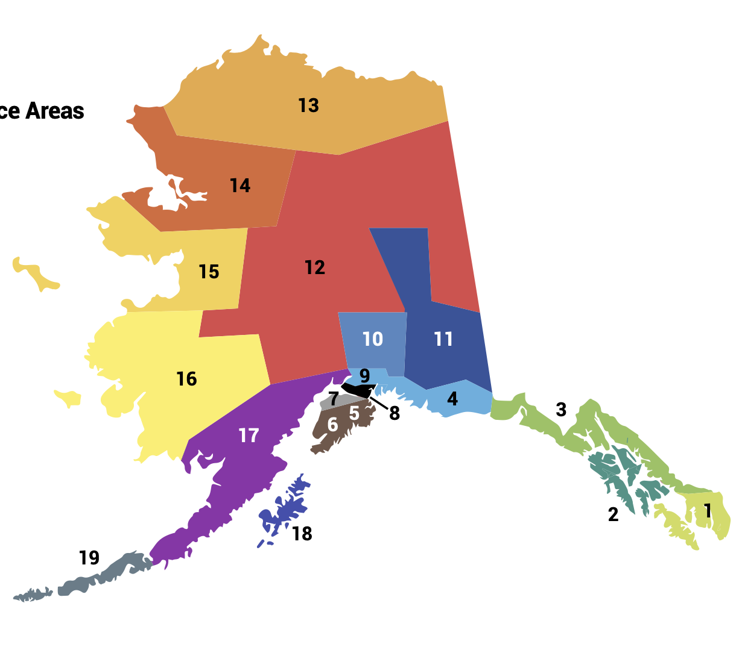

AK ILP Network
ILP Grantees provide services throughout the state
15 Regional contracted providers
1800+ families served each year

Slide 38

The Basic Idea
Specific Changes
Expected Outcomes
Increase the ILP budget by $5.72M from general funds
… to align Part C ILP eligibility with Part B special education;
… to avoid delay in services for AK children with developmental delay between 25%-50%;
… to invest earlier in life for the sake of substantial impact and savings across the lifespan
Change the eligibility threshold in the ILP statute from 50% to 25% delay – Alaska currently has the most restrictive eligibility criteria in the nation.
77% more children receiving services
ILP recipients have improved health outcomes and cost the state less in future services.
Regularly update the list of eligible conditions and develop supporting workflows to make it easier to use.
46% of children who receive ILP services achieve age-typical development (don’t need special ed support in K-12).
Make supporting changes to the Medicaid statute
… add new ILP provider type and reimburse for all ILP services
… allow the IFSP as an authorizing document for Medicaid coverage
Increased funding, improved rates and supports that make billing easier allow for more effective and sustainable ILP services for AK children.

Slide 39
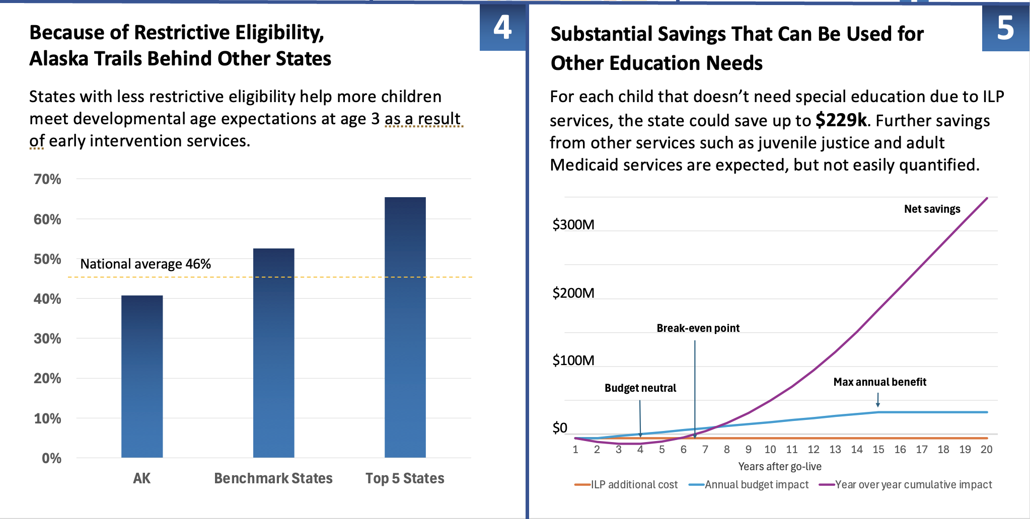
Percent of children in ILP that achieve age typical development by age 3.

Slide 40
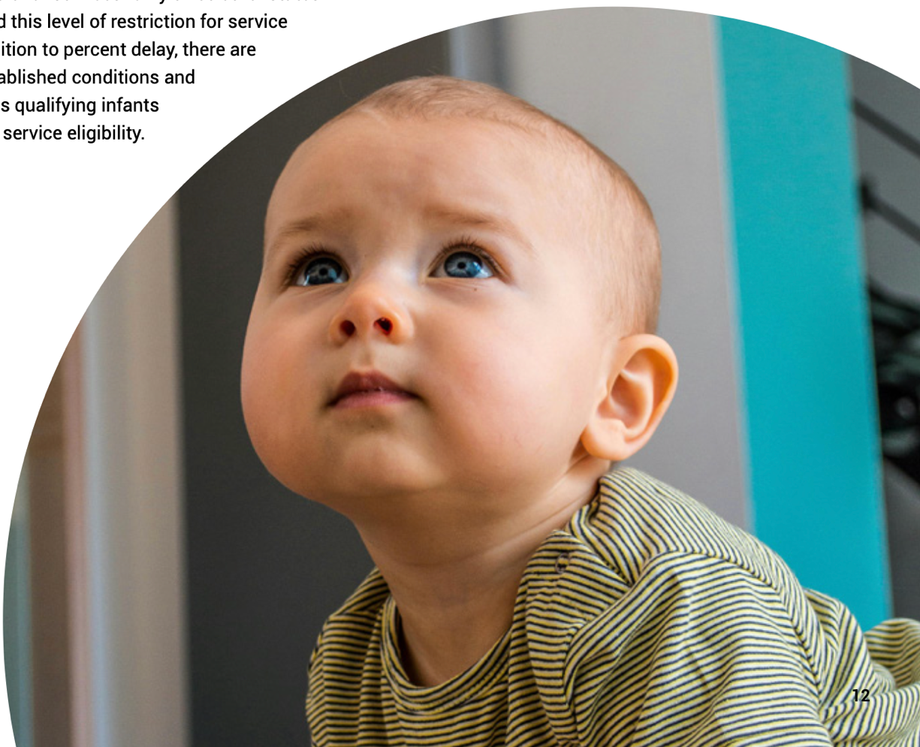
Take-Away: Invest in the People of Alaska​
Approve expanded eligibility and additional $5.7M funding for AK ILP.​
Ensure all Alaskan children have equitable access to early intervention services.​
ROI: Early intervention saves up to $229K per child just in special education costs. Annual cost savings up to $34.9M

Slide 41
Dr. Amy Dressel
Bartlett Glacier Pediatrics

Slide 42
Heidi Richardson-Mazon
SEARHC Home Visiting

Slide 43


HOME VISITING
Notes:
https://www.canva.com/design/DAGt6K3dEL4/ju09Dt6r76U9_jtqEayWKg/watch?utm_content=DAGt6K3dEL4&utm_campaign=designshare&utm_medium=link2&utm_source=uniquelinks&utlId=h1537db0193

Slide 44




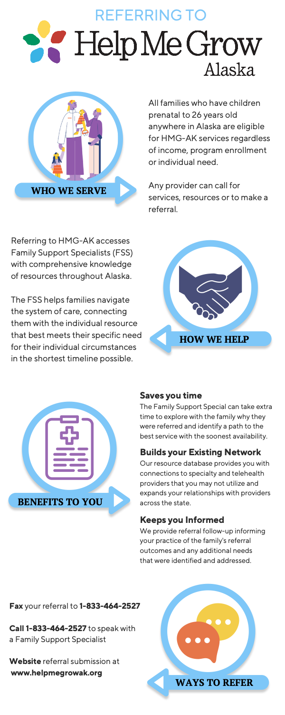
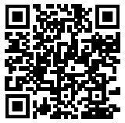
Help Me Grow Alaska is an agency dedicated to promoting healthy child development across Alaska by providing support and information to individuals and organizations who care for and about children, youth, and adults ages prenatal-26. Whether you are a parent, provider, teacher, or other caregiver with questions or concerns about a child in your life, we are here to help you.
Our call center is staffed with Family Support Specialists, individuals with experience in, and an understanding of, child development, social services, and resources available in Alaska and beyond. They are available to listen to concerns, help organize a path forward, and get families connected to the most available and appropriate service across Alaska.
To order materials scan the QR code or visit:
a2p2.org/help-me-grow-alaska/

Slide 47
Thank you for joining!
Special thanks to the State of Alaska Department of Health for hosting the February Partnership Meeting
To the providers and colleagues who presented: Thank you so much for all your meaningful connections, impactful partnerships, and for actively listening to your community to support their needs. Your actions, hopes, and continued partnerships are an inspiration to many!
Thank you!

Slide 48
Notes:
Put link in chat: https://secure.givelively.org/donate/all-alaska-pediatric-partnership/a2p2-30th-anniversary

Slide 49
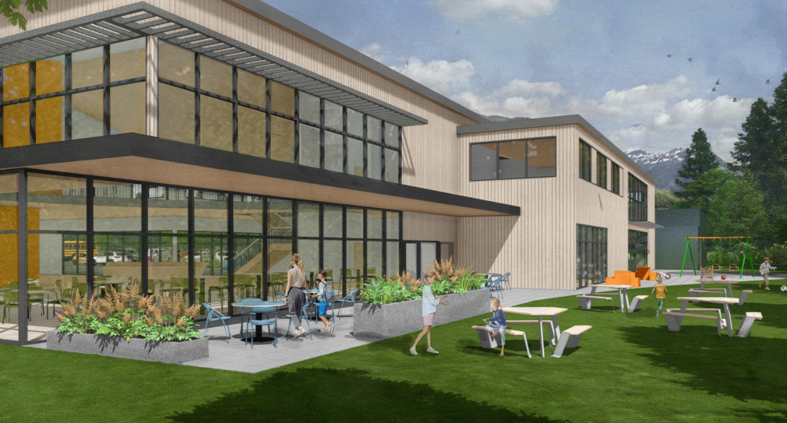
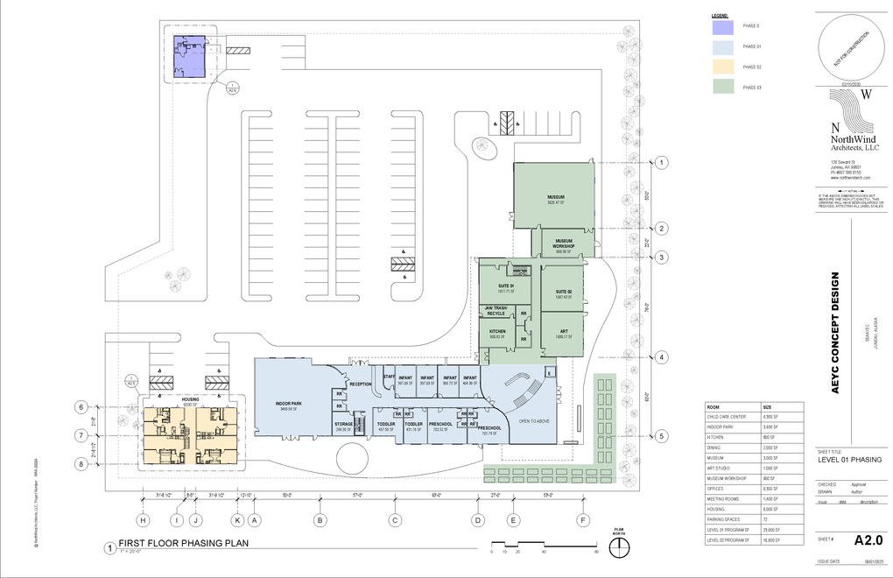
Thank you for joining this months Partnership Meeting!
Stay informed!
Scan the QR code and sign up to the All Alaska Pediatric Partnership’s mailing list.
Partnership Meeting resources and presentations from recent meetings are available on the
All Alaska Pediatric Partnership (A2P2) website a2p2.org

Slide 53


Slide 54


