Slide 1



March Partnership Meeting
Anchorage, Alaska
Friday, March 6, 2026
12:00-1:30 pm
Presented by the All Alaska Pediatric Partnership (A2P2).
A2P2 transforms systems of care and increases equitable access to health care and related services to ensure all Alaska’s children reach their full potential.
Learn more at a2p2.com or by scanning the QR code

Slide 2

Agenda
Welcome!
  Thea Agnew Bemben, Municipality of Anchorage
Announcements
  Tamar Ben-Yosef, All Alaska Pediatric Partnership
Presentations
  Kim Rash, Anchorage Health Department
  Dr. George Conway & Dr. Kristin VanderEnde, Anchorage Health Department
  Katie Stodgell, Anchorage Health Department
  Amanda Johnson, North Start Behavioral Health
  Christina Hulquist, Anchorage Early Care and Education Fund
  Carmen Wenger & Toni Rae Osiecki, Growing Minds
  Heidi Huppert, Covenant House Alaska
  Amie Collins & Amy Simpson, Anchorage Early Childhood Coalition

Slide 3





Welcome!
Thea Agnew Bemben
Municipality of Anchorage,
Office of Mayor LaFrance
Anchorage, Alaska

Slide 4
Announcements
Tamar Ben-Yosef
A2P2 Executive Director

Slide 5


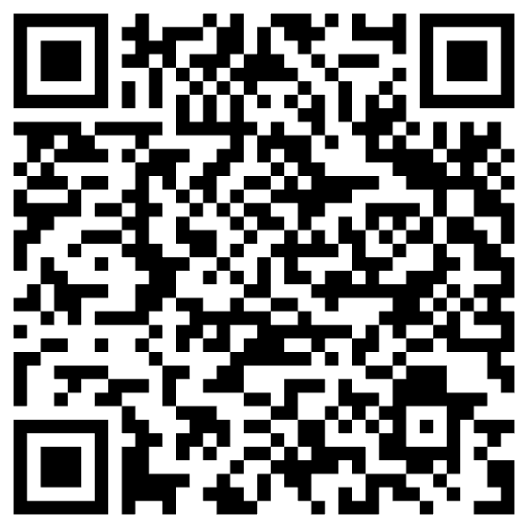

For 30 years, A2P2 has brought together private, public, and tribal partners to improve the health and wellbeing of Alaska’s children. From shaping the state’s first pediatric subspecialty clinics to leading efforts in provider education, early childhood systems, and family support through Help Me Grow Alaska, our work is built on collaboration and care.
As we celebrate this legacy, we invite you to help carry it forward. Your gift supports A2P2's work on behalf of Alaska’s children, families, and the communities they are part of.
Notes:
Put link in chat: https://secure.givelively.org/donate/all-alaska-pediatric-partnership/a2p2-30th-anniversary

Slide 6



Slide 7


Slide 8

Kim Rash
Deputy Director
Anchorage Health Department

Slide 9
Dr. George Conway,
Chief Medical Officer
&
Dr. Kristin VanderEnde,
Epidemiologist
Anchorage Health Department

Slide 10


Clinical Services Division
Dr. George Conway, Chief Medical Officer
Kristin VanderEnde, PhD, Epidemiologist

Slide 11
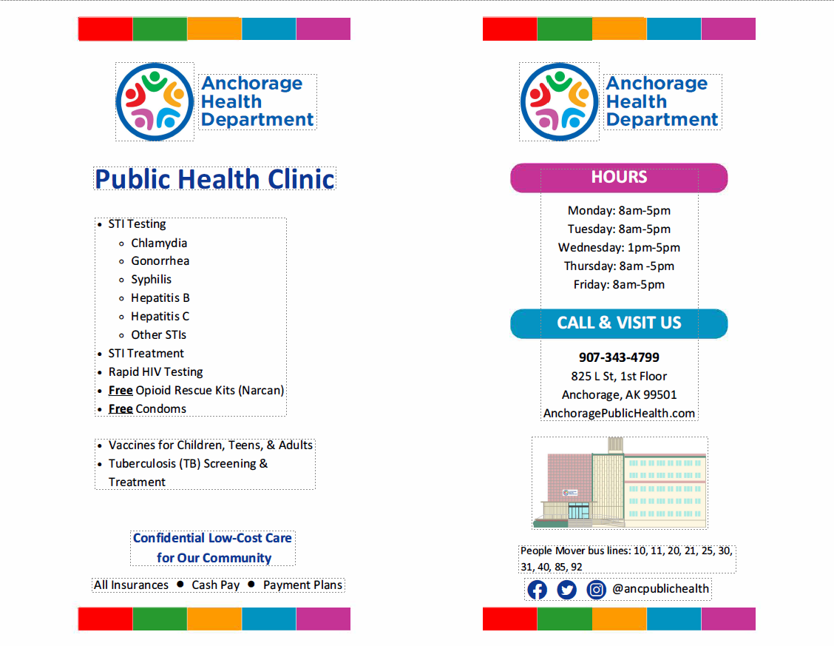

Slide 12
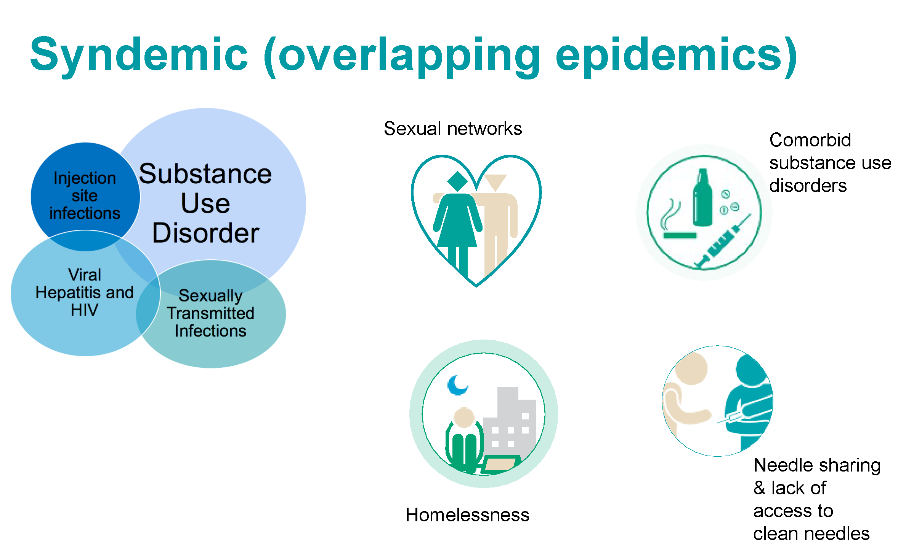

Slide 13



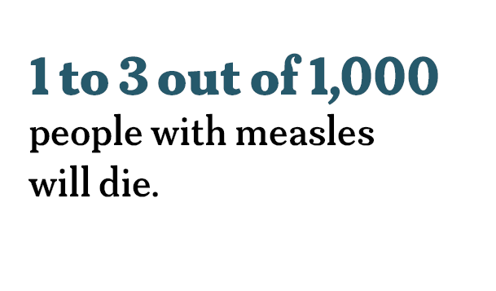
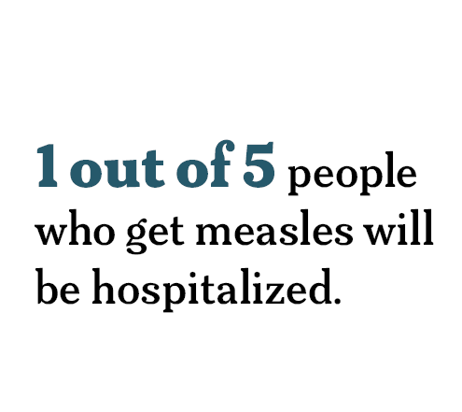
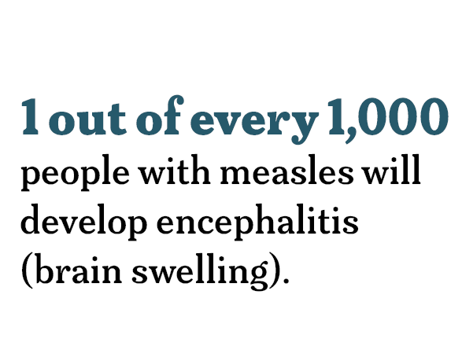
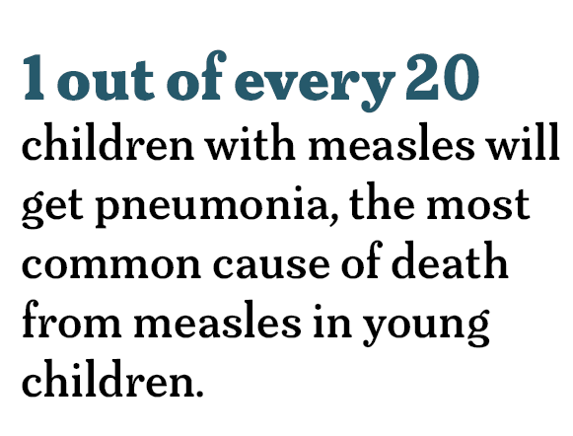
  Measles can be serious
Notes:
Specifically, 1 of 5 people who get measles will be hospitalized.

Slide 14
  Measles is preventable
The Measles, Mumps, Rubella (MMR) vaccine provides strong protection, with 97% effectiveness after two doses.
A single dose of MMR is 93% effective.
Vaccinated individuals are less likely to experience severe disease.
Notes:
After infection, individuals typically have lifelong immunity to measles.
The MMR vaccine provides strong protection, with 97% effectiveness after two doses.
A single dose of MMR is 93% effective.
Vaccinated individuals are less likely to experience severe disease.

Slide 15
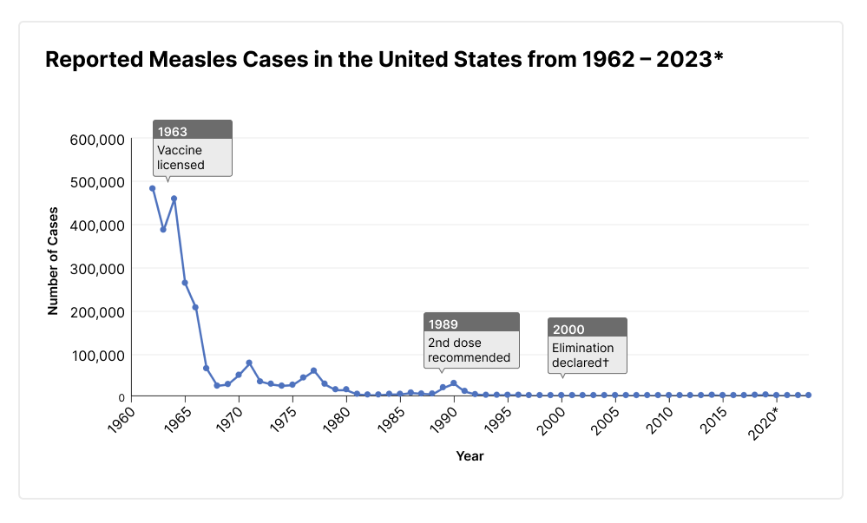
Qualitative Data
  Historical perspective – United States
Source: CDC

Slide 16
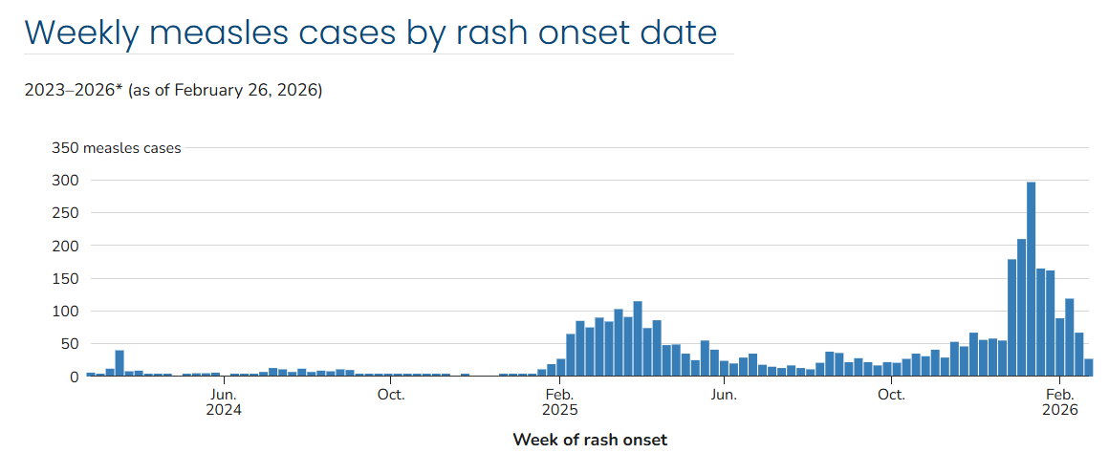
  U.S. measles cases 2023 to 2026*
Source: CDC, *data as of February 27, 2026

Slide 17
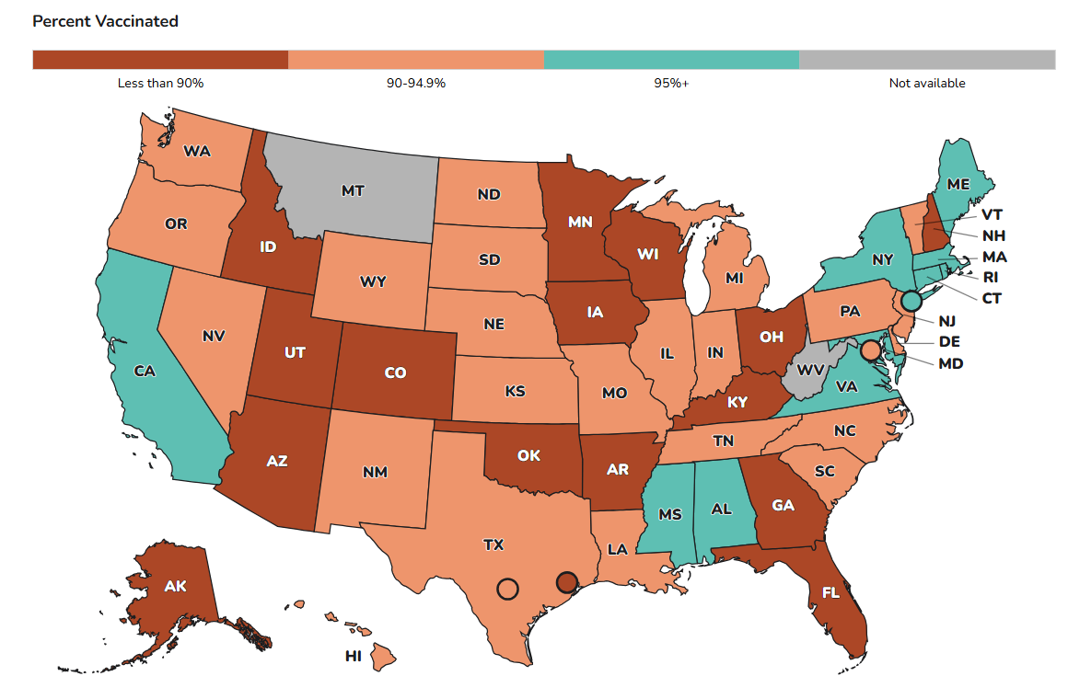
Qualitative Data
  MMR vaccine coverage for kindergarteners 2024-25
Alaska has second lowest vaccination rate – 81.2%. Only Idaho is lower (78.5%).
Source: CDC
Notes:
We know that low vaccination rates are a risk factor for measles outbreaks. Here is a map showing coverage for kindergarteners for 2024-25. This shows 2-dose MMR coverage for kindergarteners in 2024-25.
Alaska’s coverage is 81.2 – the second lowest of all states. To note, 95% coverage is the goal for herd immunity and to prevent outbreaks.

Slide 18
  Measles – the role of AHD
Identify measles cases – coordinate for laboratory testing
Coordinated response with State of Alaska, Anchorage School District, and Community Partners
Identify those at risk and offer post-exposure prophylaxis when appropriate
Continue focus on prevention – immunization
Building community trust is critical. We look forward to connecting with you on ways we can work on this together.

Slide 19
Katie Stodgell
Public Health Division Manager
Anchorage Health Department

Slide 20

WIC Program Update
Women, Infants & Children — Anchorage Health Department
A2P2 March Partnership Meeting | March 6, 2026
www.muni.org/health

Slide 21
What Is WIC?
Federally-funded nutrition & support program serving Anchorage families
WHO WE SERVE
WHAT WIC PROVIDES
Pregnant women
Postpartum & breastfeeding women (up to 1 year)
Infants up to 12 months
Children up to age 5
Monthly food benefits via eWIC card
Infant formula support
Breastfeeding peer counseling
Nutrition education & health screenings
Referrals to healthcare & social services
Anchorage Health Department | WIC Program | muni.org/health

Slide 22
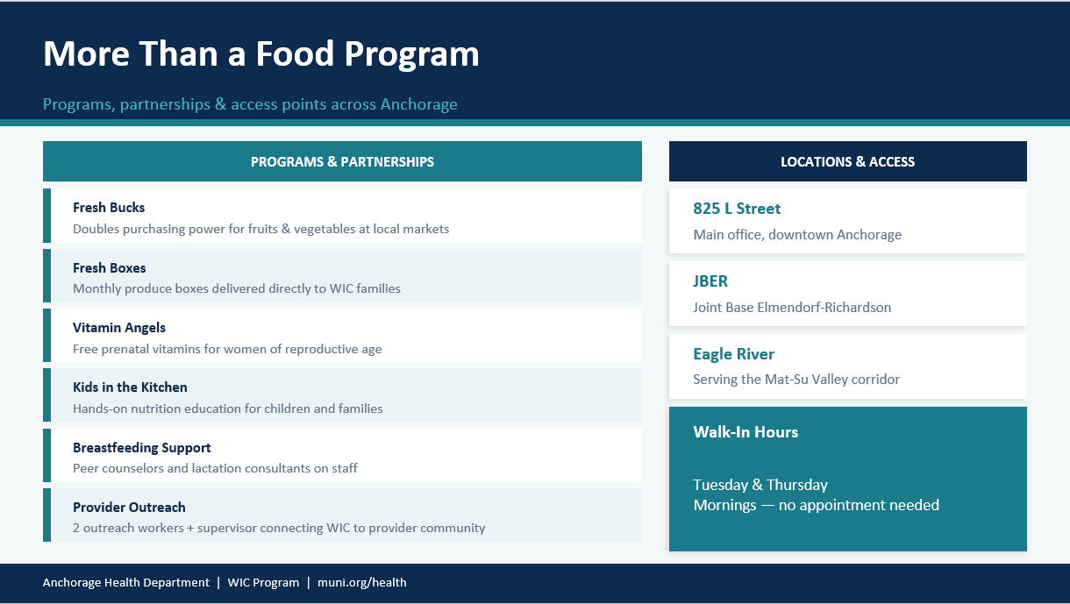

Slide 23
WIC in Anchorage: Who We're Serving
AHD WIC Program - current snapshot
~4,200
52%
5
Anchorage households
served annually
of state-mandated
participation goal currently met
program areas:
food, education, BF support,
screenings, referrals
Why it matters: WIC is currently serving about half of the eligible families in our community. That means thousands of Anchorage children and mothers who qualify aren't yet connected to the nutrition support, screenings, and referrals they need, and that's where your partnerships become essential.
Anchorage Health Department | WIC Program | muni.org/health

Slide 24
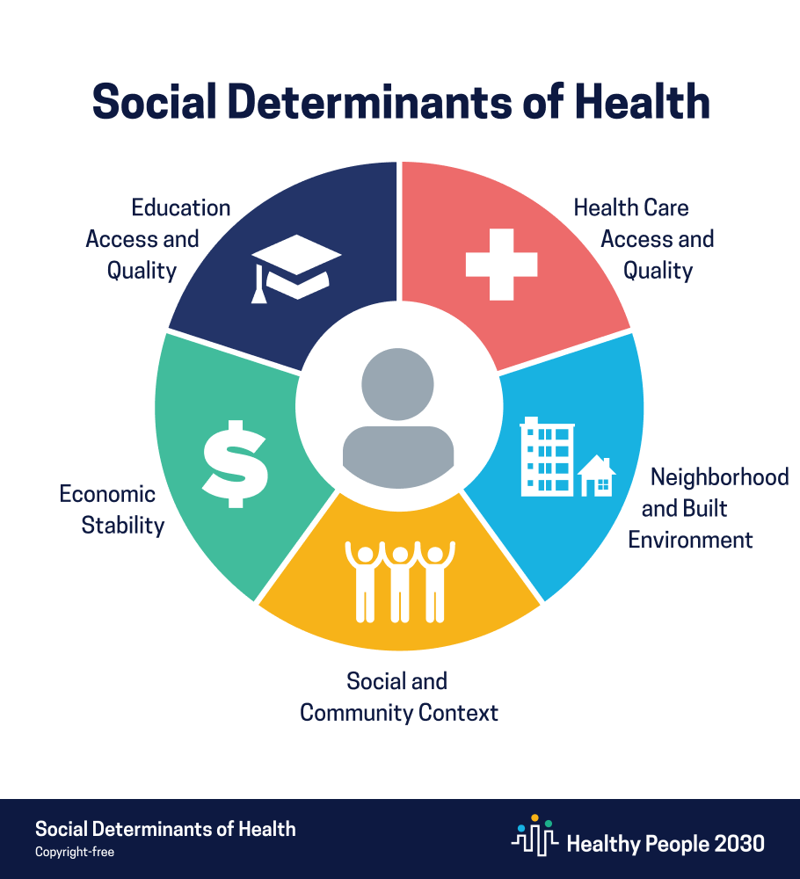
What are Social Determinants of Health
SDOH Basics
WHAT WIC PROVIDES
Social determinants of health (SDoH) are the conditions in the environments where people are born, live, learn, work, play, and age that affect a wide range of health, functioning, and quality-of-life outcomes.
Examples include:
Safe housing and transportation
Access to nutritious food
Income and employment
Education and literacy
Social support and community connection
Access to healthcare and legal services
Childcare availability
Experiences with stress, discrimination, and trauma
Anchorage Health Department | WIC Program | muni.org/health

Slide 25
What We're Hearing: SDoH Survey
629 AHD clients surveyed | February – April 2025 | Voluntary, paper-based
629
Voluntary
AHD clients surveyed
paper-based surveys
administered by staff
No
Goal
demographic data
collected — privacy first
Identify barriers affecting
client health & wellbeing
Anchorage Health Department | WIC Program | muni.org/health

Slide 26
Economic Stability & Food Access
What WIC clients told us about their daily reality
22.1%
23.6%
25.7%
15.8%
41.9%
worry about running
out of food
have no steady
source of income
say income doesn't
meet basic needs
can't pay for utilities,
rent & groceries
have no regular
primary care provider
The connection: Food insecurity and income instability are exactly what WIC is designed to address. And nearly 4 in 10 clients without a primary care provider — WIC's referral network is often the only pathway connecting these families to healthcare.
Anchorage Health Department | WIC Program | muni.org/health

Slide 27
Barriers to Access & Participation
What stands between families and the care they need
Lack affordable or reliable childcare
49.2%
Lack education/training for desired job
27.5%
Difficulty accessing medical care due to cost
27.8%
Transportation prevents attending appointments
12.6%
Need help reading, writing, or understanding forms
8.1%
Anchorage Health Department | WIC Program | muni.org/health

Slide 28
How WIC Addresses These Needs
We don't just provide food, we connect families to a broader system of care
Food Security
Healthcare Access
Monthly eWIC food benefits and formula directly address food insecurity and income strain
We connect uninsured and unconnected clients to primary care, Medicaid, and community health resources
Child Development
Referral Network
Growth screenings, nutrition education, and developmental referrals support children's long-term health
We actively refer clients to childcare assistance, transportation programs, education support, and social services
Anchorage Health Department | WIC Program | muni.org/health

Slide 29
Partner With WIC
Three things you can do starting today
1. Ask Your Clients
2. Share Referral Info
3. Let's Build Together
Ask every eligible patient if they're enrolled in WIC. Income threshold is 185% FPL, higher than most assume. Medicaid/SNAP often qualifies automatically.
Post our information in your waiting room. A provider referral is one of the most trusted pathways families use to connect with WIC.
If you serve pregnant women, infants, or young children, let's talk about warm handoff processes between our programs.
WIC Program: (907) 343-4611 | muni.org/health | 825 L Street, Anchorage AK 99501

Slide 30
Amanda Johnson
Director of Business Development
North Star Behavioral Health

Slide 31
Child & Adolescent Services

Slide 32


Acute Stabilization
Main Hospital - Children & Adolescents
Acute psychiatric hospital for youth (boys and
girls) ages 4 to 18
Term: stabilization up to 30 days
Capacity: 74

Slide 33



Residential Services
Alpine Academy – RTC, Adolescent Girls
Psychiatric residential treatment center for adolescent
girls ages 12 to 18
Capacity: 20 beds
Length of stay: 6 – 12 months
Summit – RTC, Adolescent Boys
Psychiatric residential treatment center for adolescent
boys ages 11 to 18
Capacity: 20 beds with future expansion to 30 beds
Length of stay: 6 – 12 month

Slide 34


Who Qualifies for Acute Services:
Boys and girls between the ages of 4-17 who are struggling with mental health concerns:
  Self-harming behaviors
  At high-risk of self-harming behaviors
  Harm to others
  In need of short-term crisis stabilization

Slide 35
Who Qualifies for Residential Services
Boys ages 11-18 and girls ages 12-18 who need more formal supports to build life skills in a safe and controlled environment.
  Those who struggle with maintaining healthy life skills in the home
  Those who are discharging from the acute level of care, but aren't ready to go home yet

Slide 36
How to Refer
Call our intake team: 907-264-3506
They are available in-person 7a-11p and oncall during the night.
Walk-in 24/7; psychiatric ER Fax referral: 907-279-1438

Slide 37
Christina Hulquist
Executive Director, Anchorage Child Care Early Education Fund
Municipality of Anchorage

Slide 38



Anchorage Child Care & Early Education (ACCEE) Fund
Summary of 2025 Investments & Accomplishments
March 6th, 2026

Slide 39



Proposition 14 passed in April 2023 by 12-point margin. Big thanks to Eric Croft and Trevor Storrs.
Dedicates marijuana tax to child care & early education
Establishes ACCEE Fund Board to oversee the fund
Funding decisions made by Anchorage Mayor and Assembly, after Board submits its budget recommendations
Expect $4-6 million in annual revenue
ACCEE Fund programs
started operating in 2025

Slide 40
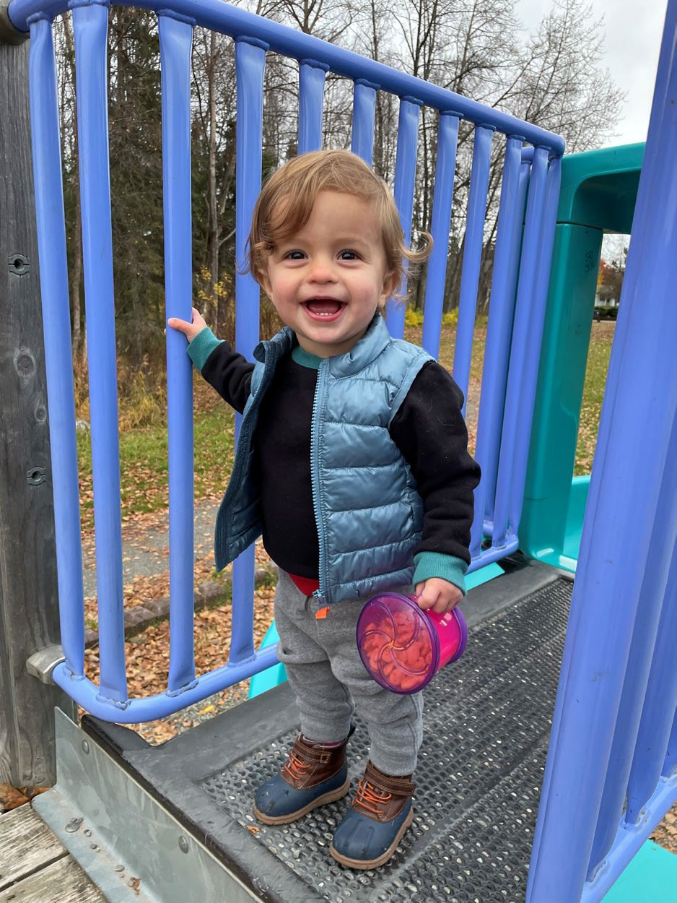

Allowed Uses
Create access to CC & EE (age 0-12) programs
Fund reading programs
Fund livable wages, training, and
staffing for CC & EE programs
Fund facilities - prioritize using underutilized or closed ASD buildings

Slide 41
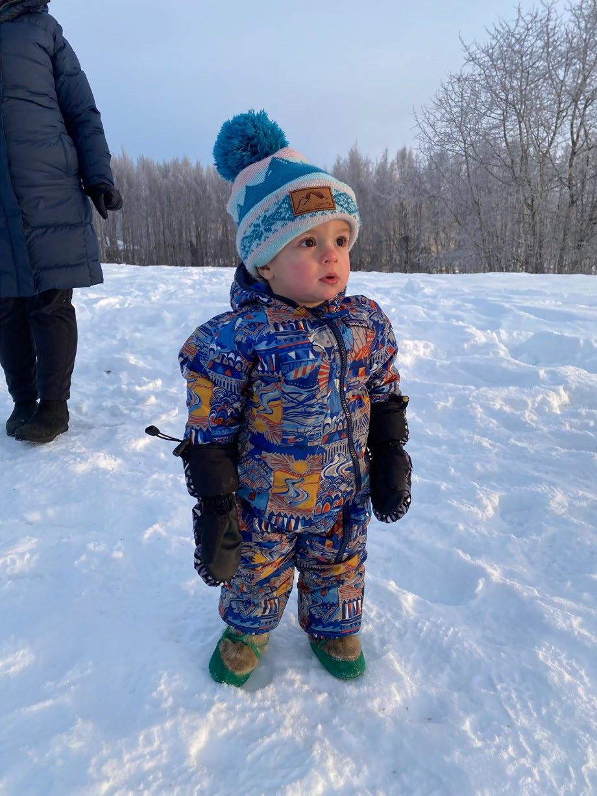
Four Primary Programs in 2025
Operational Assistance: $2.4M
Sector Worker Child Care Subsidies: $1.25M
Pilot & Capital Projects: $2M
ASD Title I Programs: $2M

Slide 42

Operational Assistance: $2.4M
Operated by thread; spent all funding
One summer payment made to 198 eligible orgs
Orgs received between $500-$55,547
Spent on staff, rent/mortgage, utilities, facilities, insurance, equipment, supplies, prof dev, mental health supports (for students & providers)
158 filled out post-funding survey

Slide 43
Survey Results
108 orgs able to maintain capacity; 18 added capacity
90%: “helped maintain capacity/avoid closures”
45%: retain staff/avoid layoffs
30%: increase in number of children served
25%: can now serve new families/underserved pops
15%: able to reduce costs to families now; 60% able to reduce costs if funding continues
15%: increased hourly wages; 10% gave bonuses
33%: offered more benefits to staff

Slide 44
Thoughts from Awardees
“Funding opportunities like this…allow us to pay our teachers a livable wage without increasing costs to families”
“We were able to pay for staff training to gain our level 3 certification for Learn and Grow”
“Without [this funding] we would have to drastically cut back services to families whose children have additional needs”
“With increasing cost on supplies, the funding was very helpful. I didn't have to raise the tuition. Thank you so much for the support.”
“This funding is essential”

Slide 45
Child Care Subsidies: $1.25M
Operated by Alaska Family Services
Payments made monthly beginning in June
81 participants; hundreds of Anchorage families likely benefited
Returning appx $406,000 (spent appx $844,000)
Appx 120 kids received paid care

Slide 46




Child Care Subsidies Program
SUBSIDY PAYMENTS BY AGE CATEGORY - NOVEMBER 2025
Infant, 13, 13%
School Age, 21, 22%
Toddler, 35, 36%
Preschool-Age, 28, 29%

Slide 47
Pilot and Capital Projects: $2M
Operated by Muni via RFGP released April 4; deadline May 15
Received 48 proposals; recommended 20 (7 pilot; 13 capital) for approval
Assembly approved in June
Awards ranged from $15,570 (facility improvements) to $224,217
(repurpose ASD classrooms into licensing-ready, rent-free spaces)
Funded training; worker-led program; addl infant capacity; employer cost sharing study; drop-in child care; flooring, playground, other updates
$248,700 not spent by awardees (12% of total funding)

Slide 48
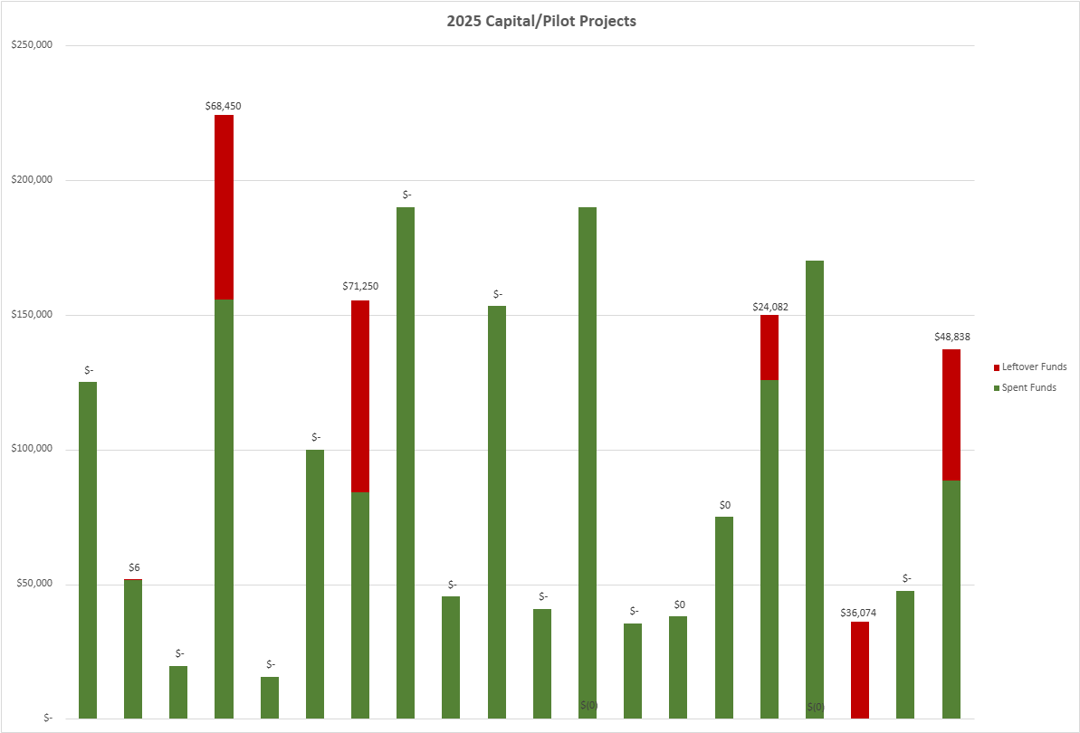

Slide 49
ASD Title I Programs
Funded 8 high-quality pre-k classrooms in Title I schools
Students selected by lottery based on risk factors (homeless, hardships)
Paid for staffing (certified teacher and paraprof in each classroom) plus Teacher Expert for coaching/guidance
Also funded Mental Health Consultant & playgroup for those who couldn’t access program (7 days a week)
Playgroup did outreach to homeless shelters, libraries, families displaced from Western Alaska
20 students received special education services
All funding spent

Slide 50
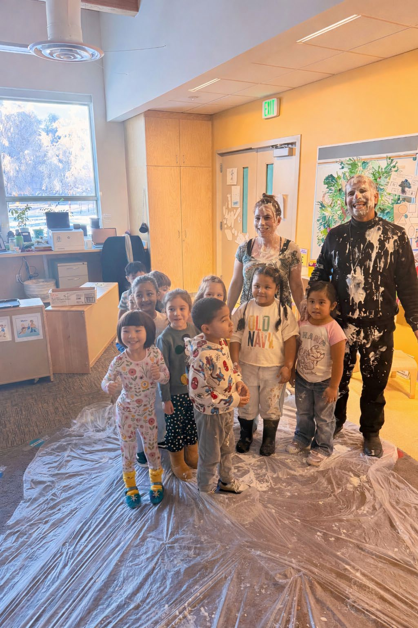

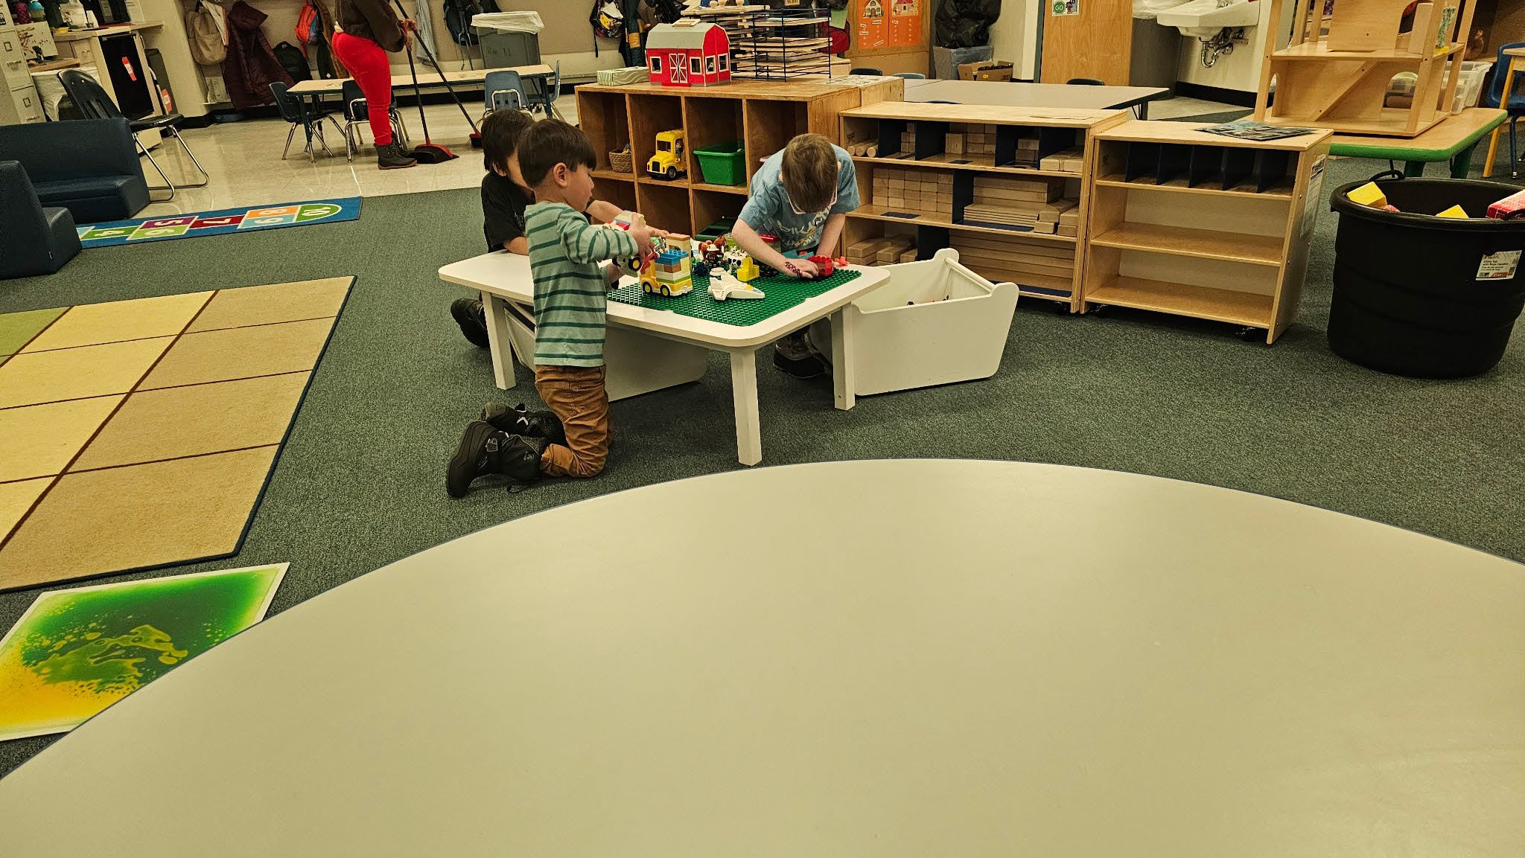


Slide 51

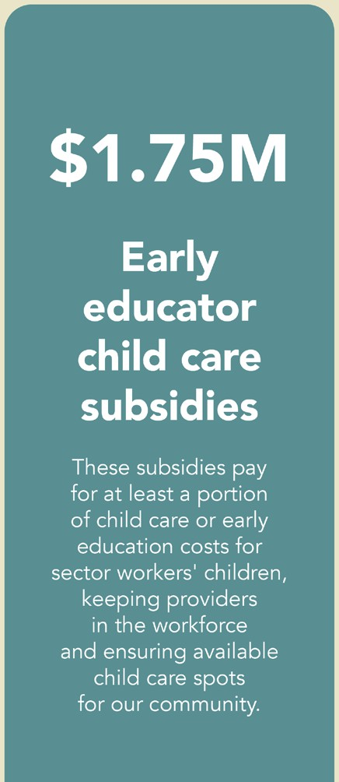
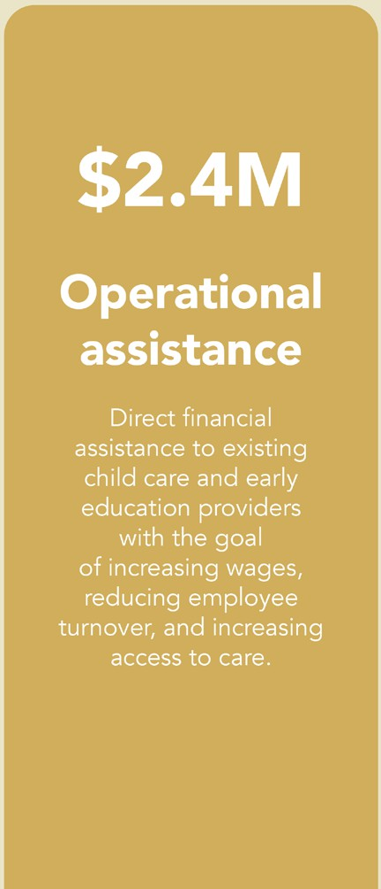
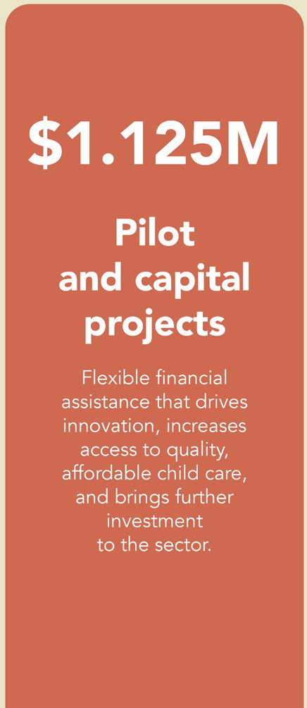


2026 BUDGET
ANCHORAGE
CHILD CARE &
EARLY EDUCATION FUND
This funding is intended to help stabilize the child care and early education sector, helping providers cover operating costs, retain staff, and maintain quality access to early learning opportunities. A strong child care sector strengthens families and supports the broader workforce and economy.
$400k
Sector worker retention bonuses
This program provides
Funding to SUPP.Ort new
modest bonuses
in-home care options
for Anchorage fam1l1es
to experienced workers,
thereby supporting sector retention and family access
to care.

Slide 52

Questions?
Christina Hulquist
ACCEE Fund Executive Director
christina.hulquist@anchorageak.gov (907) 343-6509

Slide 53
Carmen Wenger
A2P2 Director of Programs
&
Toni Rae Osiecki,
SLP, A-Z Speech Therapy Inc.
Growing Minds

Slide 54


Carmen Wenger & Toni Rae Osiecki

Slide 57
SCHOOL-BASED
PROFESSIONAL DEVELOPMENT
Supplemental Funding to Expand Services.
Rural & Itinerant School Counselors and School Nurses.
Monthly Webinars Offered During School Year.
Variety of Mental and Behavioral Health Topics.
FY 25 Opened to Rural and Urban Providers.
Notes:
In FY24 HRSA offered supplemental funding to expand PAL-PAK into a new area. Alaska decided to offer services to school personnel after consultation between the Healthy Schools Collaborative at the State of Alaska, a partnership of the Department of Education and Early Learning (DEED) and the Division of Public Health, and SCH psychiatry and the University of Washington School Mental Health Assessment, Research, and Training (UW SMART).
Specific content and consultation was developed for rural itinerant school counselors, school nurses and social worker in some of Alaska’s most remote locations only accessible by plane or boat. This was an opportunity for providers who often have few educational opportunities available to them because of their remote location to gather and learn together.
In FY 25 it was decided to open webinars up to be available to any school nurse, counselors, and school social workers across Alaska, as there was such a positive response about the topics covered.
Topics covered have included school avoidance, psychotropic medications, mental health emergencies, behavioral management strategies, managing self-harm behaviors to name a few.

Slide 58



Are you a professional working with young children not currently able to access Infant and Early Childhood Mental Health (IECMH) Consultation, including Family, Friend and Neighbor care, home visiting, early intervention, medical or social service providers?
Growing Minds offers support for providers in nurturing young children’s social and emotional development and to enhance the quality of care for children from birth through five years old across settings. This is a non-emergency service for providers to receive guidance on their practice or to ask questions about a specific concern in their professional setting.
Call 1-833-HMG-ALASKA (1-833-464-2527) today and ask to be connected with Growing Minds!
or visit helpmegrowak.org/growing-minds
The Health Resources and Services Administration (HRSA), Department of Health and Human Services (HHS) provided financial support for this publication. The award totaled $3,057,637.00 and contents may not reflect the policies of HRSA, HHS, or the U.S. Government.

Slide 59
Connection Process
Referral Received
Provider calls HMG-AK or submits the online form
Eligibility screening
Family Support Specialist calls to review eligibility criteria
Match to Consultant
HMG-AK Sends case information to iecmh consultant for intake
Next Steps Email Sent
provider will receive an email outlining next steps and what to expect

Slide 60

Intake
Receive phone call, schedule intake
Intake: approximately 30 minutes
  Discuss concerns
  Learn about provider's story
  Learn about child's story
Schedule next appointment
Also

Slide 61


Follow up consultation: What to Expect
Plan 45-60 minutes
Grounding moment
Updates on child, review recent challenges
Reflective practice
Care consultation: joint planning responsive care
Relationship based skill building
Social emotional strategy development
Also

Slide 62
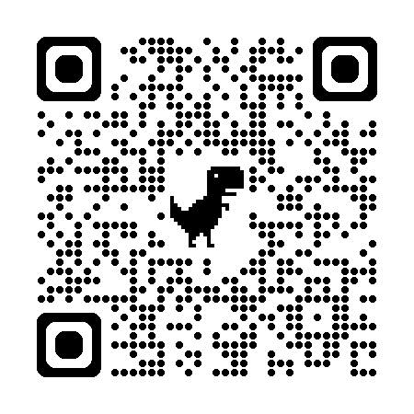
Help Me Grow Alaska Information
For more information on Help Me Grow Alaska
Visit: www.HelpMeGrowAK.org
Call: 1-833-HMG-ALASKA
1-833-464-2527
Fax: 1-833-464-2527

Slide 63

Questions?
Carmen Wenger
Director of Programs, All Alaska Pediatric Partnership
carmen@a2p2.com

Slide 64
Heidi Huppert
Chief Program Officer
Covenant House Alaska

Slide 65




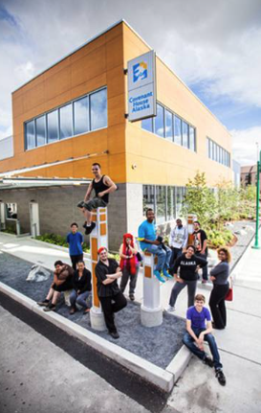
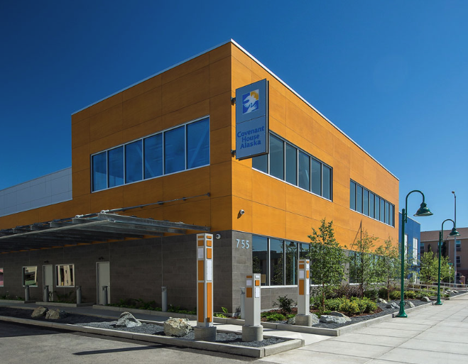

Slide 66
Amie Collins
Executive Director, Best Beginnings
&
Amy Simpson
Executive Director, Programs for Infants & Children
Anchorage Early Childhood Coalition

Slide 67

ECN Reps:
Amie Collins, Best Beginnings
Amy Simpson, Program for Infants & Children
ancearlychildhoodcoalition.org
Start Slide

Slide 68

Early Parent Support Anchorage
Kids’ Corps, Inc.
Programs for Infants and Children
Providence Nurse-Family Partnership
Rural Alaska Community Action
Program Inc.
Section of Women’s, Children’s &
Family Health (Alaska
Department of Health)
Stone Soup Group
Southcentral Assocatiion for the Education of Young Children
Southcentral Foundation
State of Alaska Child Care
thread
Program Office
United Way of Anchorage
Coalition Partners:
Anchorage Early Childhood Coalition
Alaska Black Caucus
Alaska Children’s Trust
Alaska Coalition of BIPOC Educators
Alaska Literacy Program
Alaska Native Tribal Health Consortium Child Development Center with Kindercare
Anchorage Public Library
Anchorage School District
Anchorage WIC Program
Best Beginnings
Boys & Girls Clubs-Alaska
Campbell Creek Science Center
CITC Ch’anik’en Home Visiting Program
Clare Swan Early Learning
Center
About
Us
We are a collaborative group of community stakeholders working to improve equity and quality in the early learning, health, and welfare of all Anchorage’s young children.
Our coalition meets 6-8 times a year to coalesce around current community issues and projects.
We welcome all members and organizations who work with or on issues impacting young children. There is no fee for membership.
Members & Mission

Slide 69

Anchorage Early Childhood Coalition
Presentations are typically introduction, or speech meant to inform, persuade, inspire, motivate, or present a new idea/product.
Advance mixed delivery early education
Improve community kindergarten readiness
Foster collaboration in the early childhood sector
2026
Projects
New Website
Local Resource Guide
SwaddleMe Bags
Shared Community
Calendar
Community Baby Shower

Slide 70


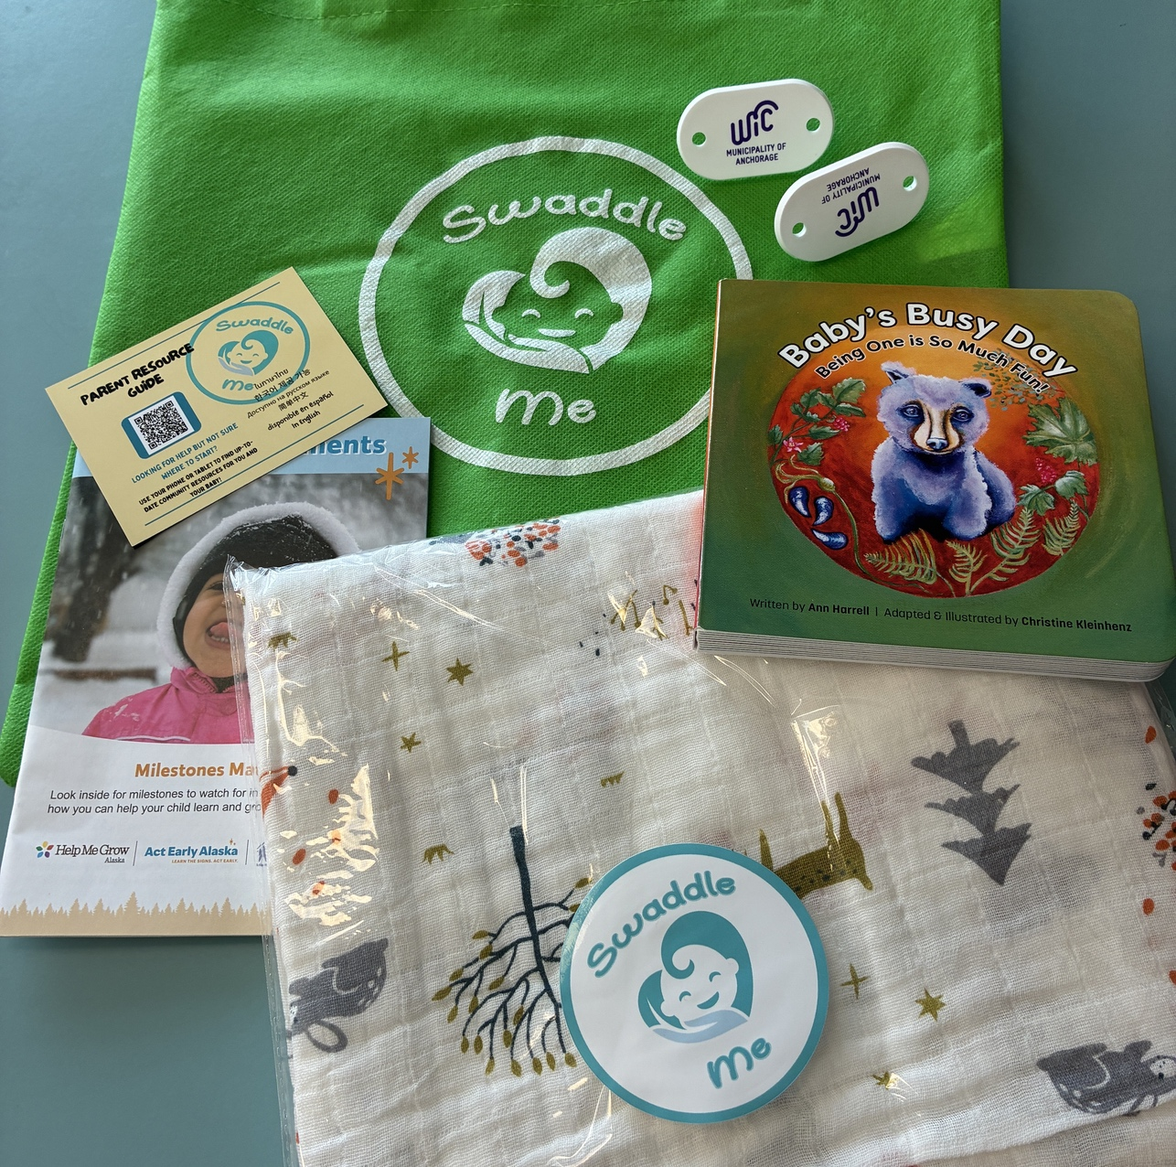
Anchorage Early Childhood Coalition
Swaddle Me!
Project
Swaddle Me gives every new parent in Anchorage and welcome their new baby to our community.
Vision: All new parents have information on developmental milestones, resources in our community, and information to help them with their new baby.
How does it work?
PIC is facilitating Swaddle Me with other partners. The gifts will be distributed through local hospitals and birthing centers, so every parent receives the gift.
Swaddle Me gift bag contains:
  Milestone Moments booklets-developmental milestones from birth to five years
  Baby’s Busy Day
  Swaddle Blanket
  Electrical outlet covers
  Digital Resource booklet available in 6 languages
    English
    Spanish
    Russian
    Thai
    Chinese
    Korean

Slide 71

Anchorage Early Childhood Coalition
Community
Baby Shower
An event to celebrate our newest residents, provide a space for parents to connect, learn about how to support their child’s development, and gain material resources to support their growing family.
Goals:
300 Families
NEW Community
Resource Guide
20 Partner-Hosted
Activities & Presentations

Slide 72

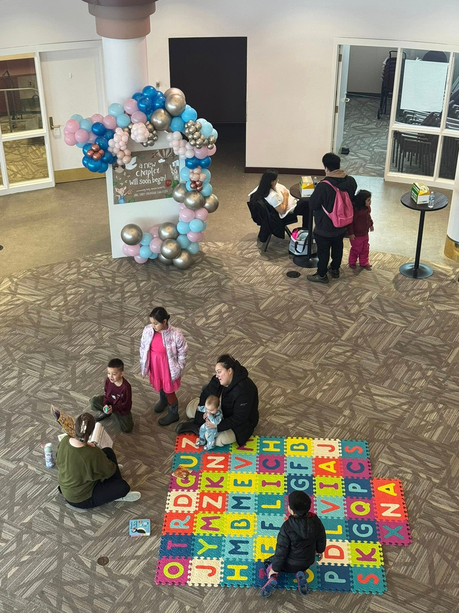
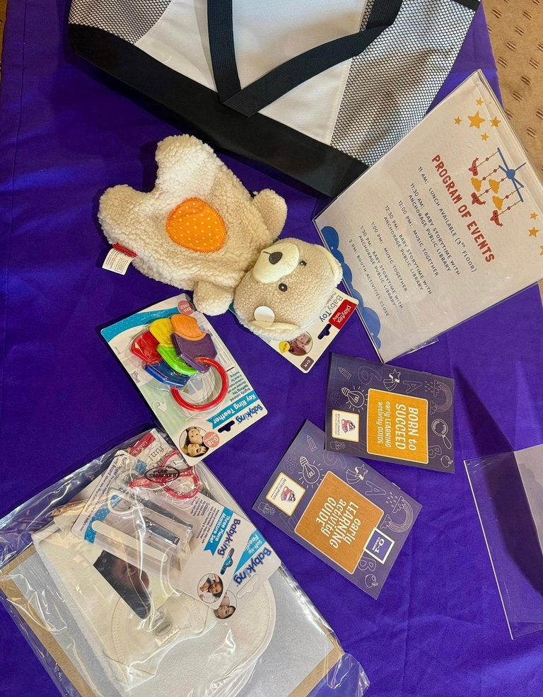
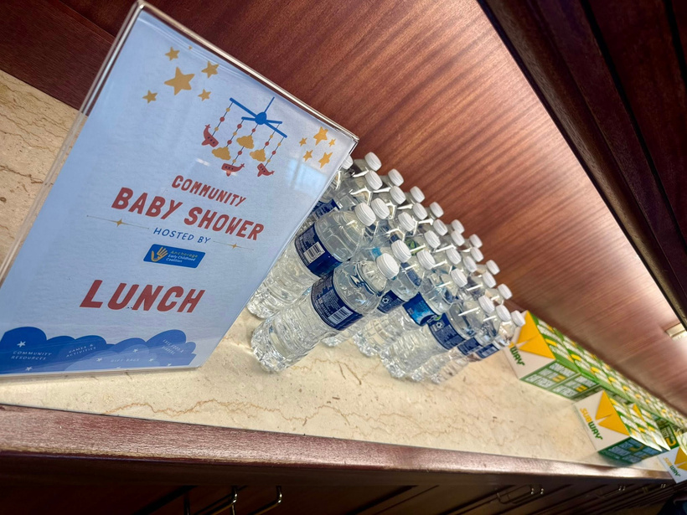
Anchorage Early Childhood Coalition
Community
Baby Shower

Slide 73
For more information:
ancearlychildhoodcoalition@gmail.com
THANK YOU
Amie Collins, Best Beginnings
acollins@bbalaska.org
(907) 297-3301
Amy Simpson, Program for Infants & Children
asimpson@picak.org
(907) 550-3024
ancearlychildhoodcoalition.org
End Slide

Slide 74





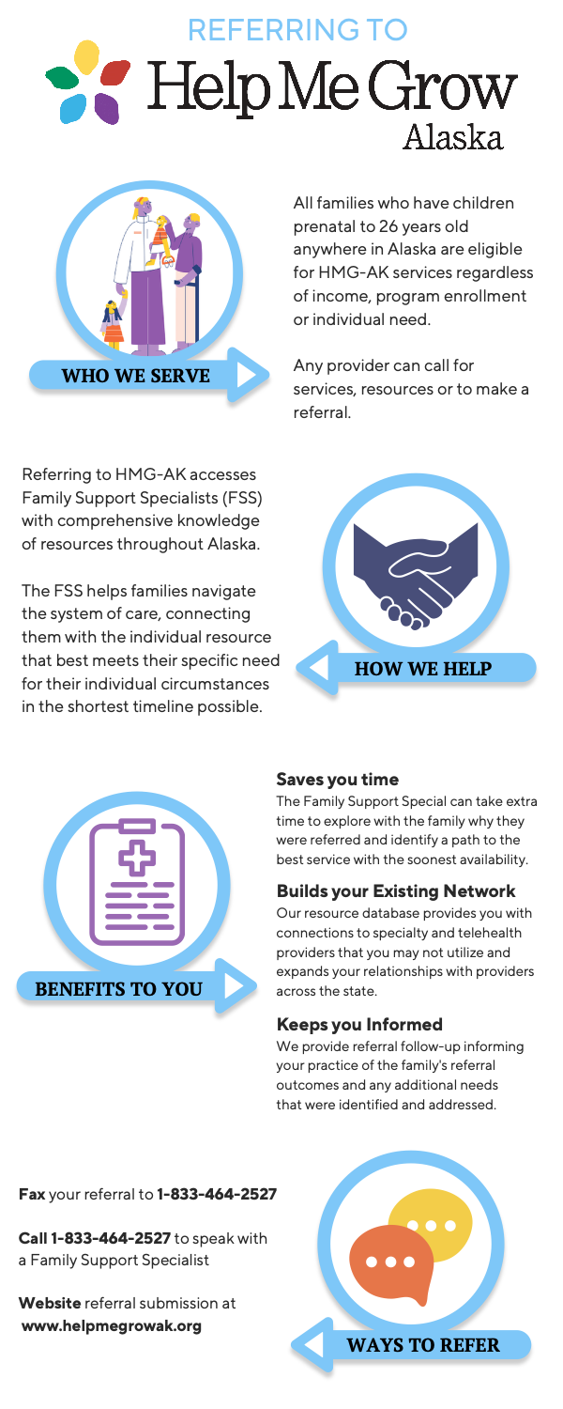
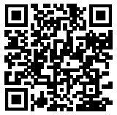
Help Me Grow Alaska is an agency dedicated to promoting healthy child development across Alaska by providing support and information to individuals and organizations who care for and about children, youth, and adults ages prenatal-26. Whether you are a parent, provider, teacher, or other caregiver with questions or concerns about a child in your life, we are here to help you.
Our call center is staffed with Family Support Specialists, individuals with experience in, and an understanding of, child development, social services, and resources available in Alaska and beyond. They are available to listen to concerns, help organize a path forward, and get families connected to the most available and appropriate service across Alaska.
To order materials scan the QR code or visit:
a2p2.org/help-me-grow-alaska/

Slide 76
Are you a professional working with young children not currently able to access Infant and Early Childhood Mental Health (IECMH) Consultation, including Family, Friend and Neighbor care, home visiting, early intervention, medical or social service providers?
Growing Minds offers support for providers in nurturing young children’s social and emotional development and to enhance the quality of care for children from birth through five years old across settings. This is a non-emergency service for providers to receive guidance on their practice or to ask questions about a specific concern in their professional setting.
Call 1-833-HMG-ALASKA (1-833-464-2527) today and ask to be connected with Growing Minds!
or visit helpmegrowak.org/growing-minds
The Health Resources and Services Administration (HRSA), Department of Health and Human Services (HHS) provided financial support for this publication. The award totaled $3,057,637.00 and contents may not reflect the policies of HRSA, HHS, or the U.S. Government.

Slide 78


Slide 79
Thank you for joining!
Special thanks to the Municipality of Anchorage for hosting the March Partnership Meeting.
To our presenters and colleagues: Thank you for your meaningful connections and for keeping the community’s voice at the heart of what you do. We are inspired by your hope and your partnership!

Slide 80
Notes:
Put link in chat: https://secure.givelively.org/donate/all-alaska-pediatric-partnership/a2p2-30th-anniversary

Slide 81
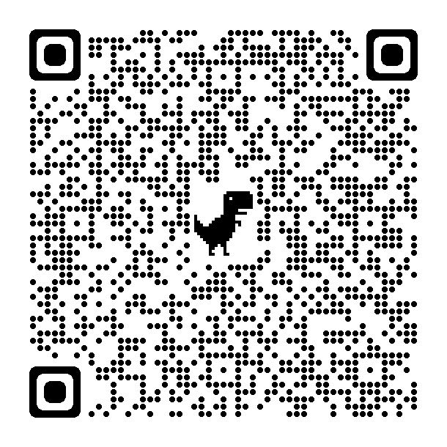
Thank you for joining this months Partnership Meeting!
Stay informed!
Scan the QR code and sign up to the All Alaska Pediatric Partnership’s mailing list.
Partnership Meeting resources and presentations from recent meetings are available on the
All Alaska Pediatric Partnership (A2P2) website a2p2.org

