Slide 1



April Partnership Meeting
Fairbanks, Alaska
Friday, April 3, 2026
12:00-1:30 pm
Presented by the All Alaska Pediatric Partnership (A2P2).
A2P2 transforms systems of care and increases equitable access to health care and related services to ensure all Alaska’s children reach their full potential.
Learn more at a2p2.com or by scanning the QR code

Slide 2

Agenda
Welcome!
Dr. Laura Brunner, Foundation Health Partners
Announcements
Tamar Ben-Yosef, All Alaska Pediatric Partnership
Presentations
Dr. Laura Brunner, Foundation Health Partners
Dr. Jessica Eiser, Tanana Chiefs Conference
Rachel Evans & Jenna Hibdon, Fairbanks Public Health Center
Amanda Johnson, North Start Behavioral Health
Heidi Haas, Alaska Center for Children and Adults
Meredith Maple Fairbanks Center for Children and Adults
Go Blue Day Photo!

Slide 3


Welcome! Dr. Laura Brunner Foundation Health Partners,

Slide 4
Introductions
Please share your:
Name, Role, Agency
Online: Name, Community, Role, Agency

Slide 5
Announcements Tamar Ben-Yosef A2P2 Executive Director

Slide 6

April is Child Abuse Prevention Month Today is Go Blue Day!
Notes:
Good morning, everyone. Before we begin today’s agenda, I’d like to acknowledge that April is National Child Abuse Prevention Month.
Pinwheels conjure up memories of play and whimsy. Each April, they also serve as a reminder of our collective hope that one day all children can lead lives free of abuse. Here in Alaska, where our vast distances and unique challenges can sometimes lead to isolation, that hope depends entirely on our commitment to looking out for one another.
Our Call to Action: We all have a role in ensuring Alaskan children grow up in safe, stable, and nurturing environments. Whether it is supporting a struggling neighbor, volunteering with local youth programs, or simply being a trusted adult for a child in your life, your presence makes a difference.
Let’s carry that spirit of protection and community into our work today. Small acts of connection can change the trajectory of a child's life.

Slide 7




Are you a professional working with young children not currently able to access Infant and Early Childhood Mental Health (IECMH) Consultation, including Family, Friend and Neighbor care, home visiting, early intervention, medical or social service providers?
Growing Minds offers support for providers in nurturing young children’s social and emotional development and to enhance the quality of care for children from birth through five years old across settings. This is a non-emergency service for providers to receive guidance on their practice or to ask questions about a specific concern in their professional setting.
Call 1-833-HMG-ALASKA (1-833-464-2527) today and ask to be connected with Growing Minds!
or visit helpmegrowak.org/growing-minds
The Health Resources and Services Administration (HRSA), Department of Health and Human Services (HHS) provided financial support for this publication. The award totaled $3,057,637.00 and contents may not reflect the policies of HRSA, HHS, or the U.S. Government.
Notes:
For those of you working with children birth through age five—including home visitors, medical providers, or social service professionals—I want to highlight Growing Minds.
If you don’t currently have access to Infant and Early Childhood Mental Health consultation, this is your resource. It is a non-emergency support service designed to help you navigate specific professional concerns or simply find new ways to nurture a child’s social and emotional development.
Whether you need guidance on your practice or have questions about a specific case, you can access this support by calling 1-833-HMG-ALASKA or visiting helpmegrowak.org/growing-minds.

Slide 8


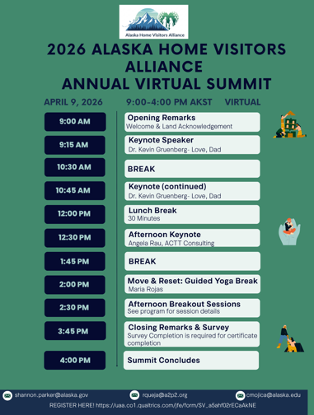
Alaska Home Visitors Alliance Annual Virtual Summit
Thursday, April 9
9:00-4:00 PM
Virtual Summit
Registration is Free!
Register on the A2P2 Website under the Community tab and Home Visitors Alliance
Notes:
The Alaska Home Visitors Alliance Annual Virtual Summit is quickly Approaching! Please register for the free FY26 Home Visiting Alliance Annual Virtual Summit that is taking place next Thursday. This full-day event provides practical tools for those serving families in high-stress environments across Alaska. We have a fantastic lineup featuring Dr. Kevin Gruenberg on father engagement , Angela Rau on the neuroscience of workforce resilience , and specialized breakout sessions covering perinatal mental health, safe sleep, and pediatric gastric health. It’s an excellent opportunity to recharge and bring new strategies back to your work with children and families .

Slide 9

Notes:
We have some exciting growth happening at the A2P2 and Help Me Grow Alaska! We are currently recruiting for multiple positions! Our mission is to build a system where every Alaskan child has what they need to reach their full potential. If you know someone who is passionate about equity, innovation, supporting families in meeting their needs and transforming systems of care, please encourage them to apply. We are looking for team members who align with our vision of healthy, thriving families across the state.
All open positions are listed on the A2P2 website, and we would love your help in getting the word out to the right candidates!

Slide 10

Please join RCPC at their 4th Annual Go Blue Day Open House!
Notes:
We have two incredible community events coming up that you won't want to miss.
First, mark your calendars for tomorrow, Friday, April 3rd! If you’re in Fairbanks, please come out to support the Resource Center for Parents and Children (RCPC) for their 4th Annual Go Blue Day Open House. From 10 AM to 4 PM, you can tour their facility at 726 26th Avenue, browse resource tables, and make great local connections—plus, there will be refreshments provided! For any questions, you can reach them at 907-456-9017.
Then, looking ahead to Thursday, April 9th, we are celebrating a major milestone: thread is turning 40! For four decades, thread has worked tirelessly to advance child development and high-quality early education across Alaska. To celebrate, they are hosting a statewide Celebration & Feast from 4 PM to 7 PM.
Whether you are in Anchorage, Juneau, or Fairbanks, you can stop by one of their locations to enjoy a FREE meal and learn how you can support their mission for Alaska’s families.
We hope to see you there to celebrate these amazing organizations and the work they do for our kids!"

Slide 11

Celebrating 40 years of thread! When: Thursday, April 9, from 4:00 PM to 7:00 PM. Where: Participating locations in Anchorage, Juneau, and Fairbanks. Details: Enjoy a FREE meal and learn more about how you can support thread’s mission to provide affordable, high-quality early childhood education for all Alaskans.
Notes:
Then, looking ahead to Thursday, April 9th, we are celebrating a major milestone: thread is turning 40! For four decades, thread has worked tirelessly to advance child development and high-quality early education across Alaska. To celebrate, they are hosting a statewide Celebration & Feast from 4 PM to 7 PM.
Whether you are in Anchorage, Juneau, or Fairbanks, you can stop by one of their locations to enjoy a FREE meal and learn how you can support their mission for Alaska’s families.
We hope to see you there to celebrate these amazing organizations and the work they do for our kids!"
For four decades, thread has been a vital force in advancing child development and early education outcomes across Alaska. Originally founded in 1985 as Child Care Connection, the organization evolved into a statewide network dedicated to connecting families, early educators, and communities.
Join the 40th-anniversary festivities with a statewide Celebration & Feast:
When: Thursday, April 9, from 4:00 PM to 7:00 PM.
Where: Participating locations in Anchorage, Juneau, and Fairbanks.
Details: Enjoy a FREE meal and learn more about how you can support thread’s mission to provide affordable, high-quality early childhood education for all Alaskans.

Slide 12
Dr. Laura Brunner Fairbanks Memorial Hospital Inpatient Pediatric, NICU, and Pediatric Hospitalist Medical Director
Foundation Health Partners Pediatrics

Slide 13
Foundation Health Partners Pediatric Update
Laura Brunner MD
Foundation Health Partners Pediatrics
April 3, 2025
Fairbanks Memorial Hospital Inpatient Pediatric, NICU and Pediatric Hospitalist Medical Director

Slide 14

Outline
Inpatient
Strengths
Current areas of work
Outpatient Facilities
Foundation Health Partners
Behavioral Health
Visiting Clinics
It takes a Village

Slide 15
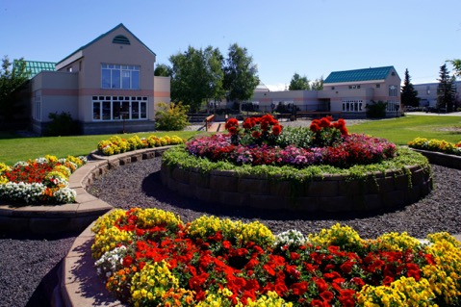
Foundation Health Partners
Providing quality health care to Interior Alaskans
The Greater Fairbanks Community Hospital Foundation (GFCHF) owns Tanana Valley Clinic (TVC), Fairbanks Memorial Hospital (FMH) and Denali Center (DC). Foundation Health Partners took over management January 1, 2018
Denali Center, FHP’s Long Term Care Facility

Slide 16
All Alaska Pediatric Partnership
Longstanding Member
Glad to be able to participate in the work that is happening around the state surrounding important topics for children and families
Continued commitment to the importance of kids and families in Alaska

Slide 17
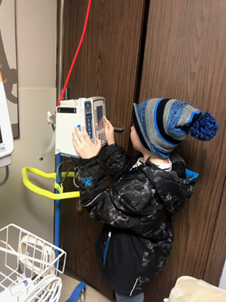
Inpatient Facilities
Fairbanks Memorial Hospital
Nursery/NICU​
Approx 1100 deliveries per year​
Bassett Army Hospital has approx. 350-450 deliveries per year​
Level II NICU​
In House Pediatric Hospitalists
Developing OB Hospitalist Program

Slide 18
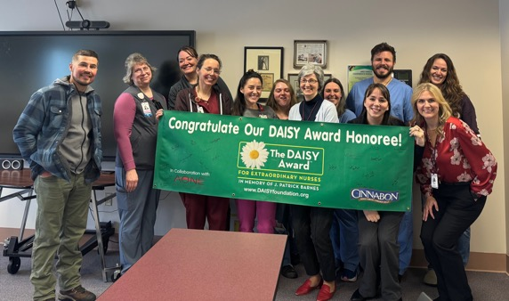
Inpatient Facilities
Fairbanks Memorial Hospital
Pediatrics​
11 bed unit with overflow to neighboring unit as needed​
Pediatric-trained nursing staff​
Quality Improvement focus for the care of pediatric patients in the facility​
Staffed 24 hours a day
Pediatric Hospitalists
NICU
Well Baby
No dedicated PICU space; can use adult ICU or NICU room as needed

Slide 19
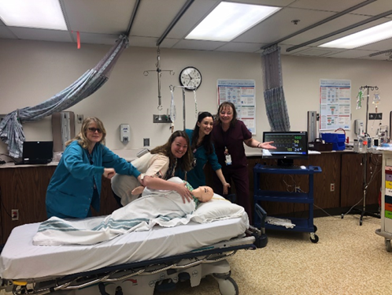
Celebrations
Continued FMH Emergency Department EMS-C designation this year
Includes committee reviews of pediatric deaths and trauma​
Visiting Pediatric Clinics
Behavioral Health
Statewide collaborative with other hospitals
Continued resident and medical student presence
It is melting!

Slide 20

Outpatient Facilities
Foundation Health Partners Pediatric Clinic
Pediatrics Clinic on the Main FHP campus
Enter the south entrance (E for Elephant)
Co-location with the hospital services
Visiting Clinics
Many stressors for families: Sicker kids, lower vaccine rates, less engagement with preventative care

Slide 21

Pediatrics at FHP
Pediatrics
Visiting Clinics Include:
In house pediatric hospitalist team
Allergist​
Child and Adolescent Psychiatrist in the Behavioral Health Clinic
​Pediatricians, Pediatric Advanced Practice Providers and Pediatric Nurses
Evening and weekend hours
Pediatric urology​
State metabolic clinic
Alaska Seattle Children’s Cardiology
Alaska Children’s Heart
State Neurodevelopment Clinic
Alaska Pediatric Surgery
ASPN Pediatric Endocrine Clinic
Alaska Pediatric Specialties GI

Slide 22

Behavioral Health Summit
Behavioral Health Summitt focused on Interior Alaska
Ongoing updates from local organizations
Focus on decision makers in the room and building out the continuum of care
Celebrations!
Partial Hospitalization at AKBH, Eating disorder treatment
Day Treatment at FNA
Graf opening at TCC
Family Centered Services of Alaska has expanded capacity
North Star length of stay and discharge, transition work

Slide 23
Adolescent Behavioral Health Unit
FHP identified the community need for acute inpatient beds for our youth
CON approved
Federal funding
Will need partnerships and collaboration with everyone in the room
Current work surrounding programing, learning from others

Slide 24
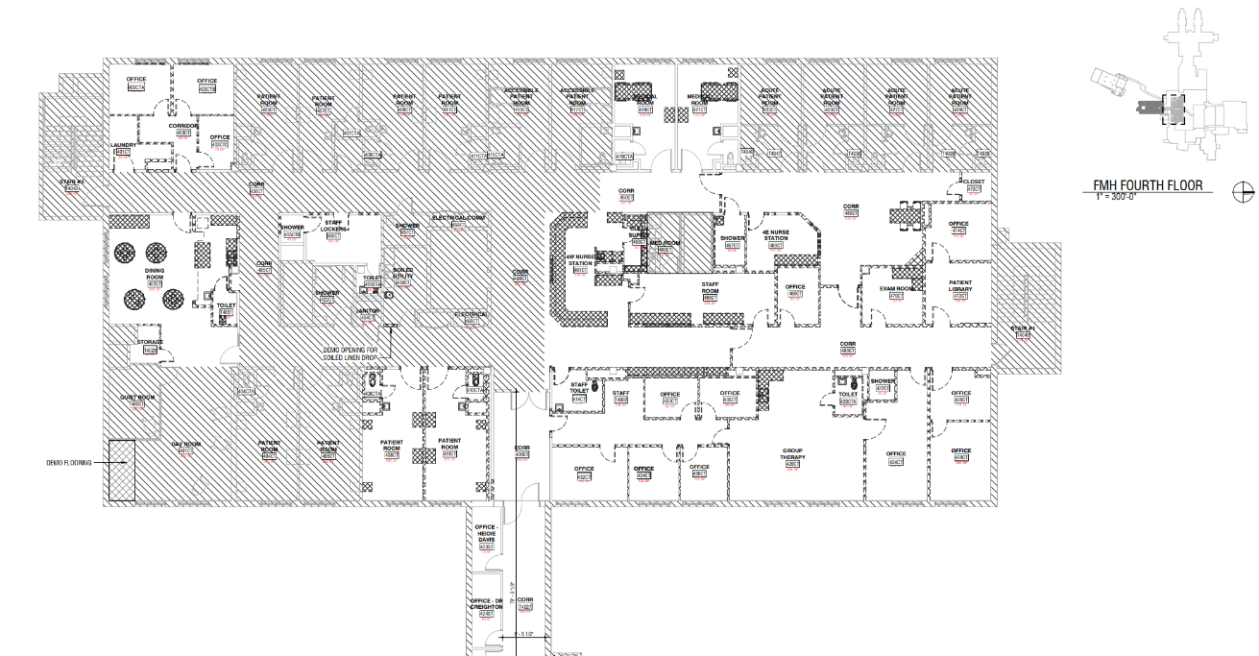
Current State

Slide 25
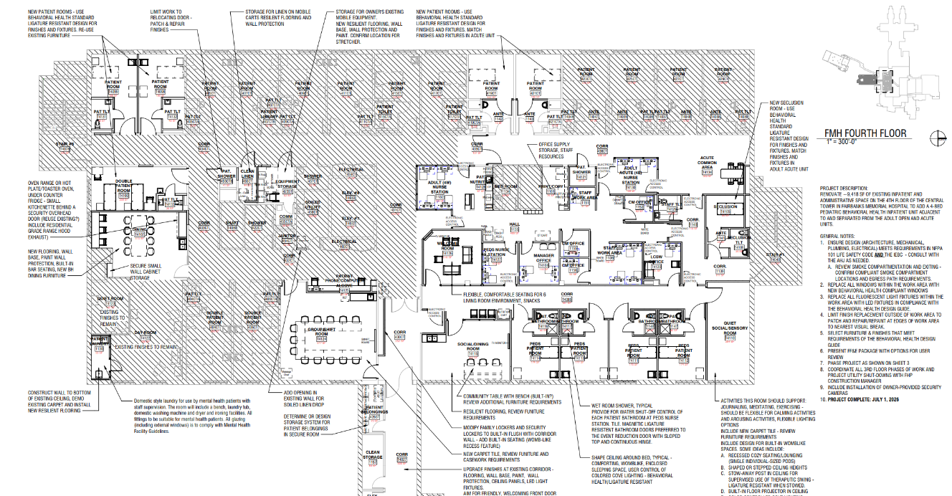
Unit Design

Slide 26
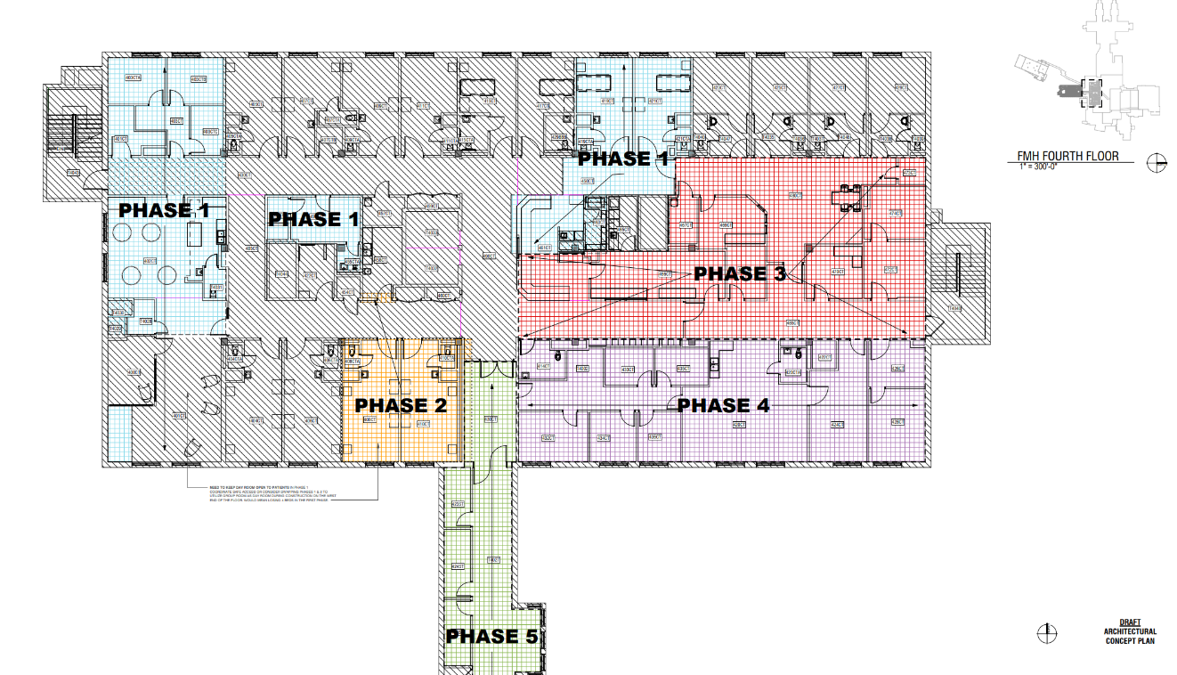
Phasing

Slide 27
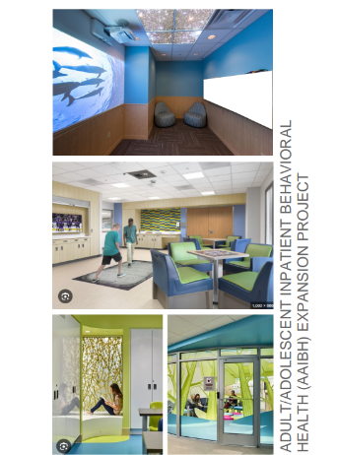
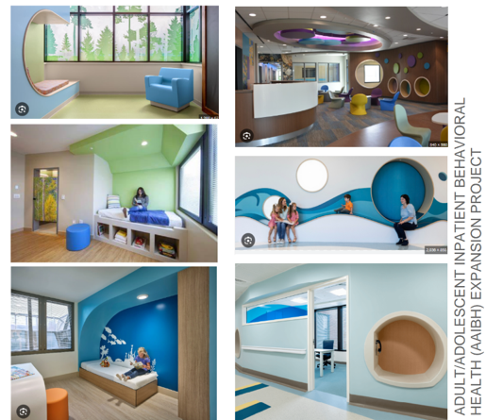
Ambiance

Slide 28
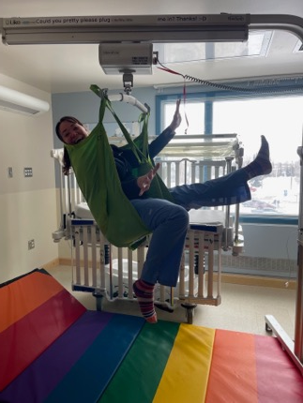
What are we working on currently?
Design Review
Ambiance, colors
Construction schedule
Phasing
Programming
Daily schedule
Daily curriculum
De-escalation approach
Outdoor activities
Intake process
Family visits
Policies/SOPs… and so much more!

Slide 29
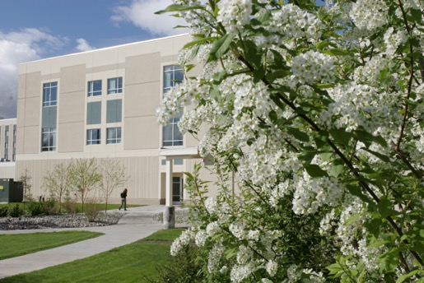
It takes a village
Non-profit and community support
The Door​
Children’s Museum
United Way
Boys and Girls club closure
Schools
WIC and public health​
All the others!
Pediatric subspecialty care
Support for ongoing visiting clinics
Fairbanks Memorial Hospital Campus

Slide 30
Questions & Comments

Slide 31
Dr. Jessica Eiser Staff Pediatrician at Chief Andrew Isaac Health Center
Tanana Chiefs Conference

Slide 32
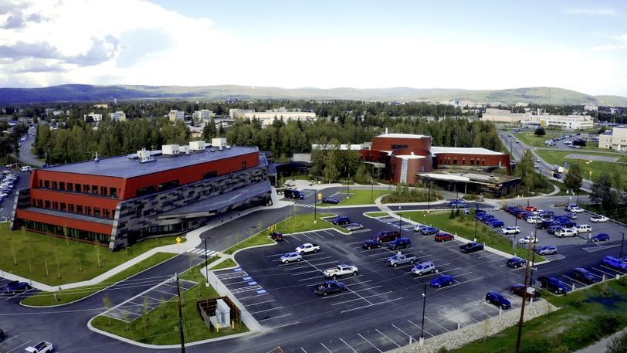
Chief Andrew Isaac Health Center Pediatric Overview

Slide 33
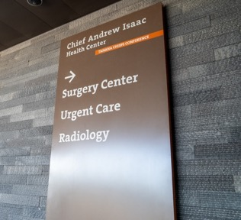
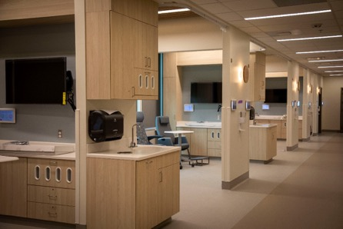
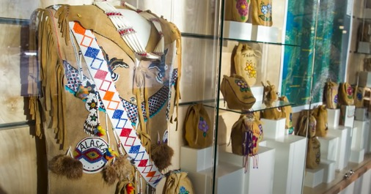

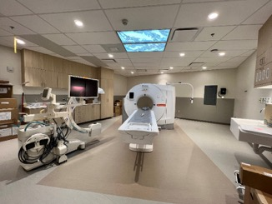
203,000 sq foot facility
Expanded Laboratory, Urgent Care, Surgery Center, Optometry, Infusion Center/Cancer Care clinic
Visiting specialty care from ANTHC (Endo, Audiology, Ortho, Neurology, +/- others/expanding), CT, Fibroscan.
OMM for Pediatrics and Adults
Traditional Healing in the form of sound therapy, reiki, etc is offered. Training programs are being created.
Notes:
New center opened Fall 2022
Cultural board: Goal was to create a building that did not look stark and institutionalized; wanted to a space where people felt safe and represented.

Slide 34

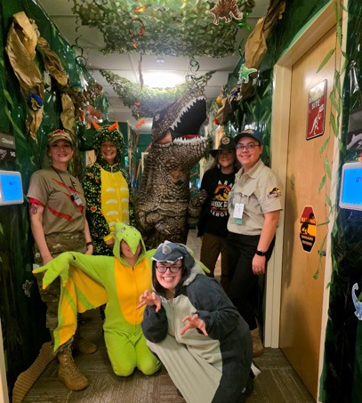
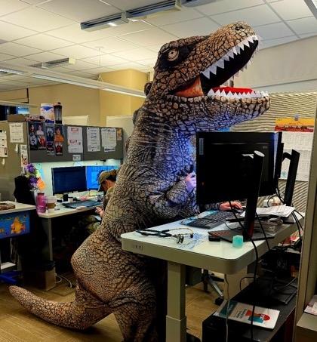
Pediatric Clinic
Dr. Jessica Eiser (Pediatric Team Lead), Dr. Eliana McKee, PA Stephanie Homan, NP Sarah Reed
Currently co-located with our CMAs and Care Coordinators
Each member is integrated into one of the three care teams: Deneege, Tudi, Teekona

Slide 35
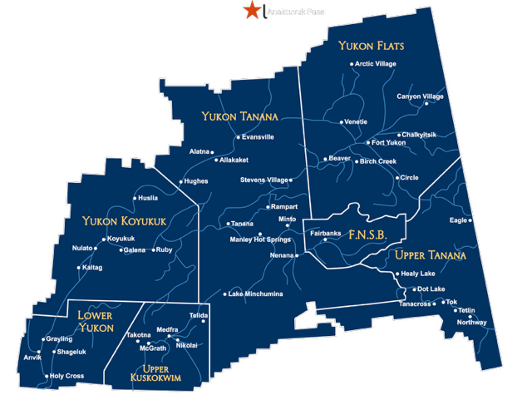
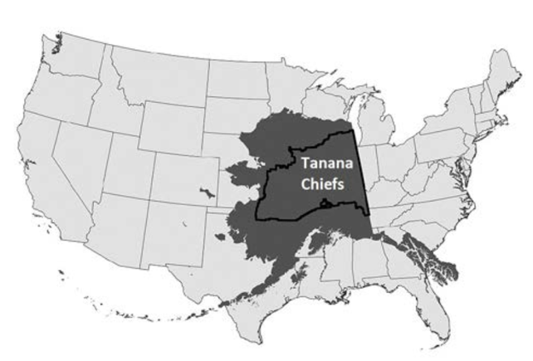
Notes:
The Tanana Chiefs Conference region covers an area of 235,000 square miles in interior Alaska, which is equal to about 37 percent of the entire state, and just slightly smaller than the state of Texas.

Slide 36
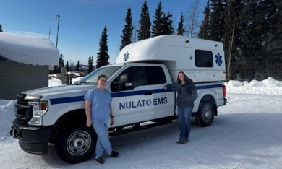
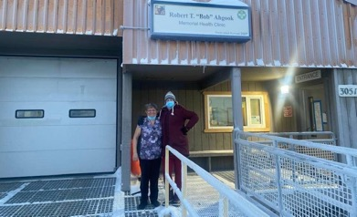
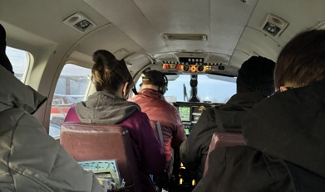
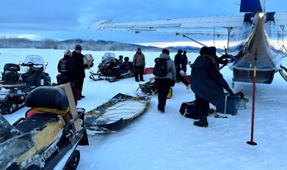
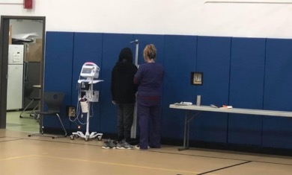
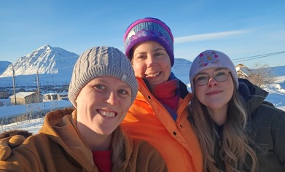
Clinic mission at CAIHC- well checks, acute visits, telehealth appointments
Pediatric call for villages and subregions, urgent care, other providers at CAIHC, and outside providers
Village Pediatric Care
Notes:
Each care team takes care of a region of villages

Slide 37
Political Changes & Healthcare Impact (2024–2026) on Alaska Native Communities
Underserved populations face disproportionate barriers to care
Key policy area changes negatively impacting health:
Medicaid
SNAP (food assistance)
Vaccine information and public health

Slide 38
Background & Medicaid Changes
Alaska Native Health Context
Life expectancy ~8 years lower than U.S. average
Higher rates of chronic disease
~52% of AIAN children are covered by Medicaid/CHIP
Recent Medicaid Changes
Proposed federal cuts of ~$911 billion over 10 years
Estimated 10 million more uninsured people
Medicaid is a primary coverage source and a major funding stream for Tribal health systems, including the Indian Health Service

Slide 39

Food Insecurity & SNAP Disruptions
Key Statistics
Alaska has some of the highest food costs in the U.S.
Rural households can spend 2–3× more on groceries
AIAN populations experience higher food insecurity rates than the national average
SNAP Changes
Temporary benefit disruptions during federal shutdown
Policy pressure to reduce program funding
Health Impact
Increased food insecurity
Increased reliance on low-quality foods
Higher rates of chronic diseases
Increased stress and mental health challenges

Slide 40

Vaccine Misinformation & Public Health
Trends
Rising vaccine hesitancy linked to misinformation
Some childhood vaccination rates have fallen below herd immunity thresholds for some diseases (~95%)
Impact on Alaska Native Communities
Rural access challenges amplify risk
Increased vulnerability to outbreaks
Key Issue
Misinformation reduces trust in healthcare systems and preventive care uptake

Slide 41
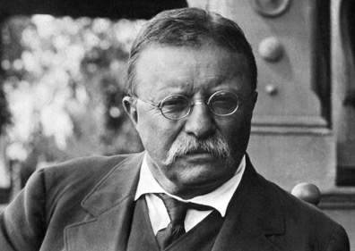
"I have never in my life envied a human being who led an easy life; I have envied a great many people who led difficult lives and led them well."

Slide 42
Resilience and Leadership from TCC
Focus on self governance and unified advocacy against Medicaid Cuts and defending tribal exemptions for Medicaid and SNAP benefits
Expanded telehealth services to reach remote villages, improving access despite provider shortages
Supported sanitation and infrastructure programs (clean water, waste systems) that directly improve health outcomes
Public Health & Vaccination Efforts
Deployed community health workers to combat misinformation and increase trust→ emphasize shared decision making
Staff awareness and education
Food Security & Community Support
Partner with local communities to support subsistence practices and food-sharing networks
Promote nutrition programs addressing chronic disease
Notes:
The only way out is through
At CAIHC clinic, we have resource advocates that help with everything from housing insecurity to food insecurity to transportation difficulties. We also have WIC and Alternate Resources to assist with navigating the difficult paperwork process

Slide 43
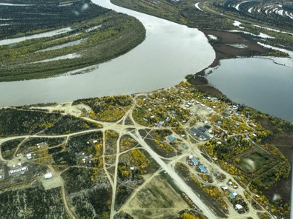
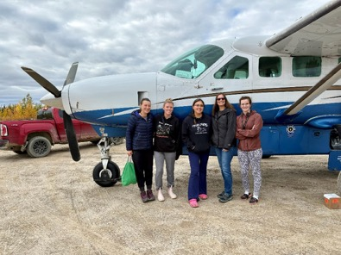
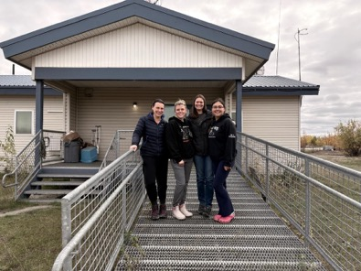
HUSLIA

Slide 44
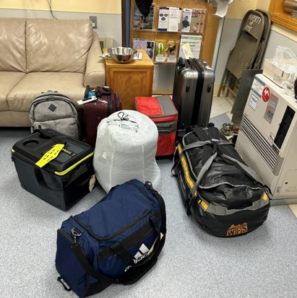
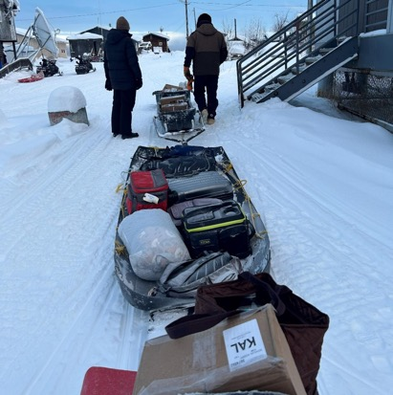
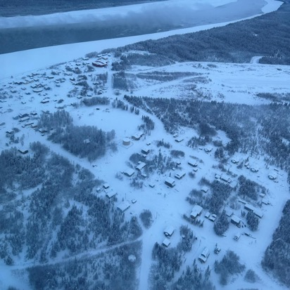
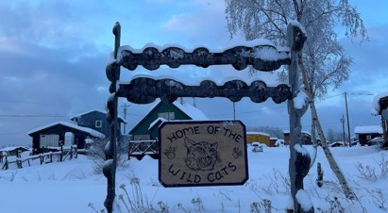
KALTAG

Slide 45
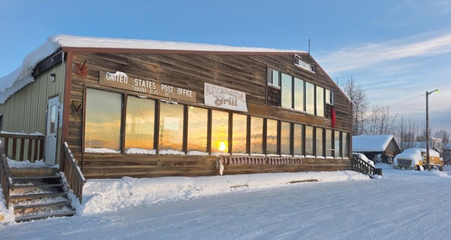
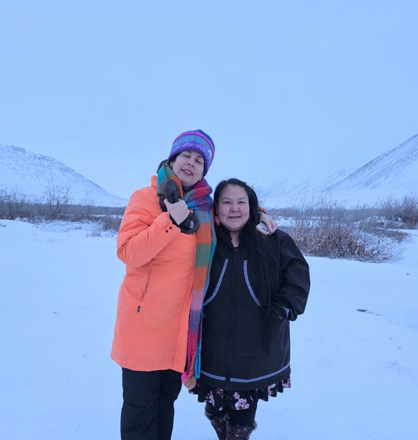
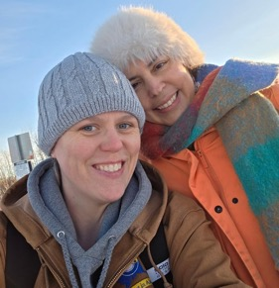
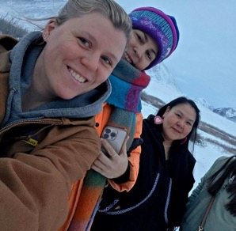
AKP and TANANA

Slide 46
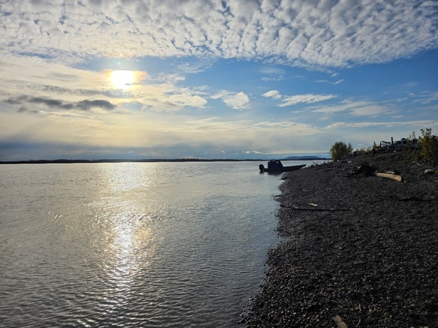
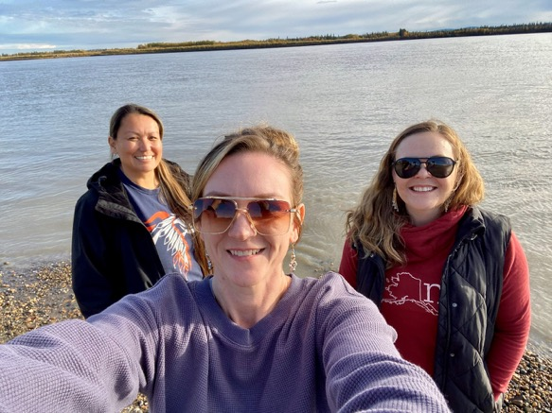
GALENA

Slide 47

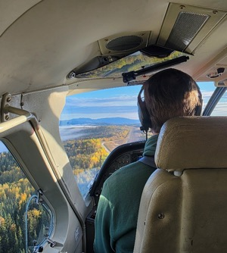
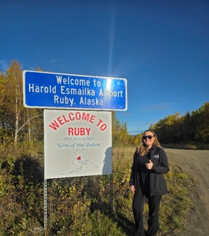

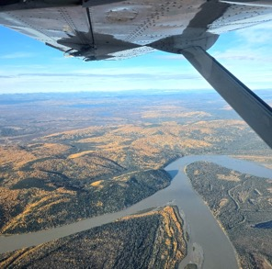
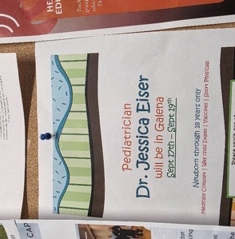

Slide 48
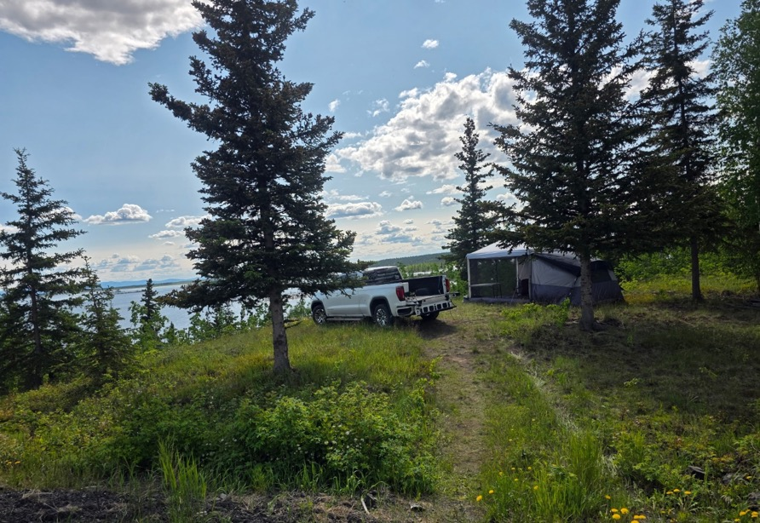
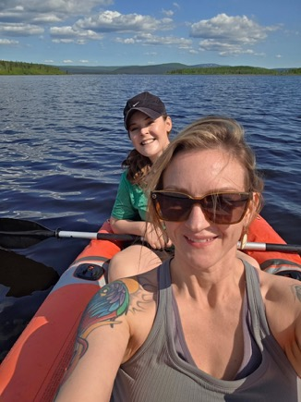
MINTO

Slide 49
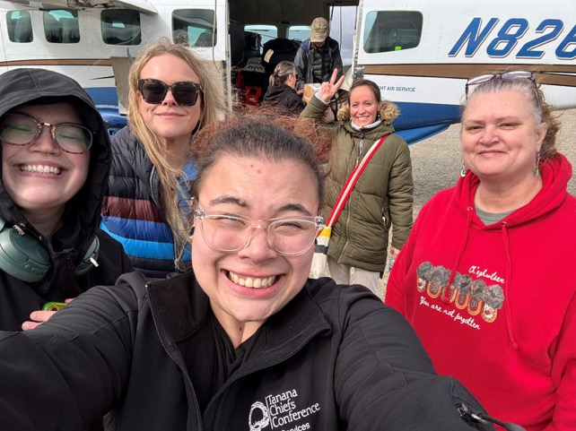
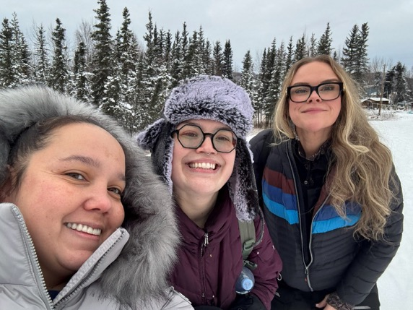
ALLAKAKET

Slide 50
ANTHC EpiCenter Public Health Grant
Grant funding for purpose of improving public health infrastructure
1 year of funding
TCC awarded funding for 3 projects:
Improve well child checks for 0-5 year old patients
Evaluate & improve Hepatitis C screening program
Continue & improve HPV vaccine initiative

Slide 51
Improving Child Health: Identifying and addressing barriers to well-child visit adherence among 0-5 year olds

Slide 52
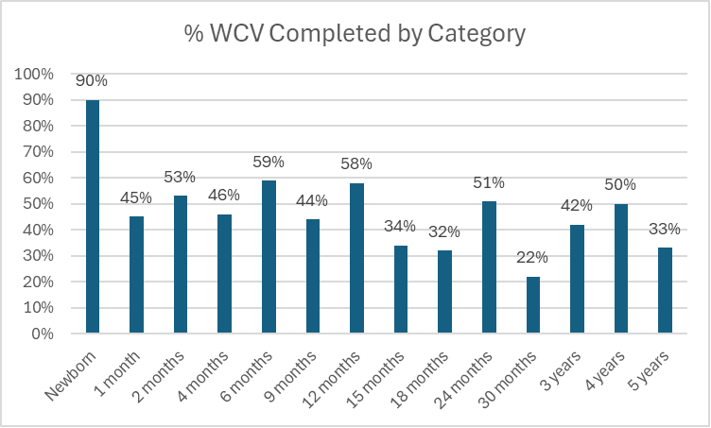
TCC Well Child Visit Rates (ages 0-5)

Slide 53
Why Well-Child Visit Attendance Matters
For Individual Children
For Families & Communities
Early detection of developmental, behavioral, and medical concerns
Timely and complete immunizations
Fewer preventable hospitalizations
Structured guidance for parents on growth, safety, and wellness
Improve access to care and support health equity
Shifts utilization from emergency and urgent care settings
Reduce communicable diseases
Serve as consistent touchpoint for social needs resources

Slide 54
Initial Steps

Slide 55




Launching Awareness: Early Messaging
Social Media Campaign & Digital Monitors
Newsletter Article

Slide 56
Getting Started: Early tweaks to scheduling & access
Expand scheduling to Family Medicine Providers & Open Access Slots
Increased sports physical clinics and convert sports physicals
→ full well child checks

Slide 57

Supporting Well-Child Visits in Primary Care
Handouts for staff
Patient facing screening schedules

Slide 58


Slide 59
HPV Campaign
1. Clinical Staff Education at staff meetings
2. EHR Alert – The Athena Quality Measure was changed from forecasting at 11yrs to forecasting due at 9yrs
3. Back-to-School Clinics
4. Village and Subregion Outreach
5. Patient Text Messages
6. Staff Acknowledgement- Recognizing clinicians and their clinical support staff
Notes:
TCC HPV vaccination rates have been historically low, and the HPV Vaccine Workgroup was formed in May 2024 to improve these rates. Since its inception, the workgroup has identified obstacles and implemented a variety of successful interventions
The group has been focusing our efforts on the younger 9-14yo to help with early vaccination and prevention as well targeting the age when the vaccine is most effective.

Slide 60

Thank you!
Jessica.eiser@tananachiefs.org
907-451-6682 ext 4972

Slide 61
Rachel Evans, PHN3 & Jenna Hibdon, PHN2
Fairbanks Public Health Center

Slide 62


Fairbanks Public Health Center: Interior Immunization Rates
Rachel Evans, Itinerant PHN 3
Jenna Hibdon, PHN 2
April 3, 2026
Notes:
Both introductions

Slide 63

Mission and Vision for the Section of Public Health Nursing
Mission: Partnering with Alaskans to protect and improve the health and wellbeing of communities.
Vision: Alaskans thriving across generations
Notes:
Rachel

Slide 64
PHN priority program areas
Reduce Vaccine Preventable Diseases
Improve the Health of Children
Prevent and Respond to Tuberculosis and other Infectious Diseases
Reduce Sexually Transmitted Infections
Support Community Mental Health and Wellbeing
Notes:
Rachel

Slide 65

Immunization Highlights
In December 2025 CDC and ACIP recommended shared clinical decision-making for administration of the Hepatitis B (HepB) birth dose in infants born to HBsAG-negative mothers. CDC continues to review evidence regarding serology testing and provide guidance at a future date.
In January 2026, the CDC updated their childhood immunization schedule recommendations. We currently are still following our current medical directives.
PHN is working with the State of Alaska Immunization program on messaging and communication.
Notes:
Jenna
Our current childhood and adolescent immunization schedule.
With all the changes with the CDC and ACIP groups, “Our practice and medical directives follows the childhood and adolescent immunization schedule as recommended by the American Academy of Pediatrics, consistent with current evidence-based guidance.”

Slide 66

Vaccine series coverage rate (%), 2019-2025
Childhood vaccination rates have been close to 60% for two years. Since 2024, school-required vaccination coverage declined among kindergarten-aged children through Q4.
https://health.alaska.gov/media/zupbfy3i/vaccination-coverage-q42025.pdf
Notes:
Rachel
History, Alaska has consistently had lower rates throughout history
In the orange is the kindergarten rates, there was a gradual decline from 2019 on and you can see from 2023 there has been a sharp decline

Slide 67


Vaccines by Region
Vaccination rates vary by region and age group. During 2025 Q4, Anchorage and Southeast regions had the highest rates for childhood immunizations. The Northern region had highest coverage rates among kindergarten ages.
https://health.alaska.gov/media/zupbfy3i/vaccination-coverage-q42025.pdf
Notes:
Rachel
This graph shows the state by region,
you can see in the orange and blue
The Interior has the lowest kindergarten rates and the lowest childhood series
These are compared to the rest of Alaska

Slide 68

















Childhood Series:
https://health.alaska.gov/media/dozcjxuu/ak-vaccination-coverage.pdf
https://health.alaska.gov/media/zupbfy3i/vaccination-coverage-q42025.pdf
2024
2025
Notes:
Jenna
Quarter 2- March through June 2024. We are looking at rates for completion for the childhood series. By end of June 2024, the interior region was at 57% and then if you look down to the second chart by the end of December 2025, rates for completion were 48%.
Biggest drops were PCV and Hib
HIB dropped from 69% to 62% and PCV was 71% to 58%.

Slide 69




Kindergarten Series:
https://health.alaska.gov/media/dozcjxuu/ak-vaccination-coverage.pdf
https://health.alaska.gov/media/zupbfy3i/vaccination-coverage-q42025.pdf
2024
2025
Notes:
Jenna
Drop from 46 to 40, 6 % in that year and a half.
DTaP went from 50 to 43 %
MMR did increase from 51 to 62 %
EPI bulletin Pertussis update Alaska 2024-2025 published Oct 25
-During the summer and fall of 2024, unvaccinated children in Alaska were more than 13 times as likely to contract pertussis as those who were up to date on their pertussis immunizations.
With how low our Dtap rates are, this is concerning and likely contributed to our pertussis outbreak numbers.

Slide 70
SOPHN Strategic Plan
In 2024, the SOPHN Strategic Plan was updated for FY 2025-2028.
What we decided to focus on…
Goal: Prevent disease and promote the physical, mental, and social health of children through on-time pediatric preventative screening and immunizations.
Objective: Increase childhood immunization rates at the local level.
Notes:
Rachel
Switching gears, a leadership group was formed and worked on updating the Strategic plan for fiscal year 2025-2028.
As a health center, we came together and discussed. What could we do, what should we focus on?
One of the goals we chose to focus on was increasing childhood immunization rates at the local level.

Slide 71
What FPHC is doing to increase rates
-Holding offsite vaccine clinics
-Working with schools
-Offering late night hours and walk-ins
-Immunizations records review
-In home Flu and Covid for those that are homebound
-Other offsite clinics and immunization education at various community events
-SWOT (Strength, Weaknesses, Opportunities and Threats) analysis
Notes:
Rachel
I am part of the Itinerant team, we have done multiple offsite vaccine events
Including in healy and working with their school nurse
We also worked with Yukon Koyukuk school district
We are going to hold a Flu POD in healy this next fall season
Currently we are in works with some of the schools to try and hold vaccine events to get children up to date including at some elementary schools and possible high schools
We also will offer some summer offsite events at certain schools which is in the works
Every month we do the North Pole Clinic trying to reach the those that might need to get up to date and don’t want to or cant come to fairbanks
Than another project we will talk about is the SWOT analysis and what that entails

Slide 72
Immunization SWOT Analysis 2025
8 semi-structured interviews were conducted with stakeholders who regularly engage with children and families.
We interviewed multiple partners in the community ranging from medical professionals, early childhood education leaders, childcare providers, Alaska Immunization program, and family/child health programs.
Interviewees shared firsthand observations about community attitudes, logistical barriers, and the effectiveness of current communication strategies.
Notes:
Rachel
SWOT analysis, the reason this came about was a leadership group updated the Strategic plan for fiscal year 2025-2028.
Due to the local vaccinations rates are group decided to focus on increasing childhood immunizations rates in our community.
We started this project in 2024 through early 2025 to collect data
We split into two workgroups. One analyzing data and the other collecting data through key informant interviews. We identified key questions and key stakeholders. We outreached and narrowed down our interviews for those available.
We outreached multiple community partners for potential interviews, ultimately completed 8 interviews with stakeholders
We did 6 semi-structured key questions with our partners to gain understanding of the current situation and identify ways to strengthen our community
introduction
Reintroducing who you are and why we are doing these interviews.
Could you please introduce yourself and your role within your agency?
How is your organization involved with vaccination efforts?
Interview Questions
What do you think are the community’s general attitudes towards childhood vaccines?
Are there any common concerns or misconceptions you’ve heard from parents or guardians about childhood vaccines? Where are they getting this information?
What do you see as the biggest barriers that prevent children from getting vaccinated in this community, and what additional supports or resources would be helpful in overcoming these barriers?
What past incidents or events, do you think have negatively affected community trust in vaccines?
What strategies, interventions, or messaging are most successful with parents or guardians in promoting childhood vaccinations?
What suggestions do you have for improving communication about childhood vaccines in this community?
Closing
Is there anything else that you would like to add?

Slide 73
Strengths
Weaknesses
Policy Requirements Drive Uptake
Digital Tools Are Making It Easier
High Compliance Among Certain Populations
Health Department Partnerships and Flexibility
Strong Staff Engagement
Flu and COVID-19 Vaccines Not Required
Technical/System Barriers
Varied Immunization Requirements
Negative Experiences for Staff
Access Barriers for Low-Income Families
Notes:
Jenna
Policy Requirements Drive Uptake: Childcare and school requirements are major motivators for parents to keep children up to date with vaccines. When a school or a daycare has a requirement to attend, parents are more likely to follow those requirements.
Digital Tools Are Making It Easier: Platforms like Docket and Self ImmAGE help streamline immunization record-keeping, improving compliance and reducing enrollment delays. Since launching Docket in late 2022, it has provided patients with direct access to their vactrak imms records and their childrens.
High Compliance Among Certain Populations: Military families, in particular, are consistently up to date on immunizations with their kids.
Health Department Partnerships and Flexibility: Offsite clinics, Clinics offering later hours, walk in availability, weekend availability at a health event are helpful for working parents to help limit barriers for those families.
Strong Staff Engagement: A lot of the partners we spoke with were actively supporting parents by checking records, notifying about upcoming needs, and encouraging use of tools.
Weaknesses
Flu and COVID-19 Vaccines Not Required: These remain optional, are not tracked by programs, and thus fall off parents’ radars.
Technical/System Barriers: Misalignment between federal (e.g., Military) and state immunization systems can cause confusion and false non-compliance. If a military child received one dose at a non-military clinic, that single dose is recorded without their full vaccination history artificially lowering rates.
Varied Immunization Requirements: Differences between requirements from different organization can lead to reduction in full vaccination compliance of the CDC recommended childhood vaccine schedule. The school district has different requirements that the CDC recommended vaccine schedule which can cause confusion.
Negative Experiences for Staff: Enforcing vaccine requirements can put staff in conflict with parents, creating emotional labor and interpersonal tension.
Access Barriers for Low-Income Families: Transportation, inflexible clinic hours, and time off work remain persistent barriers.

Slide 74
Opportunities Threats
Normalize Vaccination Through Peer Stories
Enhanced Use of Reminder Systems
Improved Messaging
Misinformation and Vaccine Myths
Distrust in Government and Medicine
Increased Use of Exemptions
Complacency Due to Success
Multiple Priorities
Notes:
Rachel
Opportunities
Normalize Vaccination Through Peer Stories: Trusted community voices sharing positive vaccine experiences could help counter misinformation and increase trust.
Enhanced Use of Reminder Systems: Promoting and expanding use of Docket or similar apps could empower families to stay current.
Provider Education on Adult/Booster Vaccines: Increase training and awareness among primary care providers to discuss Tdap and other boosters during adult visits.
Improved Messaging: Emphasize vaccine safety, community protection, and clarify that vaccines like dTap needs boosters.
Threats
Misinformation and Vaccine Myths: Persistent beliefs in disproven theories (e.g., autism link) continue to influence decisions and drive exemption use.
Distrust in Government and Medicine: Historical and cultural distrust, amplified by media and social networks, undermines confidence in public health messaging.
Increased Use of Exemptions: Religious or philosophical waivers are being used not just for belief but also as a workaround for convenience or control.
Complacency Due to Success: Low visibility of vaccine-preventable diseases can reduce perceived urgency for maintaining immunization schedules.
Multiple Priorities: Schools, childcare, and health clinic are managing competing needs, making vaccine education and enforcement more challenging.

Slide 75
Recommendations
1. Launch a “Trusted Community Voices” Campaign
2. Bring Vaccines to the Community — Not the Other Way Around
3. Equip Schools and Childcare Staff with Vaccine Communication Tools
Notes:
Jenna
Multi layered campaign. Part of it we thought would be helpful to have those that have been effected by vaccine preventable diseases sharing their story, an elder affected sharing their trusted guidance to others, a doctor giving their trusted recommendation to their patient, public health nurses giving vaccines at a school. The AK immunization program has some grant funding specific to communication and trusted messaging. We want input from our partners on what a strong campaign would like like and are open to suggestions.
We go to the community. Rates are low so we’ve outreached schools. Those that are low in compliance, let us come to you and set up clinics, work with families and let them know that we’re coming and want to get their kids up to date.
Communication with parents and families can be challenging. The vaccine climate is hard right now. Conversations can be hard. Providing schools and childcare staff with tools on approaching the topic of vaccines, what they are due for, and how to have these conversations could be helpful.
Including getting input from partners. This is not set in stone.
Immunization has grant money related to communications,

Slide 76

Fairbanks Public Health Center 1025 W. Barnette Street
Open
Mon/Fri 8-5pm
Tues/Wed/Thurs 8-7pm
Walk-in hours Wed/Thurs 1-6pm
Rachel Evans, Itinerant PHN 3
Jenna Hibdon, PHN 2
907-452-1776
Notes:
Questions?

Slide 77
Amanda Johnson Director of Business Development
North Star Behavioral Health

Slide 78
Child & Adolescent Services

Slide 79


Acute Stabilization
Main Hospital - Children & Adolescents
Acute psychiatric hospital for youth (boys and
girls) ages 4 to 18
Term: stabilization up to 30 days
Capacity: 74

Slide 80



Residential Services
Alpine Academy – RTC, Adolescent Girls
Psychiatric residential treatment center for adolescent
girls ages 12 to 18
Capacity: 20 beds
Length of stay: 6 – 12 months
Summit – RTC, Adolescent Boys
Psychiatric residential treatment center for adolescent
boys ages 11 to 18
Capacity: 20 beds with future expansion to 30 beds
Length of stay: 6 – 12 month

Slide 81


Who Qualifies for Acute Services:
Boys and girls between the ages of 4-17 who are struggling with mental health concerns:
Self-harming behaviors
At high-risk of self-harming behaviors
Harm to others
In need of short-term crisis stabilization

Slide 82
Who Qualifies for Residential Services
Boys ages 11-18 and girls ages 12-18 who need more formal supports to build life skills in a safe and controlled environment.
Those who struggle with maintaining healthy life skills in the home
Those who are discharging from the acute level of care, but aren't ready to go home yet

Slide 83
How to Refer
Call our intake team: 907-264-3506
They are available in-person 7a-11p and oncall during the night.
Walk-in 24/7; psychiatric ER Fax referral: 907-279-1438

Slide 84
Heidi Haas Executive Director
Alaska Center for Children and Adults

Slide 85

Alaska Center for Children & Adults (ACCA) Presentation to A2P2 | April 3, 2026

Slide 86
Why are we here?
Vision
All Alaskans are able to reach their full potential.
Mission
ACCA improves the lives of individuals experiencing developmental disabilities, delays, and mental health needs, regardless of income, throughout their lifespan.
Values
Compassion, Respect, Relationships, Quality, Inclusion

Slide 87


Our Team
Developmental Therapists
Occupational Therapists
Speech-Language Pathologists
Physical Therapists
Teacher of the Visually Impaired
Teacher of the Deaf/Hard of Hearing
Social Workers
Autism Specialists
Infant Massage Specialist
FASD Coordination and Support
Developmental Disabilities Access Coordinator
Family Service Coordinators
Our Region
Hearing and Vision Screeners
Family Service Specialists
Referral Specialist
Billing Support Specialists
Program Support Specialist
Office and Financial Management

Slide 88

ACCA PROGRAMS
Child & Family Wellness Program
FASD Diagnostic Team
Clinical Mental Health Services
Infant Early Childhood Mental Health Services
Developmental Disabilities Resource Connection
Waiver and resources for individuals with disabilities
Infant Learning Program
Early Intervention/Special Education Services for children birth to age 3
Loan Closet
Adaptive mobility equipment

Slide 89
ACCA UPDATES
Child & Family Wellness Program
Accreditation and Medicaid Licensing for behavioral health services.
Now accepting children for clinical services (waitlist)
Developmental Disabilities Resource Connection
Statewide support for resource connection
Infant Learning Program
Working on legislation to expand early intervention services

Slide 90

Referrals
Referrals can be made to any of our programs by individuals or other providers in the communities. Visit our website or email us to learn more about programs available in your region.
www.alaskacenter.org
907-456-4003
ACCA programs are voluntary, and we respect individual choice to decline referral to our services.

Slide 91
Meredith Maple Executive Director
Fairbanks Children’s Museum

Slide 92
Current Location: Historic Woolworths 302 Cushman Street
7,500 SF
Future Location:
City Hall
800 Cushman Street
15,000 SF
Attendance:
On-Site: 50,000+
Outreach: 20,000+
Budget:
$470,000 in 2019
$850,000 in 2025
Museum Staff:
Leadership (3 FT & 1 PT)
Education (7 FT & 4 PT)
Support (1 PT)
Wellness Coalition Staff: Leadership Staff (1 FT) Program Staff (2 PT)
Future Early Learning Center Staff:
Leadership (1 FT)
Education (5 FT)
Support (2 PT)

Slide 93

Programs
Interactive Play-Based Exhibits
Daily Pre-K Programming Mess Makers, Pint-Size Science, Movin’ & Groovin’, After School Skills
Parent Support
Baby Mingle, Baby Cafe, Kids Night In, Foster Care Visitation
School Age Programming
Field Trip Workshops, Art & Science Classes, Homeschool Support
Drop Off Programming PreKamp, Summer Camps, FNSBSD Break Day Camps

Slide 94



it’s more than just play...
preventing ACEs providing PCEs
supporting isolated parents
many Interior families’ sole resource for early childhood education
improving kinder readiness & increasing high school graduation rates
...it’s prevention & education
through play

Slide 95








Help Me Grow Alaska is an agency dedicated to promoting healthy child development across Alaska by providing support and information to individuals and organizations who care for and about children, youth, and adults ages prenatal-26. Whether you are a parent, provider, teacher, or other caregiver with questions or concerns about a child in your life, we are here to help you.
Our call center is staffed with Family Support Specialists, individuals with experience in, and an understanding of, child development, social services, and resources available in Alaska and beyond. They are available to listen to concerns, help organize a path forward, and get families connected to the most available and appropriate service across Alaska.
To order materials scan the QR code or visit:
a2p2.org/help-me-grow-alaska/

Slide 97

Are you a professional working with young children not currently able to access Infant and Early Childhood Mental Health (IECMH) Consultation, including Family, Friend and Neighbor care, home visiting, early intervention, medical or social service providers?
Growing Minds offers support for providers in nurturing young children’s social and emotional development and to enhance the quality of care for children from birth through five years old across settings. This is a non-emergency service for providers to receive guidance on their practice or to ask questions about a specific concern in their professional setting.
Call 1-833-HMG-ALASKA (1-833-464-2527) today and ask to be connected with Growing Minds!
or visit helpmegrowak.org/growing-minds
The Health Resources and Services Administration (HRSA), Department of Health and Human Services (HHS) provided financial support for this publication. The award totaled $3,057,637.00 and contents may not reflect the policies of HRSA, HHS, or the U.S. Government.

Slide 98


Slide 99
Thank you for joining!
Special thanks to the Foundation Health Partners for hosting the March Partnership Meeting.
To our presenters and colleagues: Thank you for your meaningful connections and for keeping the community’s voice at the heart of what you do. We are inspired by your hope and your partnership!

Slide 100


Notes:
Put link in chat: https://secure.givelively.org/donate/all-alaska-pediatric-partnership/a2p2-30th-anniversary

Slide 101


Thank you for joining this months Partnership Meeting!
Stay informed!
Scan the QR code and sign up to the All Alaska Pediatric Partnership’s mailing list.
Partnership Meeting resources and presentations from recent meetings are available on the
All Alaska Pediatric Partnership (A2P2) website a2p2.org

