Slide 1


January Partnership Meeting
Alaska Native Medical Center
Anchorage, Alaska
Friday, January 9, 2026
12:00-1:30 pm
Presented by the All Alaska Pediatric Partnership (A2P2).
A2P2 transforms systems of care and increases equitable access to health care and related services to ensure all Alaska’s children reach their full potential.
Learn more at a2p2.com or by scanning the QR code

Slide 2

Agenda
Welcome!
Announcements
  Tamar Ben-Yose, All Alaska Pediatric Partnership
Presentations
  Dr. Robert Lawrence, Complex Care Initiative, State of Alaska Dept. of Health
  Jen Bracamontes, Rachel Lescher, & Jessical Kelly, ASPN Program
  Jodi Sides & Pam Finch, Nutaqsiivik Tribal Home Visiting Program
  Carly Byrne, Primary Children’s Collaboration
  Rebecca Cleveland and Sam Matteucci, Pediatric SLP
  Summer Lefebvre, Pediatric Behavioral Health
  Monica Lee and Dawson Hoover, Typhoon Halong Response in Yukon-Kuskokwim Region

Slide 3

Announcements
Tamar Ben-Yosef, All Alaska Pediatric Partnership

Slide 4



2026 Alaska Rural Health
Transformation Program
Convening
January 14 | Virtual
January 15-16 | In Person in Anchorage, AK

Slide 5



For 30 years, A2P2 has brought together private, public, and tribal partners to improve the health and wellbeing of Alaska’s children. From shaping the state’s first pediatric subspecialty clinics to leading efforts in provider education, early childhood systems, and family support through Help Me Grow Alaska, our work is built on collaboration and care.
As we celebrate this legacy, we invite you to help carry it forward. Your gift supports A2P2's work on behalf of Alaska’s children, families, and the communities they are part of.
Notes:
Put link in chat: https://secure.givelively.org/donate/all-alaska-pediatric-partnership/a2p2-30th-anniversary

Slide 6
Growing Minds
Carmen Wenger, All Alaska Pediatric Partnership

Slide 7
Dr. Robert Lawrence
Complex Care Team, State of Alaska Department of Health

Slide 8
Complex Care Team
Department of Health
Medical
Conditions
& Disabilities
Behavioral
Health
Conditions
Complex Care
Robert Lawrence, MD
Amanda Woody, MPH
Christal Hays
Other Factors
January 9, 2026

Slide 9
DOH Complex Care Team
Established in June 2025 in the Commissioner’s Office
Representatives from each of DOH’s Divisions:
DPH, DBH, HCS, SDS, and DPA
Medical
Conditions
& Disabilities
Behavioral
Health
Conditions
External Functions
Complex Care
Unclogging System-Level Issues:
If you’re encountering a delay or barrier within one of our divisions,
we can facilitate communication
Coordinating Complex Medical Cases:
We can assist in coordinating transfers for medically complex individuals
Connecting to Grant Resources:
We can help identify grant programs designed to serve specific populations
Connecting to other State Departments:
DOH’s Complex Care Team also works closely with other Departments including:
DFCS, OPA, and DOC and can triage cases involving multiple State entities
Other Factors

Slide 10
DOH Complex Care Team
Contact Information
Doh.complex.care.team@alaska.gov
Robert Lawrence, MD
Chief Medical Officer
Amanda Woody, MPH
Policy Advisor to the Chief Medical Officer
Christal Hays
State Medicaid Coordinator

Slide 11
Jen Bracamontes, Rachel Lescher, & Jessical Kelly
ASPN Program, Southcentral Foundation

Slide 12
Jodi Sides & Pam Finch
Nutaqsiivik Tribal Home Visiting Program, Southcentral Foundation

Slide 13
Nutaqsiivik
Tribal Home Visiting
Pamela Finch, RN, BSN, MSML, CPN, CCCTM, CLC
Jodi Sides, RN, BSN, MPH, IBCLC, ANLC
January 9, 2026

Slide 16
Nutaqsiivik: A Place of Renewal
Use the Nurse-Family Partnership model
  Children are healthy. Families thrive. Communities prosper. Cycles are broken.
Our approach:
  Focus on relationships, build trust​
  Foster self-sufficiency—education, job, home
  Help families navigate community resources, social services, and healthcare system​
  Meet families “where they are at” (figuratively and literally!)

Slide 17

Who We Serve
Pregnant women living in Anchorage and the Matanuska-Susitna Borough who have:
limited social support (including teens);
historical or recent OCS involvement;
history of substance misuse; or
history of mental health conditions, such as depression and anxiety

Slide 18
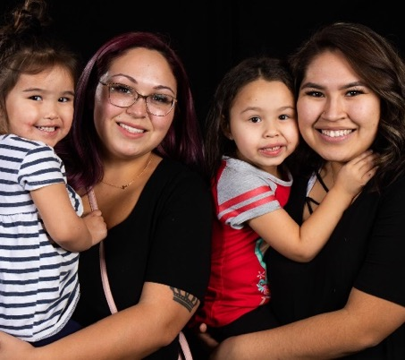
Services
During pregnancy and until the child is two, an assigned nurse provides:
Pregnancy, infancy and toddler development education
Breastfeeding education and support
Environmental assessments and home safety education
Appointment and transportation assistance
Referrals to and help navigating community resources
A listening ear and trustworthy support

Slide 19
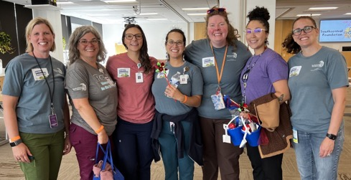
Nutaqsiivik in 2025
Over the past year, the Nutaqsiivik home visiting program:
Received over 700 referrals
Enrolled and connected with at least 148 new families
Served 261 families in Anchorage, Chugiak, Eagle River, Palmer, and Wasilla
Conducted 2,646 home visits
Graduated 46 families (engaged in the program for ~2.5 years)

Slide 20
Nutaqsiivik in 2025 (con’t)
86%
Caregivers screened for depression
94%
Caregivers screened for substance abuse
91%
Children had well-child visits
100%
Families received injury prevention training
100%
Caregivers screened for intimate partner violence

Slide 21
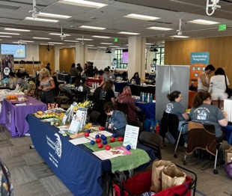
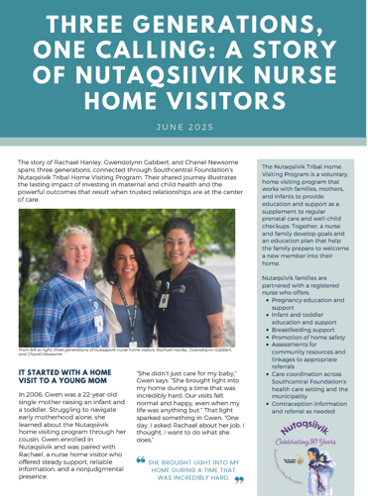
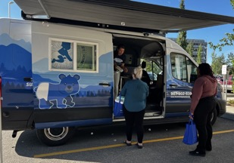
Activities and Accomplishments
Maternal Health Resource Fair
Incorporated Count the Kicks
Safe Sleep training
Community Advisory Board meetings
Connected with other home visiting programs across Alaska
Dissemination
  Presentation at National Indian Health Board
  “Issue brief” highlighting three generations of home visitors in Nutaqsiivik
Notes:
The August 4th event included 23 community programs including the State immunization program, car seat program, the local diaper pantry, Stone Soup Group, Head Start, as well as SCF programs like Health Education, WIC, midwife/OBGYN clinic, and Child and Family Developmental Services. Over 175 customers attended the event. Nurse home visitors and other team members were available at a table to answer questions of potential participants and those awaiting an invitation to join the program. The diaper pantry gave out 2,800 diapers to 51 families. The Health Education department made egg bites, mini pancakes, sandwiches, and hummus. There was a door prize raffle with 16 prizes that included safe sleep kits with pack and plays and sleep sacks; strollers; and other fun prizes.

Slide 22

Looking Forward in 2026
Focus on:
  postpartum care for moms (ensure they receive a postpartum visit with a health carte provider)
  educating families about safe sleep
Continue to contribute to a coordinated, comprehensive early childhood system that supports the development happy, healthy, and successful Alaska Native/American Indian children and families.

Slide 24
Carly Byrne & Ceci Rodriguez
Primary Children’s Collaboration, ANMC

Slide 25
ANMC PICU Training with Intermountain Health Primary Children’s Hospital
Carly Byrne, DNP, APRN, PCNS-BC, CCNS, FCNS
Ceci Rodriguez, BSN, RN
January 7, 2025

Slide 26
Problem Statement
ANMC has not had a comprehensive orientation program for PICU RN training for many years. Due to the small size of the unit and low patient volumes, it is challenging to orient staff and build upon knowledge and skills in a way that ensures patient safety. In 2023-2024, the unit experienced PICU RN turnover and has largely been reliant on PICU traveler RNs. Nurses currently on the unit have either voiced concerns and/or declined to train due to orientation gaps. Efforts to build a training program within ANMC and within the State of Alaska have proven to be challenging due to low patient volumes. When new-to-specialty staff are provided with a comprehensive orientation, patient safety, staff retention, and employee satisfaction/confidence are best optimized.

Slide 27
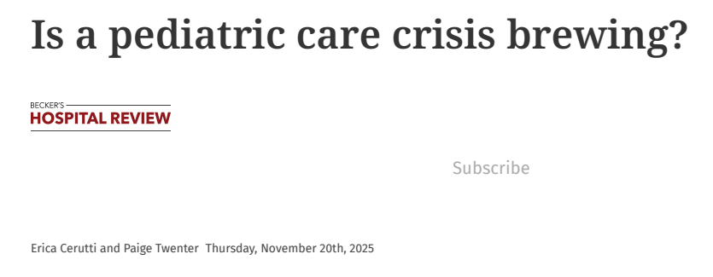
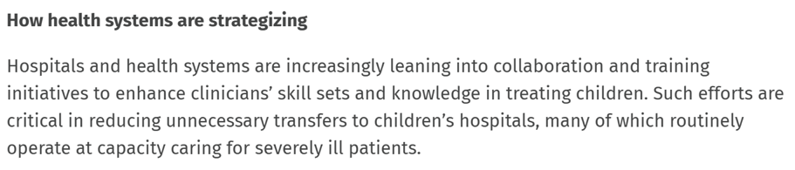
Accessed Jan 7, 2026 from Is a pediatric care crisis brewing?

Slide 28
Goals
Create a sustainable PICU RN training program that optimizes patient safety, RN scope of practice, and RN confidence related to critical care skills and knowledge.
Incorporate evidence-based learning strategies:
  Hands-on
  Didactic
  Online learning
  Simulation
Identify an outside organization willing to partner with ANMC to create a sustainable training program.

Slide 29

Strategic Alignment
ANMC Strategic Plan:
Empower the Workforce
Enhance the System of Care
ANCC Pathways to Excellence:
Appropriate Staffing
AACN Healthy Work Environment Standards:
Several EOPs within the Professional Development section

Slide 30
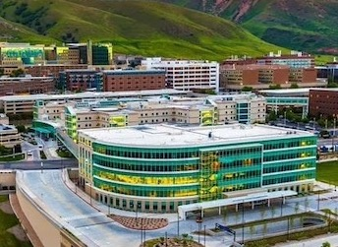
Intermountain Health Primary Children’s Hospital
Large PICU and CVICU
Well known for their training and education programs
Opportunity aligned with PCH’s own mission and values

Slide 31
Outcomes
Secure
Secure training contract with Intermountain/PCH.
Implement
Implement initial training plan (hands-on/didactic) and trial with 1 cohort.
Train
Train 8-12 RNs in PICU for FY 2026 at Intermountain/PCH and complete their orientations at ANMC.
Reduce
Reduce the number of travelers by 60% in FY2026.
Create
Create a sustainability plan that shifts education/didactic responsibilities to ANMC staff by end of FY2026.
Monitor
Monitor impact of program on key metrics (patient safety, staff satisfaction, and staff turnover) during FY2026.

Slide 32
Timeline- Key Events
Jan.–Mar. 2015
Initial discussions with ANMC/PCH leaders
Apr. 2015
ANMC site visit to PCH
Aug. 2015 – 2022
Multiple attempts to secure training
Feb. 2024
Stakeholder meeting to determine PCH’s interest
Sep. 2024
Purchased Children’s Hospital Association (CHA) Modules
Jan. 2025
All CHA PICU modules uploaded
Feb. 2025
Contract secured
Apr.–May 2025
Trial onsite training with 1 ANMC RN
Oct. 2025
PCH offers PICU didactic training at ANMC
Oct.–Nov. 2025
4 RNs complete 4-week PICU training at PCH

Slide 33
PICU Training
1. Online CHA Modules
2. Didactic Education with Case Studies
3. Training at PCH (4 weeks)
4. Training at ANMC
5. Simulation

Slide 34
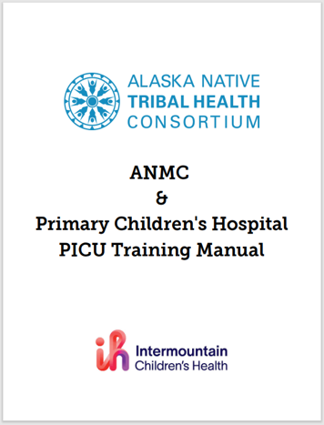
Overview of Didactic Education
Class One
  Metabolic
    Cardiac Output
    Shock
    Vasopressors Indication
  Neuro Trauma
    Anatomy Review
    Monroe-Kellie Doctrine
    ICP management
    EVD and bolts
    Seizure Management
Class Two
  Respiratory
    Pediatric Anatomy
    Oxygenation/Ventilation
    Ventilator Management
    Blood Gas Interpretation
  Cardiac
    Blood flow through the heart
    Congenital Heart defects
    Qp:Qs

Slide 35
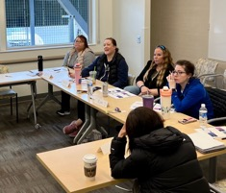
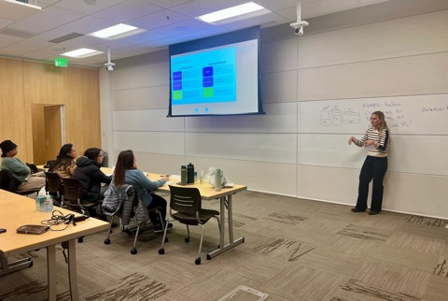
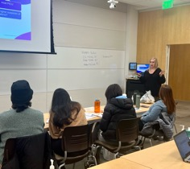
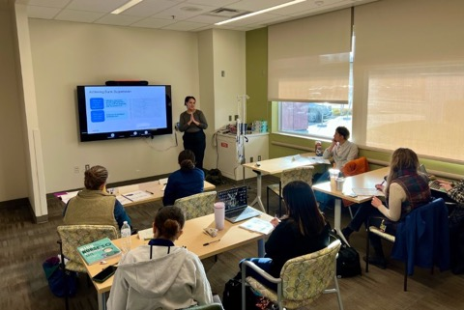
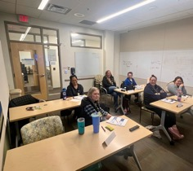
Didactic Education

Slide 36
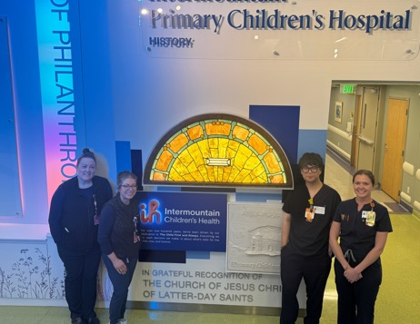
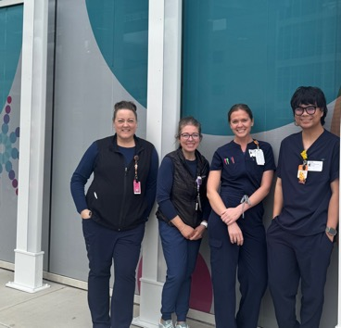
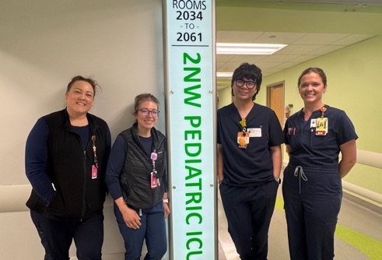
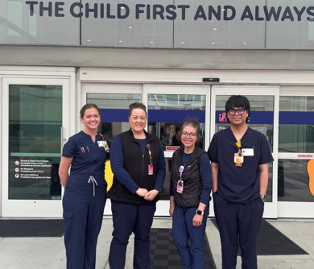
4 Week Training at PCH- November 2025 Cohort #1
November 2025 Cohort:
Rachel Cooper, RN
Christina Griffin, RN
Talia Sladek, RN
Sian Gonzales, RN
Training Dates:
October 27-November 20, 2025
Training at Intermountain/PCH:
Direct patient care, didactic education, simulation
Engaged with leaders across different disciplines to highlight the collective effort behind high-quality care delivery

Slide 37

Next Steps
Renew contract
Organizing future cohorts for training
  Experienced and new to specialty
Host more collaborative didactic classes with PCH team
Continue to restructure and develop ANMC PICU Orientation using PDSAs
Track/monitor outcomes
  RN retention
  RN satisfaction
  RN competency
  Financials
  Number of PICU RNs
Begin succession planning- shifting the education to ANMC staff

Slide 38
Dissemination of Work
Submit for poster/podium presentation
ANOL, ANPD, Magnet Conferences
Write manuscript for publication
Target journal: JONA
Magnet Exemplar for PCH/ Pathways for ANMC
Write up exemplars for both organizations

Slide 39
Key Learnings
Highly complex- would have benefited from more change management tools & ensured all stakeholders had access to it:
  Logic Model
Intentional communication plans from all stakeholders
  Needed a thoughtful communication plan that all stakeholders agreed to
Flexibility and persistence is key

Slide 40
Big thanks!!!
ANMC Teammates
Intermountain Health
Meri Clare
Rachel Cooper
Audrey DeGrote
Gina Demasellis
Patti Ellisor
Ben Ferreira
Sian Gonzales
Christina Griffin
Ed Groves
Matt Hirschfeld
Jolie Limon
Stephanie McBride
Robert Miljure
Ceci Rodriguez
Talia Sladek
Emily Stevens
Brooke Adams
Katie Davies
Angie Hunt
Shantelle Jensen
Kara Kamerath
Jessica Lake
Jake Miller
Jillian O’Karma
Erin Rickey
Tracey Webb
And many others at Primary Children’s and within PCH’s PICU

Slide 41

With much Gratitude
Dr. Matt Hirschfeld and Sandy Haldane for their initial out-of-the-box thinking and initial funding for a site visit back in 2015
Special thanks to Marilyn Deykes and Linda Oxley for their early support of this initiative

Slide 42

Contact Information:
Carly Byrne, DNP, APRN, PCNS-BC, CCNS, CENP, FNCS
Clinical Nurse Specialist
cdbyrne@anthc.org
Ceci Rodriguez, BSN, RN
Clinical Nursing Professional Development Practitioner
carodriguez@anthc.org

Slide 43
Rebecca Cleveland & Sam Matteucci
Pediatric SLP, Southcentral Foundation

Slide 44
Alaska Cleft Lip & Palate Program

Slide 45
About Cleft Clinic
Sponsored by Southcentral Foundation and housed in the K’kuyaqa Niłtu building on the main Anchorage campus
Occurs every 6 weeks, across two days (Monday & Tuesday)
OPEN TO ALL Alaska residents with qualifying cleft and/or craniofacial needs
No age limit; we see 18+
Interdisciplinary
Insurance is billed for beneficiaries and non-beneficiaries. We can see anyone across AK if they have a cleft lip/palate.
Notes:
-We are the only accredited cleft lip and palate program in Alaska. We see customer-owners from across the state regularly.
We do not impose an age limit and see people across the lifespan, including prenatal visits when possible.
Timeline for intervention can often range across the lifespan and involve multiple disciplines.
Interdisciplinary – Monday is used for more intensive evaluations including those at ENT; Tuesdays are for quicker check-ins and the interdisciplinary round table, where all the team members share current updates/info for each CO.
[extra info]
Cleft lip +/- Cleft Palate occurs in about 1 in 700 births globally -
Higher Risk Groups: Alaska Native/American Indian, Asian, Pacific Islander and Caucasian populations
Alaska Native/Native Americans are at one of the highest risk rates, about 3.6 per 1000 births
Lower Risk Groups: Hispanic, African populations

Slide 46
Current Team:
  Administrative Care Coordinator
  RN Case Manager
  Two Plastic Surgeons
  ENT provider
  Audiologist
  Pediatrician
  Two SLPs
  Pediatric dentist
  Orthodontist
  Oral and Maxillofacial Surgeon
  Dietician
  Stone Soup Parent Navigator
  Behavioral Health Consultant
Notes:
List of current CLP team members –reference briefly for more information
Referral form is at the bottom of the CLP Clinic page, access it from SCF main home page. Current team page needs some updating, but all the roles are filled!
Preferred to have referral from PCPs with a diagnosis, if possible

Slide 47
SLP role in the cleft clinic
The American Cleft Palate Craniofacial Association (ACPA) requires cleft clinics to have a speech therapist, to maintain accreditation
Provide prenatal visits if possible (SLPs and surgeons)
Evaluate and treat for feeding/swallowing needs
Provide specialized speech therapy, assess resonance, screen for hearing problems, monitor language development
Collaborate with other disciplines, assess whether certain speech errors can be treated in therapy
Collaborate with school and community SLPs as needed
Notes:
-ACPA – nationally recognized standard of excellence for cleft care
-Prenatal visits – support with feeding with a cleft, parent education, answer questions
-Evaluate resonance in speech while ENT performs imaging (nasopharyngoscopy)
-Provide input to plastic surgeons if speech errors can be treated in therapy or not (implication being that the family may be recommended a surgery)
-There are specific speech errors that develop when a child has a cleft palate. We may provide speech therapy before and after surgery. Speech therapy is not always, but often required after palatal repair to correct the speech errors that have developed as well as other developmental errors. This is a good example of why SLPs in this role need to be trained to distinguish between an error that a child can unlearn vs. an error that is obligatory to their oral structures. We don’t want to put someone in therapy for months working on a sound they can’t change. We also don’t want to direct families to consider physical management when we could have identified speech errors treatable in therapy.

Slide 48
Follow-Up Care
Families are encouraged to:
Attend annual multidisciplinary care clinics
  May be every 2-3 years dependent on need
Attend specialty appointments (dental, SLP, ENT, etc.) as recommended by the discipline
  Customers may follow up with SCF/ANMC specialty providers or utilize local providers dependent on home location and preference
Utilize various benefits and community resources (taxi vouchers, Stone Soup, ILP, etc.)
Notes:
Different for each individual, frequently does occur across the lifespan

Slide 49
Referrals
  Referrals must be placed by a professional (PCP, SLP, Dental, ENT, etc.)
  Referrals can be placed prenatally or postnatally
  If customers have received care from other teams, providers, or in other countries, they are encouraged to obtain as much medical documentation as possible from the previous places
Notes:
Referral form located at the bottom of the CLP homepage, linked
Please have PCP send referrals with a related diagnosis or concern.

Slide 50
Contact information:
AK Cleft Lip & Palate Program (link)
4441 Diplomacy Drive
Anchorage, AK 99508
Phone: 907-729-5265 Fax: 206-238-9262
Email: scfclpteam@southcentralfoundation.com
Rebecca Cleveland
rcleveland@southcentralfoundation.com
Samantha Matteucci
smatteucci@southcentralfoundation.com

Slide 52
Summer LeFebvre
Pediatric Behavioral Health, Southcentral Foundation

Slide 53
Behavioral Health for Children and Families
Continuum of Care, Service Intensity, & Components of Care
Summer LeFebvre, LCSW, BCBA Clinical Director of Behavioral Services Division
Megan Sherman, Behavior Health Specialty Division Administrator

Slide 54
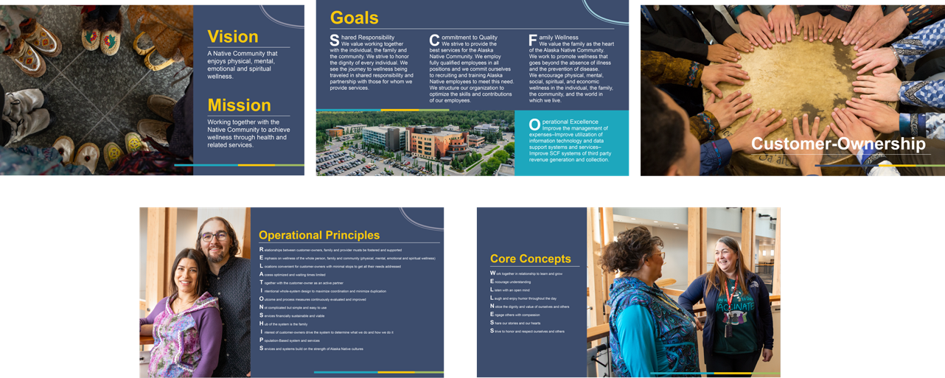
Strong Foundation

Slide 55
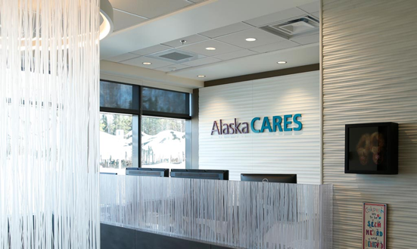
Alaska CARES
Child Abuse Response Evaluation Services (CARES) and Child Advocacy Center (CAC) at The Children’s Hospital at Providence
Provides a multidisciplinary response team for suspected child maltreatment such as physical abuse, sexual abuse, neglect, or witness to extreme violence.
Provides advocacy and forensic interviewing services to Alaska Native and American Indian youth and families undergoing a CARES evaluation.
Serves youth under 18 and adults with developmental delays

Slide 56
Children, and Family System of Care Behavioral Health Service Groups
Child and Family Outpatient Services (CFOS)
  Trails Program
  Intensive Homebased Family Treatment (IHBT)
Alaska Native Cultural Charter School
Benteh Nuutah Valley Behavioral Health
The Pathway Home

Slide 57
SCF Service Intensity Map – BH
Level of Service Intensity
Composite
Score
Composite
Score
All ages
Child & Adolescent
7-10
PCC & VNPCC
Rural
Alaska Native Charter School
7-10
0
1
2
3
4
5
6
11-13
10-13
BH VNPCC
CFOS
14-16
TRAILS Program
14-16
17-19
BURT^{1,2}
17-19
20-22
IHBT
20-22
23-27
TPH²
23-27
28-35
28-35
1. Does not provide all Level 5 & 6 services but does provide some components of care until disposition to those levels of care 2. Statewide resource

Slide 58
Care Components
Care Environment
Clinical Services
Support Services
Crisis Stabilization and Prevention Services

Slide 59
Levels of Service Intensity – CASII
Level 1
Level 4
Level 2
Level 3
Level 5
Level 6
Level 0
Recovery Maintenance & Health Management
Basic Services
Intensive Outpatient Services
Intensive Integrated Services w/o 24h Monitoring
Outpatient Services
Non-secure 24h Services w/ Psychiatric Monitoring
Secure 24h Services w/ Psychiatric Management

Slide 60
SCF Service Intensity Map – BH Child
Level of Service Intensity
All ages
Composite
Score
Child & Adolescent
PCC & VNPCC
Rural
0
1
2
3
4
5
6
7-10
BH
VNPCC
CFOS
10-13
TRAILS Program
14-16
BURT^{1,2}
17-19
IHBT
20-22
TPH²
23-27
28-35
1. Does not provide all Level 5 & 6 services but does provide some components of care until disposition to those levels of care 2. Statewide resource

Slide 61
SCF Service Intensity Map – BH Valley
Level of Service Intensity
Composite
Score
Composite
Score
All ages
Child & Adolescent
PCC & VNPCC
7-10
0
1
2
3
4
5
6
7-10
11-13
10-13
BH
VNPCC
14-16
14-16
17-19
BURT^{1,2}
17-19
20-22
20-22
23-27
TPH²
23-27
28-35
28-35
1. Does not provide all Level 5 & 6 services but does provide some components of care until disposition to those levels of care 2. Statewide resource

Slide 62

0 – Basic Services for Prevention & Health Maintenance
Goal
Prevent onset of illness or limit magnitude of morbidity associated with individual family & social risk factors, developmental delays, & existing BH disorders in various stages of improvement or remission
Placement Criteria
Available to all children, adolescents, & families in community
Crisis resolution & emergency services
Anchorage Native Primary Care Center (Yagheli Shesh Qenq’a)
Valley Native Primary Care Center (Benteh Nuutah)
Family Wellness Warriors (Nu’iju)

Slide 63
0 – Basic Services for Prevention & Maintenance
Care Components
Care Environment
Clinical Services
Support Services
Crisis Stabilization & Prevention
Variety of community settings
Consultative services by MH professionals integrated into all prevention & support functions
Collaborate with distinct community groups to make services available to all
Access to 24-hour emergency evaluation, brief intervention, outreach
Direct services and/or consultation from child & adolescent psychiatrist(s) and/or APRN should be available 24/7.
Primary care & medical settings
Screening for mental health & developmental disorders; systematic screening per Early Periodic Screening Detection & Treatment guidelines
Comprehensive multidisciplinary assessments for children who screen positive for medical, developmental, behavioral, or substance use problems
Prevention services
Community sites, i.e., schools, adult education centers, daycares, faith-based centers, recreational & social settings, family resource centers, vocational & social service agencies
Psychoeducation for parents around behavioral management & early awareness/detection of developmental difficulties
Outreach to vulnerable populations (i.e., homeless families, victims of trauma/disaster, etc.)
Child’s home

Slide 64
0 – Basic Services for Prevention & Health Maintenance
Goal
Provide follow up care
Placement Criteria
Living independently or w/minimal support
Provide non-intensive, episodic care
Avert the need for a higher level of care
Provide care to those with limited need for formal services
Not requiring intense supervision
Anchorage Native Primary Care Center (Yagheli Shesh Qenq’a)
Valley Native Primary Care Center (Benteh Nuutah)
Family Wellness Warriors (Nu’iju)

Slide 65
1 – Recovery Maintenance & Health Management
Care Components
Care Environment
Clinical Services
Support Services
Crisis Stabilization & Prevention
Mental health clinic
Non-intensive, episodic, readily accessible as needed
Natural community supports & resources that families can access without professional intervention
Access to 24-hour emergency evaluation, brief intervention, outreach
Integrated behavioral health program in primary care
Direct services and/or consultation from child & adolescent psychiatrist(s) and/or APRN should be available 24/7.
Typically, CO only needs single service from the system of care

Slide 66
2 – Outpatient Services
Goal
Placement Criteria
Mental health services for those living in community with their families
Living in community with family
Not requiring intense supervision, or extensive system or care coordination
May be step up from level 1 or step down from level 3
For those stepping down from higher level, goal is to maintain and build upon gains already made
Valley Native Primary Care Center (Benteh Nuutah) Behavioral Health
Child and Family Outpatient Services
  Trails
Rural Behavioral Health

Slide 67
2 – Outpatient Services
Care Components
Care Environment
Clinical Services
Support Services
Crisis Stabilization & Prevention
Mental health clinic
1 hour every other week – 2 hours/week (or less if just Rx management)
Access to 24-hour emergency evaluation, brief intervention, outreach
Integrated behavioral health program in primary care
Direct services and/or consultation from child & adolescent psychiatrist(s) and/or APRN should be available 24/7.
Generally, do not require extensive care coordination; families able to use community supports with minimal assistance
School setting
Home setting
Juvenile justice
Community setting
Resembles traditional outpatient services
Individual, group, family therapies
Psychiatric consultation or management available
Usually natural community supports
May need help/support with financial assistance, housing, childcare, vocational and/or educational services

Slide 68
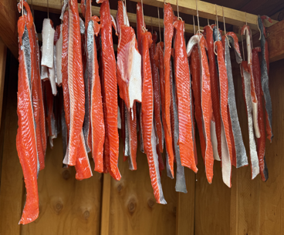
3 – Intensive Outpatient Services
Goal
Placement Criteria
Help child and their family stabilize with care and targeted/limited care coordination
Living in community with family with support or in alternative family/group setting
For those who need higher level of care than traditional outpatient services but do not need restrictive settings
For those stepping down from higher level of care, to maintain gains made.
Consider age, size, degree of cooperation of child and family/community resources available
Child and Family Outpatient Services
  Trails Program

Slide 69
3 – Intensive Outpatient Services
Care Components
Care Environment
Clinical Services
Support Services
Crisis Stabilization & Prevention
2+ days per week
Access to 24-hour emergency evaluation, brief intervention, outreach
Direct services and/or consultation from child & adolescent psychiatrist(s) and/or APRN should be available 24/7.
Home setting
Traditional outpatient mental health setting
Individual, group, family therapies
May need help/support with financial assistance, housing, childcare, vocational and/or educational services
Community setting
Individualized crisis plan
Psychiatry services
Recreational and/or vocational services, as indicated for stabilization
Referral for clinical services for family members
Transition planning for discharge to lower level of care
SLP/OT/PT, as indicated
Support services should emphasize natural supports within community
May include care coordination
Family partners/peer mentors

Slide 70
4 – Intensive Integrated Services w/o 24-Hour Psychiatric Monitoring
Goal
Placement Criteria
Provide intensive treatment with a multidisciplinary team
Living in community with support with family or in placement (e.g., group home, foster care, transitional housing, shelter)
Needs require involvement of multiple components of system of care
Consider ability of child to maintain safely within community
Examples: ACT, PHP
Child and Family Outpatient Services
  Trails Program
  Intensive Homebased Family Treatment (IHBT)

Slide 71
4 – Intensive Integrated Services w/o 24-Hour Psychiatric Monitoring
Care Components
Care Environment
Clinical Services
Support Services
Crisis Stabilization & Prevention
Access to 24-hour emergency evaluation, brief intervention, outreach
Direct services and/or consultation from child & adolescent psychiatrist(s) and/or APRN should be available 24/7.
Intensive day treatment
Individual, group, family therapies
Detailed, individualized crisis plan
Psychiatry services
Recreational and/or vocational services, as indicated for stabilization
Transition planning for discharge to lower level of care
SLP/OT/PT, as indicated
Individualized service plan with dedicated care coordinator
Partial hospitalization program
Home-based care
Available at times to meet family need, including non-traditional times (evenings, weekends)
Accessible primary care
Wrap around plan to build on child/family strengths
Professional care coordination services
Recreational activities
Assistance for family with support/assistance for housing, finance, childcare, vocational and/or educational services
Family centered services with goal of reintegrating child into home and community
Mobile crisis
Access to specialized providers during crisis
Respite care
Care provided wherever needed to maintain child in their home or community placement
Address transportation needs

Slide 72

5 – Non-Secure, 24-Hour Services w/ Psychiatric Monitoring
Goal
Placement Criteria
Environment to meet therapeutic needs of child & family intensively
May begin services at or transition into Level 5.
Timely return of the child to their family & community
Consider child’s age, size, degree of cooperation of child, and family & community resources
The Pathway Home

Slide 73
5 – Non-Secure, 24-Hour Services w/ Psychiatric Monitoring
Care Components
Care Environment
Clinical Services
Support Services
Crisis Stabilization & Prevention
May require higher levels of care for brief periods to manage crises and maintain safety
Direct services and/or consultation from child & adolescent psychiatrist(s) and/or APRN should be available 24/7.
Detailed, individualized crisis plan (especially prior to community re-integration)
Psychiatry services
Transition planning for discharge to lower level of care
Individualized service plan with dedicated care coordinator
Daily clinician services
Wrap around plan to build on child/family strengths
Professional care coordination services
Family support partners and family centered services with goal of reintegrating child into home and community
Access to specialized providers during crisis, either in program or part of community
Non-hospital setting
Residential care
Therapeutic foster home
Child’s home if wraparound services to insure safe & intensive treatment environment
Frequent psychiatric provider contact
Individual, group, family therapies
Supervision of ADLs
Escorted off campus passes to help with safe community reintegration
Assistance for family with support/assistance for housing, finances, childcare, legal, vocational and/or educational services
When in an institutional setting, space must be safe, appropriate to developmental status of child
Adequate staffing to manage aggressive and/or endangering behaviors

Slide 74
6 – Secure, 24-Hour Services w/ Psychiatric Management
Care Components
Care Environment
Clinical Services
Support Services
Crisis Stabilization & Prevention
Provide all necessities of living and wellbeing
Detailed, individualized crisis plan that anticipates complications during transition to lower level of care
Comprehensive clinical services
Secure setting; closed & locked facility typically
Hospital
Locked residential facility
Child’s home if wraparound services to insure safe & intensive treatment environment, and maintain medical & psychiatric care standards of Level 6
Assess & meet legal, educational, recreational, vocational, spiritual needs
24/7 monitoring
Psychiatric medication management
Individual and family therapy
May include medical detoxification
Individual plan must address aggressive, suicidal, and/or self-endangering behavior
Child & adolescent psychiatrist supervising care with daily contact
Review clinical status daily
Treatment of co-occurring medical conditions
Consider social & cultural factors in care & d/c planning
Assistance for family with support/assistance for housing, finances, childcare, legal, vocational and/or educational services
Early development of transition/coordination plan for transition to lower level of care
Describe all services in an individualized treatment plan
Rapid response to fluctuations in psychiatric and/or medical status
Emergency medical services available on-site or in close proximity
All staff trained in emergency protocols
Free of potential harms
Adequate staffing to monitor child

Slide 76
Monical Lee & Dawson Hoover
Typhoon Halong Response in the Yukon-Kuskokwim Region

Slide 77
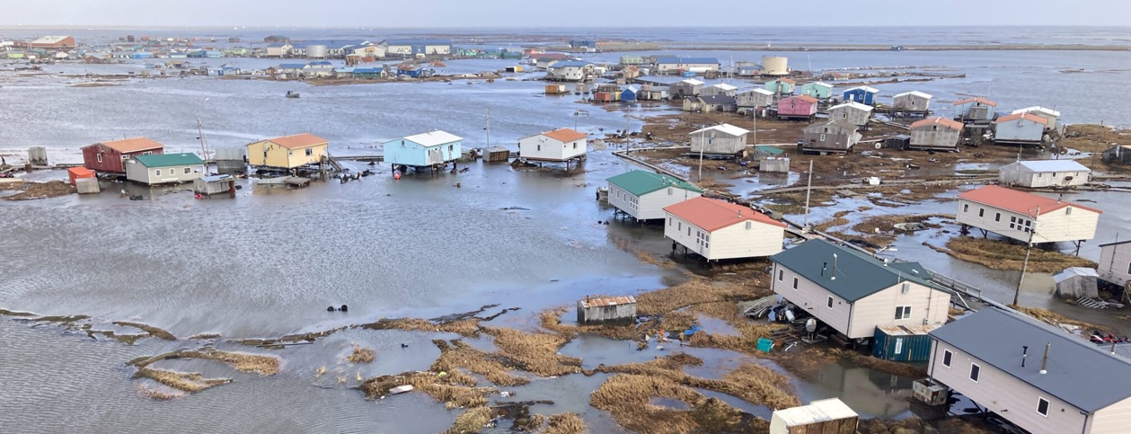
Typhoon Halong 2025: A Crisis and Its Aftermath
Understanding the impact and recovery efforts of the disaster
Monica Lee and Dawson Hoover
Notes:
---
This slide references information from the following file: https://www.usatoday.com/story/news/nation/2025/10/16/alaska-search-rescue-operations-typhoon-halong/86722266007/
What Caused the Crisis

Slide 78
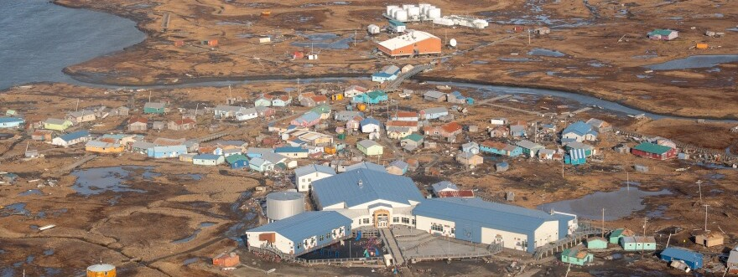
On October 12, 2025, powerful hurricane-force wind gusts from what once was
Typhoon Halong tore though remote, coastal communities, unleashed record-breaking storm surges and shifted homes completely off their foundations.
This primarily affected the indigenous communities of Kipnuk, Kwigillingok,
Bethel, Kotzebue and Nome.

Slide 79
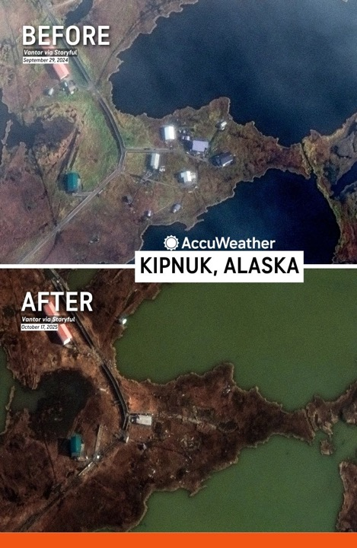
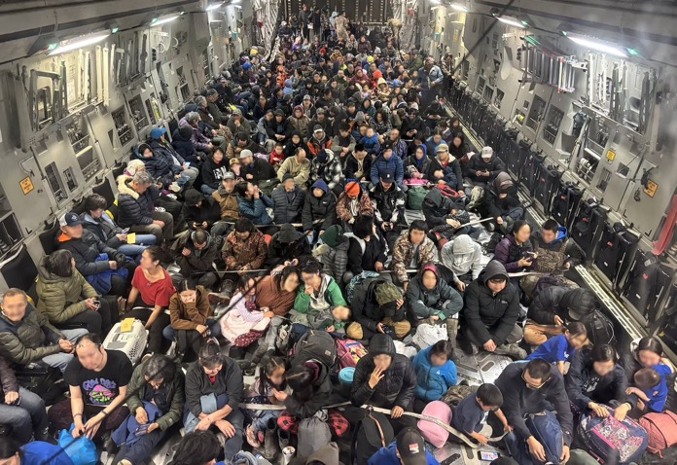
Impact and Evacuation
Photo Credit: Staff Sgt. Joseph Moon/Alaska National Guard

Slide 80
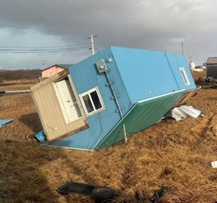
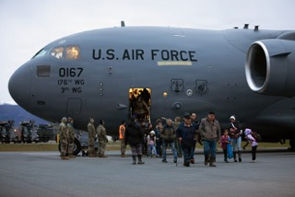
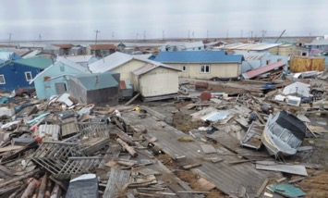
Impact on Villages and People
Extensive Home Destruction
About 90% of homes in Kipnuk and one-third in Kwigillingok were destroyed by the typhoon.
Displaced Residents
Over 1,600 residents were displaced due to homes and infrastructure damage.
Infrastructure Damage
Storm severely damaged roads, power lines, and water systems essential to daily life.
Cultural and Economic Impact
Loss of fishing equipment and food stores disrupted the subsistence lifestyle of residents.
Notes:
---
This slide references information from the following file: https://en.wikipedia.org/wiki/Typhoon_Halong_%282025%29
The impact of Typhoon Halong on Western Alaska was devastating, particularly for the Alaska Native villages of Kipnuk and Kwigillingok. In Kipnuk, approximately 90% of homes—121 in total—were destroyed, while Kwigillingok saw about a third of its homes swept away. These communities, which rely heavily on subsistence hunting and fishing, were left in ruins. Over 1,600 residents were displaced, with many homes floated off their foundations and essential infrastructure, such as roads, power lines, and water systems, severely damaged or rendered inoperable. Tragically, one person was confirmed dead, and two others remain missing. The storm's force uprooted boardwalks, snapped utility poles, and scattered personal belongings across miles. The destruction extended beyond physical damage, disrupting the cultural and economic lifelines of these communities. The loss of food stores, fishing equipment, and traditional structures has had a profound impact on the residents' way of life. The scale of the disaster has prompted urgent calls for federal assistance and highlighted the need for long-term recovery and adaptation plans to safeguard these vulnerable populations.

Slide 81
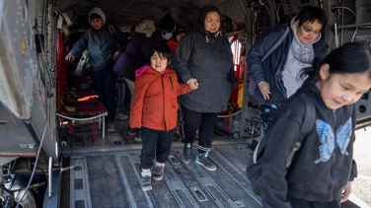
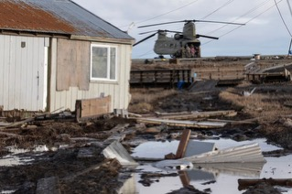
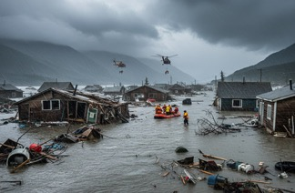
Evacuation to Anchorage
Search and Rescue Operations
Alaska National Guard and U.S. Coast Guard evacuated residents from flood-affected villages.
Large-Scale Military Airlift
Hundreds transported via C-17 Globemaster planes to Anchorage from regional hub Bethel.
Emergency Shelter Setup
Shelters established in schools and arenas to support displaced residents in Anchorage.
Collaborative Relief Services
Red Cross, FEMA, and local authorities provided food, medical care, and emotional support.
Notes:
---
This slide references information from the following file: https://en.wikipedia.org/wiki/Typhoon_Halong_%282025%29
In the wake of Typhoon Halong's destruction, the Alaska National Guard and U.S. Coast Guard launched an extensive search-and-rescue operation to evacuate residents from the hardest-hit villages. Hundreds of people were airlifted from flooded homes in Kipnuk and Kwigillingok to Bethel, a regional hub. From there, evacuees were transported to Anchorage aboard military aircraft, including C-17 Globemaster planes. The evacuation was one of the largest airlifts in Alaska's history, necessitated by the remote locations of the affected communities and the urgency of the situation. In Anchorage, emergency shelters were established in schools, sports arenas, and convention centers to accommodate the influx of displaced residents. The American Red Cross, in collaboration with FEMA and local authorities, provided essential services such as food, water, medical care, and emotional support. The rapid mobilization of resources and personnel was critical in ensuring the safety and well-being of evacuees, many of whom had lost everything. The evacuation effort also underscored the logistical challenges of disaster response in remote and infrastructure-limited regions.

Slide 82
Response and Recovery
Notes:
---
This slide references information from the following file: https://alaskabeacon.com/2025/10/15/in-photos-mass-evacuation-of-kipnuk-and-kwigillingok-residents-begins-from-western-alaska/
First 2 Days in Anchorage, Week Since the Storm

Slide 83
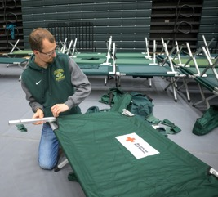
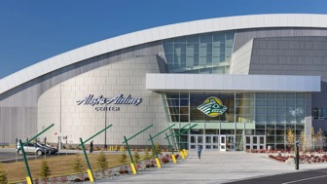
First Days in Anchorage
Emergency Shelter Setup
Shelters at the Alaska Airlines Center and Egan Center provided safe spaces with cots, meals, and medical aid.
Volunteer and Organizational Support
Alaska Native organizations, State and local governmental efforts, military support, Red Cross, churches, schools and community members came together to feed, provide medical care, donate time, supplies, and emotional support to evacuees.
Local Aid and Healthcare Coordination
ANTHC and SCF collaborate to have a presence in shelters to support immediate health and wellness needs and accommodate access to local services.
Notes:
---
This slide references information from the following file: https://alaskabeacon.com/2025/10/15/in-photos-mass-evacuation-of-kipnuk-and-kwigillingok-residents-begins-from-western-alaska/
Upon arrival in Anchorage, evacuees from the storm-ravaged villages were welcomed into emergency shelters set up at the Alaska Airlines Center and the Egan Civic and Convention Center. These facilities were quickly transformed into safe havens, offering cots, meals, and medical assistance. Volunteers and staff from the American Red Cross and other organizations worked tirelessly to provide basic necessities, including clothing, hygiene products, and emotional support. The Anchorage School District played a pivotal role by enrolling displaced students and offering services such as mental health counseling, language assistance, and transportation. The first 48 hours were marked by a flurry of activity as local and state officials coordinated logistics, assessed needs, and began planning for longer-term housing solutions. The cultural and emotional toll on the evacuees was profound, as many faced the reality of not being able to return home for months, if at all. Community leaders emphasized the importance of creating an environment of healing and support, recognizing the unique cultural and social needs of the Alaska Native populations. The swift and compassionate response in Anchorage provided a critical foundation for the ongoing recovery efforts.

Slide 84
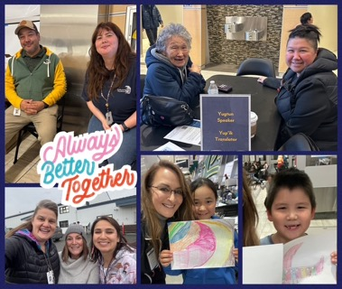

Week Since the Storm
Shift from Rescue to Recovery
Recovery efforts moved from rescue to stabilization and damage assessment across affected regions.
Community Resolutions for Support
Alaska Federation of Natives called for national disaster declaration and rural infrastructure investment.
School District Assistance
Schools enrolled displaced students and provided counseling, language help, and transport.
Coordination and Planning
Officials coordinated logistics and began planning longer-term housing solutions quickly.
Notes:
---
This slide references information from the following file: https://alaskabeacon.com/2025/10/15/in-photos-mass-evacuation-of-kipnuk-and-kwigillingok-residents-begins-from-western-alaska/
In the week following Typhoon Halong's landfall, recovery efforts have shifted from immediate rescue to stabilization and assessment. Federal and state agencies, including FEMA and the Alaska Division of Homeland Security and Emergency Management, have been conducting damage assessments across the affected regions. The Alaska Federation of Natives convened during its annual convention in Anchorage, where it passed resolutions calling for a national disaster declaration and long-term investments in rural infrastructure. These resolutions emphasized the need for improved housing, emergency preparedness, and climate resilience in remote communities. Meanwhile, tribal organizations and local governments have been working to dry out and salvage homes, distribute supplies, and provide support to displaced residents. The Yukon-Kuskokwim Health Corporation has been instrumental in coordinating healthcare services and anticipating the challenges posed by the approaching winter freeze. The collective response has highlighted both the resilience of the affected communities and the systemic vulnerabilities that need to be addressed to prevent future disasters of this magnitude.

Slide 85
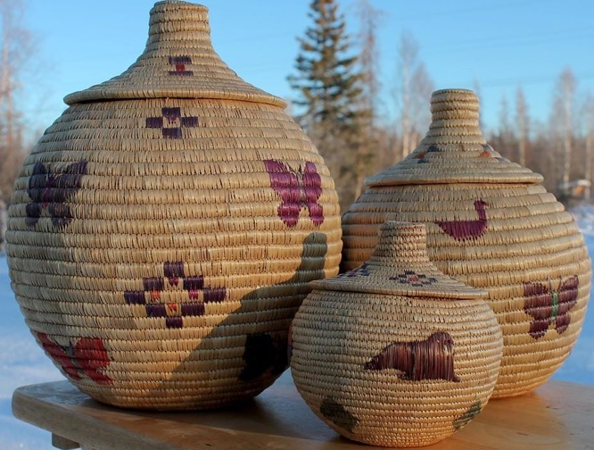
Quyana for your interest and support
(Yup’ik word for Thank you)

Slide 86






Help Me Grow Alaska is an agency dedicated to promoting healthy child development across Alaska by providing support and information to individuals and organizations who care for and about children, youth, and adults ages prenatal-26. Whether you are a parent, provider, teacher, or other caregiver with questions or concerns about a child in your life, we are here to help you.
Our call center is staffed with Family Support Specialists, individuals with experience in, and an understanding of, child development, social services, and resources available in Alaska and beyond. They are available to listen to concerns, help organize a path forward, and get families connected to the most available and appropriate service across Alaska.
To order materials scan the QR code or visit:
a2p2.org/help-me-grow-alaska/

Slide 87
Thank you for joining!
Special thanks to Alaska Native Medical Center for hosting the January Partnership Meeting.
To the providers and colleagues who presented: Thank you for your tireless advocacy for our people and for the excellence you bring to the Alaska Native Medical Center, Southcentral Foundation, and Alaska Native Tribal Health Consortium every day. Your hard work does not go unnoticed.
Thank you!

Slide 88


Thank you for joining this months Partnership Meeting!
Stay informed!
Scan the QR code and sign up to the All Alaska Pediatric Partnership’s mailing list.
Partnership Meeting resources and presentations from recent meetings are available on the
All Alaska Pediatric Partnership (A2P2) website a2p2.org

