Slide 1



May Partnership Meeting
Unalaska, Alaska
Friday, May 1, 2026
12:00-1:30 pm
Presented by the All Alaska Pediatric Partnership (A2P2).
A2P2 transforms systems of care and increases equitable access to health care and related services to ensure all Alaska’s children reach their full potential.
Learn more at a2p2.com or by scanning the QR code

Slide 2

Agenda
Welcome!
  Dawn Johnson, Iliuliuk Family & Health Services
Presentations
  Dawn Johnson, Iliuliuk Family & Health Services (IFHS)
  Gregory Walter, Iliuliuk Family & Health Services (IFHS)
  Will Day, LifeMed Alaska
  Marie Schliebe, Aleutian Pribilof Islands Association Head Start (APIA)
  Karen Kresh, Unalaska Public Library
  Lynn Crane, Unalaskans Against Sexual Assault & Family Violence (USAFV)
  Libbey Houseman, Sprout Family Services
Announcements
  Carmen Wenger, A2P2 Director of Programs

Slide 3

Dawn Johnson
Chief Executive Officer
Iliuliuk Family & Health Services (IFHS)

Slide 4

WELCOME TO UNALASKA
All Alaska Pediatric Partnership
2026 Partnership Meeting Season Finale
Iliuliuk Family & Health Services, Inc.
Providing Quality Integrated Health Care
For Over 50 Years

Slide 5
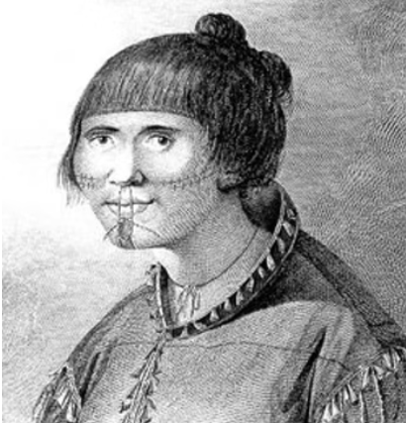
Unalaska: Land of Ancient Heritage
The Unangan people (commonly known as Aleuts) have inhabited Unalaska Island for at least 10,000 years, developing a rich maritime culture. Their population was drastically reduced due to exploitation and diseases brought by Russian fur traders starting in the mid-18th century.
Unalaska is a volcanic island in the Fox Islands group of the Aleutian Chain. Its terrain is rugged and mountainous, with the active Makushin Volcano (6,680 ft) being its highest point. The coastline is dramatically irregular, featuring numerous inlets and bays.
Geographically, Unalaska is farther west than Hawaii.

Slide 6
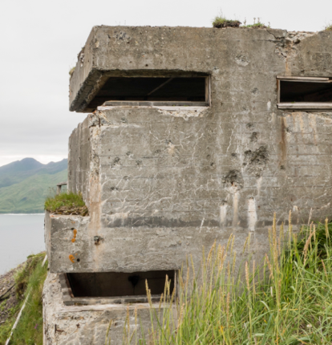
History
Russian Era: Russian fur traders and colonizers were the first non-Natives to establish a permanent settlement in 1759. The Russian-American Company heavily relied on Dutch Harbor for the sea otter fur trade.
World War II Significance: Dutch Harbor was the site of a significant Japanese attack in June 1942, just months after Pearl Harbor. It was one of the few instances of a foreign power bombing the continental United States during World War II. Remnants of military installations from this era, such as bunkers and gun emplacements, are still visible today.
Internment of the Unangan People: Following the bombing of Dutch Harbor, the U.S. government evacuated and interned hundreds of Unangan people from the Aleutian Islands, including Unalaska, to squalid camps in Southeast Alaska. Many died due to poor conditions, and this event had a devastating and lasting impact on Unangan culture and communities.

Slide 7
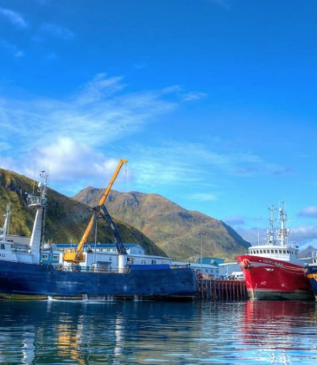
The Nation's Premier Fishing Port
The Port of Dutch Harbor is consistently the #1 commercial fishing port in the United States by volume of seafood landed, a title it has held for over 25 consecutive years. It also frequently ranks first or second in terms of the value of its catch.
It serves as a crucial hub for the Bering Sea and Aleutian Islands fisheries, with massive harvests of pollock, cod, halibut, and various species of crab (like those famously depicted in the Discovery Channel series "Deadliest Catch," which is largely based out of Dutch Harbor).
The port is ice-free year-round, a critical factor for its bustling fishing industry.

Slide 8
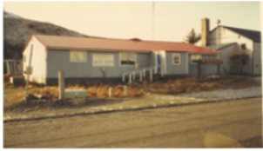
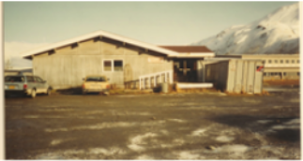
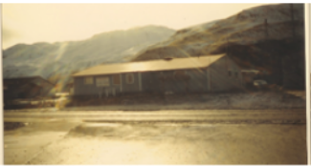
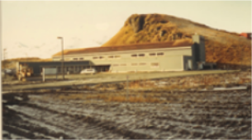
IFHS: Our History
1970
A Community Health Aide clinic was started in the Unalaska school.
1971
Unalaska Board of Health contacted the State to help establish a more definitive medical facility and the name Iliuliuk Family and Health Center was chosen.
1972
IFHS recognized as a non-profit organization by the State of Alaska. The clinic moved from the school to a room in the community center.
1973
IFHS placed a pre-fab building from Seattle on acquired land in Unalaska to serve as the clinic.
1992
IFHS moved into their current building of approximately 20,000 sq ft.
1996
IFHS named as “Outstanding Rural Practice” by National Rural Health Association.
2002
IFHS changed its designation from a Rural Health Center to a Community Health Center which provided funding from the federal government for primary care.

Slide 9
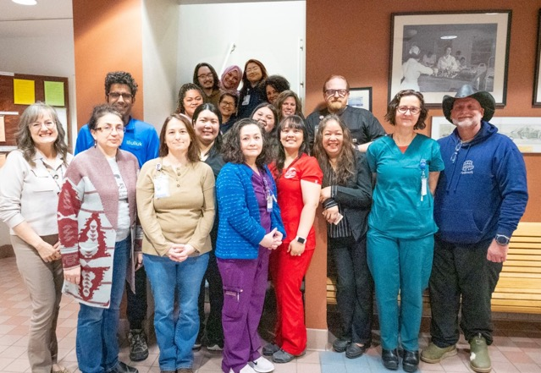
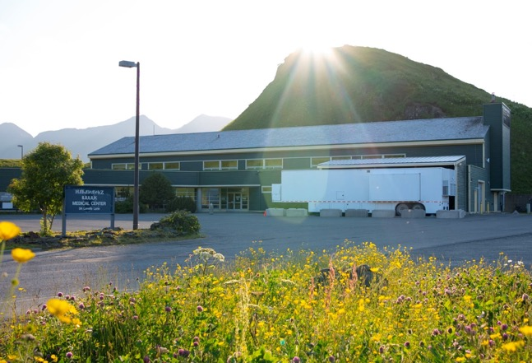
IFHS Today
Primary Care
Dispensary
Lab and Radiology
CT Services added in 2024
Emergent and After-Hours Care 24/7

Slide 10
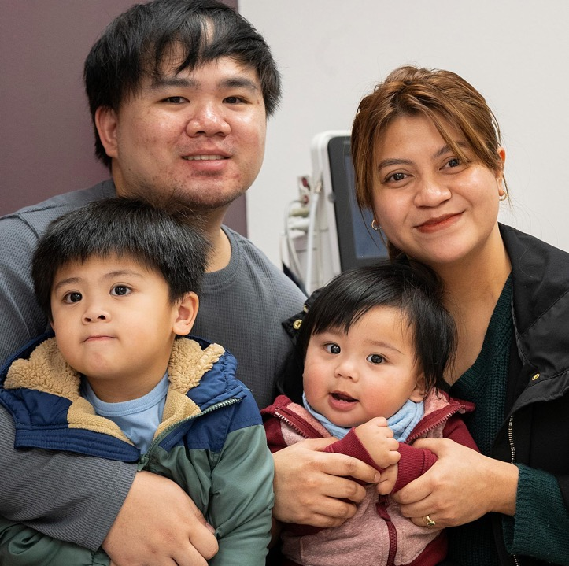
Serving Unalaska’s Children & Families
Since 1971, Iliuliuk Family and Health Services has been woven into the fabric of life in Unalaska — present for first steps, well-child visits, late-night fevers, and every milestone in between.
As a Federally Qualified Health Center and the only primary care provider on Unalaska Island, we are honored to serve children and families with compassionate, comprehensive care 365 days a year.
In a place as remarkable as Unalaska, our families deserve a health center that shows up. That's exactly what we've been doing for over 50 years.

Slide 11
Gregory Walter
Nurse Practitioner (NP)
Iliuliuk Family & Health Services (IFHS)

Slide 12
Iliuliuk family and health services
Greg Walter, NP

Slide 13
agenda
Strengthening pediatric care in Unalaska
2025 Referral overview

Slide 14
Partnership with A2P2
Monthly care coordination meetings
Facilitates access to pediatric specialists
Additional support for patients with complex needs
Notes:
Monthly meetings where A2P2 shares changes and resources for pediatric patients in Anchorage

Slide 15
Challenges
Travel often required for specialty care
Delays are common
No pediatrician on island or for consultation
No specialists
Notes:
Getting flights can be challenging – just one airline that has regularly scheduled flights here, very expensive, can be delayed for days by weather
Care can also be delayed when parents having difficulty getting extended time off work to go to Anchorage for the referral, and because of problems with insurance coverage.
No medical specialists on the island
No local neuropsychologist
No pediatricians to consult with
What we do have:
Visiting dentists, here about every other month
Optometrist here a few times a year
One to two behavioral health counselors
For our obstetrical patients, we don't have an OB or midwife on island, but we have a physician with OB expertise in Anchorage who we consult with and who reviews all of our OB charts monthly and as needed
For orthopedics, we have a close relationship with Dr. Jason Gray at Alaska Orthopedic Specialists, who consults with us on patients with fractures and other orthopedic injuries that require complex care
For acutely ill kids, we talk with the ICU at Providence in Anchorage, but we don't have a resource for complex outpatient pediatric questions

Slide 16
2025 Pediatric referrals
Total referrals: 27
Includes developmental, behavioral, and specialty care
Notes:
A lot of these are referrals for patients where we want to evaluate for a possible developmental delay or condition
Often delayed for many months or even over a year due to provider availability (particularly neuropsychological evaluations) and transportation and time off for the parents

Slide 17
Goals
Improve access to care and consultation
Reduce delays
Increase support for Unalaska families
Notes:
We look forward to continuing to work together with A2P2 and the other organizations in Unalaska to continue improving access to care, and getting appropriate consultation when it's needed
We want to help families here get the care they need when they need it
And do whatever we can to provide support, connecting Unalaskans to the resources they need

Slide 18
Thank you!
Questions?

Slide 19
LifeMed Alaska

Slide 20
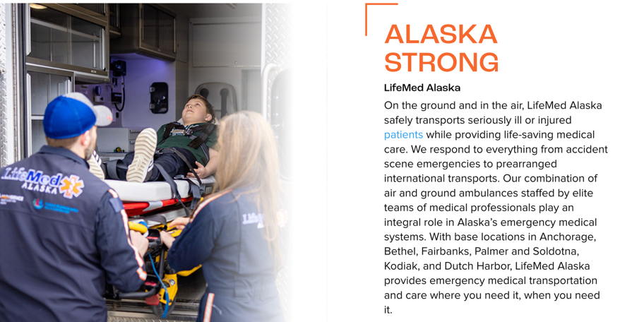
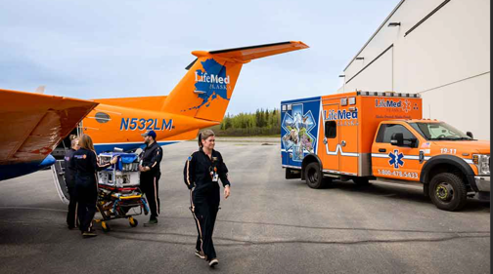


Slide 21
Marie Schliebe
Lead Teacher
Aleutian Pribilof Islands Association, Head Start

Slide 22
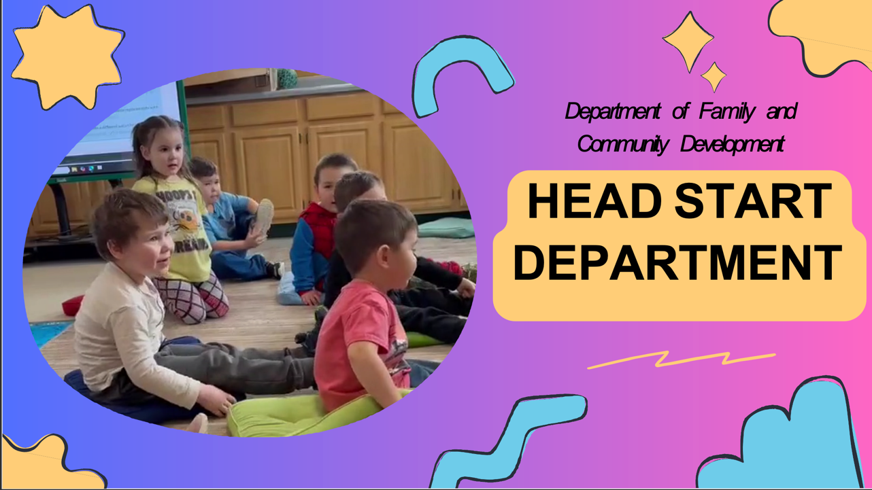

Slide 23
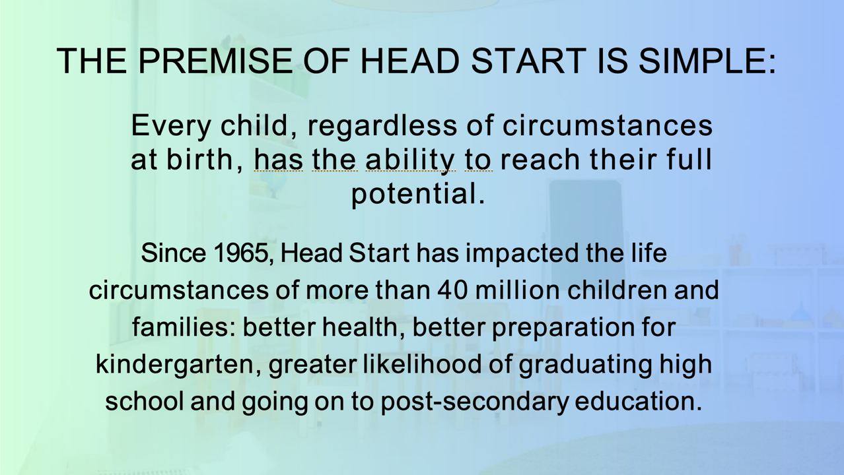

Slide 24
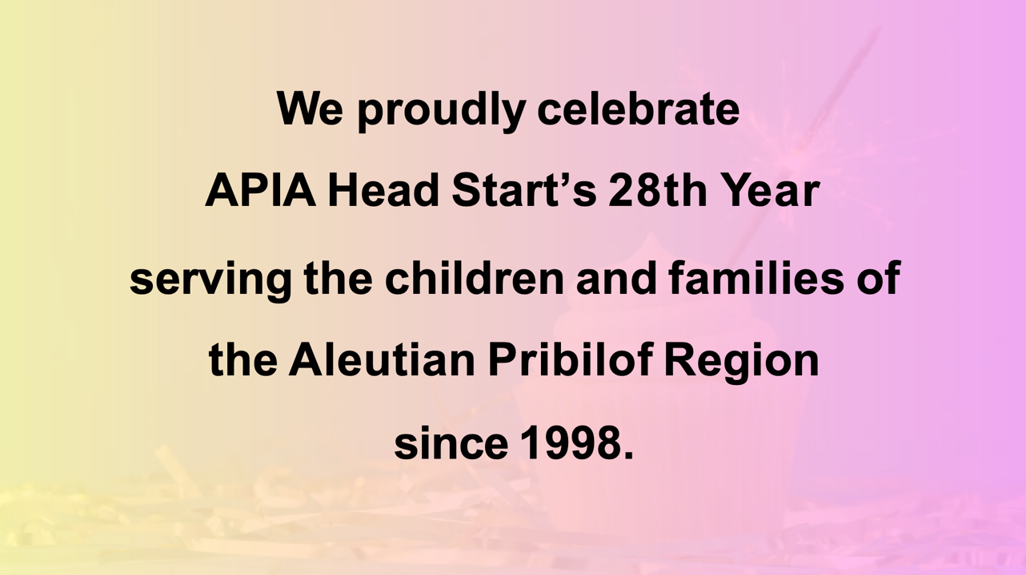

Slide 25


Slide 26
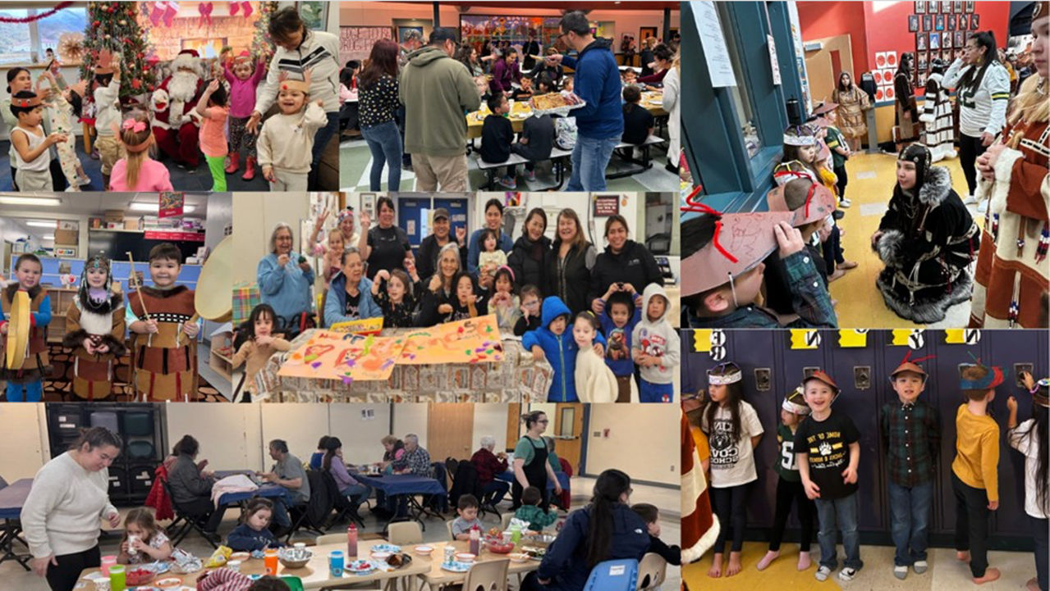

Slide 27
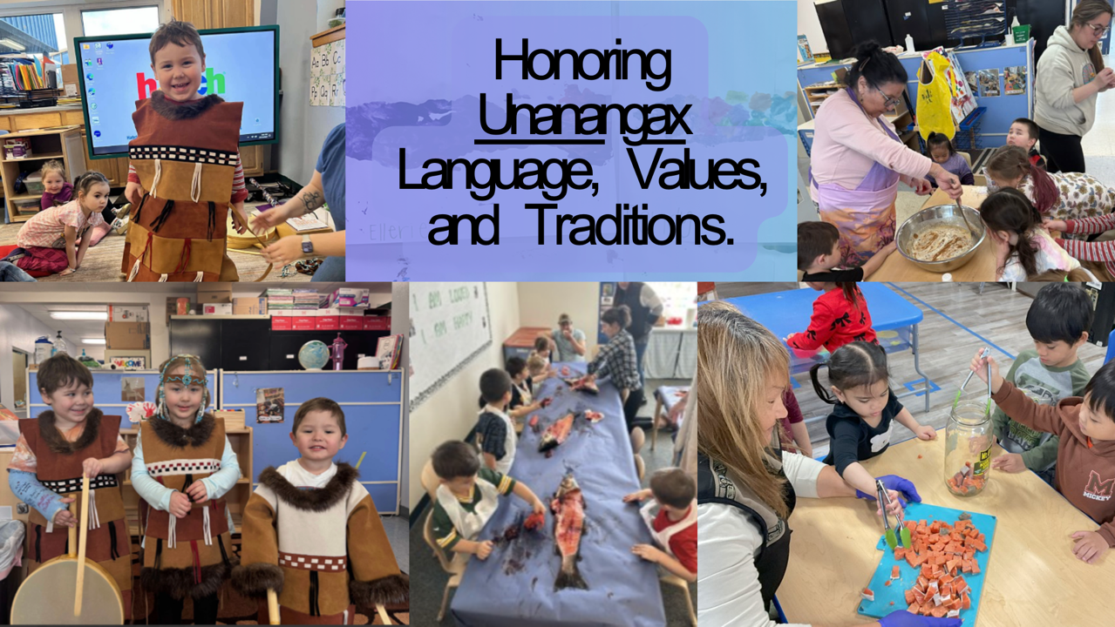

Slide 28
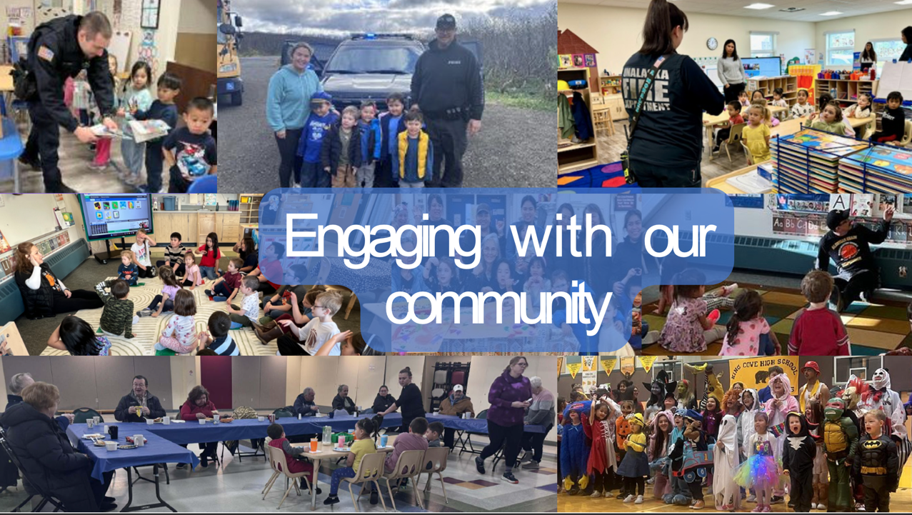

Slide 29
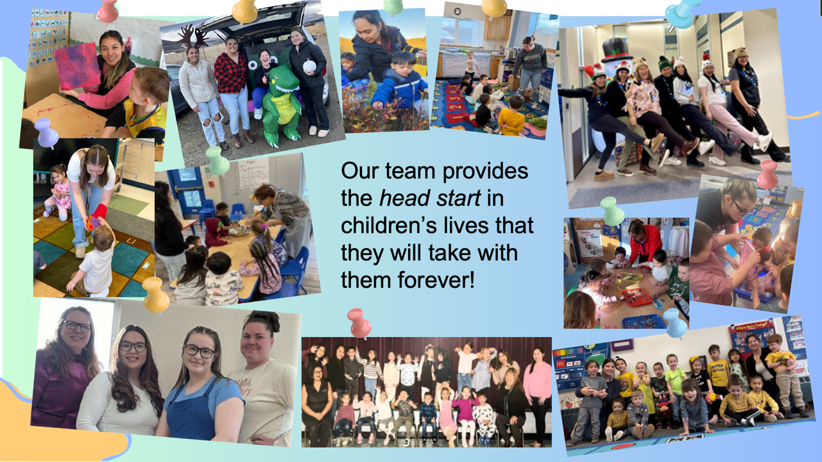

Slide 30
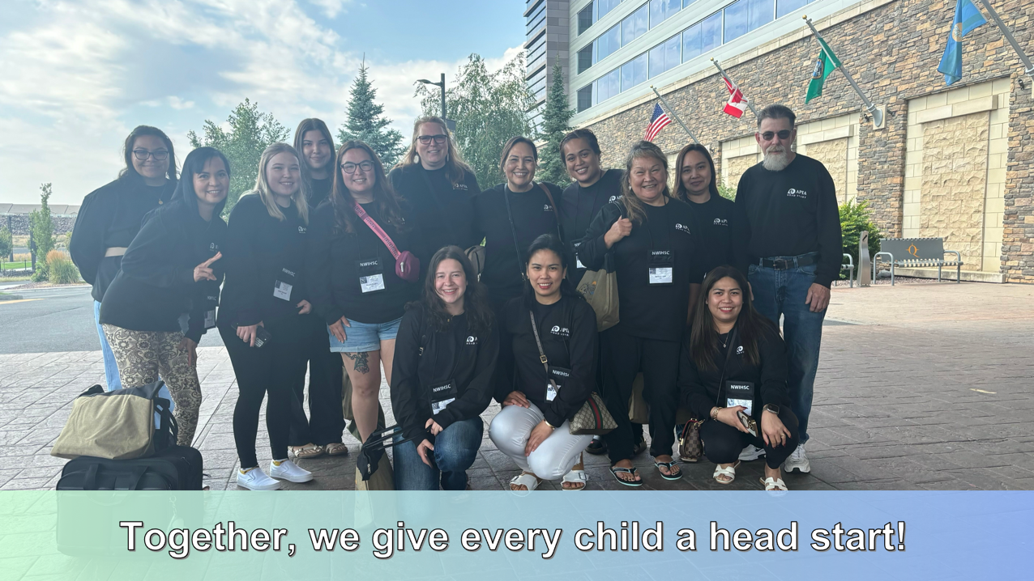

Slide 31
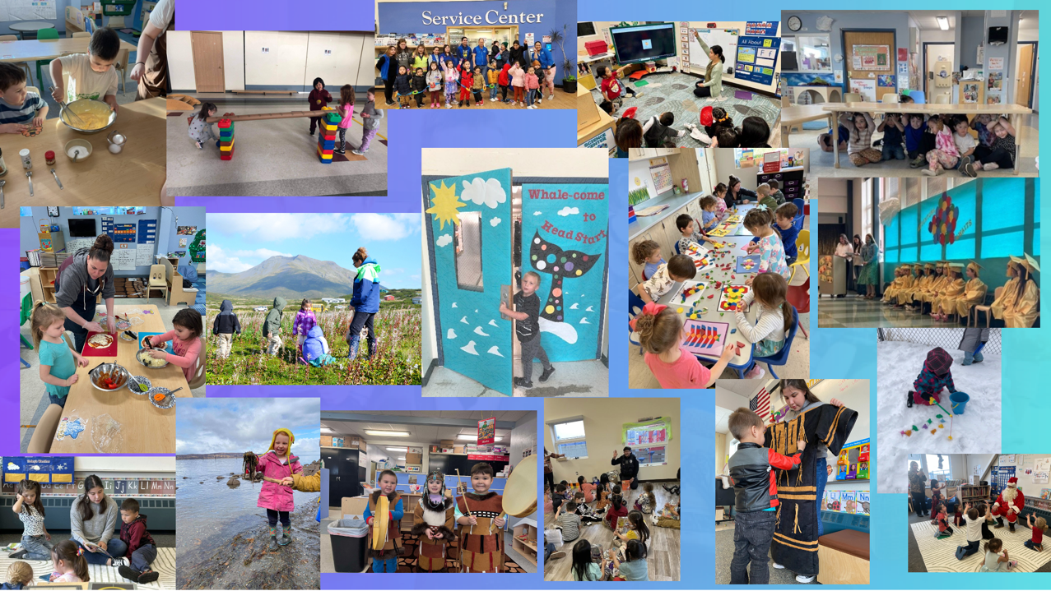

Slide 32
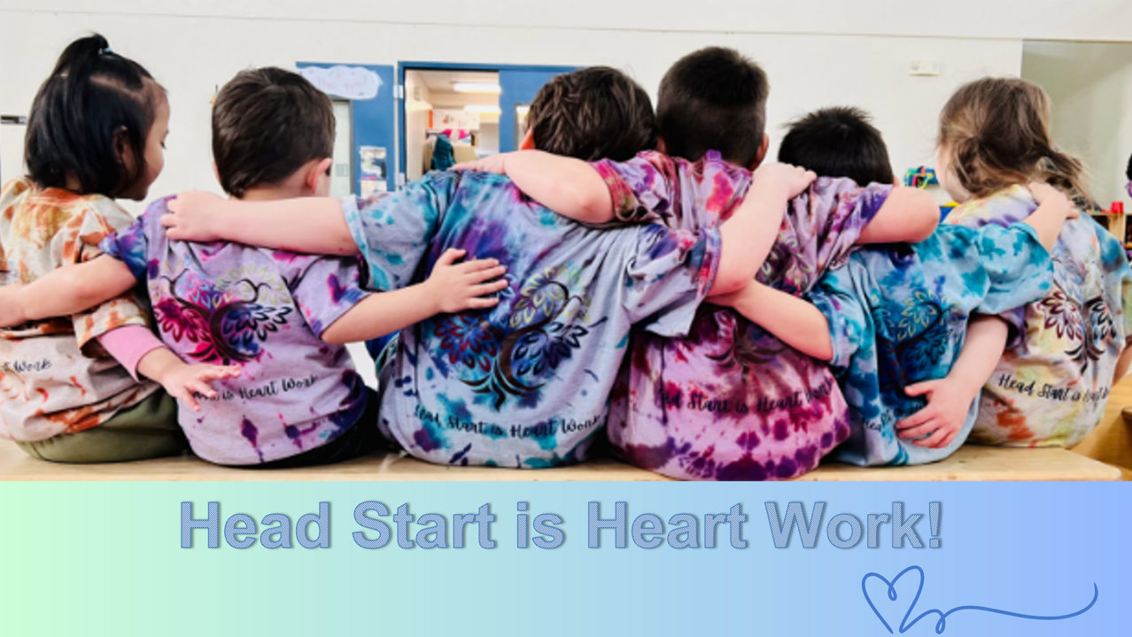

Slide 33
Karen Kresh
City Librarian
Unalaska Public Library

Slide 34
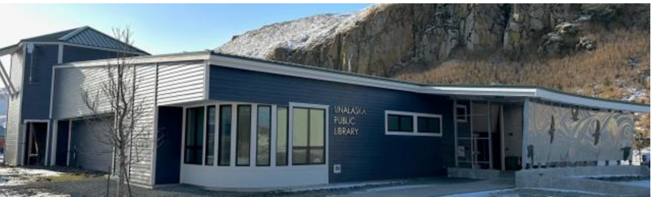

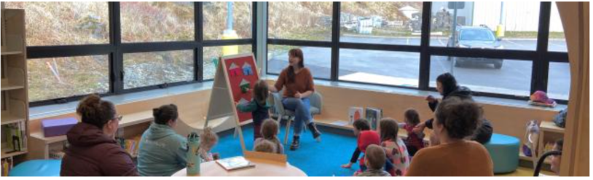
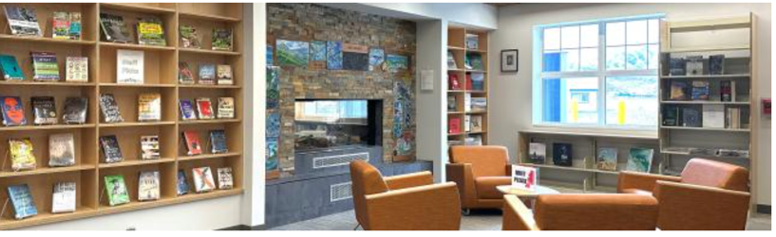

Slide 35
Lynn Crane
Executive Director
Unalaskans Against Sexual Assault & Family Violence (USAFV)

Slide 36








Slide 37
Libbey Houseman
Occupational Therapist
Sprout Family Services

Slide 38
Sprout Family Services
Promoting the Healthy Development of Children Birth to Three

Slide 39




Our Mission
Sprout Family Services
Our Vision
Our Values
Promoting the healthy development of young children in partnership with families and community.
ALL children are valued and nurtured and give the same to the next generation.
Compassion Connection Collaboration Community

Slide 40


Virtual & Home Visits Developmental & Community Resources
Emergency Baby Supplies Pediatric Therapies (Occupational, Physical, & Speech) and Social Work Developmental Evaluations Vision & Hearing Screenings Infant Massage Workshops for Caregivers
Lactation Support Community Partner Referrals
Our Services

Slide 41
Our Partnerships

Slide 42

Loving Communication: The Art of Infant Massage
FREE FOR FAMILIES!
Session Time:
10:30 AM-12:00 PM
Session Dates:
May 22nd
*additional sessions will be available virtually
Location:
Unalaska Public Library, Community Room
Sprout's Infant Learning
Program
will be in Unalaska on
Friday, May 22nd
Call or email Libbey Houseman: (907) 299-7050
libbey@sproutalaska.org
E N R O L L

Slide 43
Announcements
Carmen Wenger
A2P2 Director of Programs

Slide 44




Are you a professional working with young children not currently able to access Infant and Early Childhood Mental Health (IECMH) Consultation, including Family, Friend and Neighbor care, home visiting, early intervention, medical or social service providers?
Growing Minds offers support for providers in nurturing young children’s social and emotional development and to enhance the quality of care for children from birth through five years old across settings. This is a non-emergency service for providers to receive guidance on their practice or to ask questions about a specific concern in their professional setting.
Call 1-833-HMG-ALASKA (1-833-464-2527) today and ask to be connected with Growing Minds!
or visit helpmegrowak.org/growing-minds
The Health Resources and Services Administration (HRSA), Department of Health and Human Services (HHS) provided financial support for this publication. The award totaled $3,057,637.00 and contents may not reflect the policies of HRSA, HHS, or the U.S. Government.
Notes:
For those of you working with children birth through age five—including home visitors, medical providers, or social service professionals—I want to highlight Growing Minds.
If you don’t currently have access to Infant and Early Childhood Mental Health consultation, this is your resource. It is a non-emergency support service designed to help you navigate specific professional concerns or simply find new ways to nurture a child’s social and emotional development.
Whether you need guidance on your practice or have questions about a specific case, you can access this support by calling 1-833-HMG-ALASKA or visiting helpmegrowak.org/growing-minds.

Slide 46








Help Me Grow Alaska is an agency dedicated to promoting healthy child development across Alaska by providing support and information to individuals and organizations who care for and about children, youth, and adults ages prenatal-26. Whether you are a parent, provider, teacher, or other caregiver with questions or concerns about a child in your life, we are here to help you.
Our call center is staffed with Family Support Specialists, individuals with experience in, and an understanding of, child development, social services, and resources available in Alaska and beyond. They are available to listen to concerns, help organize a path forward, and get families connected to the most available and appropriate service across Alaska.
To order materials scan the QR code or visit:
a2p2.org/help-me-grow-alaska/

Slide 47

Notes:
We have some exciting growth happening at the A2P2 and Help Me Grow Alaska! We are currently recruiting for multiple positions! Our mission is to build a system where every Alaskan child has what they need to reach their full potential. If you know someone who is passionate about equity, innovation, supporting families in meeting their needs and transforming systems of care, please encourage them to apply. We are looking for team members who align with our vision of healthy, thriving families across the state.
All open positions are listed on the A2P2 website, and we would love your help in getting the word out to the right candidates!

Slide 48
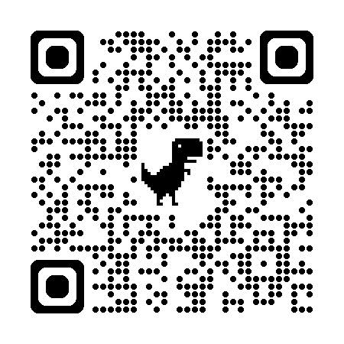
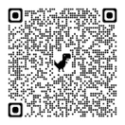
Partner Announcements
Stay informed!
Scan the QR code and sign up to the All Alaska Pediatric Partnership’s mailing list.
Partnership Meeting resources and presentations from recent meetings are available on the
All Alaska Pediatric Partnership (A2P2) website a2p2.org
Thank you for joining this months Partnership Meeting!

Slide 49

Thank you for joining!
Thank you for your commitment to authentic connection and for centering the community’s voice in your work. We are continually inspired by your hope and the strength of this partnership.
As we close out another impactful year of Partnership Meetings, we want to share our gratitude. Learning how Alaska’s communities unite to support children and families has been a highlight of our season. You are building a brighter, safer future for our state’s most precious resource, and we are honored to be in this work with you.
Notes:
Put link in chat: https://secure.givelively.org/donate/all-alaska-pediatric-partnership/a2p2-30th-anniversary

